Slide 1
Program of the Month:
“Turning a New Page” with
Story Stroll
Nick Steuer
Park Ranger, Mount Rose District

Slide 2
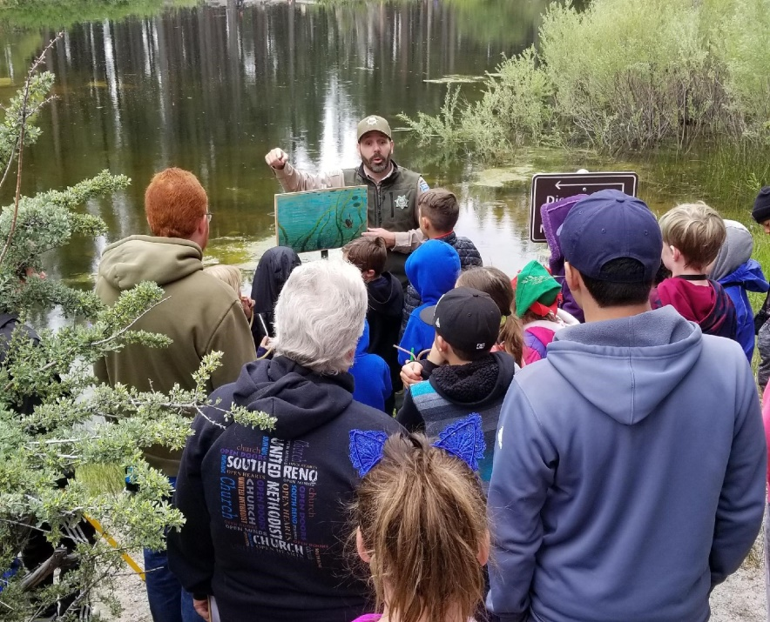
The Formation…
Idea came from the Carson City Parks Dept., who did a Story Stroll along the Carson River in September, 2017.
‘Springtime Story Stroll’ at
Davis Creek Regional Park
was born!

Slide 3

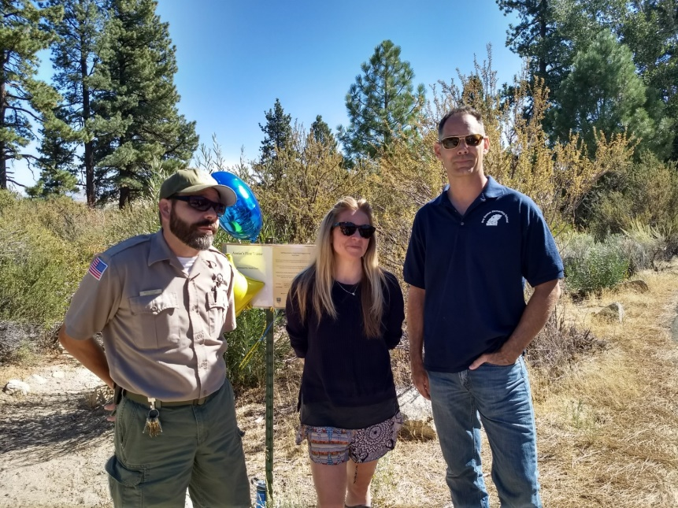
The Facts…
Partnered w/ Washoe County Library System & Washoe County School District
2018 Spring & Fall Story Strolls (2 weeks each)
Self-led strolls & Ranger-led strolls
At least 500 folks participated!

Slide 4

The Film…

Slide 5
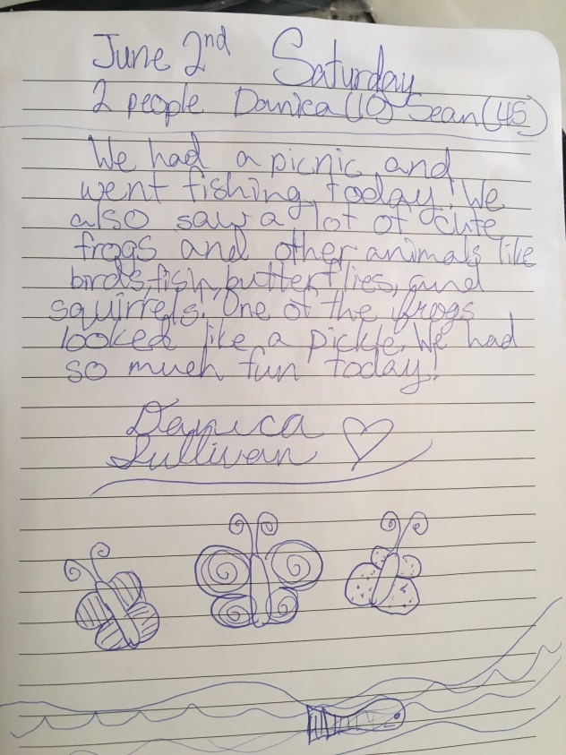
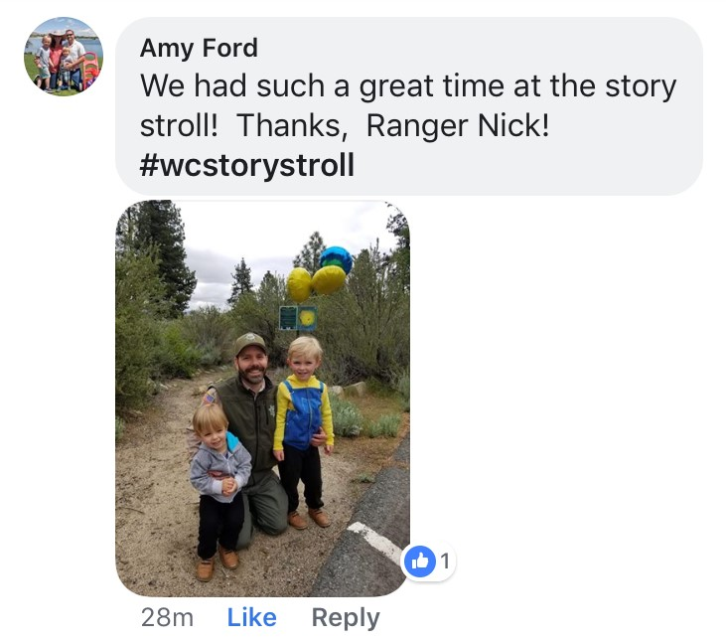
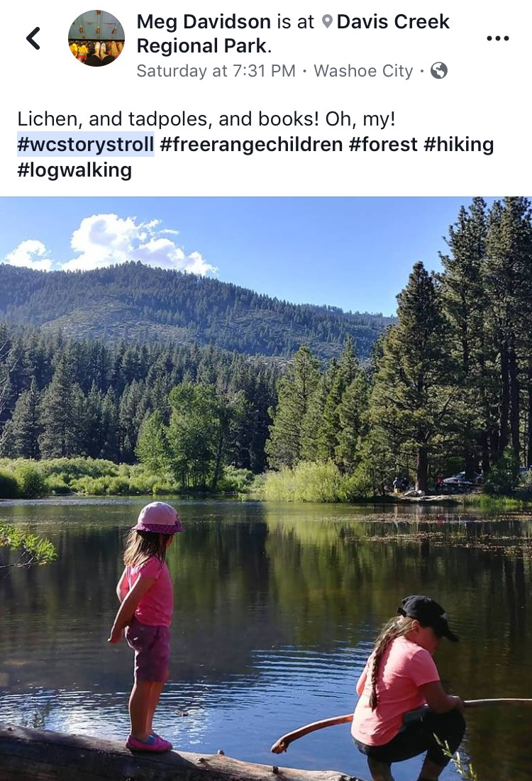
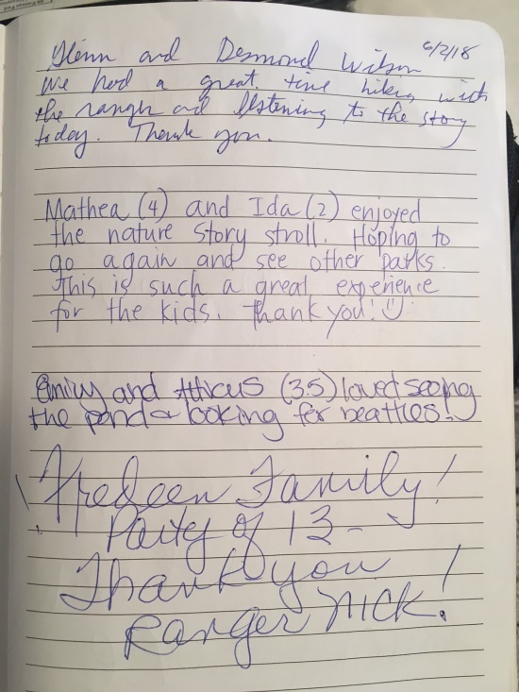
The Feedback…

Slide 6
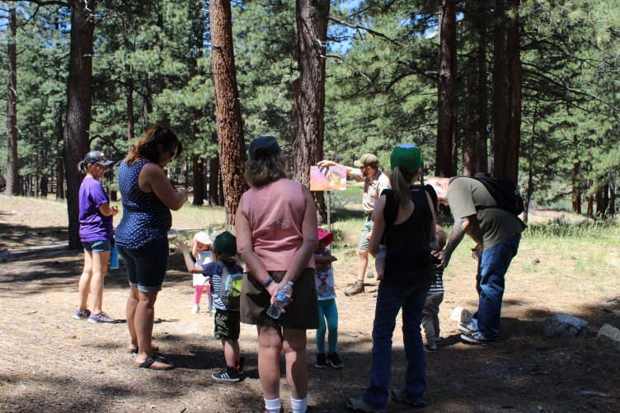
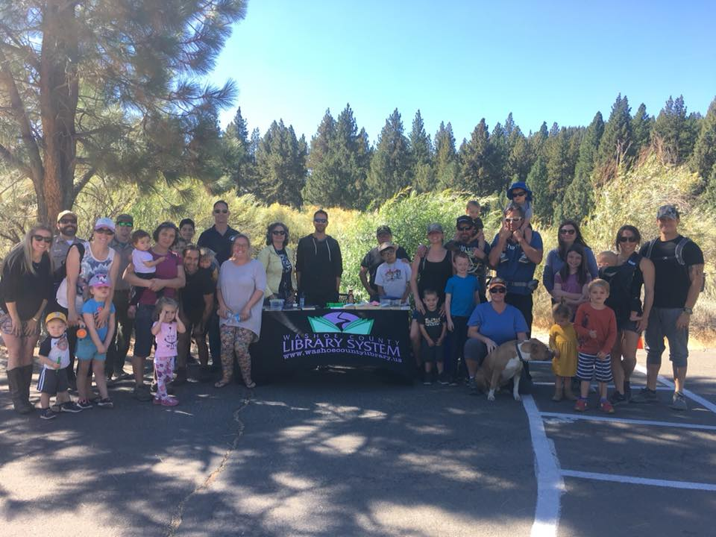
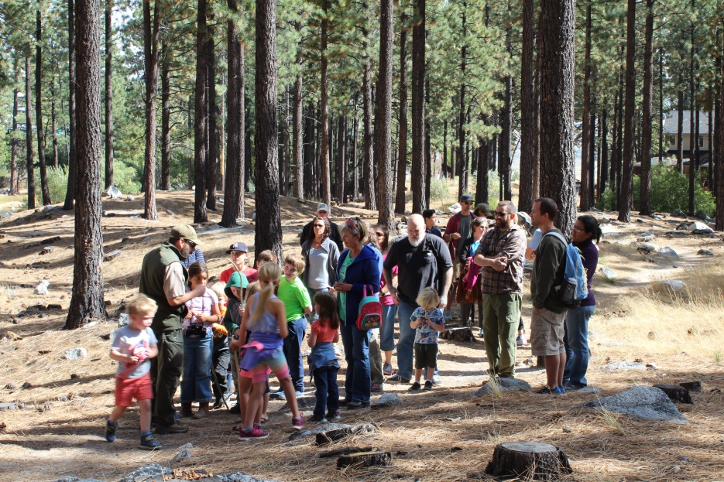
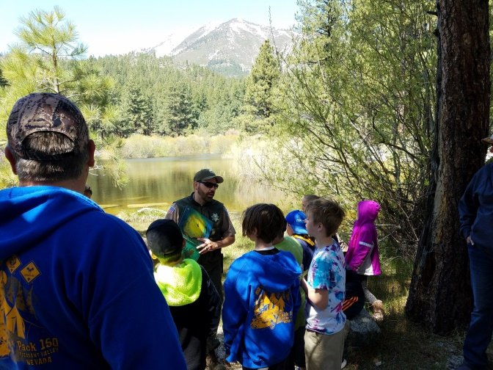
The Fun…

Slide 7
Expand to other parks?
(Galena VC in spring – ADA Accessible)
Permanent displays along trail to house story’s year-round?
The Future…

Slide 8
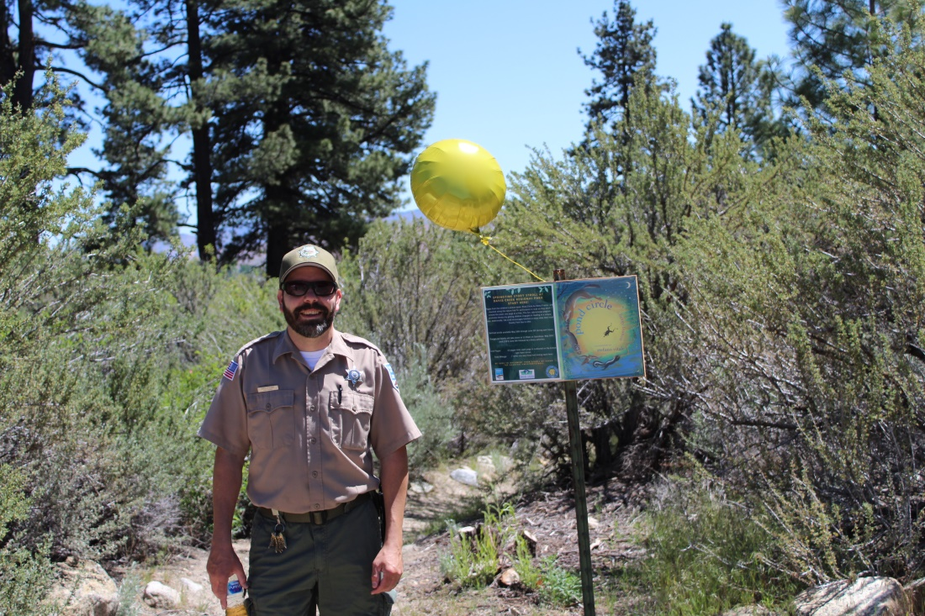
Questions?

