Slide 1
The Role of the News Media in Hazmat Response

Slide 2
News that matters to you
What messages do First Responders need to communicate to the public?

Slide 3
New – Now – Next
Traffic?
Evacuations?
Health Concerns?

Slide 4
December 13, 2019 I-580 Closure
Within our newscasts, we covered:
Road Closures Airport Impact
Alternates Other Containers
Evacuations Weather – Wind

Slide 5
December 13, 2019 I-580 Closure
How many people did we reach?

Slide 6
December 13, 2019 I-580 Closure
Comscore StationView Essentials ®
Demo Rating Grid (Daily From 12/13/19 to 12/13/19 Weekdays (Mon-Fri))
M-F Morning/Evening News (4:30AM – 4:30AM), KOLO Reno, Nev. (ABC), KRNV Reno, Nev. (NBC), KRXI Reno, Nev. (FOX), KTVN Reno, Nev. (CBS), OOLO Reno, NV (The CW) [KOLO3], Same Day, HH Live + DVR
 |  | KOLO (ABC)
 |  | HH (Live) and Live+ DVR Same Day
Local Time | SIU | Tlcst Rtg | Sh | SIU
4:30 PM | 37 | KOLO 8 News Now @ 4:30pm 5.2 | 13.8 | 37 w/DVR 5.32 (+3.12%) | 13,000 | 13.8
4:45 PM | 38
5:00 PM | 40 | KOLO 8 News Now @ 5pm 6.7 | 16.3 | 41 w/DVR 7.06 (+5.47%) | 16,750 | 16.3
5:15 PM | 42
5:30 PM | 43 | KOLO 8 News Now @ 5:30pm 6.2 | 14.4 | 43 w/DVR 6.43 (+4.06%) | 15,500 | 14.4
5:45 PM | 43
6:00 PM | 44 | ABC World News Tonight with David Muir 8.2 | 18.6 | 44 w/DVR 9.30 (+13.00%) | 20,500 | 18.6
6:15 PM | 44
6:30 PM | 44 | KOLO 8 News Now @ 6:30pm 7.0 | 15.9 | 44 w/DVR 7.40 (+5.62%) | 17,500 | 15.9
13,000 households at 4:30pm and the numbers rose through the evening!

Slide 7
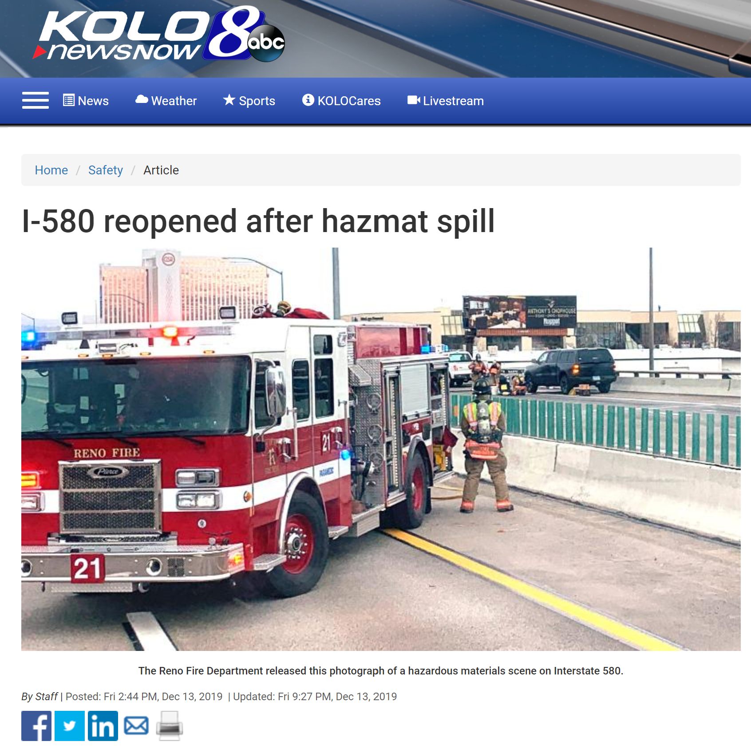
December 13, 2019 I-580 Closure
25,000 page views on KOLOTV.com on the homepage and story.

Slide 8
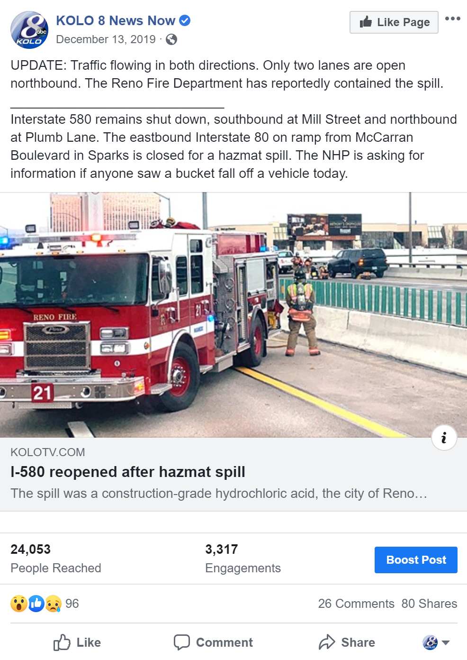
December 13, 2019 I-580 Closure
Facebook, Twitter, Push Alerts, Radio (KOH Partner)

Slide 9
News that matters to you
What messages do First Responders need to communicate to the public?

Slide 10
News that matters to you
Our role is to keep the public informed, out of the way and safe!

