Slide 1

Yasord property easement abandonment
WAB21-0004
Planning Commission
May 4, 2021

Slide 2
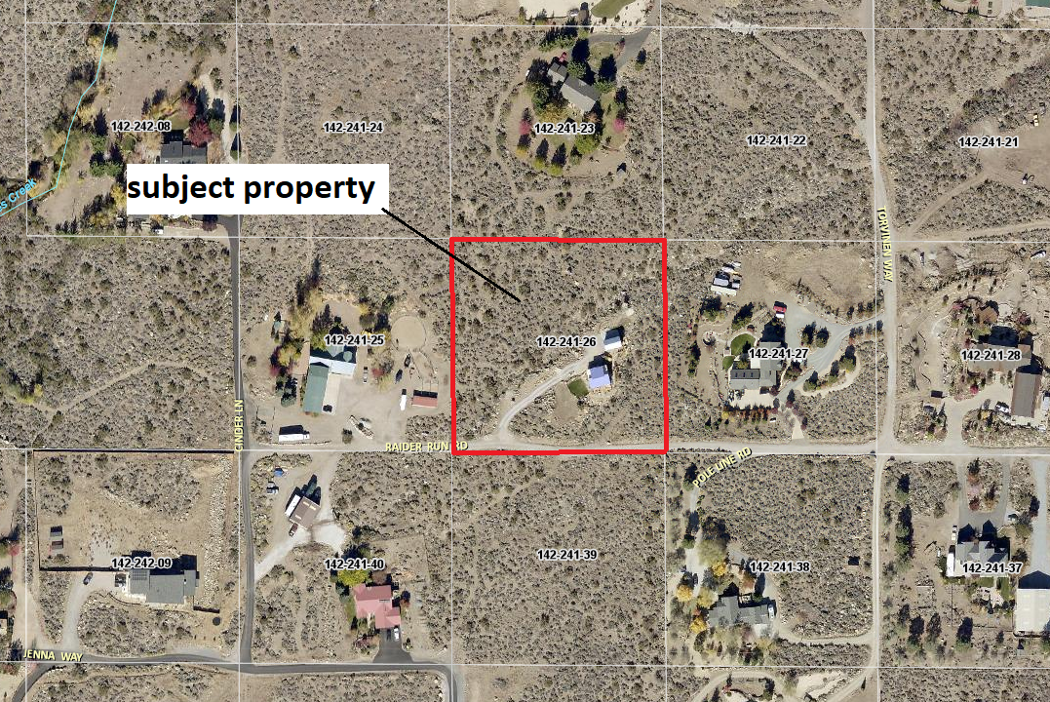
location
14437 Raider Run Road
(south of Arrowcreek
Parkway)
2.5-acre parcel (conforms to zoning)
Site, and surrounding area
are zoned High Density Rural (HDR) and General Rural (GR)

Slide 3
Purpose of abandonment
Remove unregulated access to the parcel
-there has been off-road vehicle activity in the area

Slide 4
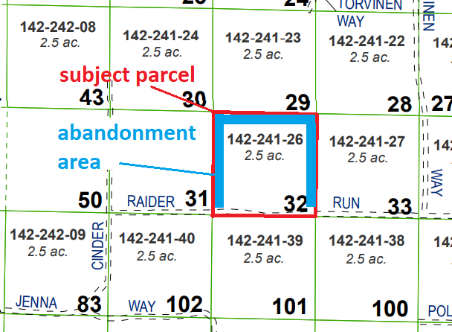
abandonment area
Existing roads not
affected.
Single family house in place on the property. Intensity of use not changed with abandonment (development right already exists).

Slide 5
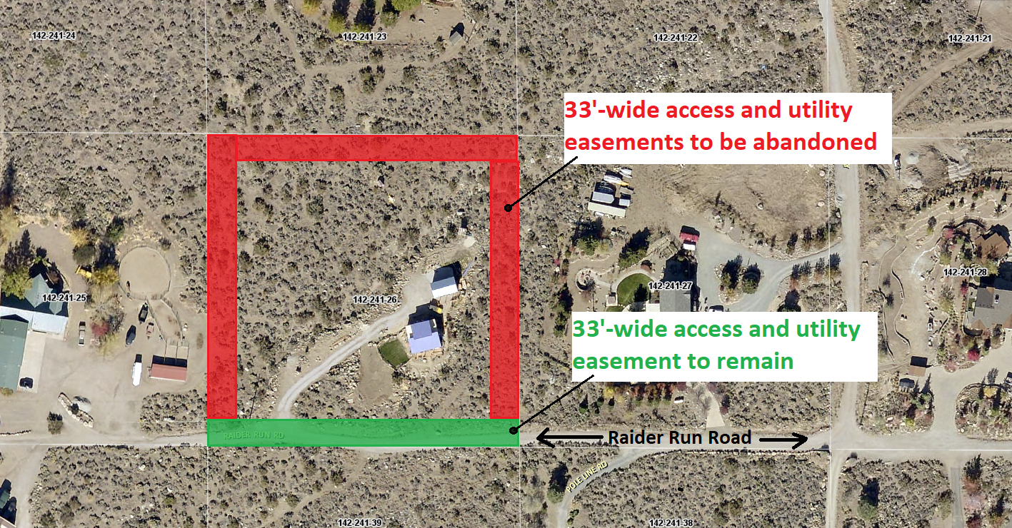
Aerial view of abandonment area

Slide 6
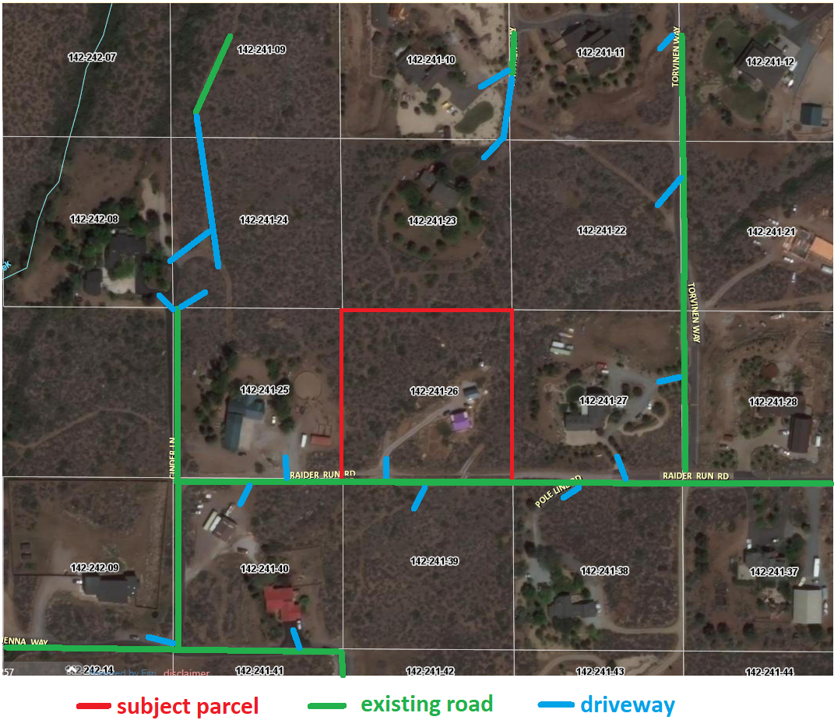
Access
Access to all parcels is maintained.
No existing access pattern is disrupted.
Parcels to the north: accessed from Torvinen Way and Whites Creek Lane.
Parcels to the south: accessed from Raider Run Road.
Parcels to the east: Torvinen Way and Raider Run Road.
Parcels to the west: Cinder Lane and Raider Run Road.

Slide 7
summary
Easement not necessary for access.
County Engineering Department has no objections.
No County Departments had objections.
Access patterns not changed.
Removes risk to owner of public claiming right to access the property.

