Slide 1
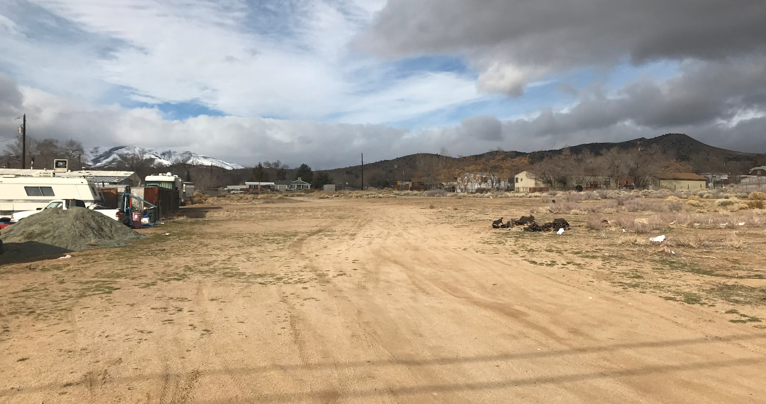
WTM21-005 (Lupin Street)
Washoe County Planning Commission
April 6, 2021

Slide 2
Request
The applicant is requesting a tentative subdivision map to develop three parcels totaling 3.83 acres into 11 single family lots.

Slide 3
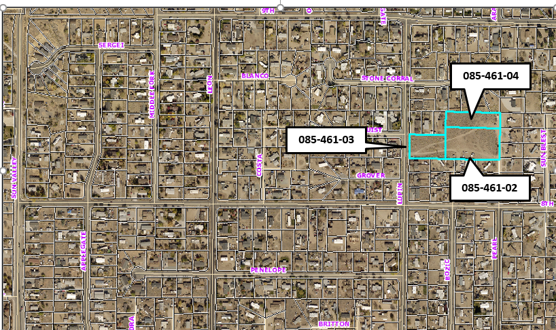
Vicinity Map

Slide 4
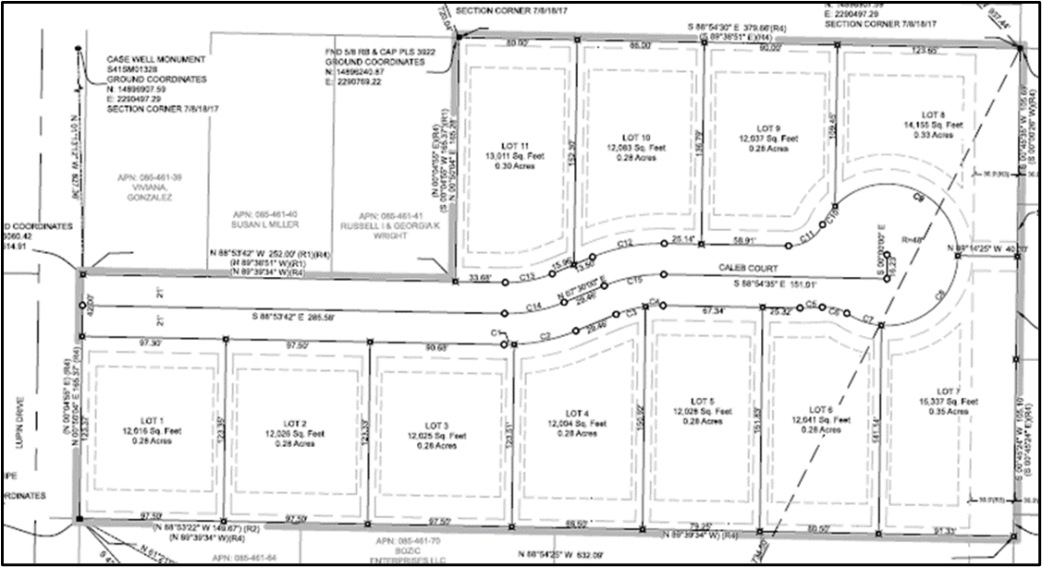
Site Layout Map

Slide 5
Site Analysis
The applicant is proposing to divide three adjacent parcels owned by the same owner into 11-lots ranging in size from 12,004 sf to 15,337 sf lots
The overall density will be 2.84 dwellings per acre
The lots will access off Lupin Drive to a new street Caleb Drive
The development will meet Washoe County standard setbacks and building standards

Slide 6
Site Analysis
The site is vacant and relatively flat
Approximately 4,900 cubic yards will be excavated
All material will be balanced on site and no material will be imported.

Slide 7
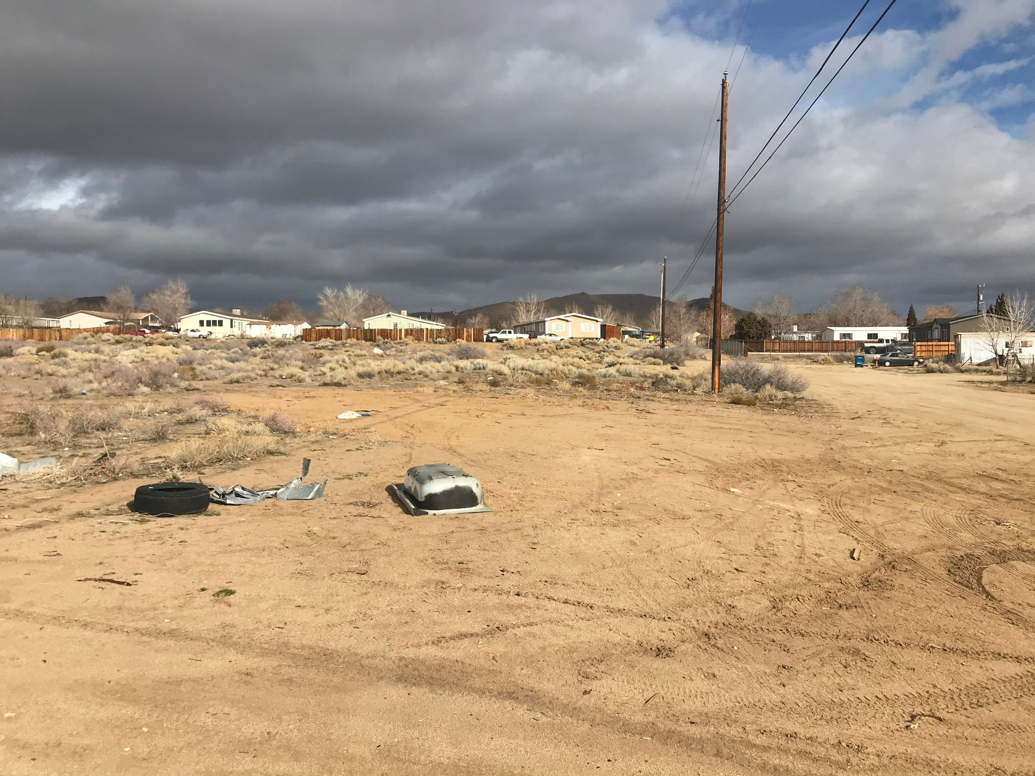

Slide 8
Water & Sewer
The site is located in an area with existing infrastructure and municipal services are either in place or can be easily established
The parcels are within the Sun Valley General Improvement District (SVGID) service area and the development will need to meet all regulations and policies
Water and sewer service will be provided by the SVGID

Slide 9
Roadways & Traffic
The proposed access is off Lupin Drive
The small size of the development did not require a traffic study
Based on the number of homes approximately 110 average daily trip should be anticipated

Slide 10
Sun Valley CAB
The CAB did not meet during the month of February and the applicant was not able to present to the CAB
However, CAB members were notified of the application and no comments were received

Slide 11
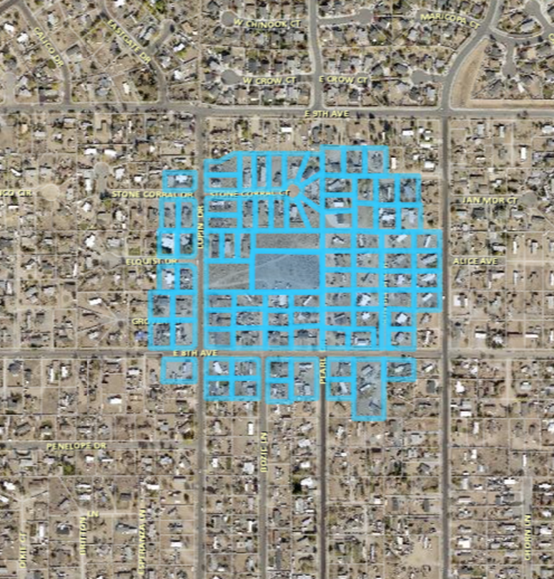
Public Notice
Notices were sent 500 feet from the site to 62 affected property owners

Slide 12
Reviewing Agencies
Comments were received from:
Washoe County Community Services
    Engineering and Capital Projects
    Water Management
    Parks
    Washoe County Health District
    Truckee Meadows Fire Protection District
    Washoe County Sheriff
    Regional Transportation Commission (RTC)
    Sun Valley General Improvement District (SVGID)
    Washoe-Storey Conservation District
No recommendations for denial were received.

Slide 13
Tentative Subdivision Map Findings
Plan Consistency;
Design or Improvement;
Type of Development;
Availability of Services;
Fish or Wildlife;
Public Health;
Easements;
Access;
Dedications; and
Energy.

Slide 14
Possible Motion
I move that, after giving reasoned consideration to the information contained in the staff report and information received during the public hearing, the Washoe County Planning Commission approve Tentative Subdivision Map Case Number WTM21-005 for Star West Homes, having made all ten findings in accordance with Washoe County Code Section 110.608.25

