Slide 1
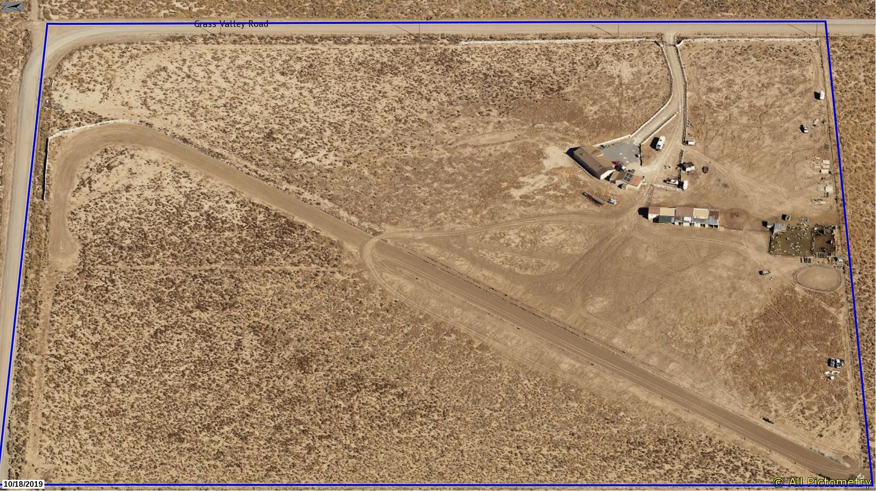
SB13-008 Revocation
Washoe County Board of Adjustment
February 4, 2021

Slide 2
Request
Revoke SB13-008 (De La Luz Horse Racing Events)
Revocation is in accordance with 110.810.70(b)(2)(3)
Grounds for Revocation. A special use permit may be revoked pursuant to the provisions of this section upon a finding of any one (1) or more of the following grounds:
  (2) That one (1) or more of the conditions upon which such development approval was granted have been violated; or
  (3) That the use or facility for which the development approval was granted is so conducted or maintained as to be detrimental to the public health or safety, or as to be a public nuisance

Slide 3
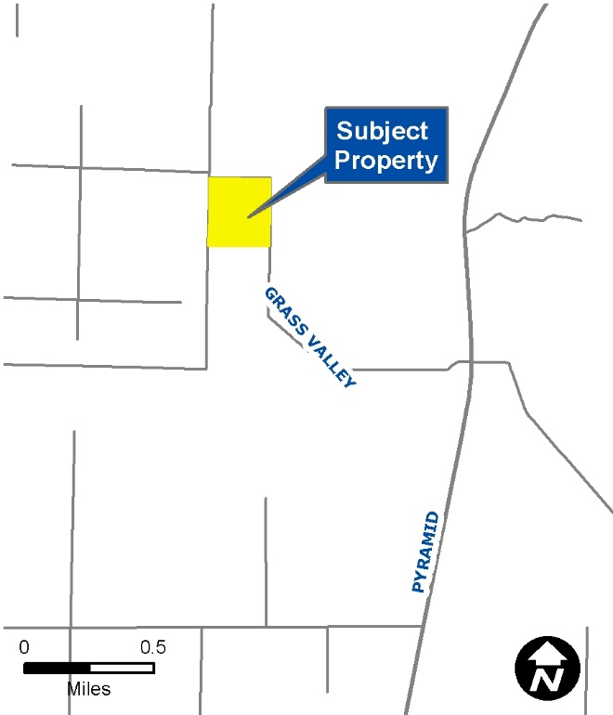
SB13-008
SB13-008 granted in 2013
Allows for 20 – 1 day horse racing events
Annual submittal no later than April 1st of an events calendar with dates and times (15-day notice)
Allows for a maximum number of 400 people
Allowed to run from May through September

Slide 4
Condition Violations
Condition 1(a): The applicant shall demonstrate substantial conformance to the plans approved as part of this special use permit.
Investigations by various agencies discovered that the event organizer was not following plans submitted to reviewing agencies

Slide 5
Condition Violations
Condition 1(c): The applicant shall comply with all conditions of approval to the satisfaction of each reviewing agency before a business license is issued for horse racing events.
The applicant consistently failed to:
  Meet agency deadlines for submission of contracts,
  Communicate with reviewing agencies about upcoming events; and,
  Even when events were approved by an agency, failed to follow the approved agency conditions.

Slide 6
Condition Violations
Condition 1(i): For the years following 2013, the applicant shall:
  Submit an events calendar on an annual basis no later than April 1st of each year showing the exact dates and times of the current year’s Horse Racing events for the months of May, June, July, August and September.
  Any changes to the event calendar shall be submitted 15 days prior to the date that was changed.

Slide 7
Condition Violations
Condition 1(i) continued:
  The applicant has consistently failed to meet these deadlines
  Even when an events calendar was eventually submitted, the applicant would change dates less than 15 days prior to the event date
  Staff also has evidence that illegal (unauthorized) events have been held in 2020 even though no event calendar was submitted and no events were reviewed nor approved.

Slide 8
Condition Violations
Condition 1(x): This special use permit shall remain in effect as long as the business is in operation and maintains a valid business license.
The applicant has not maintained a valid business license.
The applicant allowed their business license to expire on August 21, 2020.
Online or over the phone renewal was available.

Slide 9
Condition Violations
The revocation is being requested at this time due to the cumulative violations, disregard of conditions, and requests from other reviewing agencies to revoke the SUP; and,
Due to the violation of the Governor’s Emergency Directive regarding large gatherings and events during the COVID-19 pandemic and during high case rates in WC

Slide 10
Condition Violations
Additionally, staff has found that the approach of using an SUP to authorize multiple recurring special events over a span of years (no sunset) is not working well (staff changes, consistency in review, staff time tracking and documenting compliance, lack of documentation by reviewing agencies, etc.)
If the SUP is revoked, the owners may still apply for similar one-time special events, but approval of such events is not guaranteed

Slide 11
Compliance History
July 2020 – Washoe County Planning: Staff was alerted that the applicant held an illegal event on July 4, 2020; and an event in June of 2020 (during COVID restrictions).
Two additional events took place on August 14, 2020 from 5:00 p.m. to 9:00 p.m. and on August 22, 2020 starting at 9:00 a.m
The applicant never reached out to staff throughout 2020.
The applicant is required to do pre, during, and post compliance operations in order to meet their approved special use permit conditions of approval.
Open communication between WC planning staff is required for continued maintenance and enforcement of the approved SUP’s conditions of approval.

Slide 12
Compliance History
On July 13, 2020 Code Enforcement issued yet another Stop Activity Order for the property.
The property owners did not contact the assigned code enforcement officer about the Stop Activity Order.
The applicant did not contact staff when staff informed the applicant of the revocation.
Staff has offered meetings/dialogue that have not been accepted

Slide 13
CAB Review/Action
The Warm Springs Rural CAB reviewed the request at its January 13, 2021 meeting
The property owners were notified of the CAB meeting (multiple times) but did not attend
Minutes of the CAB meeting have been provided to the BOA
Most of the discussion centered around negative impacts stemming from the on-going events
The CAB voted unanimously to recommend the BOA revoke the SUP

Slide 14
Notice
Per NRS 241.034, the property owners were noticed of the BOA hearing by certified mail and within the required timeframe (2x actually)
Staff contacted the property owners to remind them of the BOA meeting
Standard mailed notice (per the Development Code SUP requirements) was also provided

Slide 15
NEXT STEPS
If BOA recommends approving revocation, then…
BCC will hold a public hearing and either approve or deny the revocation request (per 110.810.70.d)
BCC action is final unless the matter is appealed to judicial review, then decision of the court is final

