Slide 1
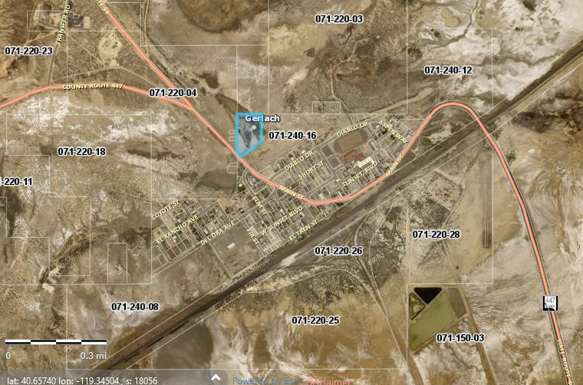
WSUP20-0015
Black Rock RV Park
Washoe County Board of Adjustment
Dec 4, 2020

Slide 2
Background/Request
The applicant is requesting to establish a Commercial Campground/RV Park Use type on 4.86 acres.
The subject parcel is split zoned 74% General Rural (GR), 15% Tourist Commercial (TC), and 11% Parks and Recreation (PR).

Slide 3
Vicinity Map

Slide 4
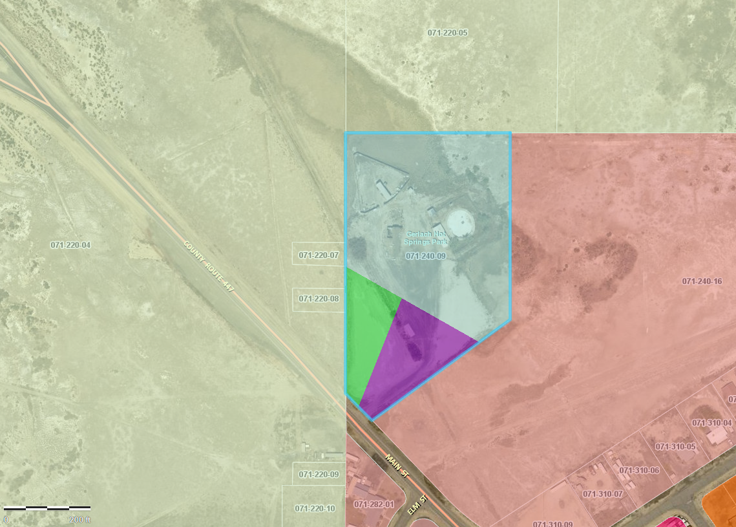
Zoning Map
GR
PR
TC

Slide 5
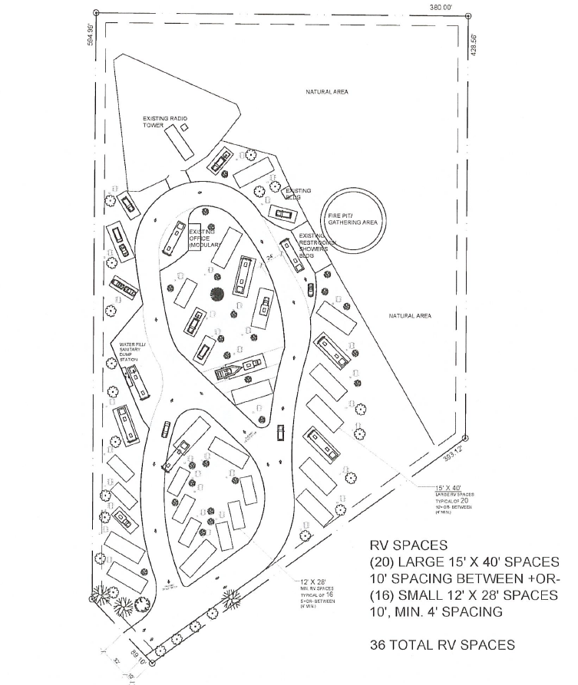
Site Plan

Slide 6
Article 206 – High Desert Modifiers
The proposed application is affected by the High Desert Area Plan modifiers.
Commercial campground uses allowed by right in General Rural regulatory zones per WCC 110.206.10(a)3(v). The other regulatory zones are unchanged by this modifier.

Slide 7
Article 302/304 – Allowed Uses
Commercial Campground/RV park requires approval of a Special Use Permit in TC, and PR regulatory zones
  Commercial Campground/RV park is allowed within GR per 110.206.10(a)3(v).

Slide 8
Article 316 – RV Parks
Application does not meet required RV park standards
  Power/Sewage hookups
  Water Supply
  RV Space size
  Traffic flow
Staff has provided conditions requiring a phasing plan addressing all outstanding issues prior to issuance of permits or business license.

Slide 9
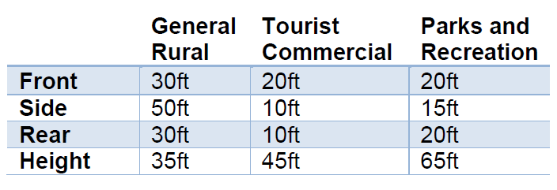
Article 406 – Building Placement
Application meets the required setback and height requirements

Slide 10
Article 410
Applicant shall meet code requirements for parking standards.
Staff does not have any objections to waiving paving requirements for spaces and roads to maintain rural character of area if requested by the applicant.

Slide 11
Article 412 - Landscaping
Applicant did not provide a landscaping plan as required
  Required to provide 20% of total developed area as landscaping
  (1) every 50ft of street frontage (2 trees total)
High Desert Area Plan
  HD 2.2 – Requirement of a noxious weed plan
  HD 2.8 – Landscaping emphasizing the use of native and low water requirements
Staff has provided conditions of approval requiring a landscaping plan in accordance with Article 412 and in compliance with HD policies 2.2, 2.8

Slide 12
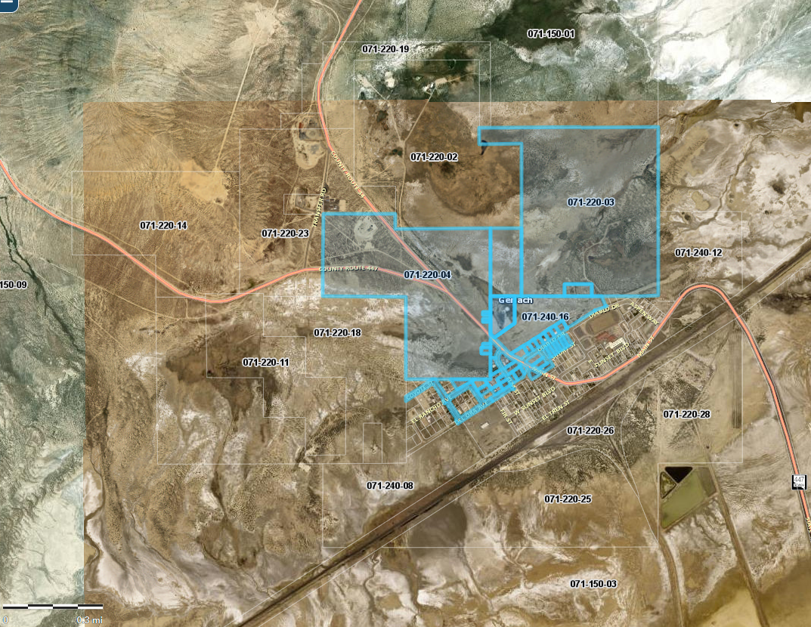
Public Notice & CAB
Notice was sent to 32 affected property owners, 800 feet from the site.

Slide 13
Citizen Advisory Board
Proposed project presented Nov 12, 2020
  Concerns:
    Length of stay of guests
      Limited by code
    Pet policy – Dogs should be allowed
    Maintaining dark skies
      Staff provided conditions to maintain dark skies in accordance with HD 2.5
    Fence Height should be 4ft
      Staff provided conditions modifying the required standard in order to preserve community character
    Parking of ATVs and Trailers
      Staff provided conditions requiring onsite parking

Slide 14
Special Use Permit Findings
Consistency. That the proposed use is consistent with the action programs, policies, standards and maps of the Master Plan and the High Desert Area Plan;
Improvements. That adequate utilities, roadway improvements, sanitation, water supply, drainage, and other necessary facilities have been provided, the proposed improvements are properly related to existing and proposed roadways, and an adequate public facilities determination has been made in accordance with Division Seven;
Site Suitability. That the site is physically suitable for child daycare, and for the intensity of such a development;
Issuance Not Detrimental. That issuance of the permit will not be significantly detrimental to the public health, safety or welfare; injurious to the property or improvements of adjacent properties; or detrimental to the character of the surrounding area;
Effect on a Military Installation. Issuance of the permit will not have a detrimental effect on the location, purpose or mission of the military installation.

Slide 15
Recommendation
Those agencies which reviewed the application recommended conditions to address applicable codes and impacts associated with the project. After a thorough analysis and review, staff recommends that the Board of Adjustment carefully consider all aspects of Special Use Permit Case Number WSUP20-0015 and the nature of the stringent recommended conditions of approval and approve the requested Special Use Permit.

Slide 16
Possible Motion
APPROVAL: I move that, after giving reasoned consideration to the information contained in the staff report and information received during the public hearing, the Washoe County Board of Adjustment approve with conditions Special Use Permit Case Number WSUP20-0015 for Black Rock City, LLC., for the following requests 1) establishment of a commercial campground/RV park use type, 2) request to vary parking and landscaping standards as recommended in the conditions of approval in Exhibit A, having made all five findings in accordance with Washoe County Code Section 110.810.30

