Slide 1
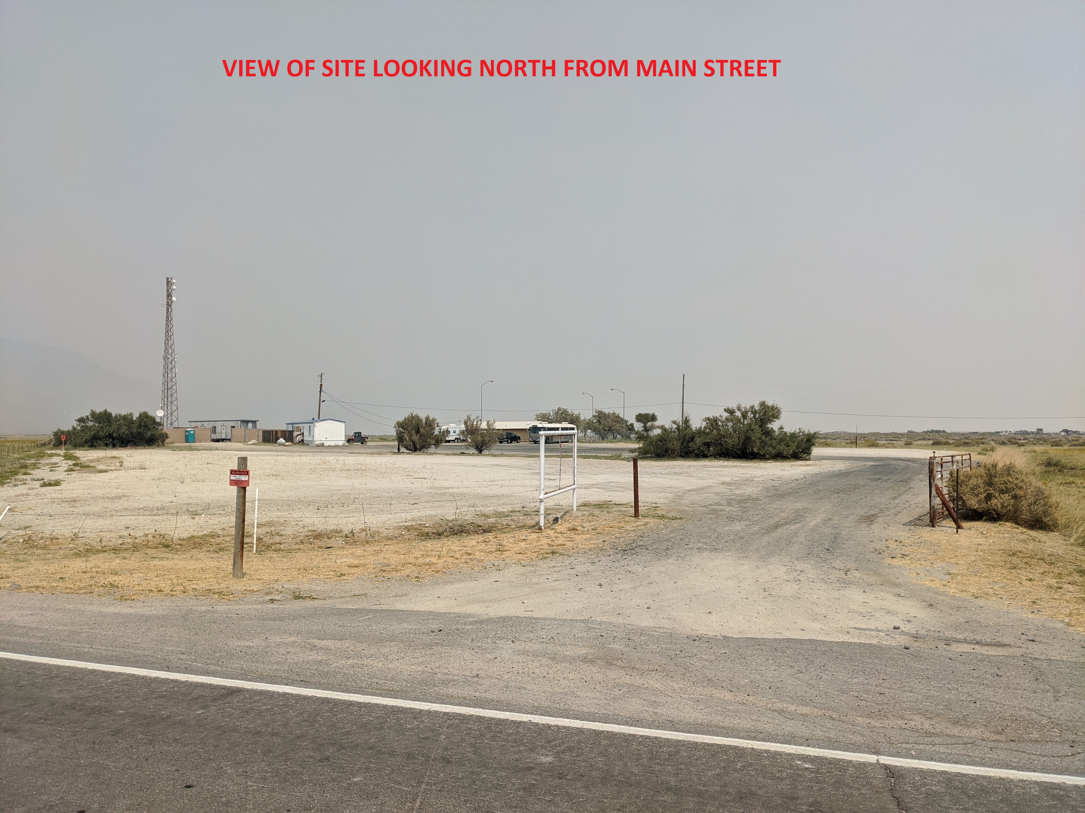

BLACK ROCK RV PARK special use permit
GERLACH citizens advisory board
November 12, 2020

Slide 2
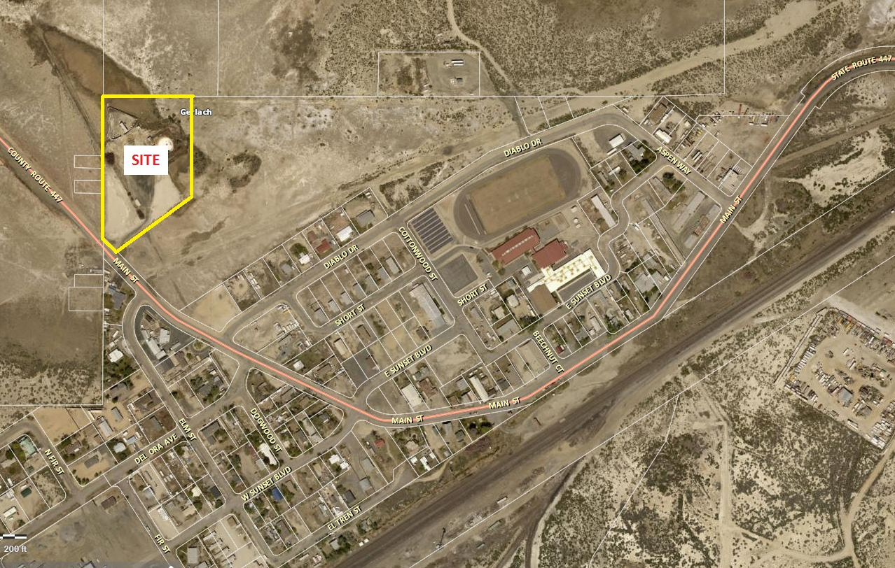

Project location
255 MAIN STREET (4.86± acres)

Slide 3

Project request
The following request has been made to Washoe County:
A Special Use Permit to allow for the establishment of a Commercial Campground (Recreational Vehicle Park) within the Tourist Commercial, Parks and Recreation, and General Rural zones.

Slide 4
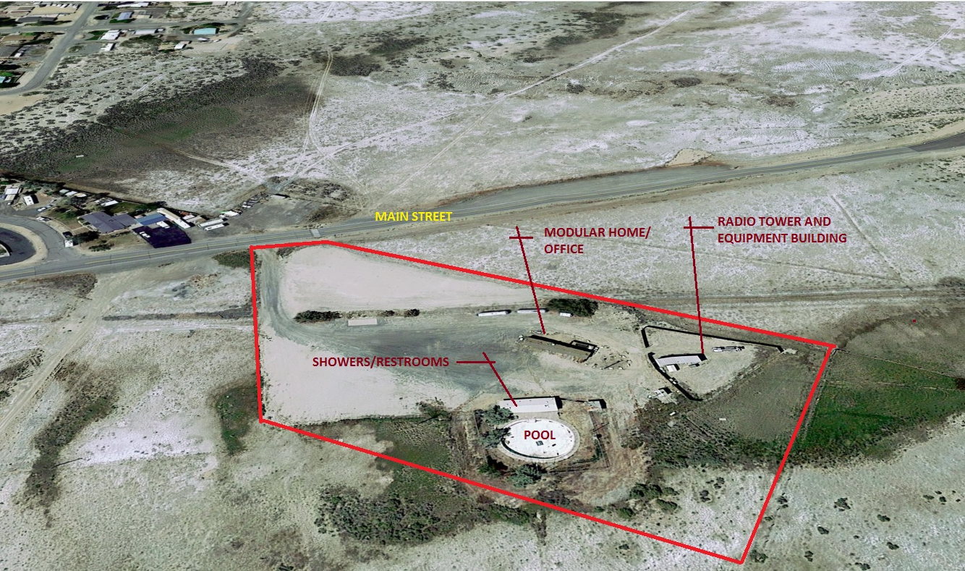
EXISTING CONDITIONS
Former Gerlach hot springs park

Slide 5

PROJECT
SUMMARY
RV Park will provide year-round camping facilities for a wide range of users.
36 total spaces.
No permanent residents will be permitted.
Site was originally planned for a campground as part of the Gerlach Hot Springs Park.
Designed to incorporate the rural character of the area.
Will be phased to include full hook-ups.
Sanitary facilities will be included with phase 1.

Slide 6
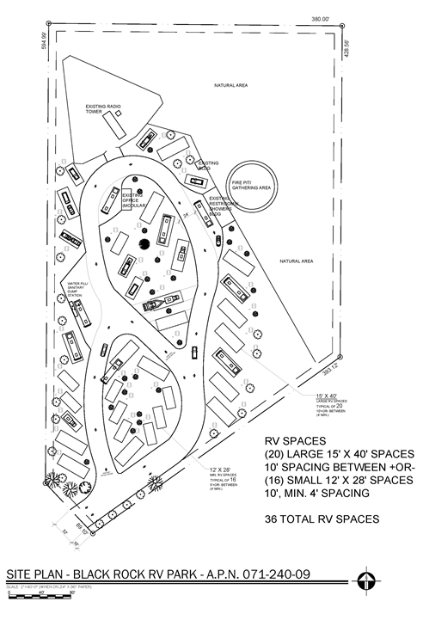

Slide 7
PROJECT
CONSIDERATIONS
Consistent with existing zoning.
Low intensity use.
Promotes economic development within Gerlach.
Onsite manager will ensure quiet hours are enforced.
Low traffic generation.
Design respects the rural character of the area.
Limited lighting ensures protection of dark skies.

Slide 8

Mike Railey
Christy Corporation, Ltd.
(775) 250-3455
mike@christynv.com

