Slide 1
ADMINISTRATIVE CASE NUMBER WADMIN20-0004
(Saint Francis of Assisi Catholic Church Expansion)
Washoe County Board of Adjustment
April 16, 2020

Slide 2
Request
To approve an administrative permit to allow the expansion of an existing church building (Religious Assembly Use Type), by means of a two-story addition of approximately 976 square feet on each level for a total expansion of the building of approximately 1,952 square feet. The existing building is approximately 12,156 square feet in size.

Slide 3
Overview
Expands existing facility by over 10%.
Meets all generally-applicable Code requirement.
Substantially screened from off-site view.
No spill over of exterior lighting will be allowed. Recommended conditions include a photometric study to ensure compliance.

Slide 4
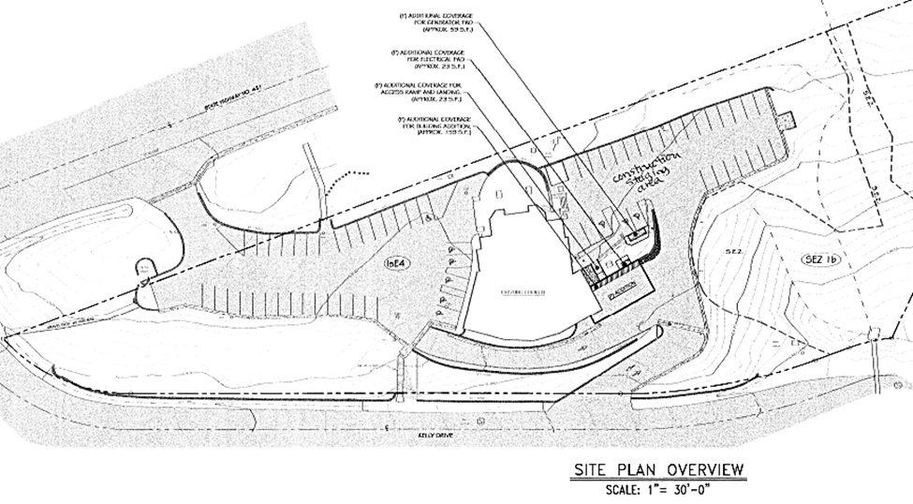
Site Plan

Slide 5
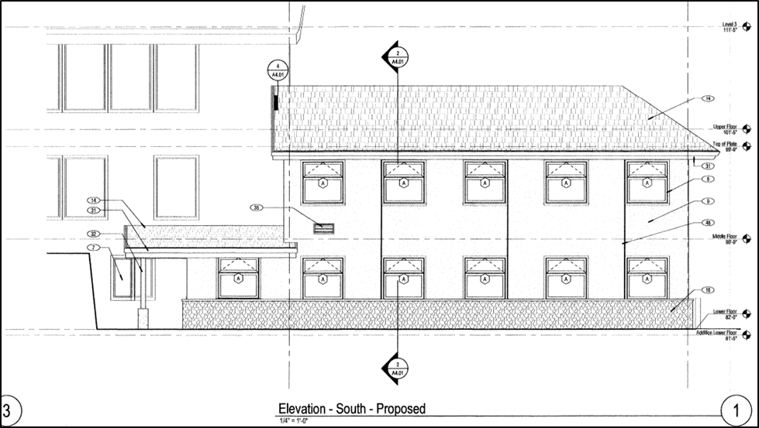
Building Elevation

Slide 6
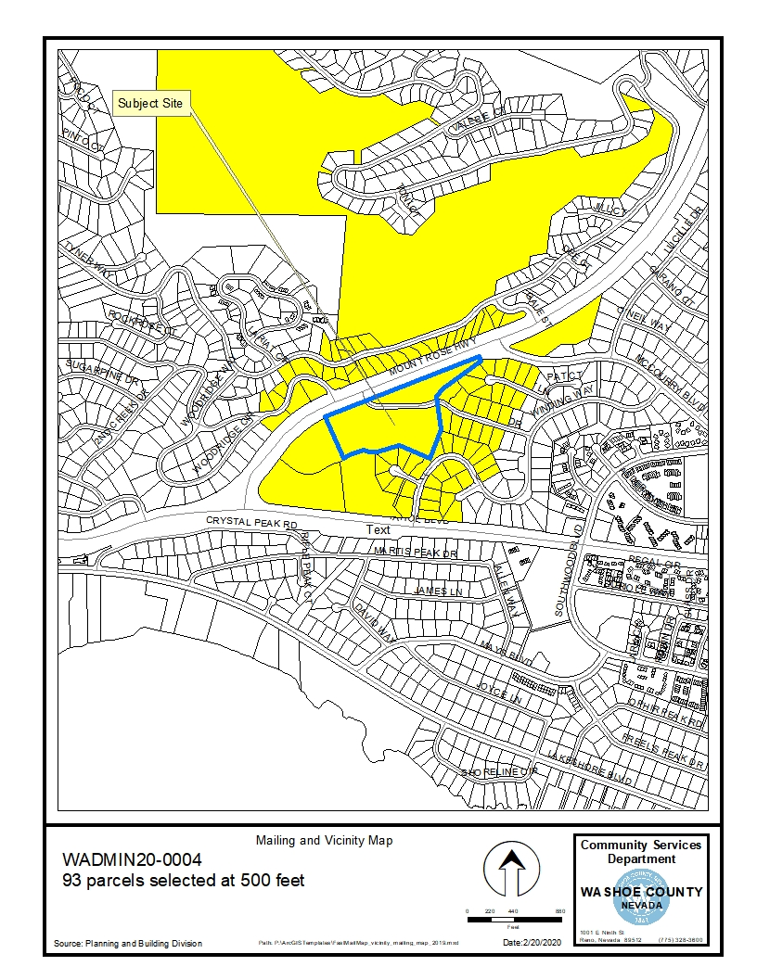
Public Notice & CAB
Notice sent to 93 affected property owners
Incline Village / Crystal Bay CAB recommended approval with very little discussion.

Slide 7
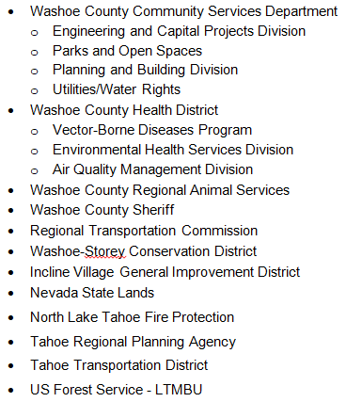
Reviewing Agencies

Slide 8
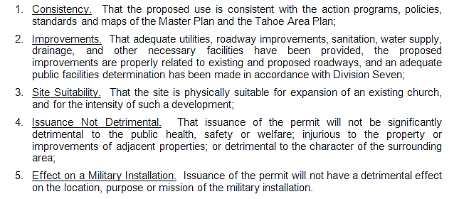
Administrative Permit Findings
Pages 7-8 of Staff Report

Slide 9
Recommendation
After a thorough analysis and review, Administrative Permit Case Number WADMIN20-0004 is being recommended for approval with conditions.

Slide 10
Possible Motions
I move that, after giving reasoned consideration to the information contained in the staff report and information received during the public hearing, the Board of Adjustment approve Administrative Permit Case Number WADMIN20-0004 for Saint Francis of Assisi Catholic Church, with conditions included at Attachment A, having made all five findings in accordance with Washoe County Development Code Section 110.808.25

