Slide 1
George & Donna Pizarro
Citation Rebuttal for Code Violation @ 11945 Chesapeake Dr

Slide 2
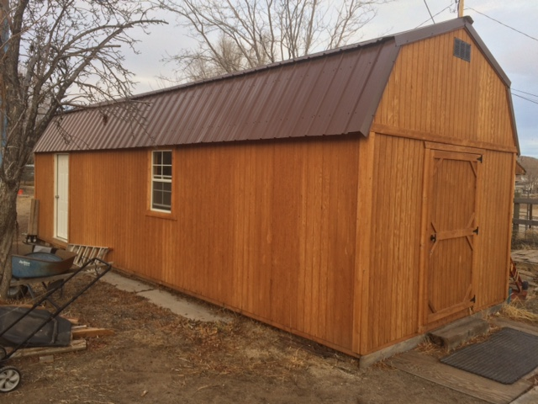

Slide 3
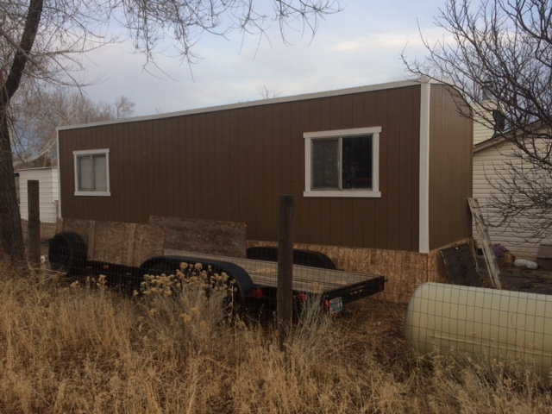

Slide 4
ARTICLE 105 - PERMITS
100.105.1 Required. Any owner or authorized agent who intends to construct, enlarge, alter,
repair, move, demolish, or change the occupancy of a building or structure,
This is an unoccupied pre-fabricated structure

Slide 5
100.105.1 Required. Any owner or authorized agent who intends to erect, install,
enlarge, alter, repair, remove, convert or replace any electrical, gas, mechanical or plumbing
system, the installation of which is regulated by this code, or to cause any such work to be done,
shall first make application to the building official and obtain the required permit.

Slide 6
This is an unoccupied pre fabricated structure that has not been altered in any way to accommodate electrical, gas, mechanical or plumbing system nor is there any plan to cause such work to be done.

Slide 7
OUTDOOR SECTION 110.306.35 or Storage/Outdoor Display.
(c) Outdoor Storage of Commercial Vehicles. No storage of commercial vehicles
shall be allowed on any providentially zoned parcel, unless specifically regulated
in another section of this code.

Slide 8
(1) Commercial Vehicles Defined. A commercial vehicle is defined as any
vehicle designed, maintained or used for business, commercial,
construction or industrial purposes that infringes on the residential
character of residential districts;

Slide 9
for the transportation of property in
furtherance of commercial enterprise; or having more than two axles on
the road; or, any vehicle in excess of 8,000 pounds unladen weight.

Slide 10
No commercial vehicle is being stored on our property. The trailer does not have more that two axles nor does it exceed 8,000 lbs.
The trailer is not connected to any plumbing or water.
The trailer is not being used for any business activities

Slide 11
Commercial vehicles includes, but is not limited to: a concrete truck,
commercial tree-trimming equipment, construction equipment, dump
truck, garbage truck, panel truck, semi-tractor, semi-trailer, stake bed
truck, step delivery van, tank truck, tar truck, and other vehicles
customarily used for commercial or industrial purposes

Slide 12
We have made numerous attempts to obtain information regarding our situation. To this point it is still not clear what we are in violation of.
Additional sections mentioned
Nuisance Code- Sections 50.300 to 50.310
We do not feel this is applicable

Slide 13
Property is not an attraction to children, vagrants, criminals or other unauthorized persons
Property does not meet the definition of Blight , disrepair or unusable
Poses no risk or danger to community

Slide 14
Your personal information (specifically, your name, address, and phone number) becomes part of the public record pertaining to the compliance case and will be released as part of the case file when fulfilling a public records request from a citizen. In certain cases, your personal information may be treated as sensitive information if the compliance case is being handled through the criminal enforcement process. In these types of cases, your information will not be released pursuant to a public records request until the case is closed.

Slide 15
Your personal information (specifically, your name, address, and phone number) becomes part of the public record pertaining to the compliance case and will be released as part of the case file when fulfilling a public records request from a citizen.
Why were we denied release of the complaintents name when the county code allows for this as part of public record.
Washoe County Code Compliance Planning & Building Division Community Services Department
Page 3-section 4- How do I report a potential violation of the County’s land use, business license and/or nuisance regulations?

Slide 16
Throughout this process we have repeatedly been directed to work with CEO Farmer to resolve this issue. On 12-18-2017 he advised us of a violation and directed us to have both detached accessory structures permitted. The documentation given called out Article 105-Permit- 100.105.1. We did not believe this was applicable but tried to comply with his direction and have the structures permitted.

Slide 17
Since then we have repeatedly been denied permits
Because we do not agree or understand why were in violation and are simply exercising our right to appeal we are being made to deal with a very stressful and unpleasant situation

Slide 18
We are also confused how the county can decide to not follow code regarding releasing the name of the person filing the complaint when we followed the request process
(1-29-2019).
Who decides which codes to follow and which do we ignore?

Slide 19
Washoe County Code Enforcement Planning & Building Division Community Services Department December 2018
Ten Commandments of Code Enforcement mindful of the public trust bestowed upon Code Enforcement Officers (CEOs), has adopted ethical and moral standards of conduct as a guide for the County’s CEOs. These standards endeavor to exemplify the highest principles of ethics for the CEOs as they enforce County Codes relative to building, grading, land use, licensing, and/or public nuisances. Washoe County Code Enforcement recognizes that adherence to these principles will foster public confidence, respect, and trust in the CEO’s performance of official duties and for the CEO as an individual. Therefore, a CEO shall:

Slide 20
1. Uphold the Constitutional rights of our customers while following the applicable regulations contained in the Nevada Revised Statutes and Washoe County Code.
2. Be ever vigilant to protect and preserve the public health, safety, and welfare of the citizens in the multitude of Washoe County communities.
3. Uphold the highest standards of fairness, integrity, and honesty.
4. Obey the rules and regulations of Washoe County.
5. Refrain from any and all conduct that may bring disfavor upon the County, the Community Services Department, and the Code Enforcement profession.

Slide 21
6. Never permit prejudices or personal relationships to unfairly influence professional decisions.
7. Place the needs of the public before personal needs, when in the performance of official duties.
8. Conduct investigations courteously and impartially. 9. Never accept any special favor or gratuity.
10. Strive to continue education and training throughout his/her career, thereby providing the highest quality of professional services to the citizens of unincorporated Washoe County.

Slide 22
In closing, it is our understanding that if this is going to continue moving forward then the person(s) making the anonymous complaints shall be named and be part of the public record. We also believe this is a form of retaliation from an event steaming from August 2016. If selective enforcement is complaint driven and a part of the counties governing body is being used to intimidate and retaliate against citizens this is extremely concerning.

Slide 23
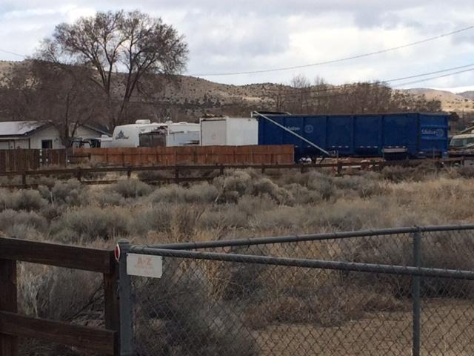
Code Violations in Lemmon Valley

Slide 24
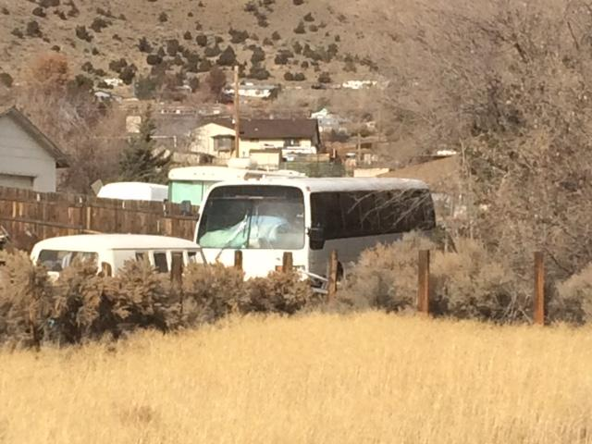
Code Violations in Lemmon Valley

Slide 25
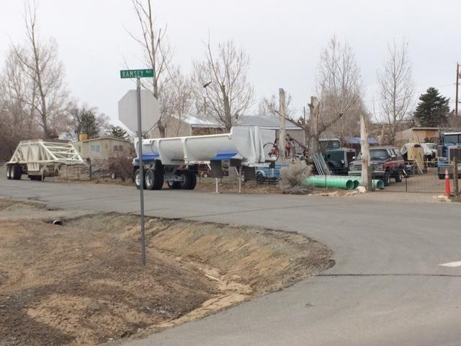
Code Violations in Lemmon Valley

Slide 26
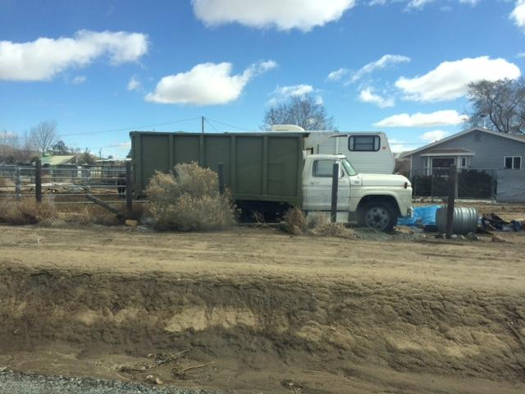
Code Violations in Lemmon Valley

Slide 27
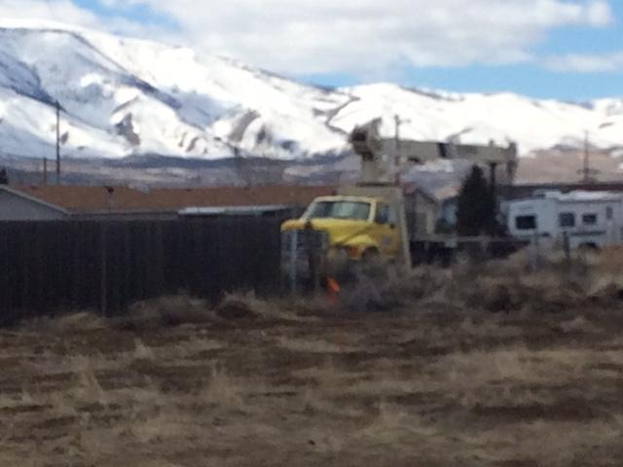
Code Violations in Lemmon Valley

Slide 28
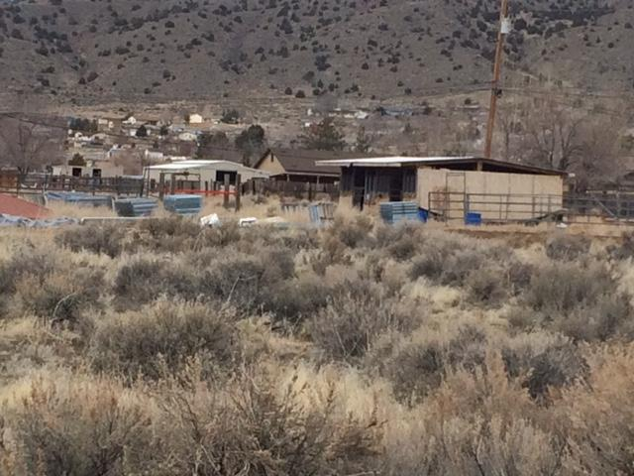
Code Violations in Lemmon Valley

Slide 29
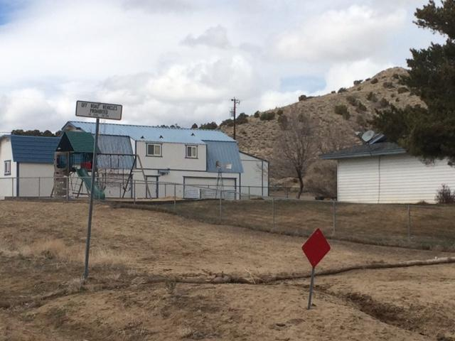
Code Violations in Lemmon Valley

