Slide 1
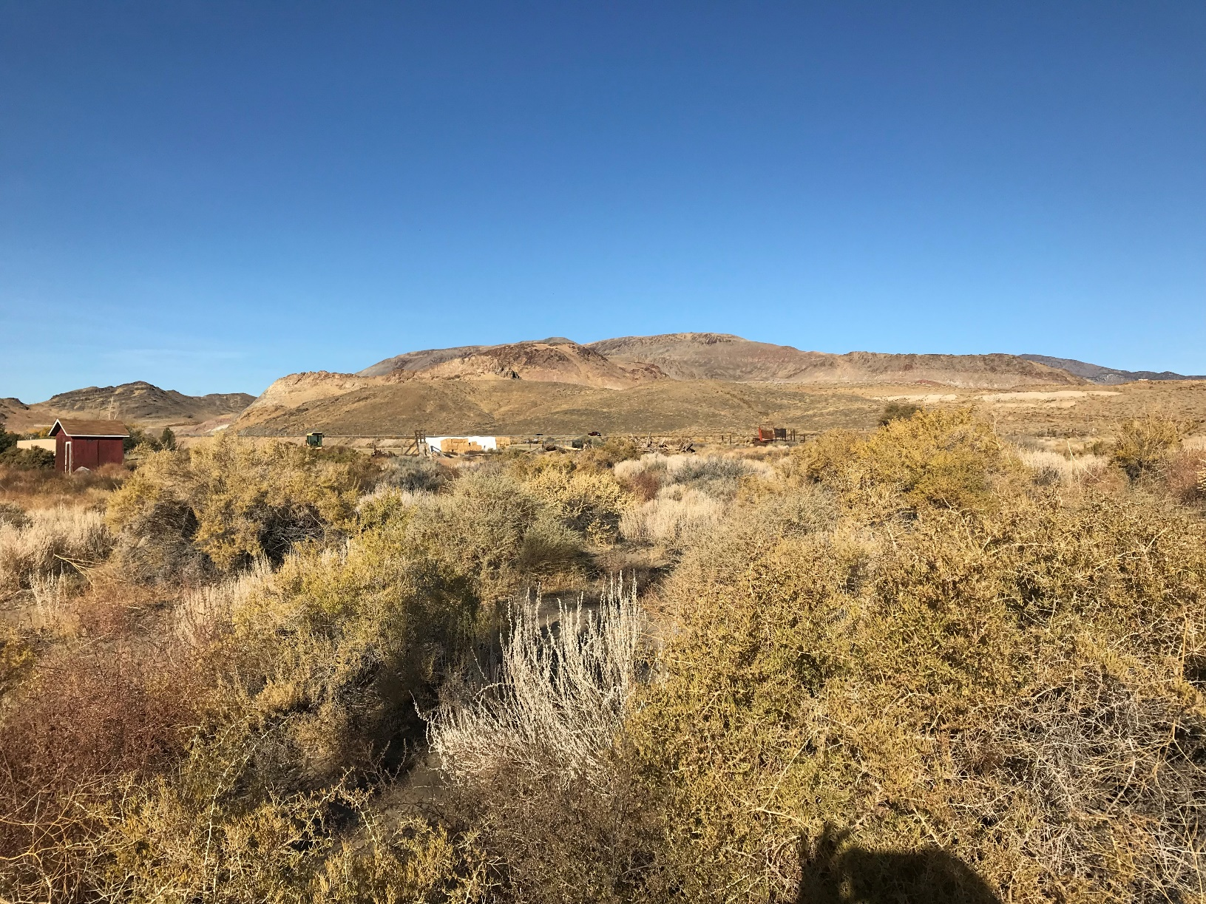
WSUP19-0022 Rosakranse Wall
Washoe County Board of Adjustment
December 5, 2019

Slide 2
Request
The application is requesting to construction a 9-foot permanent earthen structure at 31000 Cantlon Drive, which requires a special use permit (SUP) per Washoe County Code 110.438.35(a)(4)

Slide 3
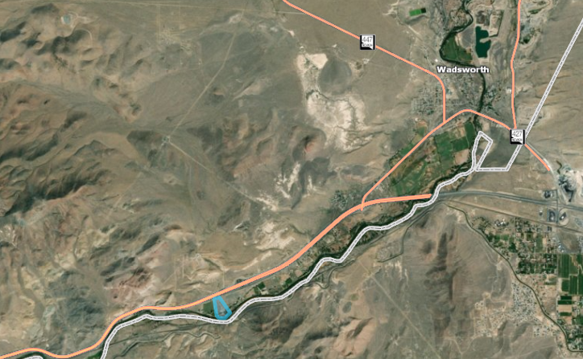

Slide 4
Background
The site is undeveloped with a few trees and native vegetation
It borders the Truckee River to the southeast and I-80 to the northwest, with other large acre parcels adjacent to the site

Slide 5
Analysis
The applicant is requesting to construct a 9-foot high berm behind a retaining wall to construct a residence
The applicant states that 20,800 sq. ft. of the 18.4 acres site will be disturbed to construct the berm and 1,414.46 cubic yards will be excavated from two sites to fill the area around the residence to construct the berm

Slide 6
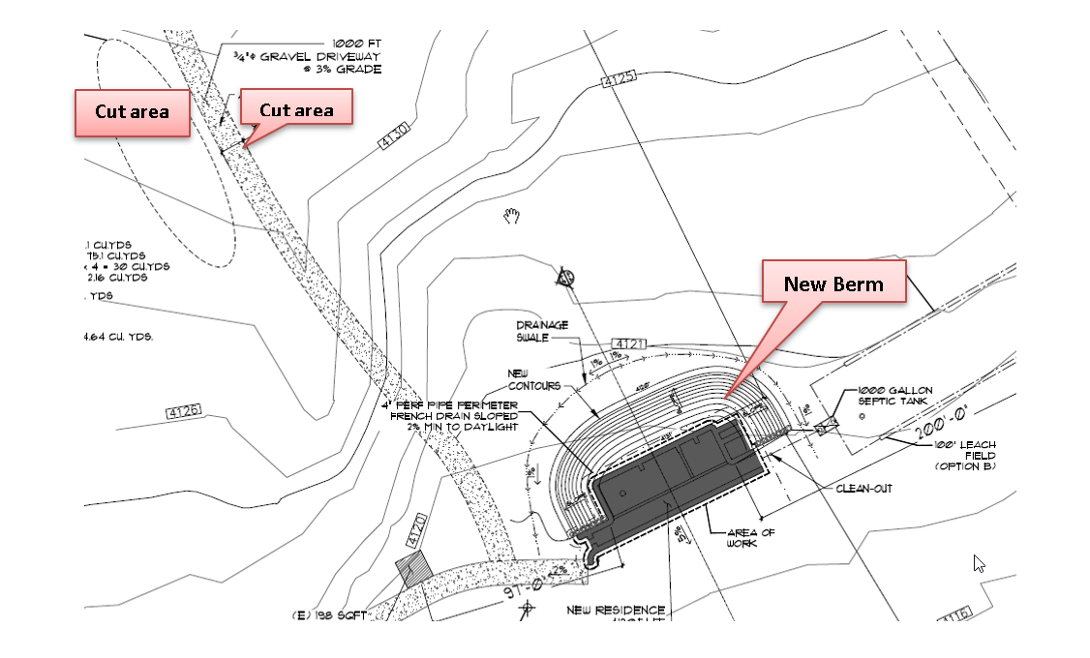
Site Layout

Slide 7
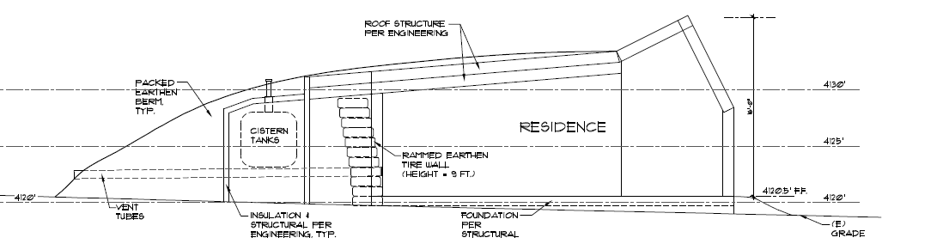
Analysis
The residence is planned as a low impact environmental design with the berm as a significant part of the design which will assist in the insulation factor, energy usage and regulation of the internal temperature of the home

Slide 8
Public Notice & CAB
Public notices were sent to parcels within 500 feet from the site
The East Truckee Canyon CAB did not meet during the month of November and the applicant was not presented to the CAB
No correspondences was received concerning the application

Slide 9
Reviewing Agencies
The application was distributed to various agencies for reviewed and their comments are included in the staff report
Agencies with conditions are included in the Conditions of Approval

Slide 10
Special Us Permit Findings
1. Consistency;
2. Improvements;
3. Site Suitability;
Issuance Not Detrimental; and
Effect on a Military Installation
Staff is able to make all the required findings, as detailed in the staff report on Page 6-7

Slide 11
Possible Motion
I move that after giving reasoned consideration to the information contained in the staff report and information received during the public hearing, the Washoe County Board of Adjustment approve with conditions Special Use Permit Case Number WSUP19-0022 for Christine Rosakranse, having made all five findings in accordance with Washoe County Code Section 110.810.30.

