Slide 1

Cold Springs Elementary School
Special Use Permit (WSUP19-0018)
Washoe County Board of Adjustment - October 3, 2019

Slide 2
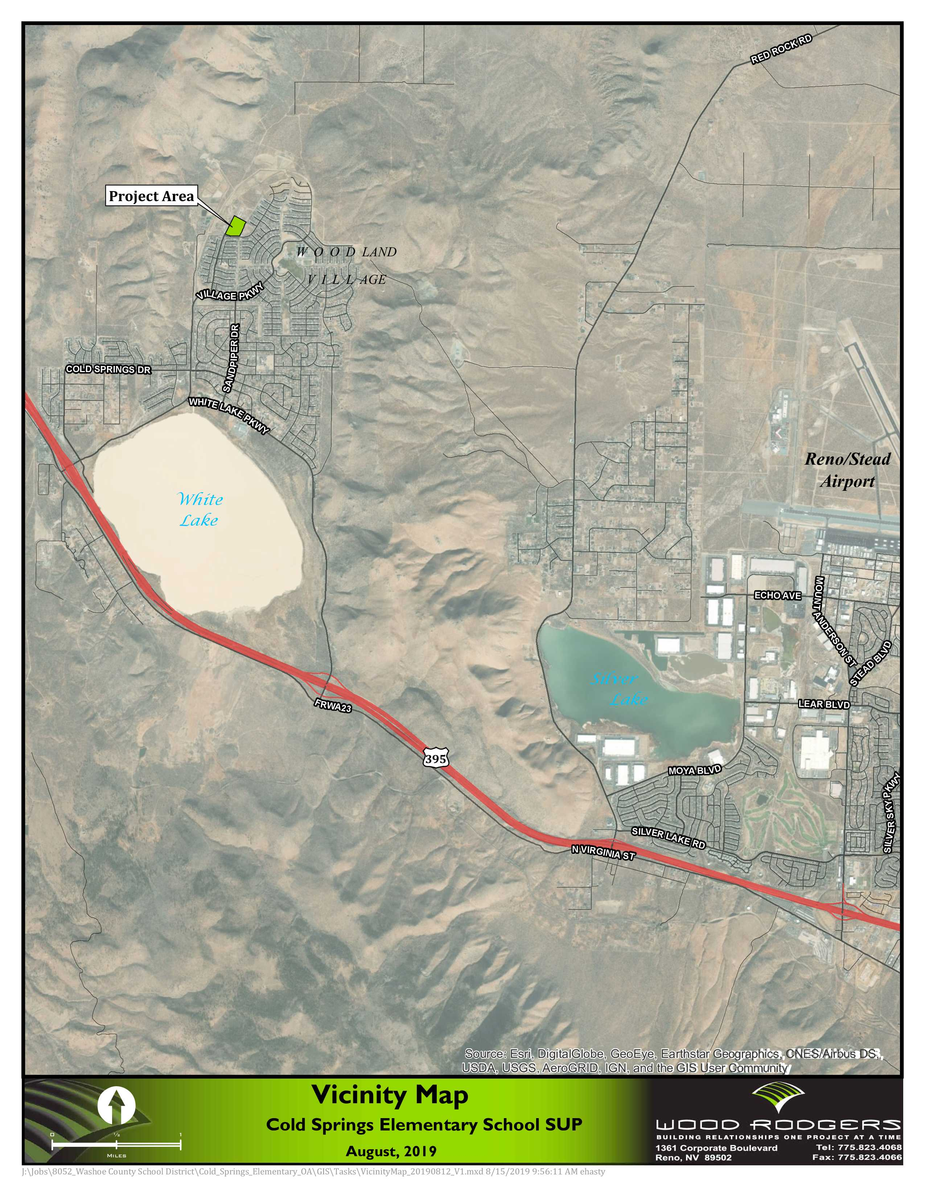
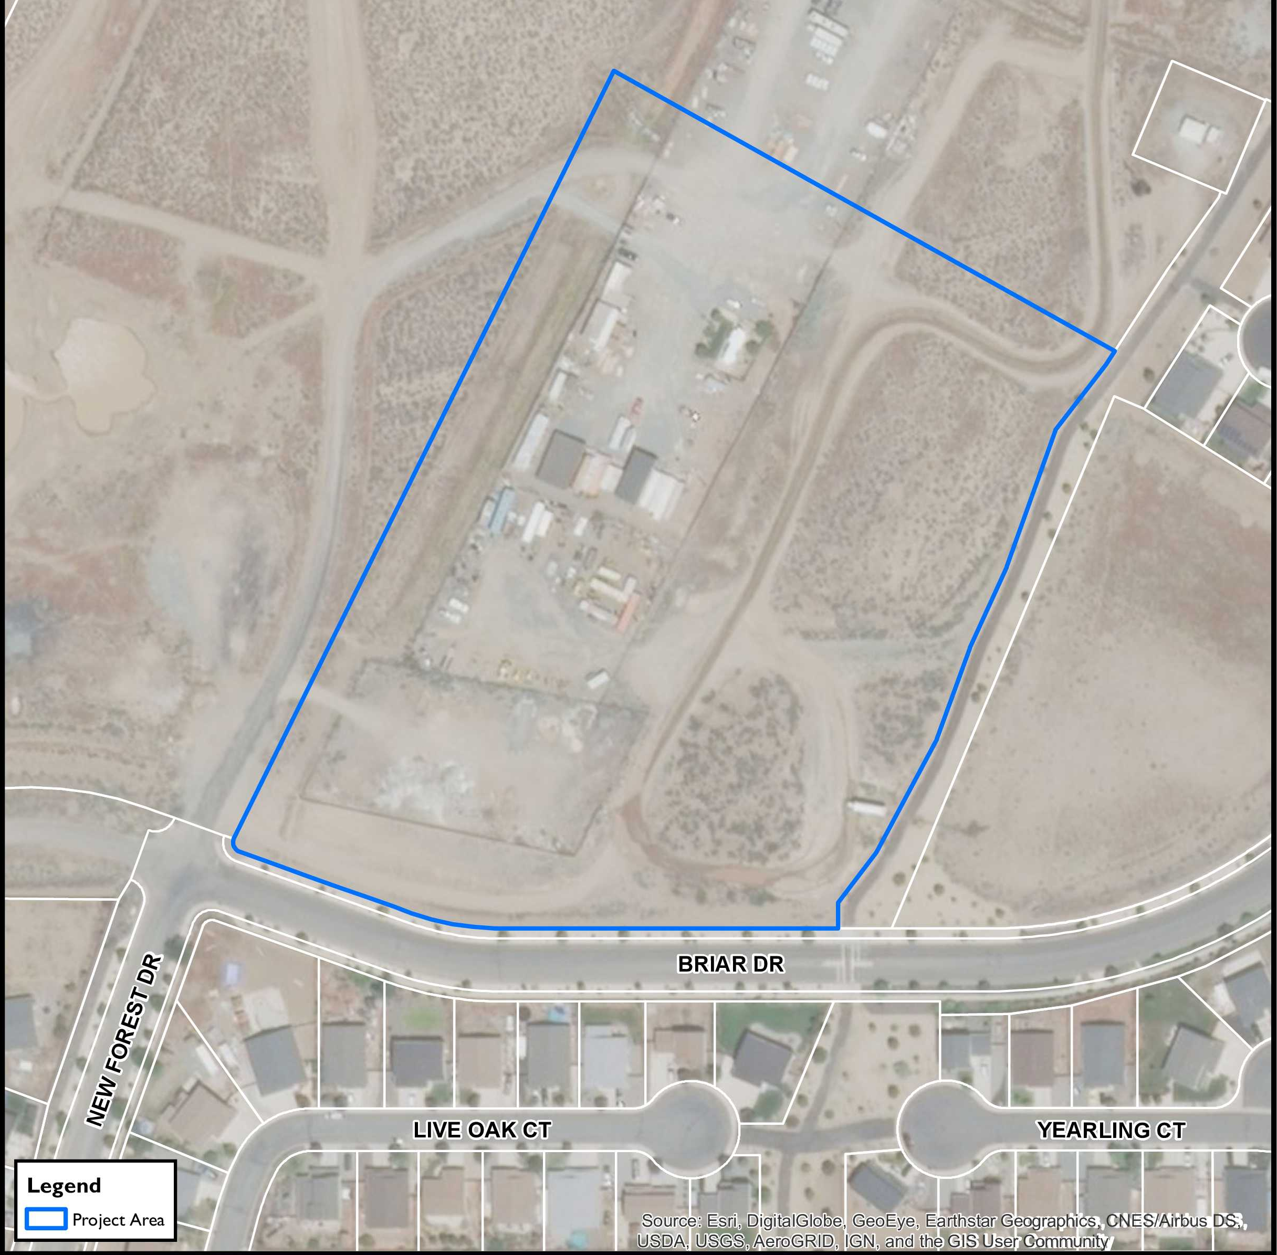
Project Location:
10.1± Acres
North of the Intersection of Briar Drive and New Forest Drive
Vacant Land

Slide 3
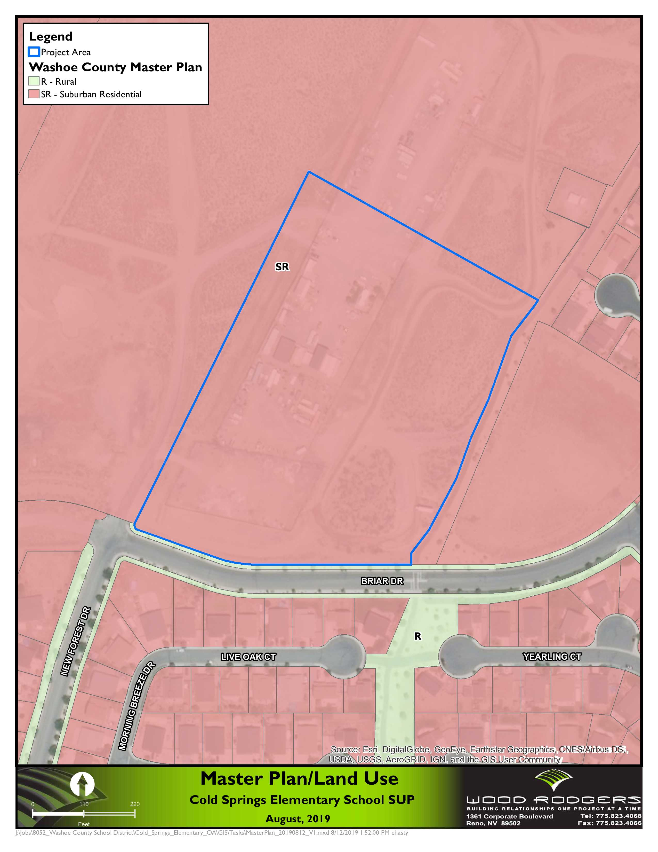
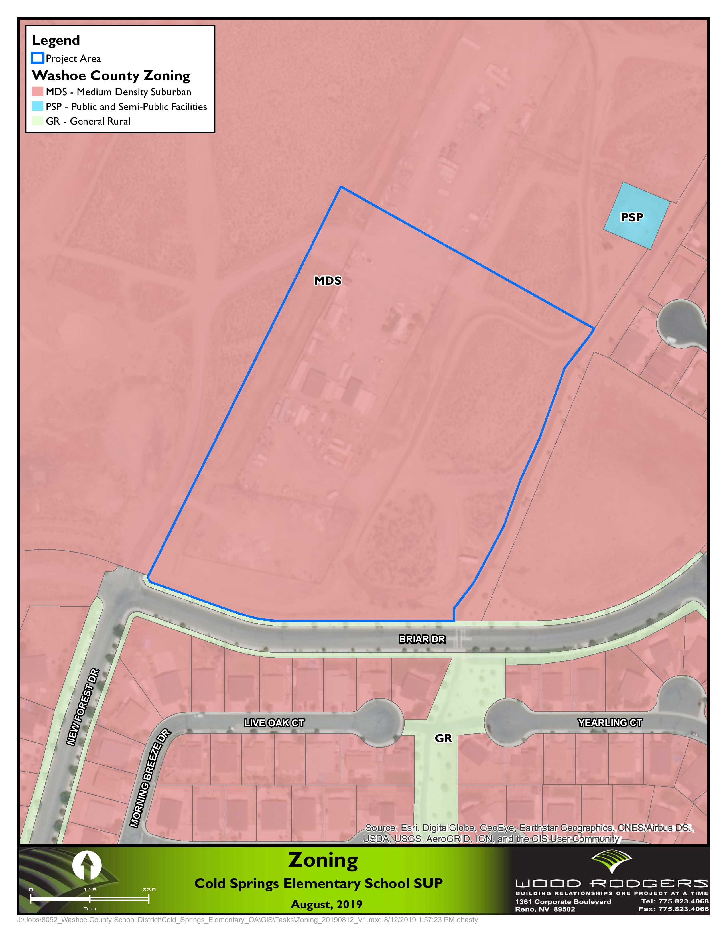
Project Site:
Master Plan = Suburban Residential
Zoning = Medium Density Suburban (MDS)
A School is a permitted use within the MDS zoning designation

Slide 4
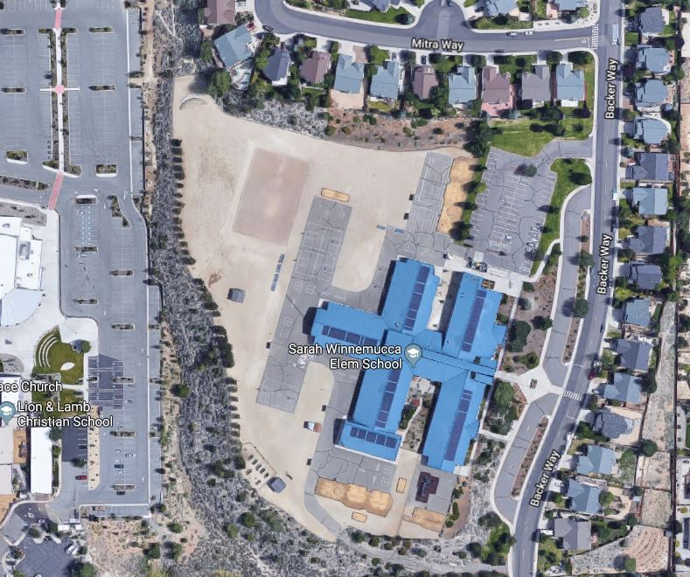
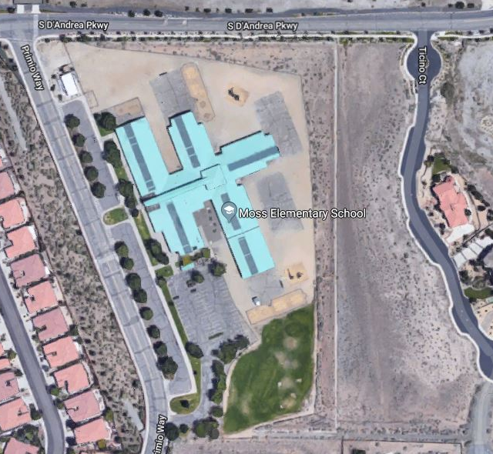
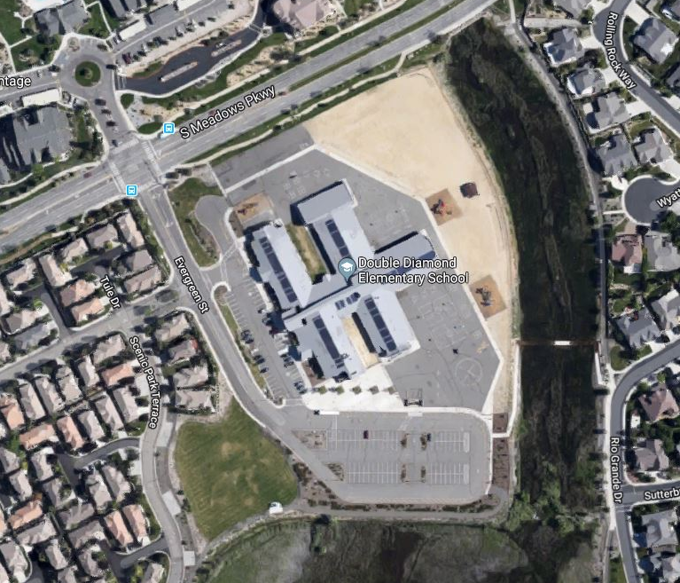
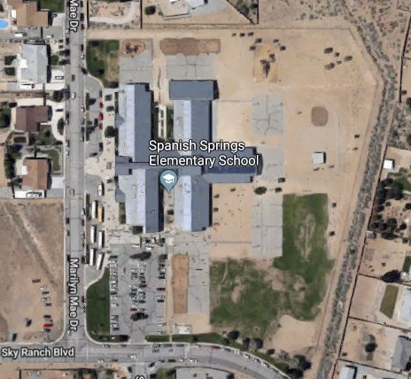

Sarah Winnemucca Elementary (Reno)
Moss Elementary (Sparks)
Project Request:
Special Use Permit to allow for grading activities associated with an elementary school totaling more than 20% disturbance for grading.
Site includes the proposal of a portion of the playground to be dedicated as a flat multi-purpose field to be covered with decomposed granite (26% of the site).
According to Section 110.412.60(j) of the WCDC, decomposed granite areas not consisting of shrubs and trees are not considered ‘Ground Cover’.
This is a common feature in most new elementary schools throughout the district including within Washoe County, City of Sparks and City of Reno
Double Diamond Elementary (Reno)
Spanish Springs Elementary (Washoe)

Slide 5
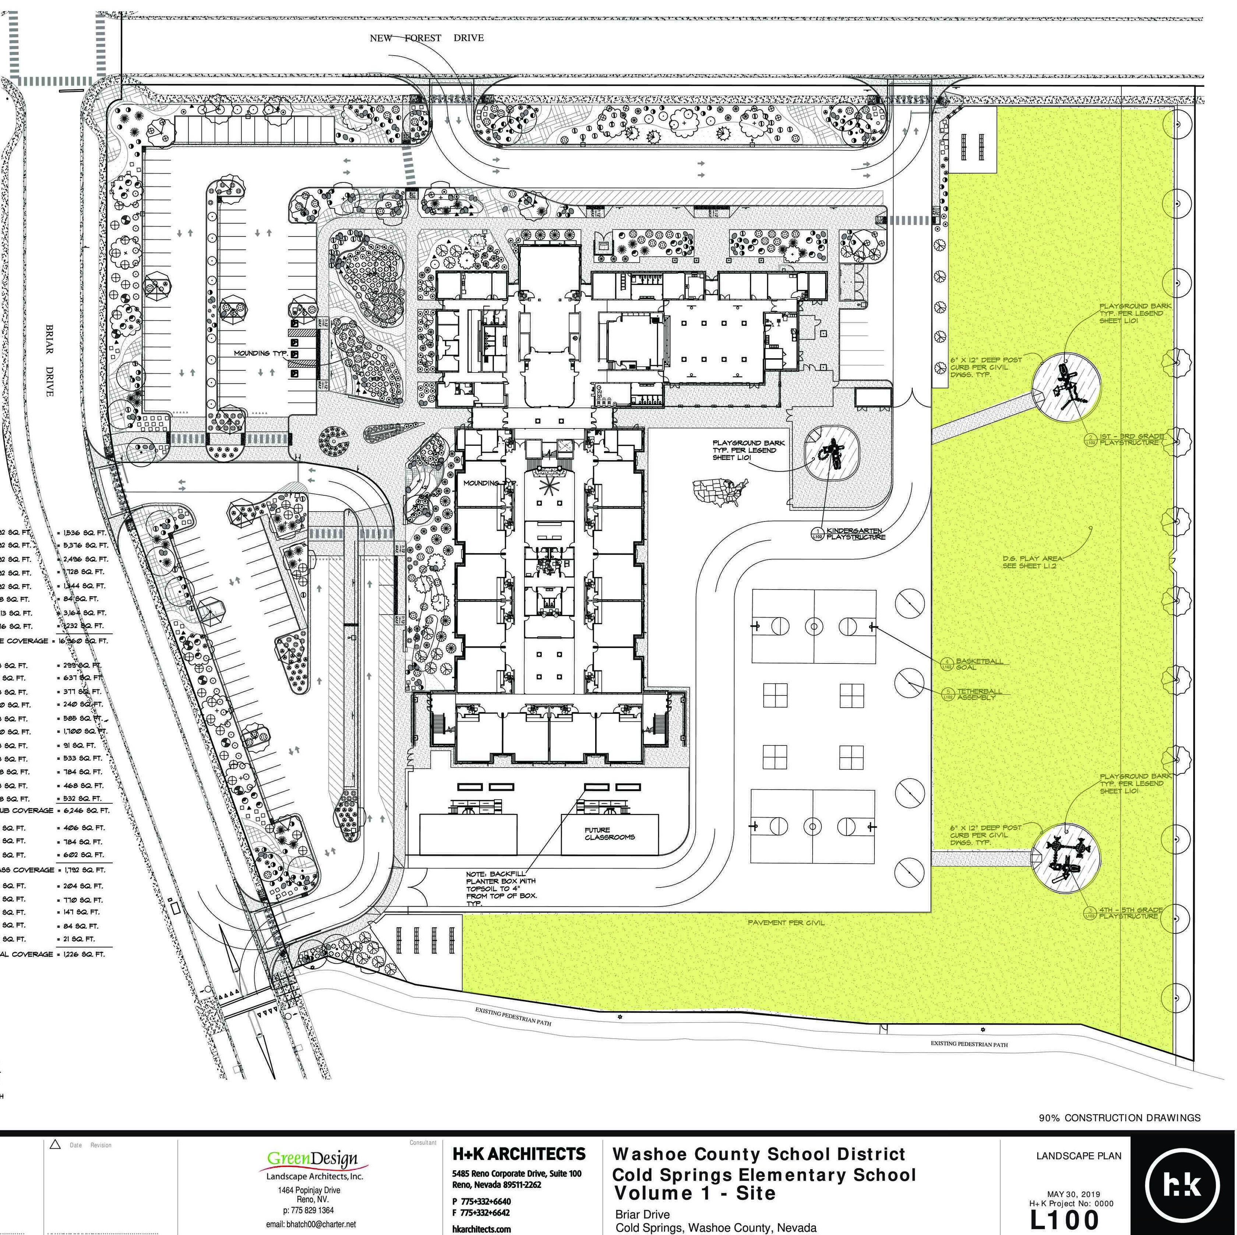
Project Details:
School construction is independent of SUP
745-student elementary school will help relieve overcrowding and provide updated facilities
2.6± acres of decomposed granite multi-purpose field
Formal Landscaping (1.2± acres)
  147 trees
  0.6± acres of shrub coverage
Two parking lots
  92 spaces (36 required)
Access
  Bus drop-off along Briar Dr.
  Individual drop-off along New Forest Dr.
Traffic/Pedestrian improvements (Briar & New Forest Dr)

Slide 6
Conclusion:
Special Use Permit to allow for grading activities associated with an Elementary School totaling more than 20% disturbance for grading.
The SUP is independent of the construction of a school at this location
26% of the site will be decomposed granite multi-purpose field
Common feature in most elementary schools in Reno and Sparks

Slide 7

Andy Durling, AICP, LEED AP
Vice President
adurling@woodrodgers.com

