Slide 1
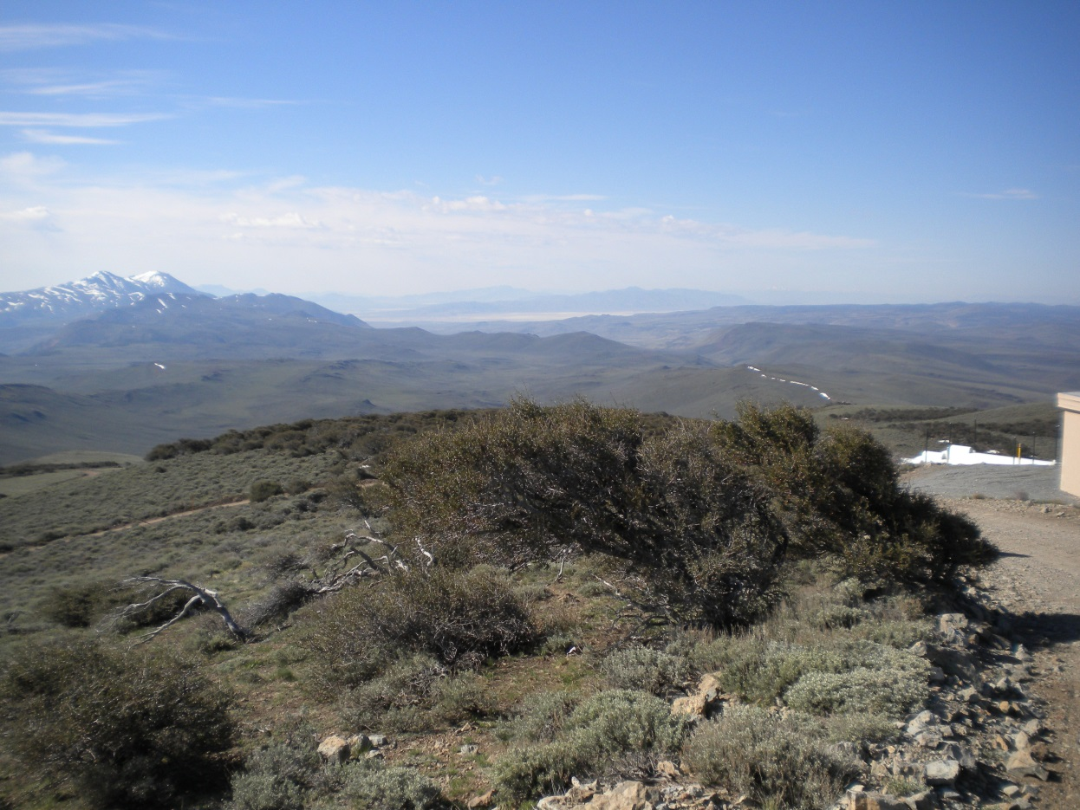
WSUP19-0004 Fox Mountain Monopole
Washoe County Board of Adjustment
June 6, 2019

Slide 2
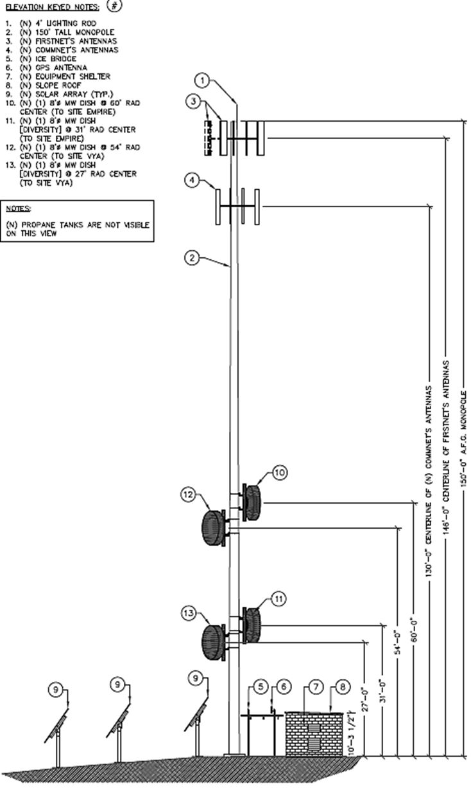
Request
Construction and operation of a new 150-foot high monopole for wireless communication.

Slide 3
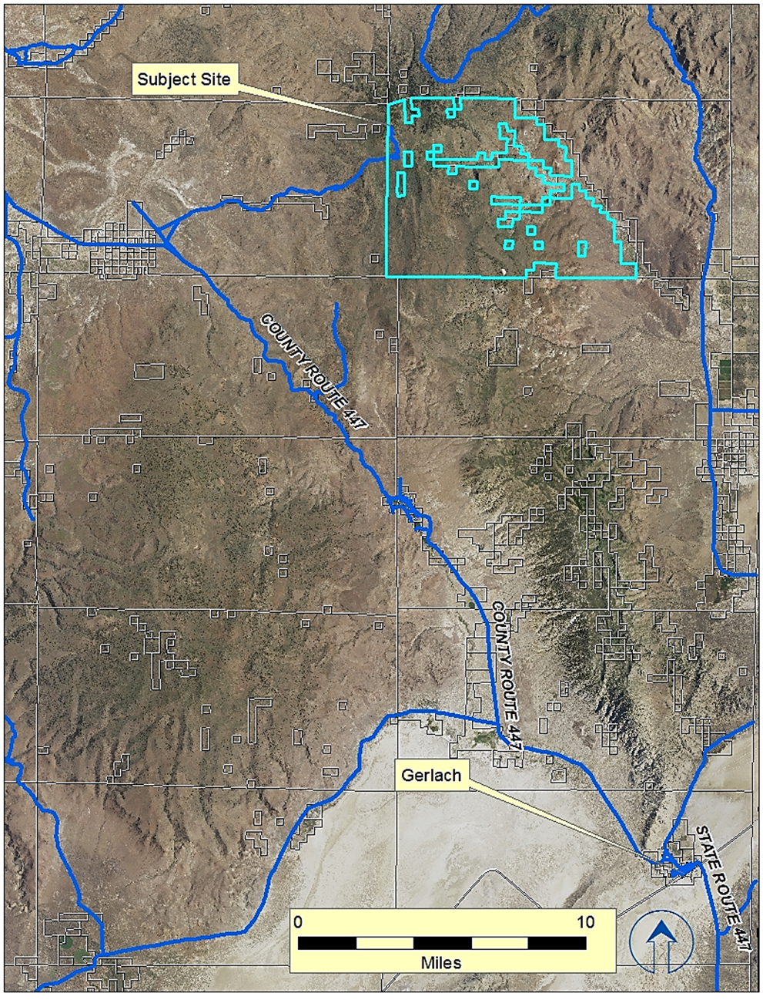
Vicinity Map

Slide 4
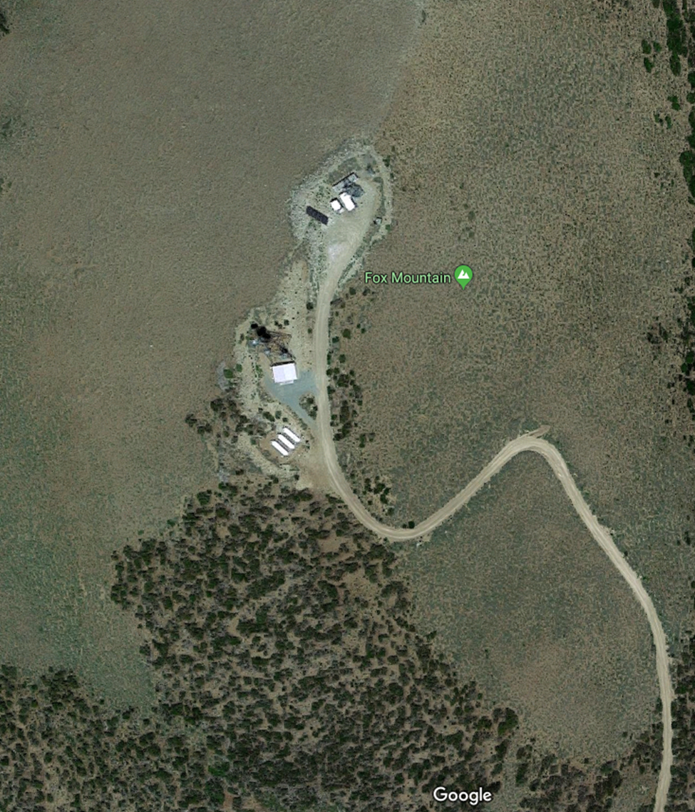
Over-Head Photo

Slide 5
Evaluation
Located approximately 30 miles northwest of Gerlach
Very remote
Two existing communication facilities at this location
Few negative impacts anticipated
No dwellings in the vicinity
Height and location meet generally applicable Code provisions

Slide 6
Citizen Advisory Board
Gerlach / Empire CAB reviewed the application on May 9, 2019: The CAB did not express opposition to the project and encouraged Washoe County to facilitate further enhancement of the cellular coverage in the High Desert Planning Area.

Slide 7
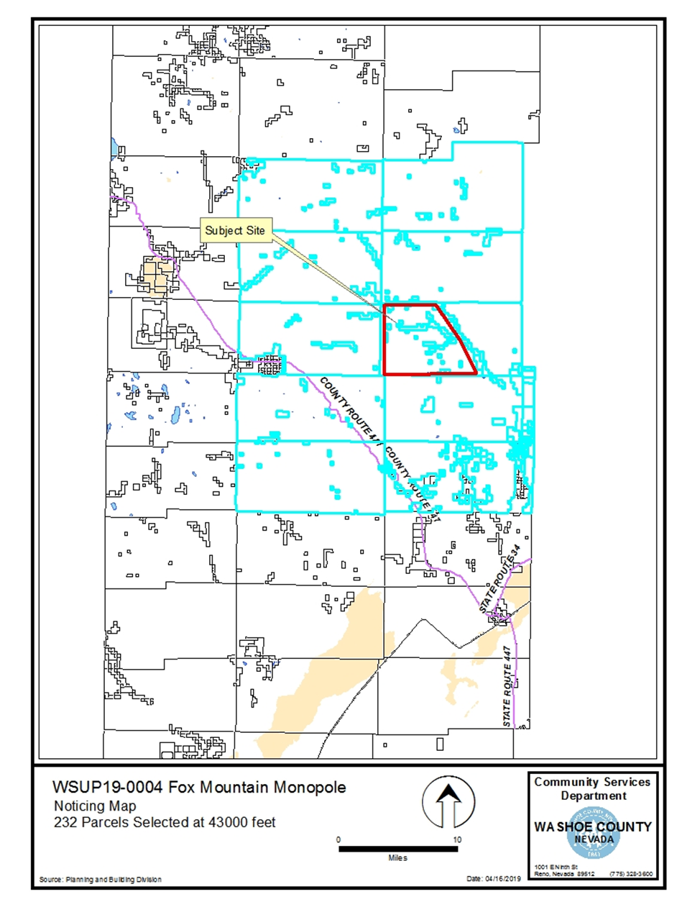
Public Notice
Public Notice was sent to the owners of 232 parcels of land within 43,000 feet of the subject parcel.

Slide 8
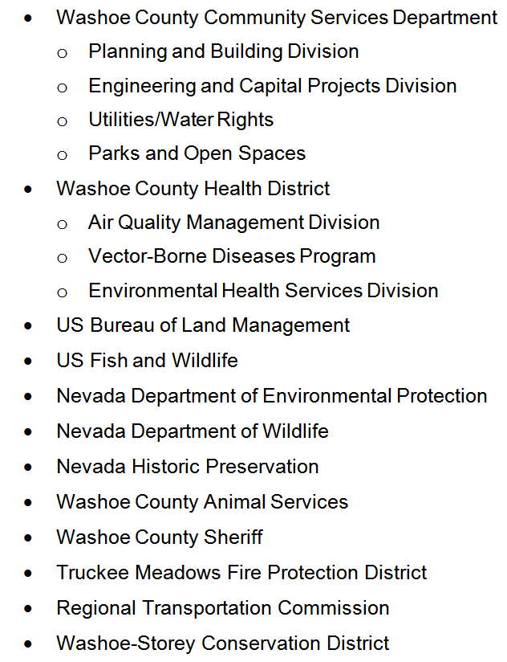
Reviewing Agencies
No extraordinary or unusual conditions of approval were received.

Slide 9
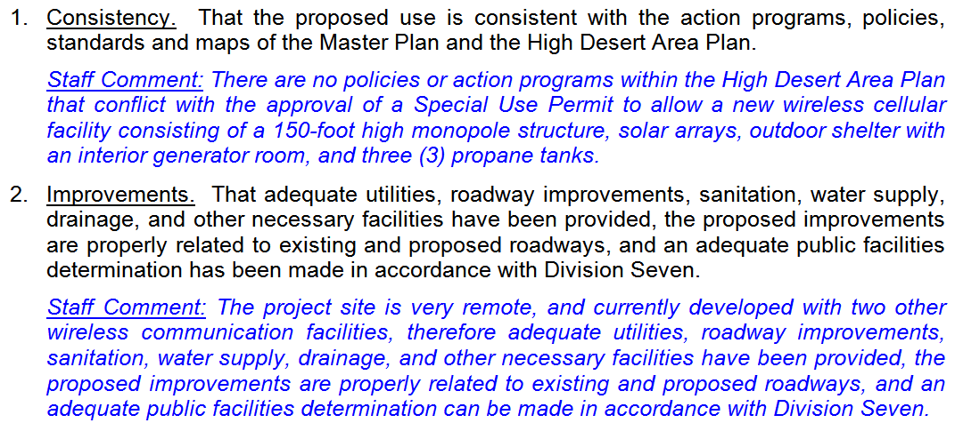
Special Use Permit Findings

Slide 10
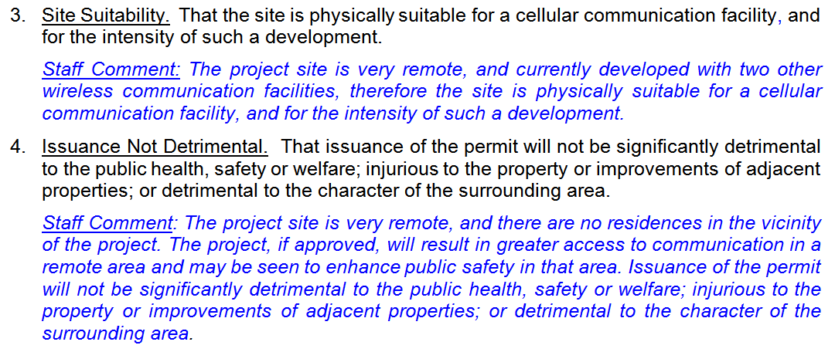
Special Use Permit Findings

Slide 11
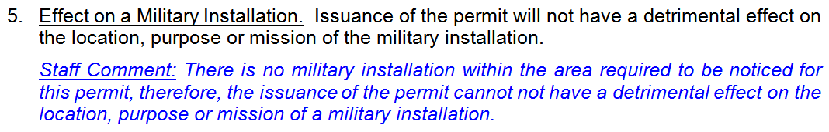
Special Use Permit Findings

Slide 12
Recommendation
Those agencies which reviewed the application recommended conditions in support of approval of the project. Therefore, after a thorough analysis and review, Special Use Permit Case Number WSUP19-0004 is being recommended for approval with conditions.

Slide 13
Possible Motion
I move that, after giving reasoned consideration to the information contained in the staff report and information received during the public hearing, the Washoe County Board of Adjustment approve with conditions Special Use Permit Case Number WSUP19-0004 for Commnet Nevada, having made all five findings in accordance with Washoe County Code Section 110.810.30

