Slide 1
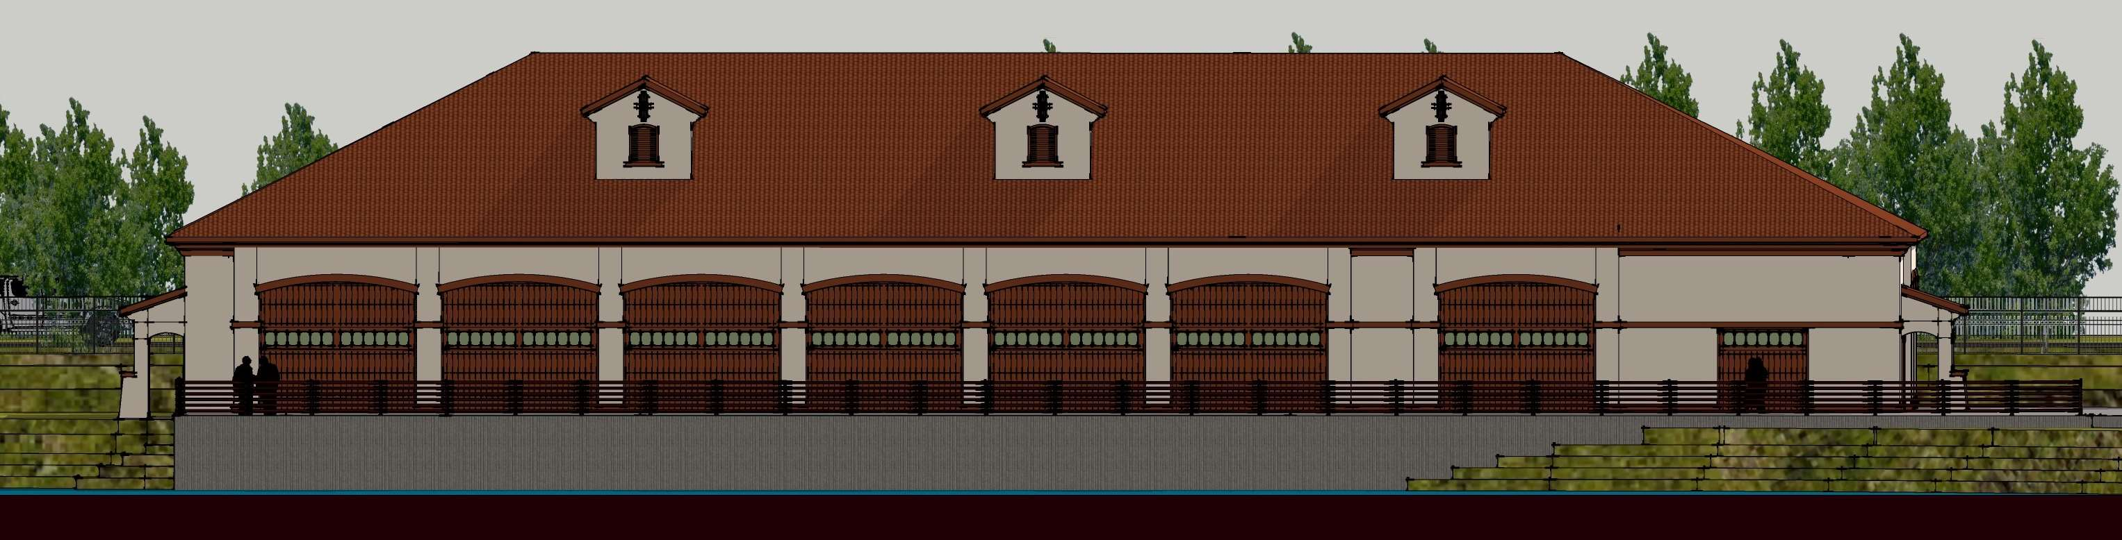
WADMIN19-0016 (DeMartini Garage)
Washoe County Board of Adjustment
October 3, 2019

Slide 2
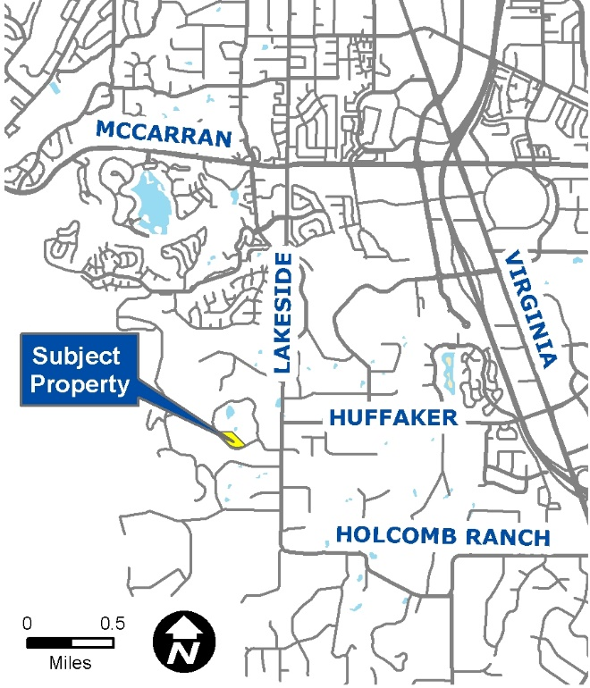
Overview
Detached accessory structure with a larger footprint than the main dwelling
9,000 sq. ft.
5-acre parcel
HDR zoning
The proposed structure meets setback requirements

Slide 3
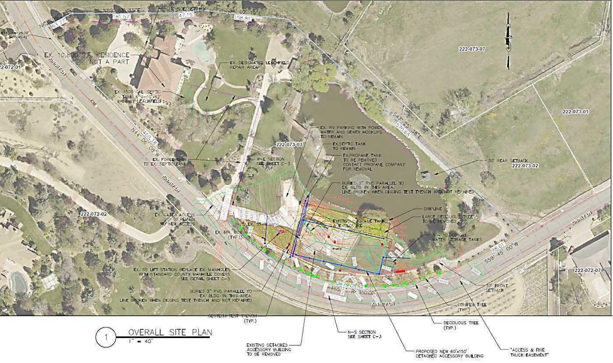
Site Plan
Main Dwelling
Proposed Garage

Slide 4
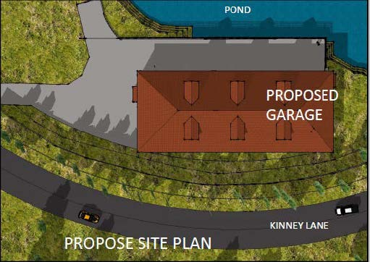
Site Plan

Slide 5
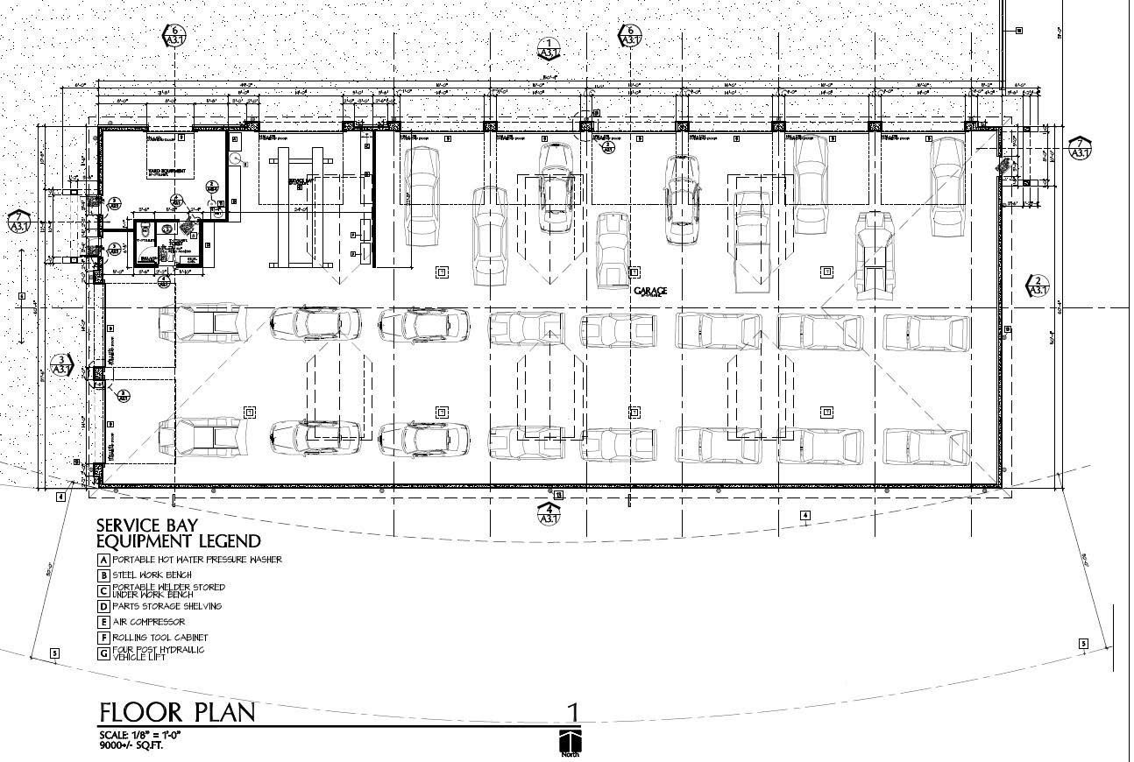
Floor Plan

Slide 6
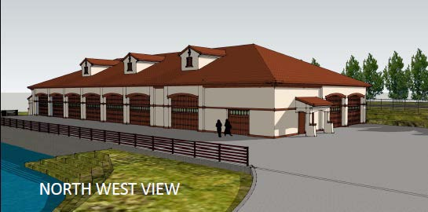
Design

Slide 7
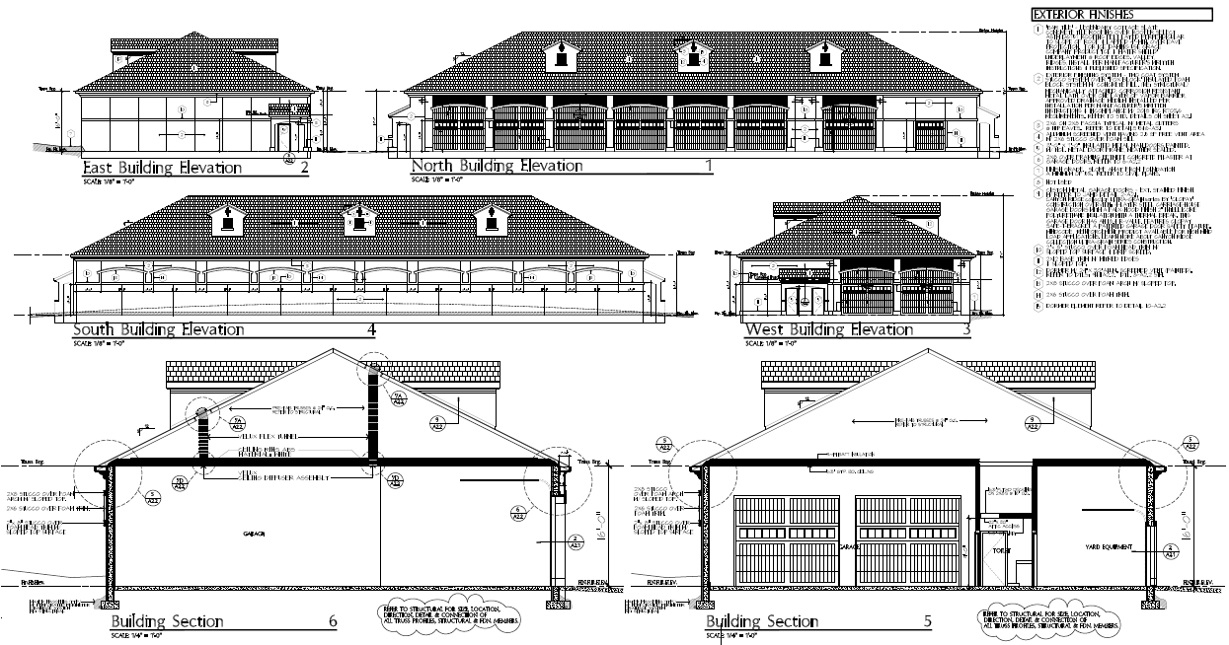
Elevation

Slide 8
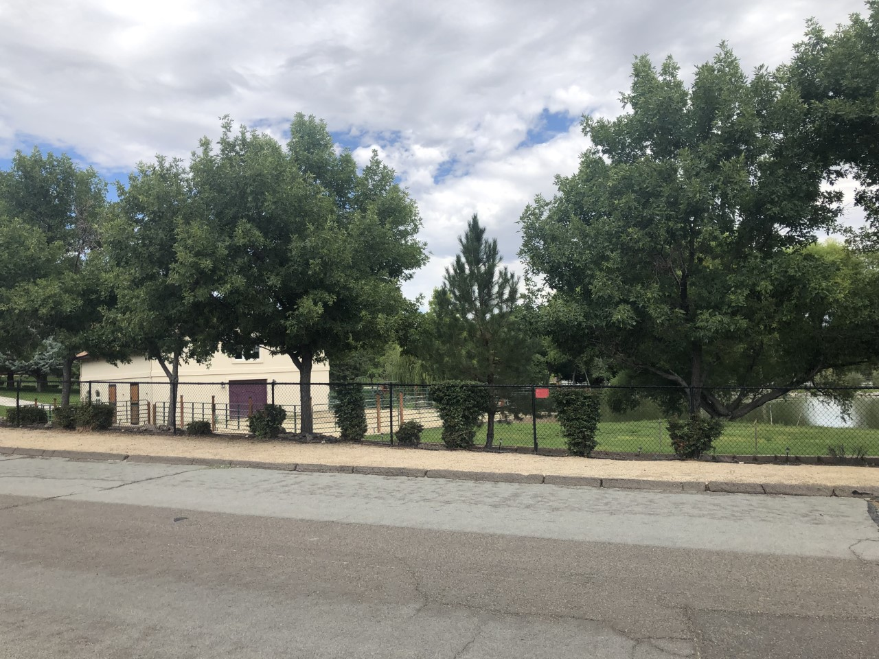
Photo from Kinney Lane

Slide 9
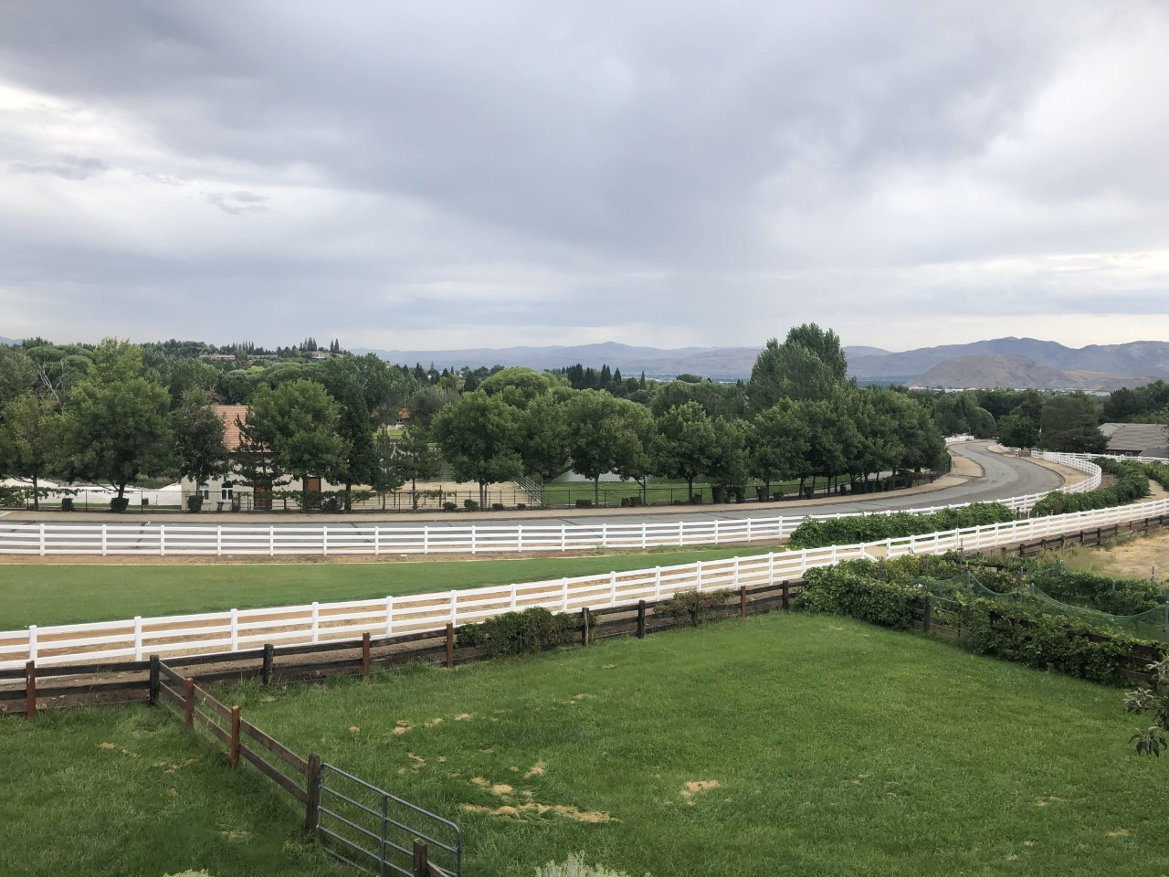
Photo from Neighboring Property

Slide 10
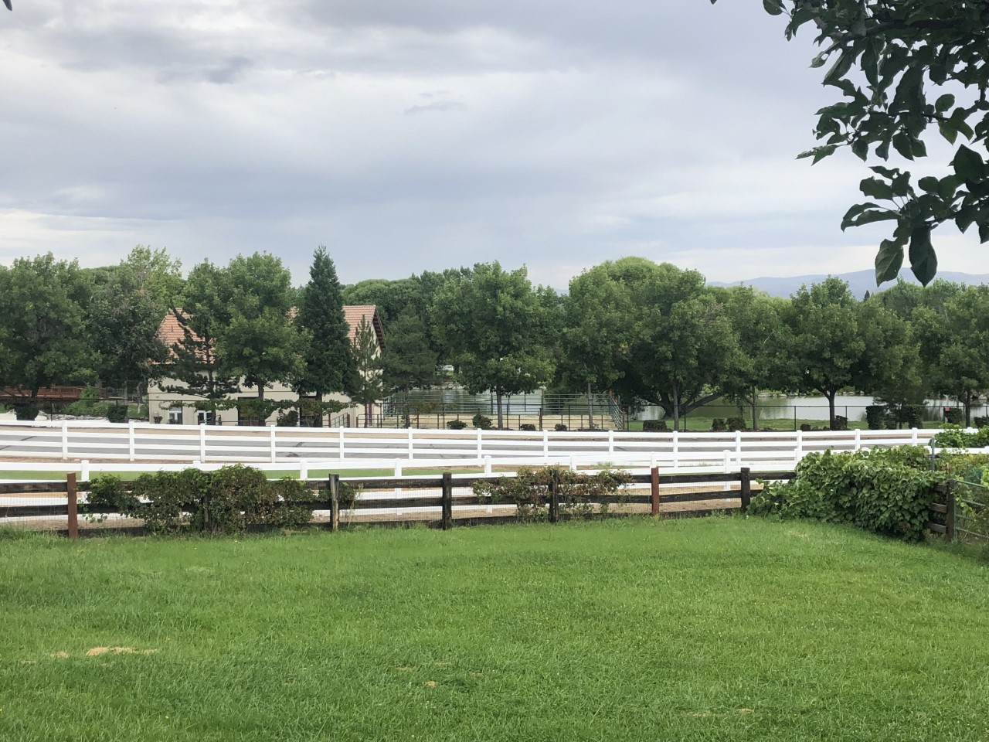
Photo from Neighboring Property

Slide 11
Public Notice & CAB
Notice sent to 37 affected property owners
South Truckee Meadows/Washoe Valley CAB reviewed the application on September 5, 2019
The CAB recommended approval with conditions to limit the hours of operation to 8:00 pm and to ensure the proposed garage will not be utilized for commercial purposes

Slide 12
Reviewing Agencies
Washoe County Community Service
  Planning and Building Division
  Engineering and Capital Projects
Washoe County Health District
  Air Quality Division
  Environmental Health Services Division
Truckee Meadows Fire Protection District
Regional Transportation Commission
Washoe-Storey Conservation District

Slide 13
Southwest Truckee Meadows Area Plan
SW.2.14 The approval of all special use permits and administrative permits must include a finding that the community character as described in the character statement can be adequately conserved through mitigation of any identified potential negative impacts. Mitigation measures shall be reviewed by the Washoe County [Board of Adjustment] as well as by the relevant Citizen Advisory Board.

Slide 14
Administrative Permit Findings
Consistency
Improvements
Site Suitability
Issuance Not Detrimental
Effect on a Military Installation

Slide 15
Possible Motion
I move that, after giving reasoned consideration to the information contained in the staff report and information received during the public hearing, the Board of Adjustment approve Administrative Permit Case Number WADMIN19-0016 for Mr. and Mrs. James DeMartini having made all five findings in accordance with Washoe County Development Code Section 110.808.25 and the required finding in accordance with the Southwest Truckee Meadows Area Plan

