Slide 1
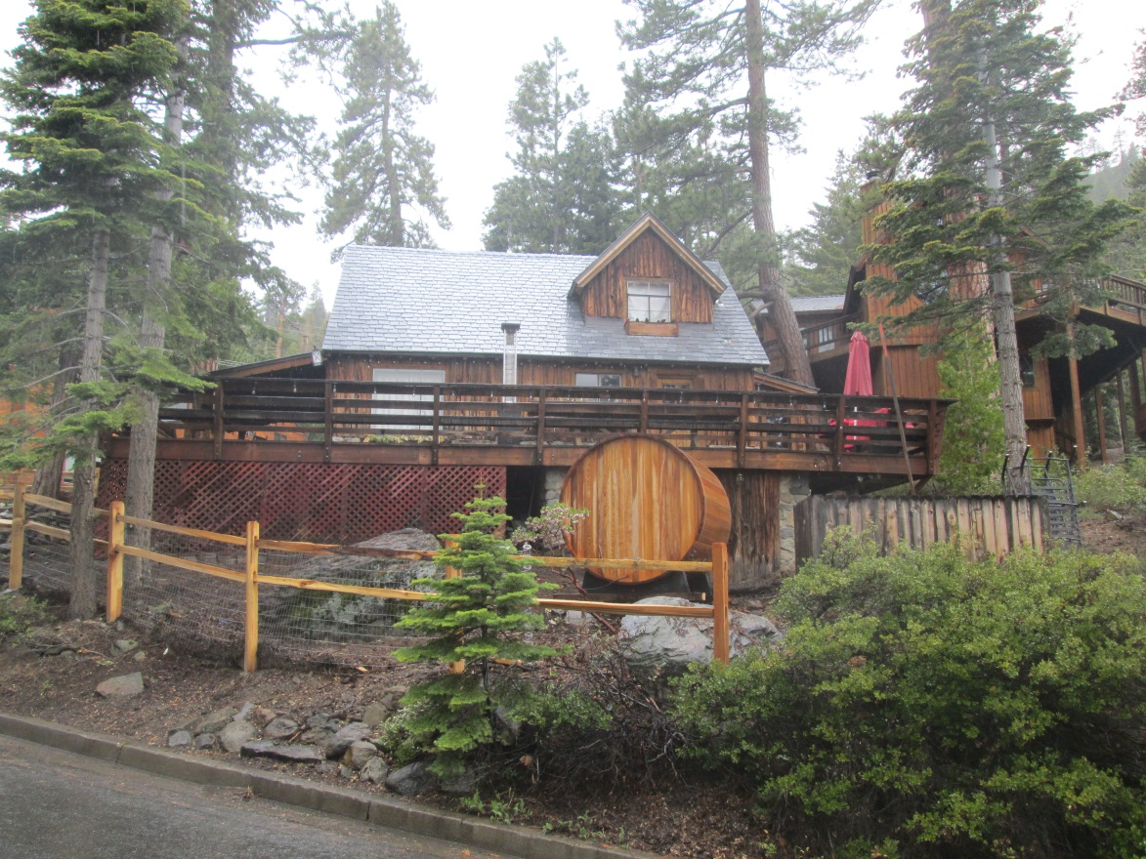
Variance Case VA16-006
vary the side yard setback from 8 feet to 5 feet for a first floor addition on the main house
expand the second floor to be in-line with the existing and proposed additions
vary the side yard setback from 8 feet to 7 feet for the detached garage.

Slide 2
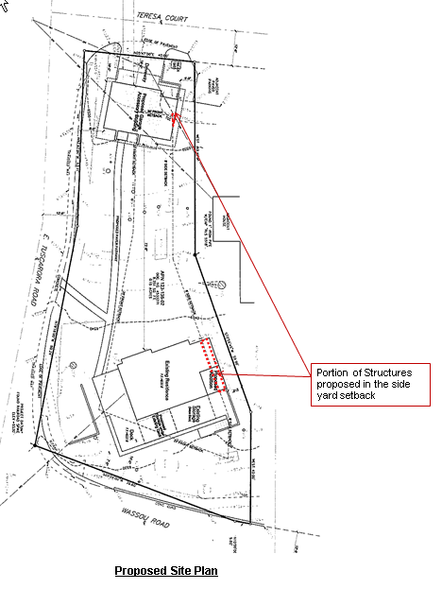
Variance Case VA16-006
Lot unusually shaped
Lot unusually narrow
Front yard setbacks on three side of property
Buildable area severely limited by setbacks

Slide 3
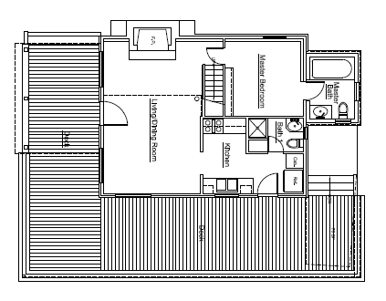
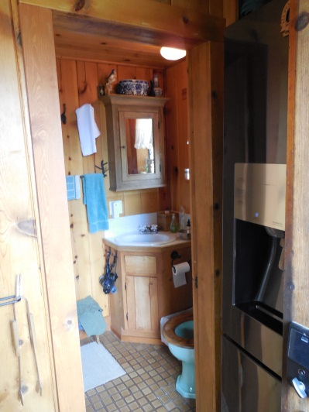
Analysis
Variance in 1999 reduced side yard setback to 5 feet so a “standard size bathroom could be added”
Proposed addition would replace existing small bathroom with a second “standard size bathroom” and enlarge the kitchen
6’-6” x 9” bathroom added in 1999
Existing first floor plan
Proposed first floor plan

Slide 4
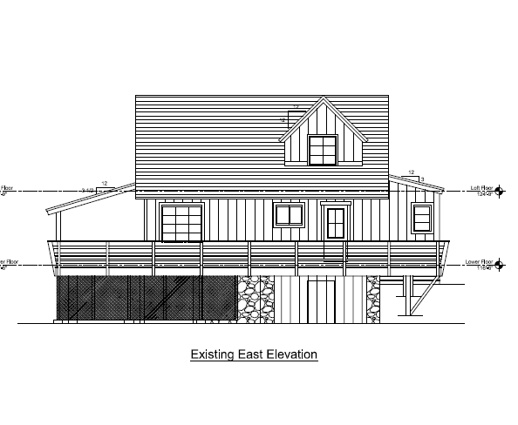
Analysis
Extend the second floor bedroom to be inline with the first floor bathrooms

Slide 5
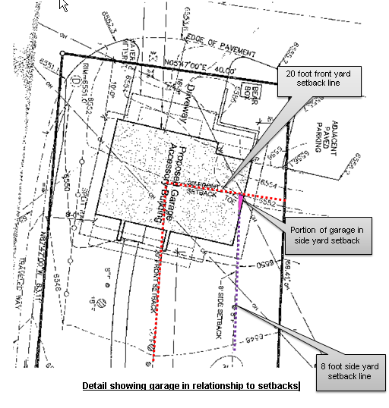
Analysis
Reduce side yard setback from 8 feet to 7 feet for garage
"Front yard" means a yard lying between the setback line and the front lot line and extending across the full width of the lot or parcel.
"Side yard" means a yard lying between the setback line and the side lot line and extending from the front yard line to the rear yard line.

Slide 6
Conditions of Approval
Substantial Conformance
Hold Harmless
If more than 50% of cabin is torn down for remodel of cabin then setback reduction granted for storage area under deck is void
Deed Restriction
Limit accessory structure foot print

Slide 7
Findings
Special circumstances
- Exceptional lot shape, size and slope
No detriment
- Conditions of approval
No special privileges
- Adjacent properties have been granted similar setback reductions and additional stories on accessory structures
Use authorized
- All proposed uses permitted in MDS

Slide 8
Motion
I move that, after giving reasoned consideration to the information contained in the staff report and information received during the public hearing, the Washoe County Board of Adjustment approve Variance Case No. VA16-006 for Jeff Eget, to vary the side yard setback from 8 feet to 5 feet for a first floor addition on the main house; to expand the second floor to be in-line with the existing and proposed additions; and to reduce the side yard setback from 8 feet to 7 feet for the detached garage, with the conditions included in Exhibit A to the staff report for this matter, having made all four required findings in accordance with Washoe County Code Section 110.804.25.

