Slide 1
Citizen Advisory Board Presentation
CSD - Roads

Slide 2
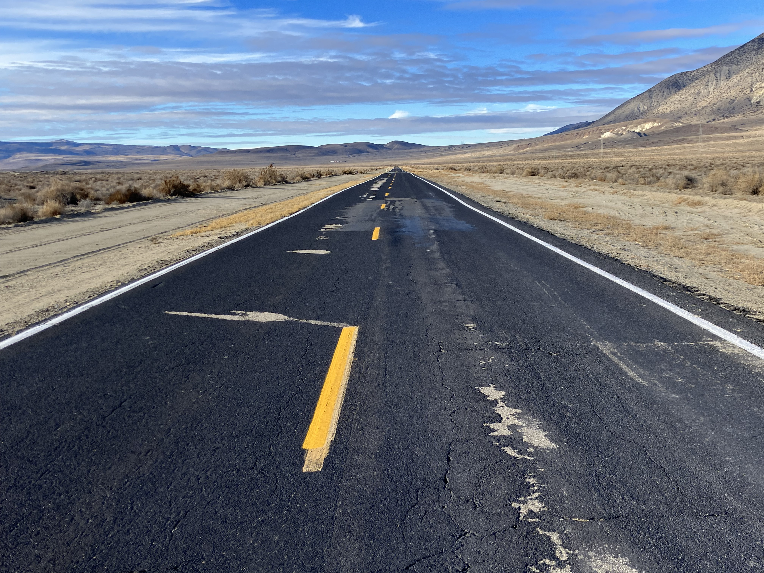
Pavement -CR447
-CR34
-Rodeo Creek

Slide 3
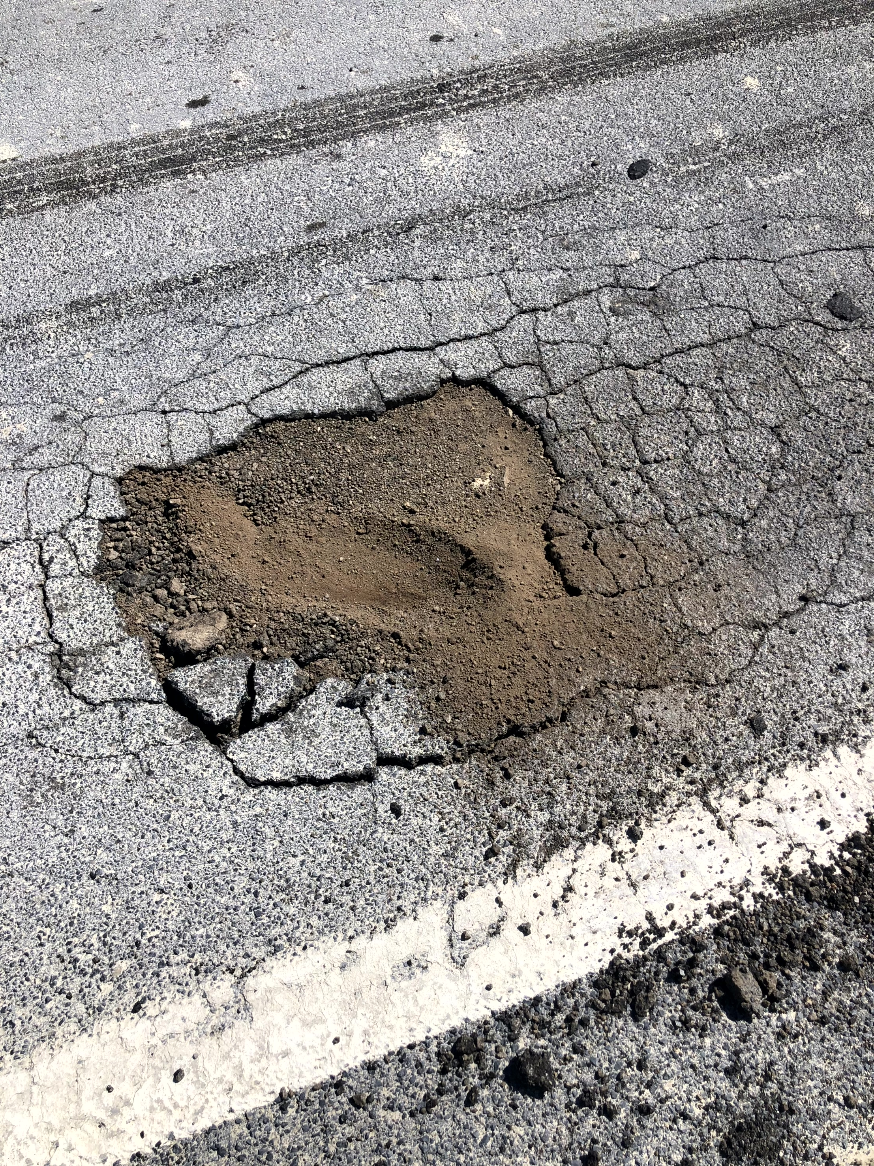
Construction
CSD - Roads
History
Both CR447 & CR34 roads originally constructed around 1975 by County road crews.
Cold Mix Asphalt w/DG as aggregate
Plant was located on hillside above Gerlach
Used belly dumps, grader, and roller to construct roads

Slide 4
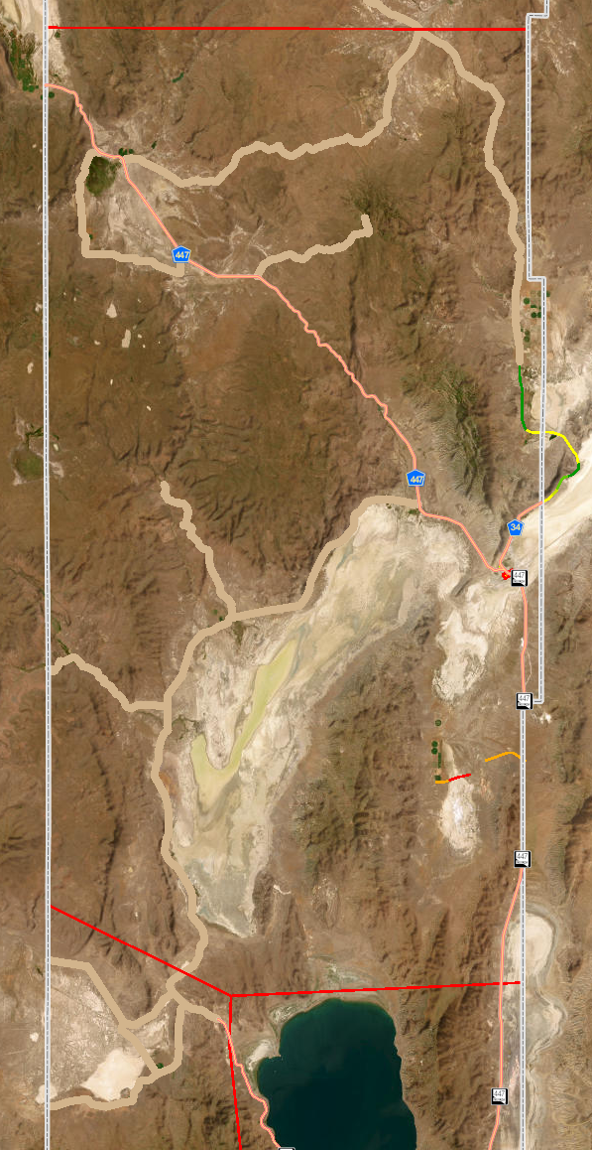
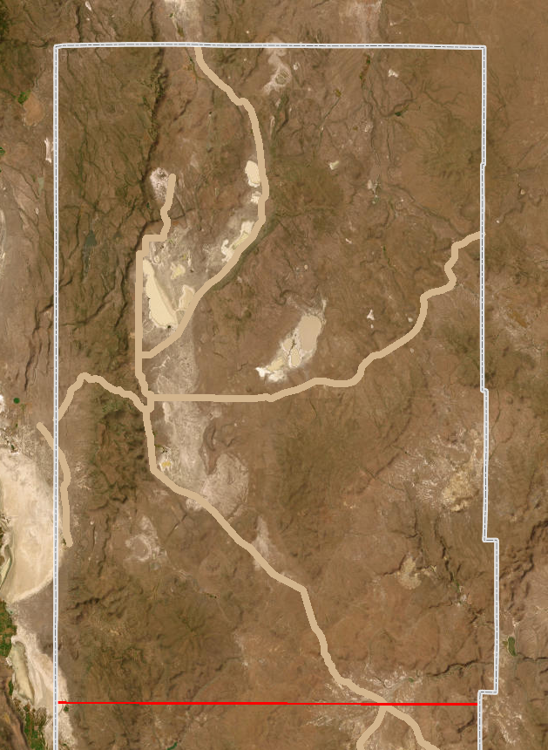
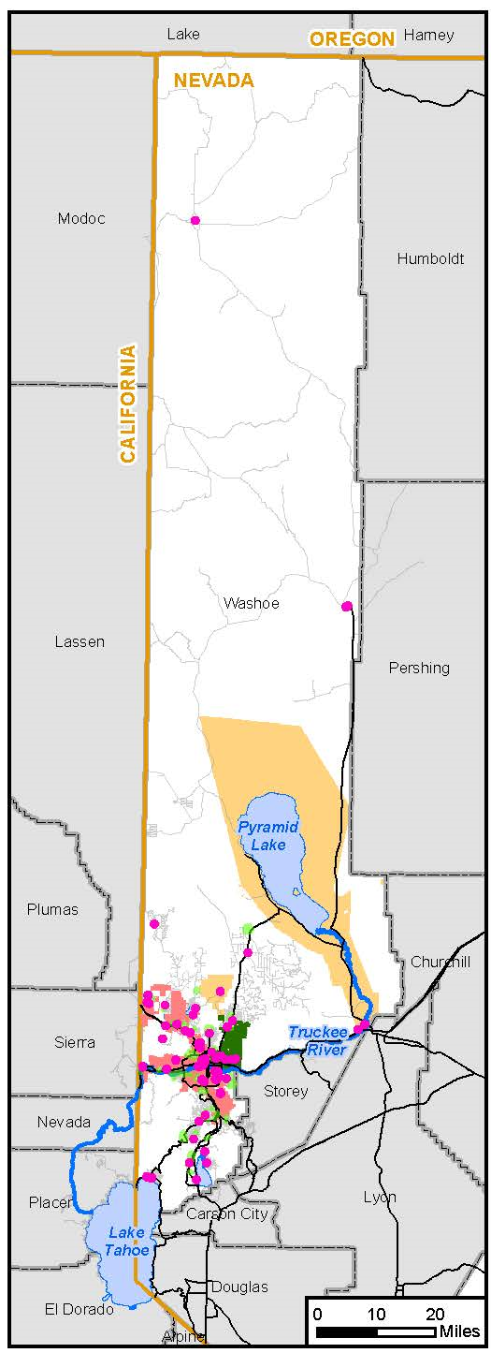
Overview of Roads
Gerlach
Responsibility
Vya
Responsibility

Slide 5
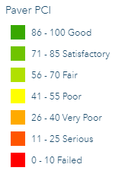
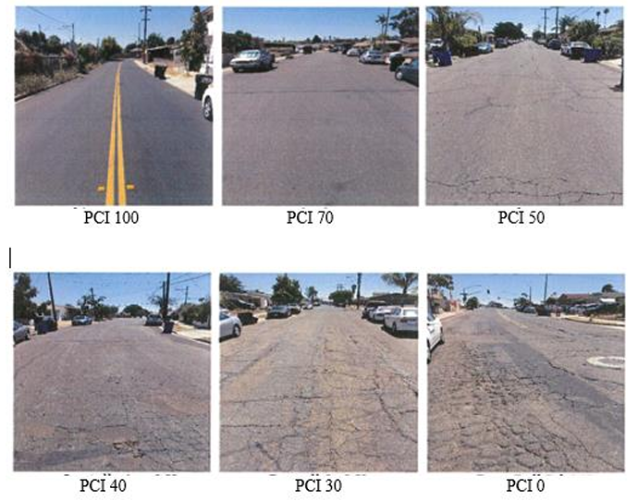
Pavement Condition Index (PCI)
CR 447: 20.66 to 80.34 PCI
CR 34: 50.06 to 96.39 PCI
Rodeo Creek Rd: 7.1 to 30.71 PCI

Slide 6
Traffic Loads
Everyday Travelers
Seasonal Hunting Traffic (Chucker, Antelope, Sheep, Deer)
Hay & Cattle Trucks
Gypsum Trucks (CR 447)
Burning Man
Set Up (MM 20 to 12 Mile Entrance)
Event Traffic (All Directions)
Teardown (12 Mile Entrance to MM 20)

Slide 7
Resources
CSD - Roads
Responsibilities
Personnel
6 - Permanent Positions
5 - Gerlach
1 - Vya
3 - Intermittent Hourly’s
2 - Gerlach
1 - Vya
Miles of Road
78 Paved
360 Unpaved
Stormwater
5+ Miles of Culvert Pipes
720+ Miles of Ditch & Shoulders

Slide 8
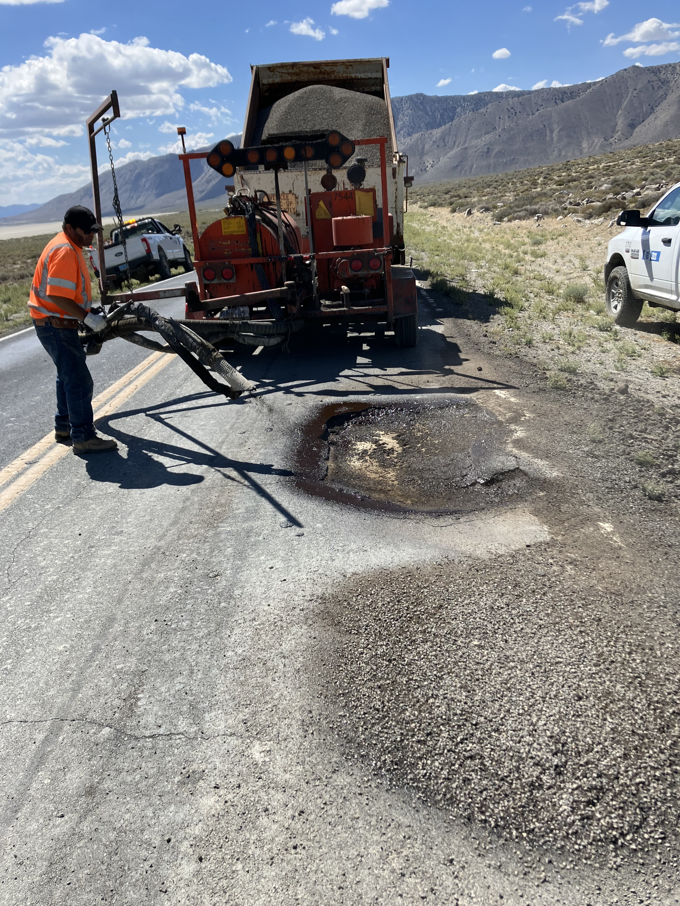
Maintenance Costs
CSD - Roads
Roads Funds
Slurry Contract

Slide 9
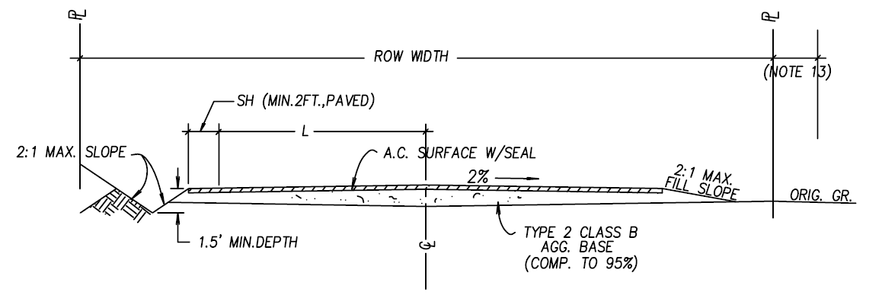
Full Reconstruction Cost
Between $770,000.00 to $1,000,000.00 per mile
CR 447 @ 53 miles = $40 million – $53 million
CR 34 @ 20 miles = $15 million – $20 million

Slide 10
Plan Forward??
Continue to spend Roads & Slurry Contract funds
Work to find alternative funding sources
Continue to apply for Grant opportunities
Federal Land Access Program (FLAP Grant)

Slide 11
Questions?
Roads Website:
washoecounty.gov/csd/operations/roads
Pavement Condition & Roads:
washoecounty.gov/csd/engineering_capitalprojects/
traffic-and-roads/pavement_pci_policy.php

Slide 12
Thank you!
CSD - Roads

