Slide 1

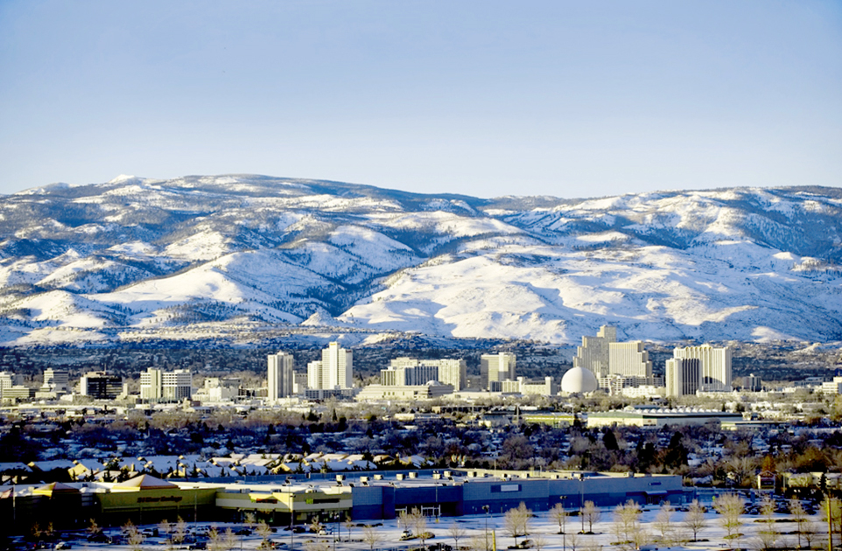
Regional Road Impact Fee (RRIF)
7th Edition Update
November 16, 2021

Slide 2

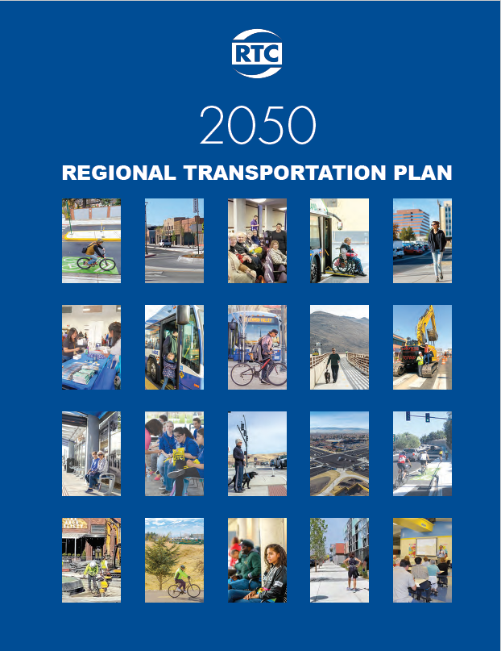
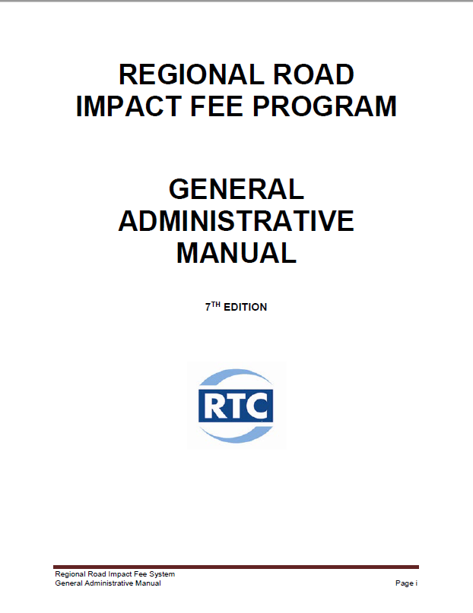
Why the RRIF Update?

Slide 3

Regional Road Impact Fee (RRIF) Program
Impact Fees are a funding tool for collecting the cost of building additional capacity needed on regional roads due to new development.

Slide 4
Regional Road Impact Fee (RRIF) Program
Advantages
  Development to pay its fair share
  Viewed as equitable system supported by community
Limitations
  Impact fees cannot be used for:
    Operating costs
    Maintenance expenses
    Non-capacity improvements

Slide 5
Regional Road Impact Fee (RRIF) Program
Nevada Revised Statute (NRS 278B)
Local governments enacting ordinances
Impact Fee Cooperative Agreement (ICA)
Capital Improvements Plan (CIP)
  Describes methodology used to establish net cost per service unit of new roadway capacity
General Administrative Manual (GAM)
  Guidelines and procedures to administer the RRIF program

Slide 6
7th Edition RRIF GAM Update
RTC is responsible for initiating periodic reviews of the RRIF Program.
Review process initiated by the approval of the long-range 2050 Regional Transportation Plan (2050 RTP).
Use 2050 RTP to define the list of capital improvements attributable to new development
Input from RRIF TAC since July 2020

Slide 7
Development of RRIF Fees
Long Range Plan
10 Year Plan
TMRPA Land Development Model
RTC Travel Demand Model
Regional Transportation Plan
RRIF Capital Improvement Plan by Service Area
Developer share of RRIF CIP Costs ($)
Calculate RRIF Rate by Service Area
($/VMT)
RRIF Fee Schedule by Land Use

Slide 8
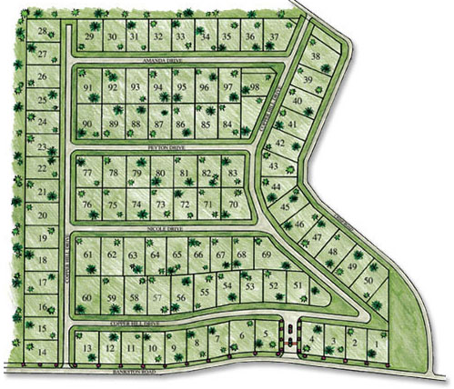

Development of RRIF Fees
Service Units
measured in
Vehicle Miles Travelled (VMT)
Typical Single Family Subdivision
Generates # of Vehicle Trips per Day
On the road network

Slide 9
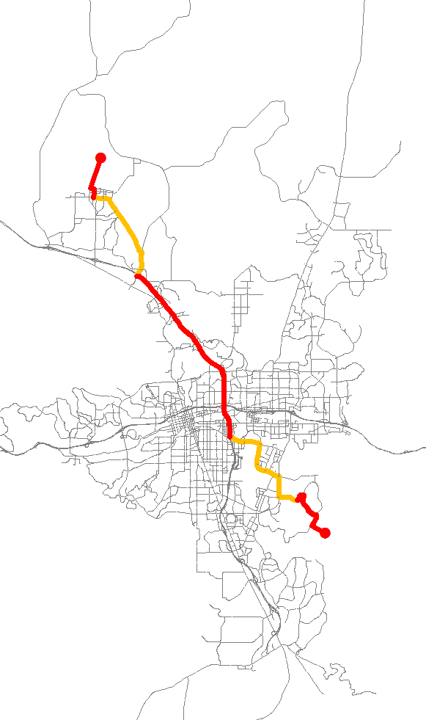
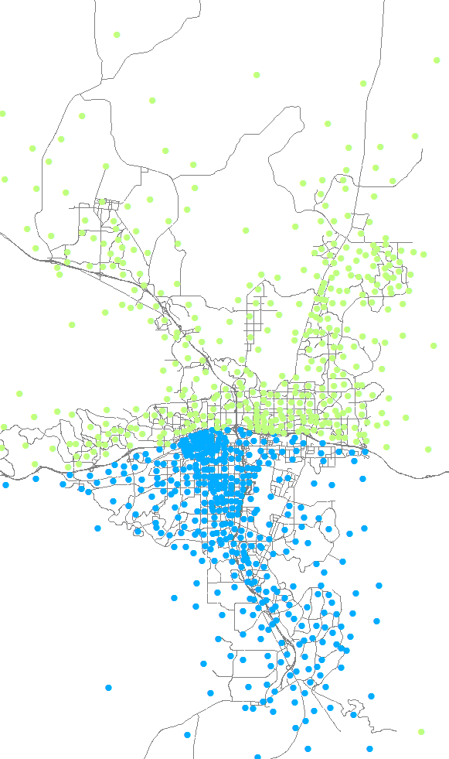
Travel Demand Model
Trip Distance on Regional Roads
Average Trip Length North/South

Slide 10
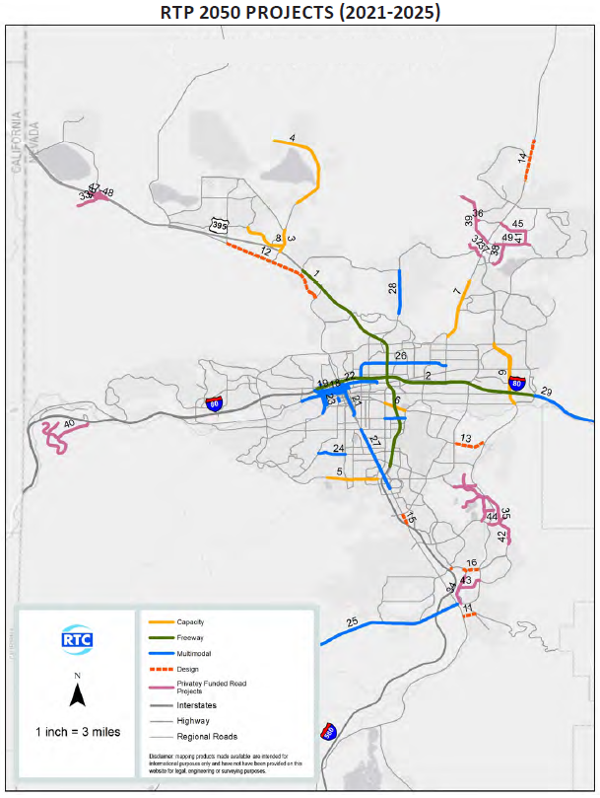
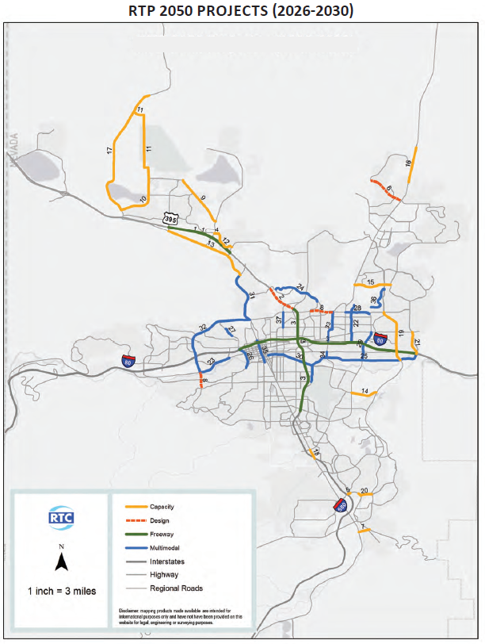
2050 Regional Transportation Plan (RTP)

Slide 11
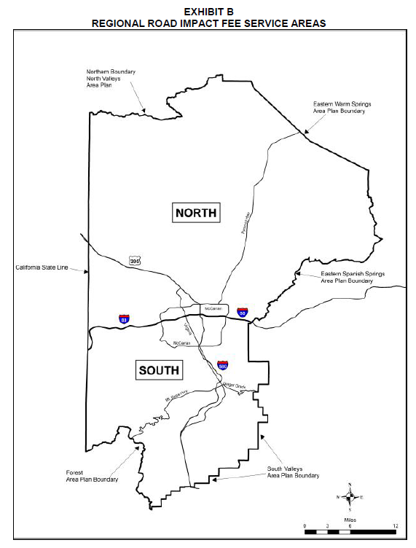
Regional Road Impact Fee – Service Areas
Capital Improvement Plan by Service Area
Growth by Service Area measured in VMTs
$/VMT by Service Area

Slide 12
RRIF Net Cost per Service Unit
Description | North Service Area | South Service Area
Total RRIF Share | $132,563,419
% RRIF Eligible RTP | 63.18% | 36.82%
RRIF Share by Service Area | $83,749,561 | $48,813,858
VMT Growth by Service Area | 325,369 | 194,434
$/VMT for RRIF Share | $257.40 | $251.06
RRIF Share ($) / VMT Growth = $/VMT Rate

Slide 13
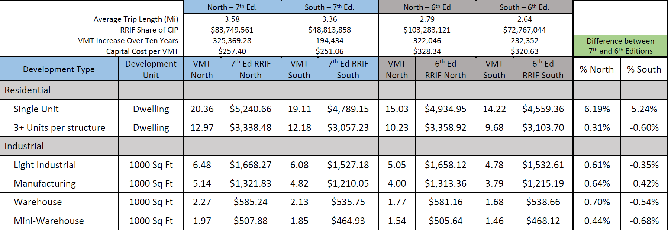
7th Edition Fee Schedule (Proposed)
Notes:
Once the $/VMT is established by Service Area, we can develop the RRIF Fee Schedule for the designated land uses.
The proposed fee schedule is shown on the screen

Slide 14
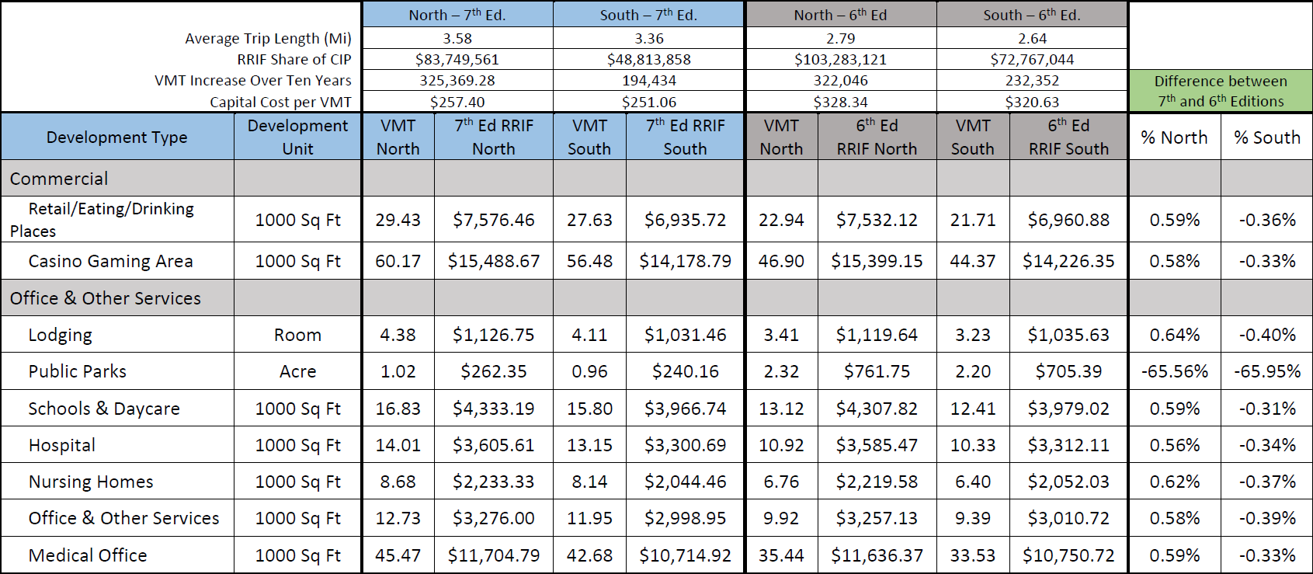
7th Edition Fee Schedule (Proposed)

Slide 15
Summary of Changes
Updated list of CIP projects
More growth within North Benefit Area
Updated vehicle data
  U.S. Census Bureau’s American Community Survey (2019)
Clarity and conformity of key terms with the GAM
Updated appeals process for feepayer
Notes:
I would like to send a minute of this presentation further explaining the fee difference for a single-unit residential land use. If you recall the fee increase for this development type was greater than the majority of the other land uses in the proposed RRIF fee schedule: 7.19% in the North and 6.20% in the South. This increase is directly related to the increase of the total number of vehicles in Washoe County.
The total number of vehicles data is collected by the U.S. Census Bureau’s American Community Survey which (READ Slide). The proposed 7th Edition of the RRIF GAM used the most recent survey data available to determine the “Number of Avg. Weekday Trip Ends” that result in the fee for single-unit development type.

Slide 16
Next Steps for Adoptions
Planning Commission Meetings November 2021
City Councils/County Commission Nov/Dec 2021
Adoption January 2022

Slide 17

Questions
Dale Keller, P.E.
Engineering Manager
Regional Transportation Commission of Washoe County
dkeller@rtcwashoe.com
(775) 335-1827
rtcwashoe.com
Your RTC. Our Community.

