Slide 1

Woodland Village
Town Center tentative map & SUP appeal
WTM20-005 & WSUP20-0021
board of county commissioners March 9, 2021

Slide 2
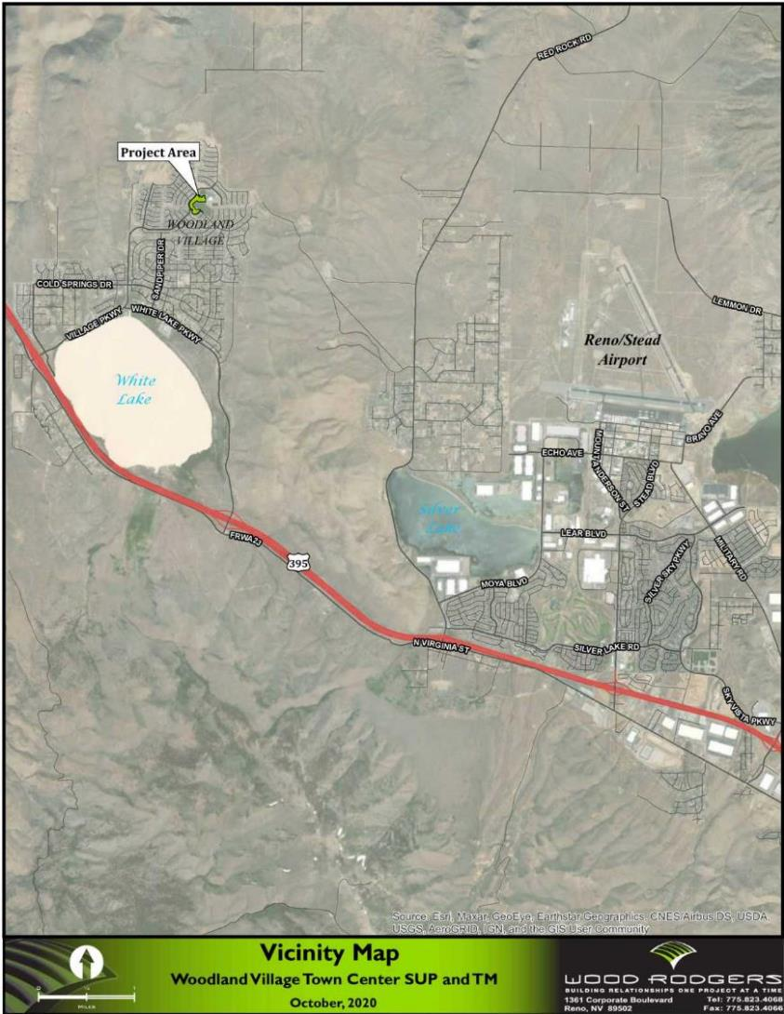

Project Location
Woodland Village Town Center
9.8± acres
Located in the heart of Woodland Village approx. 400 feet northeast of the intersection of Rockland Drive and Village Parkway
Cold Springs Area Plan

Slide 3
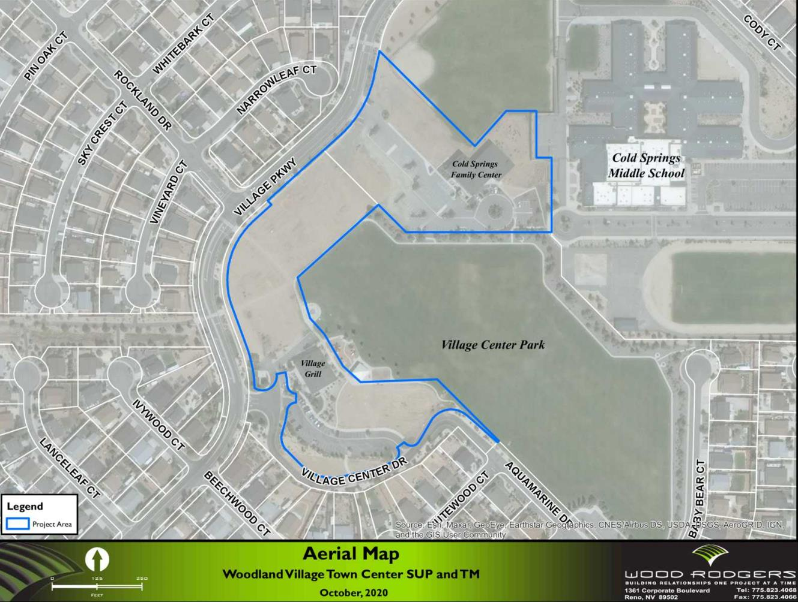
Project Location
Infill development
Mostly vacant
Village Grill and Cold Springs Family Center
Surrounded by:
  CS Middle School
  Village Center Park
  Single-Family Neighborhoods
  Village Parkway and Village Center Drive

Slide 4
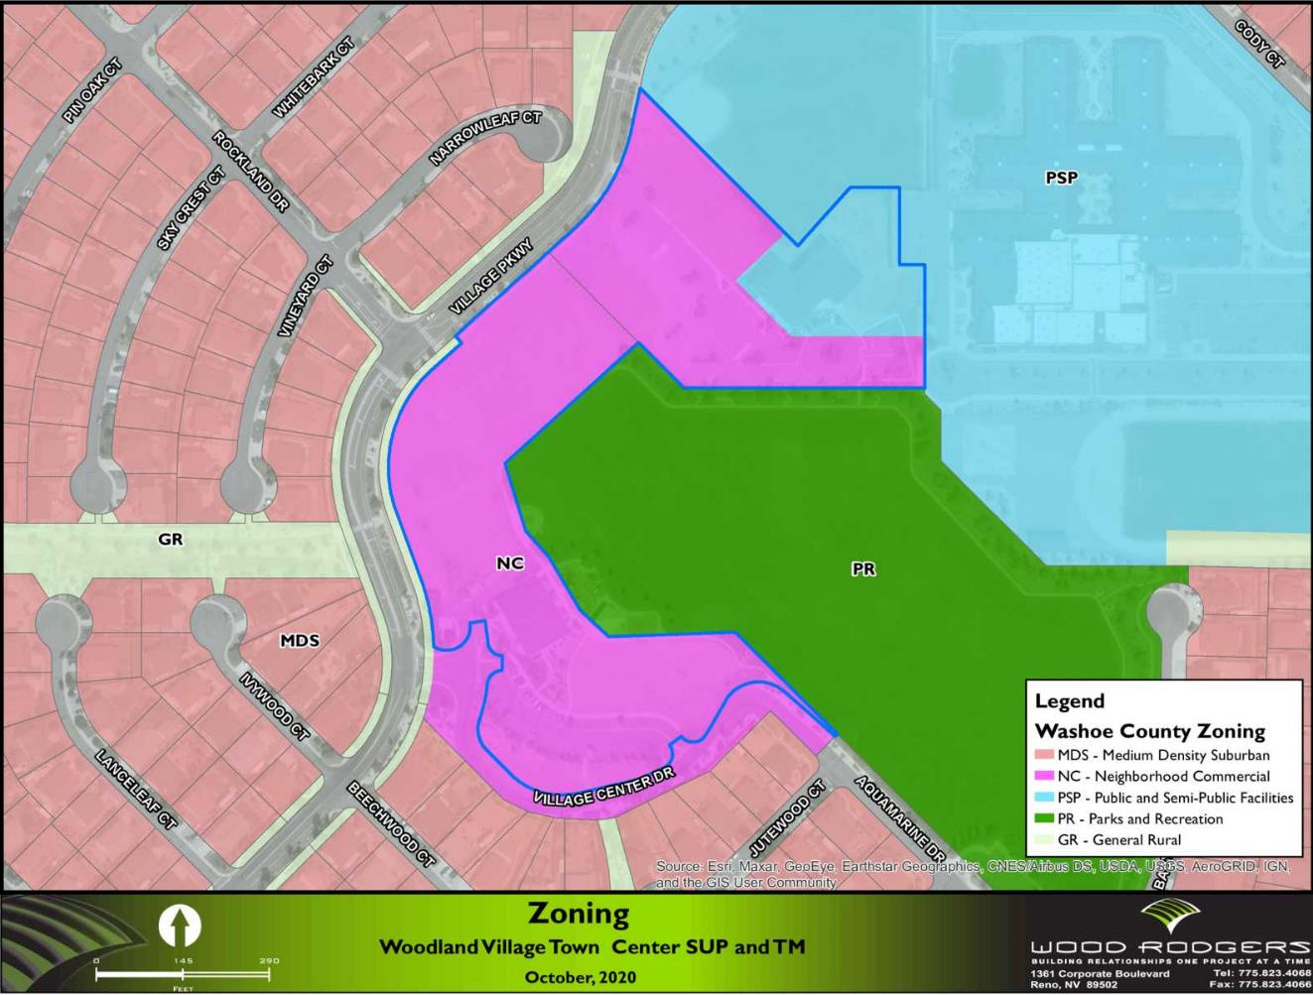
Master Plan & Zoning
MPA and RZA unanimously approved by the PC (4/20/2020) & BCC (5/26/2020)
MPA and RZA were in anticipation of this request
Master Plan = Commercial (C) & Suburban Residential (SR)
Zoning = Neighborhood Commercial (NC) & Public-Semi Public (PSP)

Slide 5
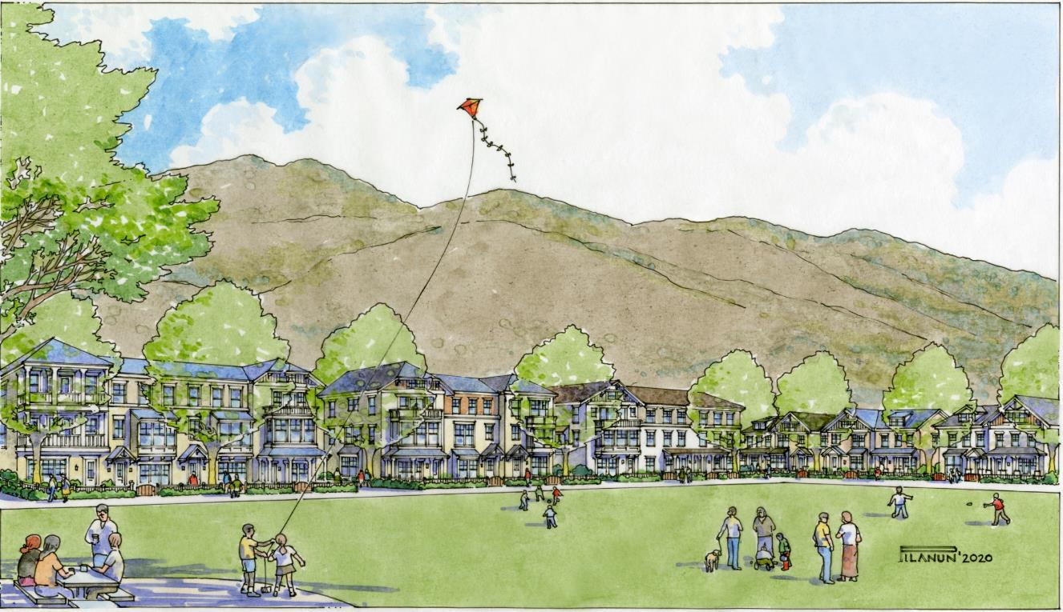
Project Request
Requesting:
A Special Use permit to allow up to a maximum of 14 dwelling units per acre (du/ac) within the Neighborhood Commercial (NC) regulatory zoning designation in accordance with the Cold Springs Area Plan (CS.2.2.2),
A Special Use Permit to modify the minimum yard standards to allow for single-family attached units in accordance with Washoe County Municipal Code Section 110.406.23; and
A Tentative Map for a 111-unit single-family attached development within the Neighborhood Commercial (NC) regulatory zoning designation.

Slide 6
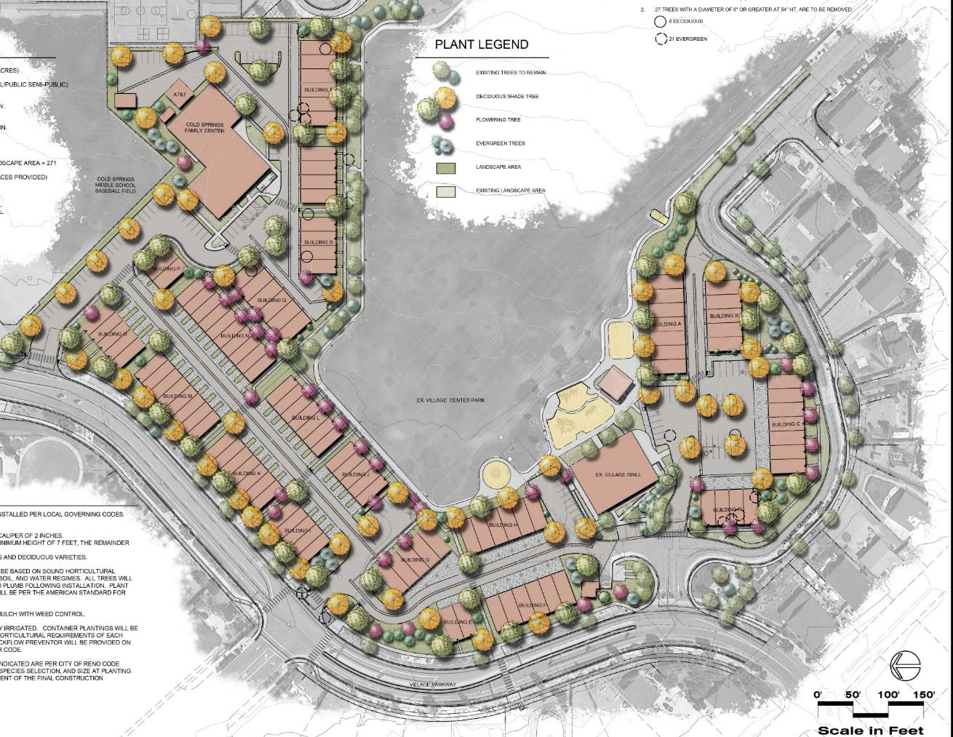
Project Details
111 townhomes mixed use development
Cold Springs Family Center and the Village Grill will remain
11.3 du/ac (14 du/ac max.)
Setbacks:
  0 ft side
  0 ft rear
  8 ft front
Pedestrian trails will provide connectivity to park and surrounding neighborhoods

Slide 7
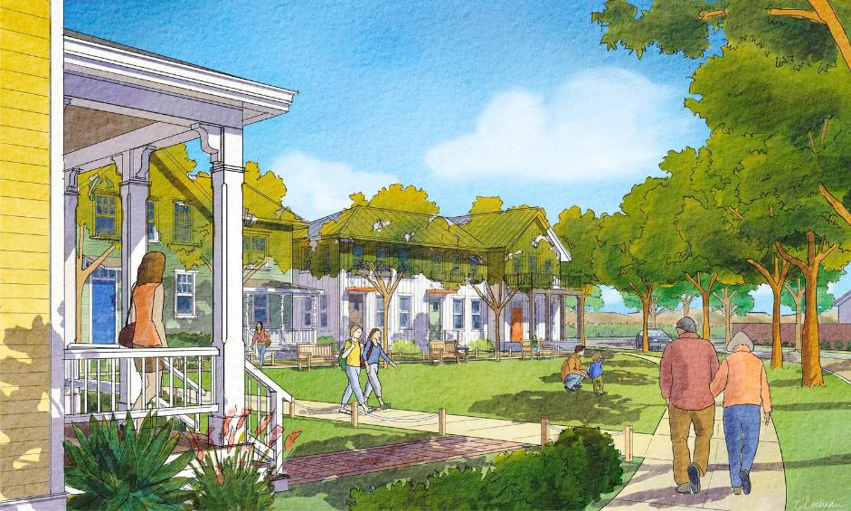
Project Details
Architecture will be designed to blend with the surrounding neighborhood
Landscaped common area
Village Center
Drive

Slide 8
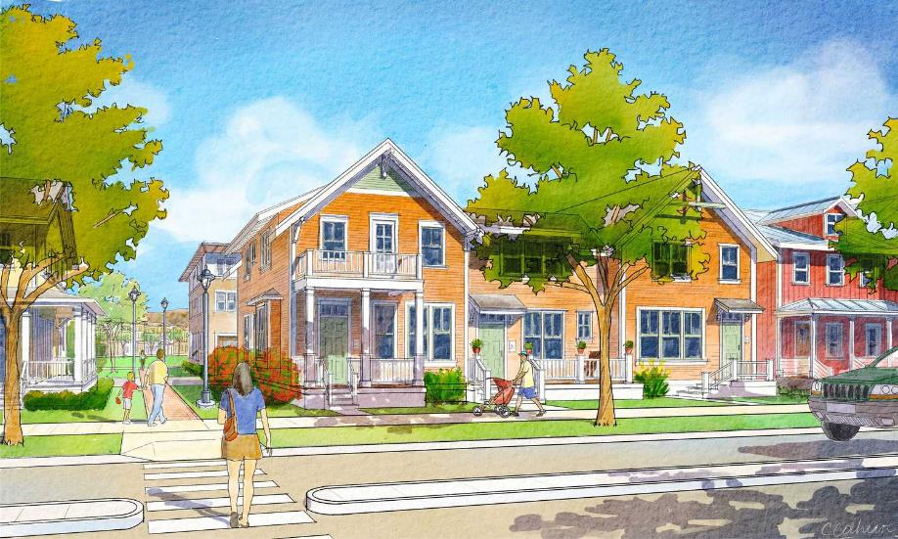
Project Details
Stepped two and three-story buildings to match the existing neighborhood
Continued pedestrian connectivity throughout the project
Woodland Village
Parkway

Slide 9
Project Details
Parking will not be reduced
Parking provided 410 spaces:
  294 residential
  45 Village Grill
  70 Family Center
Traffic generated will be 851 average daily trips and 71 PM peak hour trips
Traffic improvements along Village Parkway

Slide 10
Project Compatibility
The project meets Policies within the WC Master Plan and Cold Springs Area Plan
  Land Use & Transportation Element
  Housing Element
  CS.2.2.2 Allows this type of development
WC Planning Staff determined it meets ALL of the legal findings
  Consistency
  Site Suitability
  Availability of services
“ Multi-family and single-family attached residential development at up to 14 dwelling units per acre shall be allowed with the approval of a special use permit in all Neighborhood Commercial regulatory zones provided there is a commercial use included in the development proposal.”
Cold Springs Area Plan
Policy 2.2.2

Slide 11


Prior Actions
North Valleys CAB voted unanimously to approve the applications
Planning Commission voted 5-2 to support the applications

Slide 12
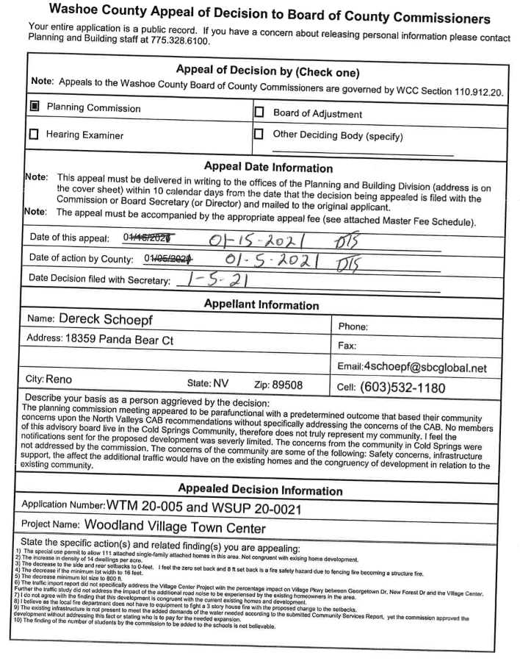
Appeal Issues
Number of homes (111) and increase in density
  MPA and RZA approved
  Policy 2.2.2 (Encourage mixed-use and multi-family development)
  Policy 7.4 (Promote home ownership as a community asset)
  Allows up to 14 units per acre (11.3 units per acre)
Decrease in setbacks, lot widths and size
  WCC 110.810.30 (site suitability and issuance not detrimental)
  WCC 110.608.25 (TM meets all density, lot size and open space criteria)

Slide 13
Appeal Issues
Congruent of existing homes in development
  LUT 3.1 (project within SCMA)
  Policy 2.2 (mixed use highly encouraged, particularly within Woodland Village Town Center)
  Policy 7.4 (will provide more opportunities for home ownership)
  WCC 110.810.30 (minimal impact and this type of development planned for this area)

Slide 14
Appeal Issues
Existing Infrastructure
  WCC 110.810.30 (“There are adequate improvements existing on the site that will adequately serve the proposed new uses. This type of development has been planned for and anticipated at this location. Also, the proposed project was reviewed by relevant agencies and any needed conditions concerning facilities have been included.”)
Number of students
  Data provided by WCSD

Slide 15

We respectfully request that you denial the appeal.
Questions?

