Slide 1
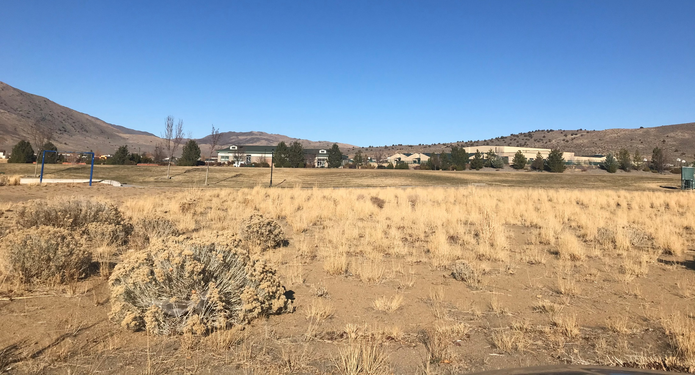
APPEAL-WTM20-005 & WSUP20-0021 (Woodland Village)
Washoe County Board of Commissioners
March 9, 2021

Slide 2
Appeal
There are two appellants:
  Dereck Schoepf, a resident of Cold Springs and
  WWC Commercial LLC, represented by Garrett Gordon

Slide 3
Request
This is an appeal for an application requesting a tentative subdivision map for 111 attached residential lots; and
A special use permit to allow:
  Single family, attached use per WCC Table 110.302.05.1;
  To allow up to 14 dwelling units per acre per Cold Springs Area Plan policy CS.2.2.2; and
  To vary building placement standards (WWC 110.406)

Slide 4
Special Use Request
The Cold Springs Area Plan policy CS.2.2.2 states, “Multi-family and single-family attached residential development at up to 14 dwelling units per acre shall be allowed with the approval of a special use permit in all Neighborhood Commercial regulatory zones provided there is a commercial use included in the development proposal. ”
Commercial uses are existing within the commercial building where the Village Grill, day care and tea shop are located
The density of the development will be 12.9 units per acre for the 8.6-acre site

Slide 5
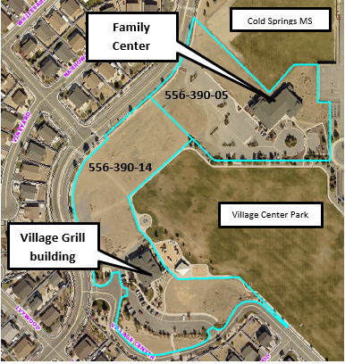

Slide 6
Building Placement Standards
Requirement | Woodland Village | Neighborhood Commercial (NC)
Front setback | 8ft. | 15 ft.
Rear setback | 0 ft. | 20 ft.
Side setback | 0 ft. | 15 ft.
Minimum lot size | 800 sf. | 10,000 sf.
Minimum width | 16 ft. | 75 ft.
Height | 2-3 stories | 60 ft.

Slide 7
Analysis
Woodland Village is planned to help create a “true town-center”
The application states that there will be 20 buildings that will be 2-3 stories high
The buildings will have 2 to 10 units in each building and the units will have 2-3 bedrooms
The buildings will be alley-loaded with either 1 to 2 car garages with a majority having a 20-foot-long driveways

Slide 8
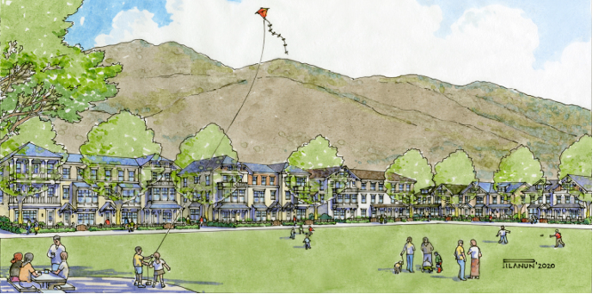
Architectural Look

Slide 9
Analysis
The applicant indicates that the 111 attached single-family units will be more affordable and will provide an alternative from the typical single-family detached housing found in the area
Though the development will be primarily residential with some commercial uses, the applicant is willing to look at adding more commercial space in the future if there is demand

Slide 10
Water & Sewer
The proposed development will be served by Great Basin Water Company for water and Washoe County for sewer service
Utility service has been planned for this site and the infrastructure will accommodate the density of the proposed development.

Slide 11
Roadways & Traffic
There will be several access points to the development primarily from Village Parkway and one access point from Village Center Drive
The applicant indicates that the various accesses points will disperse traffic
The main access to the development will be at the intersection of Rockland Drive and Village Parkway
The access for the family center will be moved and is not anticipated to have any adverse impacts
The streets and off-street parking areas will be privately owned and maintained by the development

Slide 12
Traffic Study
The project is anticipated to generate 851 average daily trips with 61 AM peak hour and 71 trips PM peak hour
The traffic study recommends that the applicant provide mechanisms to mitigate the impacts and the applicant is proposing improvements at the ingress and egress intersections on Village Parkway to include signage, striping, crosswalks and turn lanes.

Slide 13
Schools
The proposed development is zoned for Inskeep Elementary School, Cold Springs Middle School and Spanish Springs High School
The School District provided the following numbers for the schools: approximately 14 elementary school students, 7 middle school students, and 7 high school students
However, following the Planning Commission meeting the School District re-accessed the numbers to 22 elementary school students, 12 middle school students, and 11 high school students

Slide 14
Schools
School | 2020/2021 | 2021/2022 | 2024/2025 | 2029/2030
Inskeep ES | N/A | 63% | 71% | 72%
Cold Springs MS | 65% | 70% | 77% | 93%
North Valleys HS | 98% | 101% | 104% | 120%

Slide 15
Schools
The school district is in discussion with developers of Stonegate in Cold Springs to acquire a property parcel for the purposes of a high school.
Also, with the changes of the current Hug High School into a career and technical academy and a new Hug High School opening in the fall of 2022 the school district expects to see some relief to North Valleys High School

Slide 16
North Valley CAB
North Valleys CAB reviewed the application on December 14th and all members unanimously recommended the application.
The comments included:
  • Traffic on US-395
  • Availability of infrastructure
  • Bus service

Slide 17
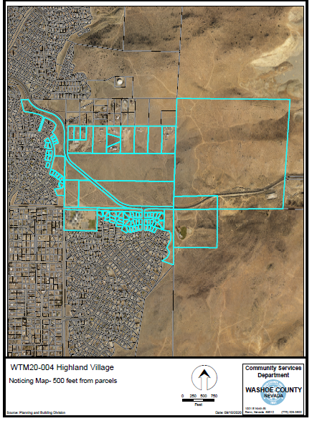
Public Notice
Notices were sent 500 feet from the site to 77 affected property owners

Slide 18
Reviewing Agencies
Comments were received from:
Washoe County Community Services
    Engineering and Capital Projects
    Water Management
    Parks
    Washoe County Health District
    Regional Transportation Commission (RTC)
    Washoe County School District
    Sun Valley General Improvement District (SVGID)
    Washoe-Storey Conservation District
    Nevada Division of Water Resources
No recommendations for denial were received.

Slide 19
Tentative Subdivision Map Findings
Plan Consistency;
Design or Improvement;
Type of Development;
Availability of Services;
Fish or Wildlife;
Public Health;
Easements;
Access;
Dedications; and
Energy.

Slide 20
Special Use Permit Findings
1. Consistency;
2. Improvements;
Site Suitability;
Issuance Not Detrimental; and
Effect on a Military Installation.

Slide 21
Possible Motions
Possible motions are found in the staff report

