Slide 1


Board of County Commissioners 2021 Annual Workshop
Jan. 13, 2021

Slide 2


Outcomes & Discussion Flow
Seeking the BCC’s direction:
  Homelessness & the County’s Role
  Appointed Boards and Commissions
  Health District Board Structure
  Supplemental Government Services Tax
  Rules of Procedure
Update on: FY22 Budget picture
Slide 2
Notes:
ERICA

Slide 3
Materials & Guidelines
Materials:
  Workshop Slides
  FY21-23 Strategic Plan
  FY22 Budget Outlook Presentation
  Washoe County Rules of Procedure
  Clark County Rules of Procedure
80% Discussion
20% Presentation
Slide 3
Notes:
DANA??

Slide 4
Strategic Topic #1
Homelessness & the County’s Role
Slide 4

Slide 5










Regional Homeless Services Summary
(Does not include Law Enforcement/Emergency Response/Outreach Teams)
HUD Block Grants
Emergency Shelters
HUD Continuum of Care (CoC)
CDBG
Received by
Funding:
Funds:
Various Community Development Projects
ESG
Received by
Funding:
Funds:
Supports Emergency Shelter Operations
HOME
Received by
Funding:
Funds:
Affordable Housing and Rental Assistance
Our Place Women & Family Shelter
Governed by
Funding:
Community Assistance Center Men’s Shelter (Soon to be NV Cares Campus)
Governed by
Funding:
Specialty Shelters & Privately Funded (Domestic Violence, Religious, etc.)
Governed by:
Varies
Funding:
(HMIS)
Homeless Management Information Systems
Coordinated Entry
Rapid Re Housing Programs
Permanent Supportive Housing Programs
Governed by:
Funding:
Governed by:
Funding:
Governed by:
Funding:
Governed by:
Funding:
Housing Authorities
Bridge/Transitional Housing
Healthcare/Managed Care Orgs.
State Licensed Facilities
Reno Housing Authority (RHA)
Governed by:
RHA Board
Funding:
Reno Sparks Indian Housing Authority
Governed by:
Housing Advisory Board
Funding:
RSIC +
Community-Based Programs (Examples like CrossRoads, Sage Street, HOPE Springs)
Governed by:
Varies
Funding:
Health Plan of Nevada (HPN)
Anthem
Silver Summit
WellCare Community Triage Center (CTC)
Substance Use Treatment Facilities
Mental Health Treatment Facilities
Group
Homes
Funding:
Funding:
Funding:
Funding:
Medicaid Provider
Funding:
Medicaid Provider
Funding:
Medicaid Provider
Funding:
Varied +
Washoe County
City of Sparks
Hud Funded
Insurance/Medicaid
Reimbursements/ Federally Funded
City of Reno
Privately Funded
Slide 5

Slide 6





Emergency Shelters
HUD Continuum of Care (CoC)
Our Place Women & Family Shelter
Governed by
Funding:
(HMIS)
Homeless Management Information Systems
Coordinated Entry
Rapid Re Housing Programs
Permanent Supportive Housing Programs
Current Washoe
County Role
Current
City of
Reno
Role
Governed by:
Funding:
Governed by:
Funding:
Governed by:
Funding:
Governed by:
Funding:
Emergency Shelters
HUD Block Grants
Bridge/Transitional Housing
HUD Block Grants
Community-Based Programs
Governed by:
Varies
Funding:
Funds:
Examples like CrossRoads, Sage Street, HOPE Springs
Community Assistance Center Men’s Shelter (Soon to be NV Cares Campus)
Governed by
Funding:
CDBG
Received by
Funding:
Funds:
Various Community Development Projects
ESG
Received by
Funding:
Funds:
Supports Emergency Shelter Operations
Slide 6

Slide 7
Regional Emergency Shelter Operational Expenses
Emergency Shelter Interlocal Agreement
 | FY 16-17 | FY 17-18 | FY 18-19 | FY 19-20 | FY 20-21
Reno | $710,205 | $773,762 | $812,627 | $890,960 | $1,837,239
Sparks | $111,840 | $277,410 | $283,899 | $302,267 | $646,950
Washoe County | $ 1,274,846 | $ 2,418,189 | $ 2,531,637 | $ 2,759,584 | $5,674,067
Total | $ 2,096,891 | $ 3,469,361 | $ 3,628,163 | $ 3,952,811 | $8,158,257
*Capital Investment
$15M Our Place
$ 3M Men’s Shelter
Emergency Shelter Regional Costs (**Women and Family Shelter - only costs reflected in the ILA FY21)
 | FY 16-17 | FY 17-18 | FY 18-19 | FY 19-20 | FY 20-21
CAC (Combined Shelter) | $ 2,096,891 | $ 3,469,361 | $ 3,628,163 | $ 3,952,811
Men Shelter |  |  |  |  | $4,363,153
Women and Family Shelter |  |  |  |  | **$3,795,104
Total | $ 2,096,891 | $ 3,469,361 | $ 3,628,163 | $ 3,952,811 | $8,158,257
**Our Place and Women’s Program
Funded by Washoe County only.
Actual County Expense *FY21= $6.9million)
Slide 7
Notes:
Eric

Slide 8
Discussion
Should the County’s role change? What might that look like?
Commissioner Discussion:
Considerations:
Items to Explore Further:
Slide 8

Slide 9
Strategic Topic #2
Appointed Boards & Commissions
Slide 9

Slide 10
Boards/Committees > BCC Appoints Members
911 Emergency Response Advisory Committee
Carson-Truckee Water Conservancy District
District Board of Health
Reno-Tahoe Airport Authority Board of Trustees
Reno-Tahoe Airport Authority Airport Noise Advisory Panel
Tahoe Regional Planning Agency Advisory Planning Commission
Truckee Meadows Regional Planning Commission
Truckee River Fund Advisory
Washoe County Advisory Board to Manage Wildlife
Washoe County Board of Adjustment
Washoe County Board of Equalization
Washoe County Building and Safety Enterprise Fund
Washoe County Internal Audit Committee
Washoe County Law Library Board of Trustees
Washoe County Library Board of Trustees
Washoe County Open Space and Regional Parks
Washoe County Planning Commission
Washoe County Regional Animal Advisory Board
800MHz Users Committee
800MHz Joint Operating Committee
P25 Radio System Joint Operating Committee
Nevada Local Justice Reinvestment Coordinating Council (To be formed July/August 2021, AB 80 (2019))
Slide 10
Notes:
WHO?? Dave?

Slide 11
Boards/Committees > BCC may be member or liaison
Community Homelessness Advisory Board
Economic Development Authority of Western Nevada
Nevada Association of Counties Board of Directors (NACO)
Nevada Tahoe Conservation District Board of Supervisors
Nevada Works
Regional Transportation Commission
Reno-Sparks Convention & Visitors Authority
State Land Use Planning Advisory Council (SLUPAC)
Statewide Partnership on Opioid Crisis
Tahoe Prosperity Center Board of Directors
Tahoe Regional Planning Agency Governing Board
Tahoe Transportation District Board of Directors
Tahoe Transportation Commission
Truckee Meadows Regional Planning Agency Governing Board
Truckee Meadows Water Authority
Truckee River Flood Management Authority
Verdi Television District (Liaison)
Vya Conservation District
Washoe County Animal Services Board
Washoe County Debt Management Commission
Washoe County Criminal Justice Advisory Committee
Washoe County District Board of Health
Washoe County Internal Audit Committee
Washoe County Investment Committee
Washoe County Legislative Liaison
Washoe County Open Space and Regional Parks Commission
Washoe County School District Capital Funding Protection
Washoe County School District Oversight Panel
Washoe County Senior Services Advisory Board Liaison
Washoe County Stadium Authority
Washoe-Storey Conservation District
Western Nevada Development District
Western Regional Water Commission
Slide 11
Notes:
Dave?

Slide 12
Discussion
What concerns do you have? Where should staff focus to affect change?
Boards/Committees to Review Further:
Slide 12

Slide 13
Strategic Topic #3
Health District Board Structure
Slide 13
Notes:
Eric

Slide 14














Health Boards Comparison
Washoe County
Clark County
Seven (7) members
Eleven (11) members
2 elected officials each from the largest two jurisdictions
2 members appointed to represent each jurisdiction, only one of which shall be an elected member
1 elected official from the 4 remaining jurisdictions in the county
The remaining member shall be appointed by the other members of the Board and must be a physician licensed to practice medicine in Nevada.
3 at-large members selected by the board meeting the following criteria:
Licensed NV Physician
Non-gaming business
Gaming industry
Slide 14
Notes:
Eric

Slide 15
Discussion
What are possible changes? What needs to stay the same?
Commissioner Discussion:
Considerations:
Items to Explore Further:
Slide 15

Slide 16
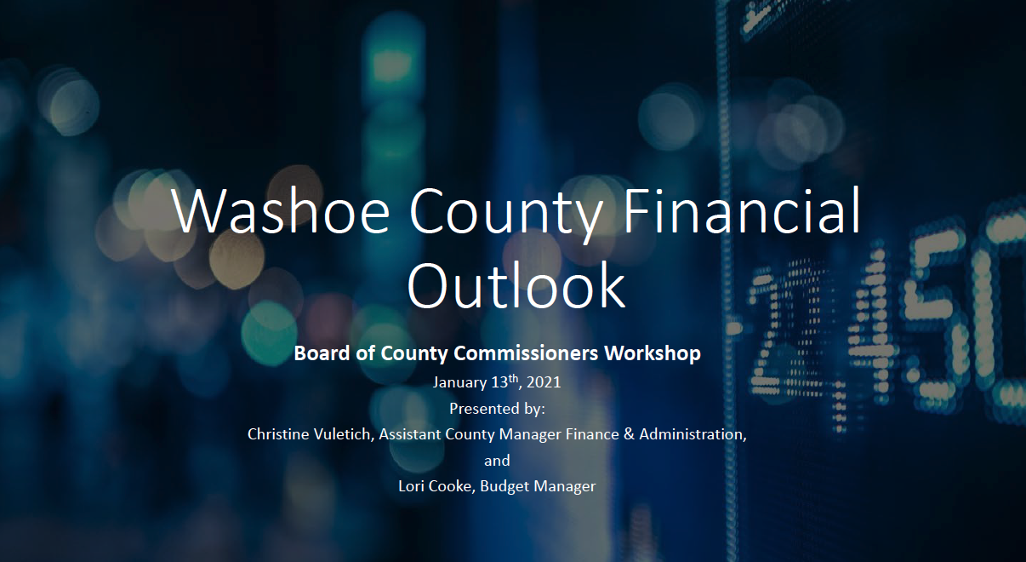
Financial Outlook
Slide 16

Slide 17
Strategic Topic #4
Supplemental Government Services Tax
Slide 17

Slide 18
Background
    If imposed at full 1 cent per $1 value of a motorized vehicle, SGST estimated average revenue generated would be $13 million annually, but is subject to fluctuations with annual motor vehicle registrations (during Great Recession decreased 24%, or $3.1M annually).
    Previous SGST imposed by BCC in 1991 and ended per AB 471 in 2005.
    2009 legislation broadened allowable uses, and 2011 Legislation allowed Washoe County to re-impose Supplemental GST without voter approval.
    BCC may impose SGST by ordinance, requiring both a first and second reading.
    2012 advisory ballot question failed with 59.6% of “no” votes.
    2016 Citizen Survey: 46% opposed GST for senior program and 53% opposed for culture and recreational facilities.
    Based on a 2020 vehicle MSRP of $40,000, the estimated annual impact would be $140.
    SB11 - City of Reno pre-filed bill, would allow an incorporated city to receive the SGST tax by imposing the tax upon its residents.
Slide 18
Notes:
Christine
* Construction and maintenance of streets, roads, highways, sidewalks, and other public rights-of-way for vehicular traffic.
• Principal and interest on notes, bonds or other obligations incurred to fund projects described above, or any combination of those uses
• Borrowing in anticipation of the tax pursuant to an inter-local agreement between the County and the Regional Transportation Commission (RTC) to fund projects.
• Operating costs of the County and any other costs to carry-out the governmental functions of the County.

Slide 19
Allowable Uses
Construction and maintenance of streets, roads, highways, sidewalks, and other public rights-of-way for vehicular traffic.
Principal and interest on notes, bonds or other obligations incurred to fund projects described above, or any combination of those uses
Borrowing in anticipation of the tax pursuant to an inter-local agreement between the County and the Regional Transportation Commission (RTC) to fund projects.
Operating costs of the County and any other costs to carry-out the governmental functions of the County.
Slide 19
Notes:
Christine
* Construction and maintenance of streets, roads, highways, sidewalks, and other public rights-of-way for vehicular traffic.
• Principal and interest on notes, bonds or other obligations incurred to fund projects described above, or any combination of those uses
• Borrowing in anticipation of the tax pursuant to an inter-local agreement between the County and the Regional Transportation Commission (RTC) to fund projects.
• Operating costs of the County and any other costs to carry-out the governmental functions of the County.

Slide 20
SB11
Allows for an incorporated city within a county whose population is between 100,000 and 700,000 to be able to enact an ordinance to impose a supplemental government services tax of not more than 1 cent per $1 of valuation of a vehicle. The supplemental government services tax would be charged for vehicles registered within the incorporated city. Funds could be used for the same governmental services as the counties may use it, they have also added programs to support of carrying out programs that provide services to persons who are homeless or at imminent risk of homelessness or other programs of public health and welfare. If an incorporated city enacts the supplemental government services tax the county would not be able to enact a supplemental government services tax on those residents. The bill is effective upon passage and approval of the bill.
https://www.leg.state.nv.us/App/NELIS/REL/81st2021/Bill/7186/Text SB11
Slide 20
Notes:
Christine
* Construction and maintenance of streets, roads, highways, sidewalks, and other public rights-of-way for vehicular traffic.
• Principal and interest on notes, bonds or other obligations incurred to fund projects described above, or any combination of those uses
• Borrowing in anticipation of the tax pursuant to an inter-local agreement between the County and the Regional Transportation Commission (RTC) to fund projects.
• Operating costs of the County and any other costs to carry-out the governmental functions of the County.

Slide 21
Discussion
Is there a scenario where SGST makes sense?
Commissioner Discussion:
Considerations:
Items to Explore Further:
Slide 21

Slide 22
Strategic Topic #5
Rules of Procedure
Slide 22

Slide 23

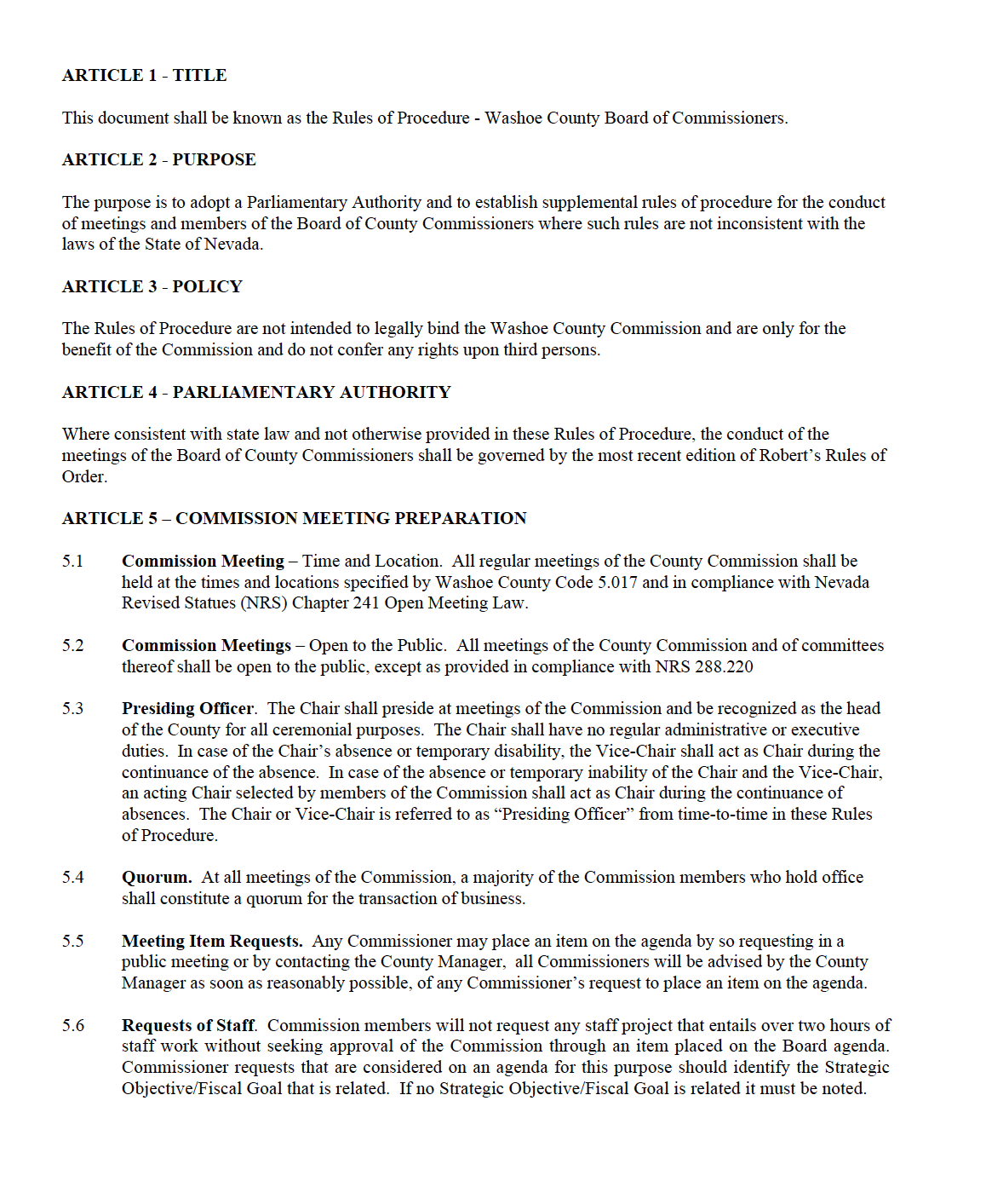
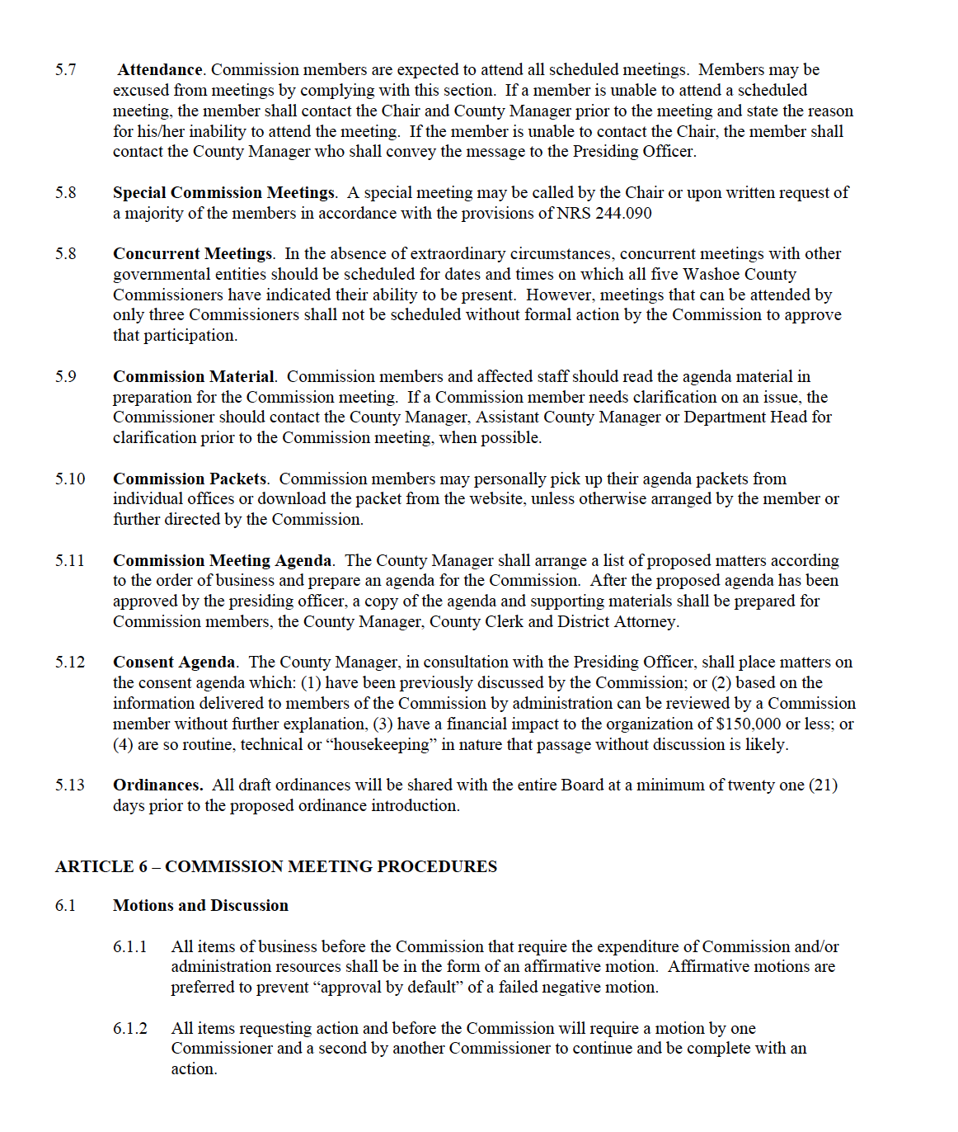
Slide 23
Notes:
Chair Lucey

Slide 24
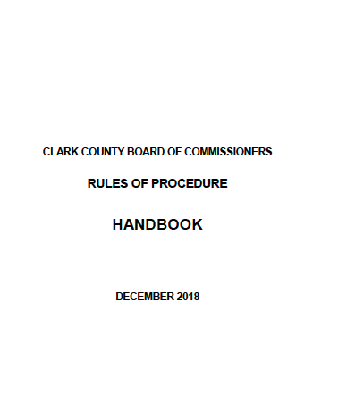
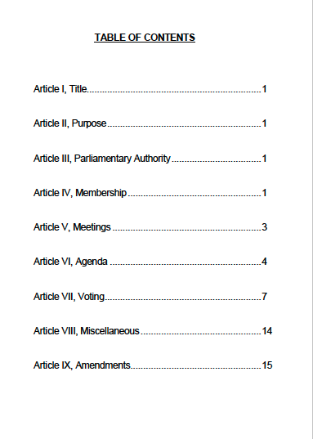
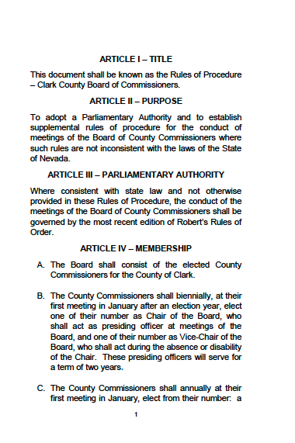
Slide 24
Notes:
Chair Lucey

Slide 25
Discussion
Direction on modifications to Rules of Procedure
Commissioner Discussion:
Slide 25

Slide 26


Slide 26

