Slide 1
Sheriff Darin Balaam

Slide 2
Crime Lab Study

Slide 3
#1 Eliminate Subsidy of Reno Services

Slide 4
#2 Eliminate Subsidy of Sparks Services

Slide 5
#3 Reduce County Subsidy of Non-Contract Agencies

Slide 6
#4 Reduce Subsidy of Option B Agencies

Slide 7
#5 Capture Full Cost of Services

Slide 8
#6 Shift Costs of FIS Services to FIS-Service-Users Only

Slide 9
#7 Reduce Subsidy of State Contract

Slide 10
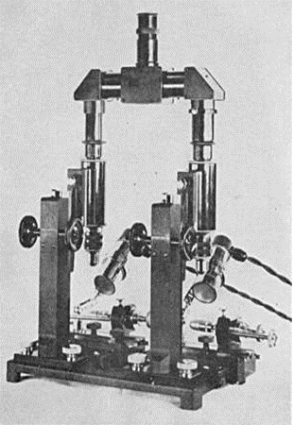
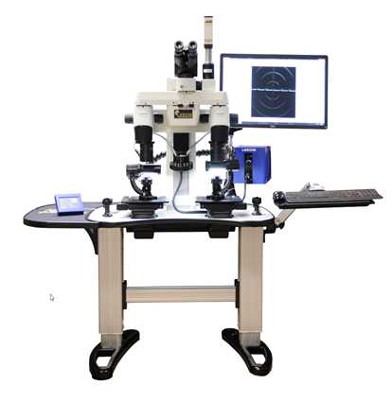
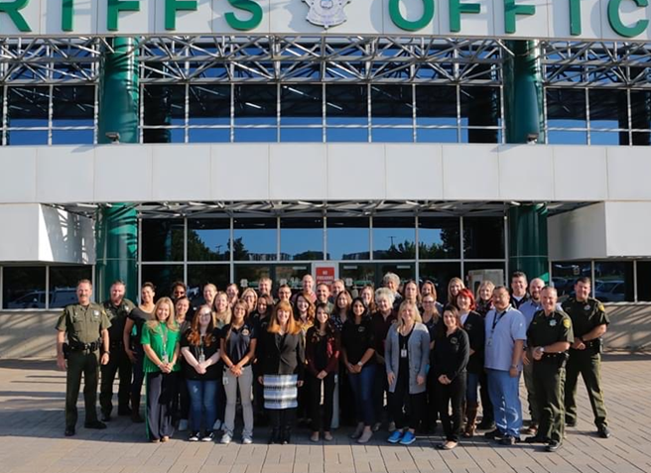
#8 Overall Recommendations

Slide 11
Questions?

Slide 12
Washoe County Sheriff’s Office Detention Facility Update
2019 Annual Report
Average Daily Population – 1,086
-4.40% decrease from 2018
Average Length of Stay – 15 Days
0.13% increase from 2018
Annual Bookings – 19,833
-5.21% decrease from 2018

Slide 13
Washoe County Sheriff’s Office Detention Facility Update
2019 In-Custody Deaths
January 10, 2019 – 1125hrs Reed, Morris
Suicide – Asphyxiation
April 12, 2019 – 2056hrs Ogg, Dennis
Suicide – Asphyxiation
April 12, 2019 – 1147hrs Recob, Chad
Suicide – Blunt Force Trauma (Jumped from Top Tier)
April 20, 2019 – 1437hrs Wilber, Brian
Natural Causes – Internal GI

Slide 14
Washoe County Sheriff’s Office Detention Facility Update
2020 January – April 2020
Average Daily Population (Avg to date 1022)
January February March April
1058 1071 1015 796
Average Length of Stay
January February March April
15.2 14.9 12.4 17.9
Bookings
January February March April
1600 1493 1128 683

Slide 15
Washoe County Sheriff’s Office Detention Facility Update
COVID Precautions at the Washoe County Jail
Single Point Entry
Medical Screening of Staff and Guest(s) at WCSO
Shoe disinfection
Inmate Medical (COVID) Screening
Intake
High Risk Population
Isolation/Quarantine Unit
HEPA Filtration
Protection of General Population

Slide 16
Washoe County Sheriff’s Office Detention Facility Update
COVID Precautions at the Washoe County Jail
Inmate Services
Free emails, phone call, iWeb Visits
Inmate medical assessment fee waived
Opened area control 4 laundry to eliminate cross contaminations
Continued coordination with Court Administrators in regards to video hearings and appearances

Slide 17
Questions?

