Slide 1
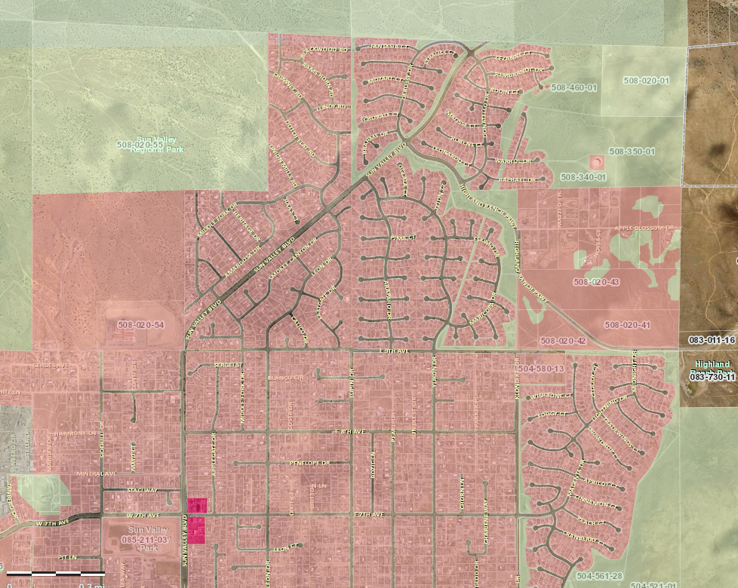

Highland Village - Regulatory Zone Amendment (RZA)
WRZA19-0010
Washoe County – Board of County Commissioners
Public Hearing July 14, 2020 (Item 18)
Zone Change summary:
A zone change to HDS to allow 7 du per acre 51.5 acres (but legally restricted to 4.2 per acre with the Development Agreement) and leaving 3 acres GR as a buffer
This is a 54.5 acre site located Highland Ranch Parkway at the north end of Sun Valley.
Applicant Team
Developer – Regal Holdings of Nevada
Ray Pezonella/Ron & Teri Bath
Civil Engineer - Odyssey Engineering
Frank Bidart
Land Use - KLS Planning & Design
John Krmpotic, AICP
Site
Sun Valley Area Plan
(almost all Suburban Residential)

Slide 2
3 key points that respond to what we've heard :
We accept ALL that has been voiced by the citizens and the CAB. We will address the CAB concerns at time of the Ten-map as the tool to deal with these. These are manageable items: safe walking to schools, traffic control, seismic, open space, etc.
These local developers are proposing a project at 4.2 per acre. If there was a zoning class for 4.2 du per acre, we would request that. HDS currently allows a range of 3 to 7 per acre. We are proposing zoning near the low end of the density range as locked-in by the Development Agreement.
This zone change is to address a home pricing issue. Our region has a lot of high-end SF, we need more entry level SF housing. There is huge demand, but we are not delivering the product. Its not cliché to call it a gap, its real.

Slide 3
Why is 4.2 du/ac the appropriate density?
There is proven infrastructure capacity provided by SVGID. This project is not a capacity burden. The developer will pay roughly $1mm for water/sewer offsites to the SVGID as part of the system upgrades.
We have addressed the PC concerns expressed at the public hearing in March about two findings: land use compatibility and available infrastructure by voluntarily restricting the density to 4.2 per acre.
It allows us to reduce housing costs for suburban SF! The most effective way is to reduce development costs which means attaining some form of suburban density. We need to spread the costs over more units.

