Slide 1
Emergency Management & Homeland Security

Slide 2
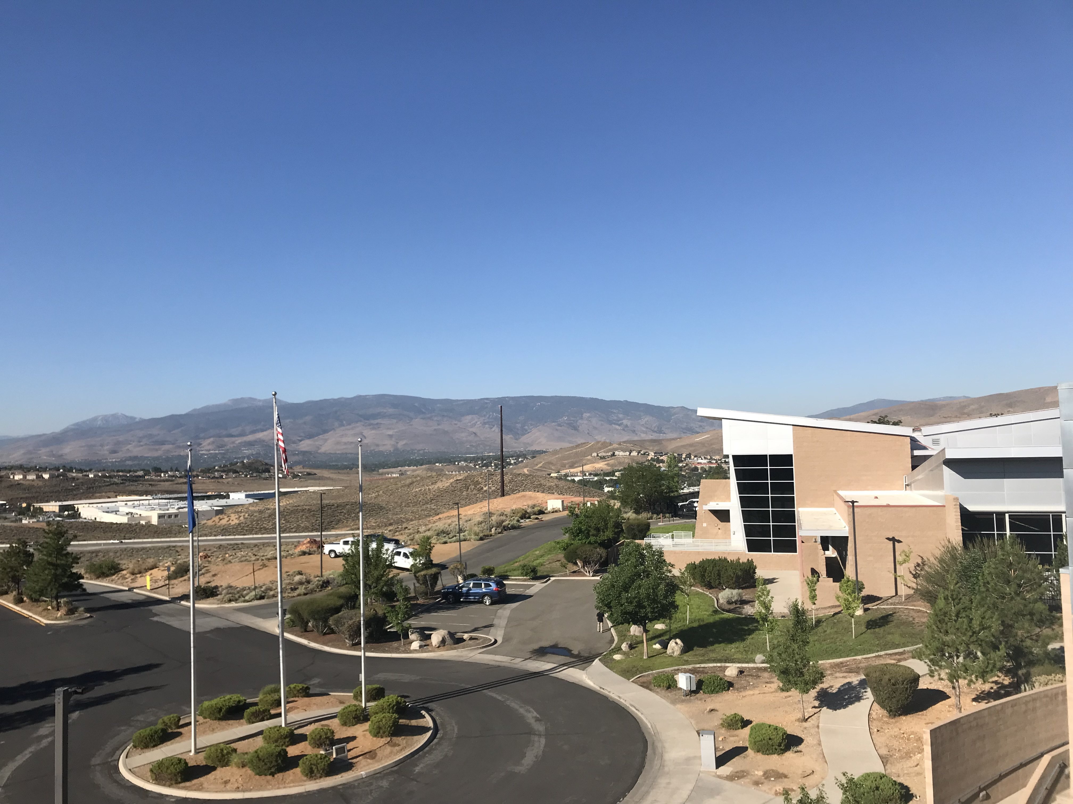
Regional Emergency Operations
Center

Slide 3
13 Hazards
Washoe County: Evacuations
Wildland Fire
Earthquake
Flood
Transportation Incident
Extreme Weather
Drought
Hazardous Materials
Infectious Disease
Avalanche/Landslide
Volcano
Criminal Acts
Radiological Waste Transport

Slide 4
Preparedness Priorities
1. Operational Coordination
2. Operational Communication
3. Mass Care Services
4. Community Resilience
5. Fatality Management Services

Slide 5
Evacuations

Slide 6
Flow of Events
Washoe County: Evacuations
Incident Occurs
Threat to the population is determined
Request for evacuation Alert sent to WCEM
WCEM Activates the Emergency Shelter Council (ESC)
Evacuation/Shelter location is determined & included in alert
Alert is sent

Slide 7
Alerts
Washoe County: Evacuations
Information includes:
Type of threat
Area being evacuated
Where to go
Evacuation point or shelter location
How to find information
Traditional and social media
www.Emergencywashoe.com
Perimetermap.com

Slide 8
Alerting Tool (CodeRED)
Washoe County: Evacuations
Allows individuals to choose the method they prefer to be notified.
WCEM staff draws a polygon larger than the evacuation area and sends the following:
EAS
WEA
Social Media
Email
Text
Voicemail

Slide 9
Pilot Program

Slide 10
Partners
PARTNERS

Slide 11
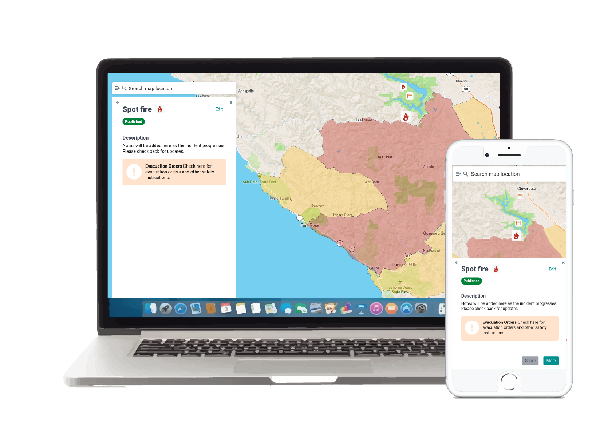
Washoe County: Evacuations
Real-time communication between fire, law, emergency management, and the public during disasters.

Slide 12
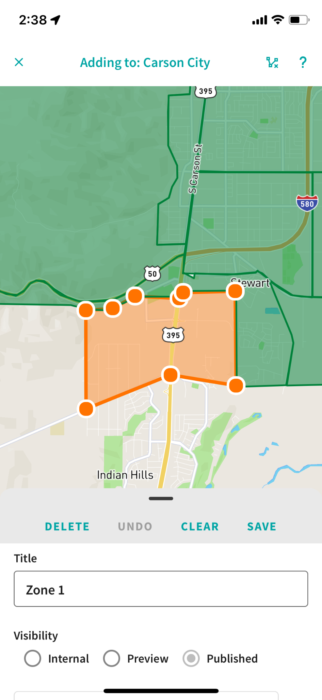
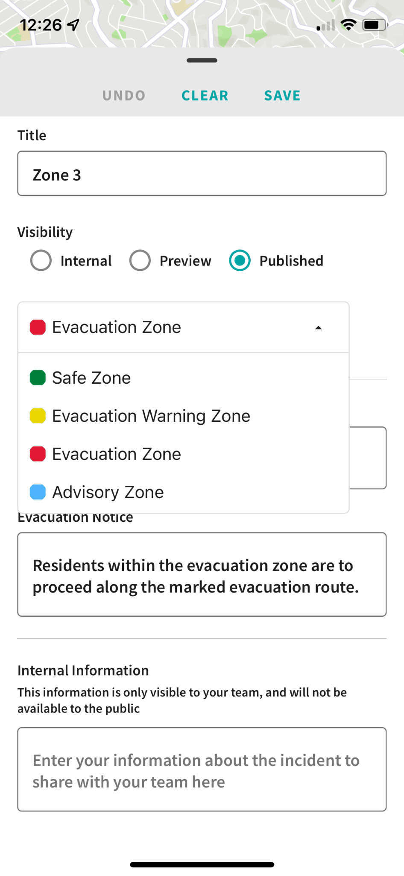
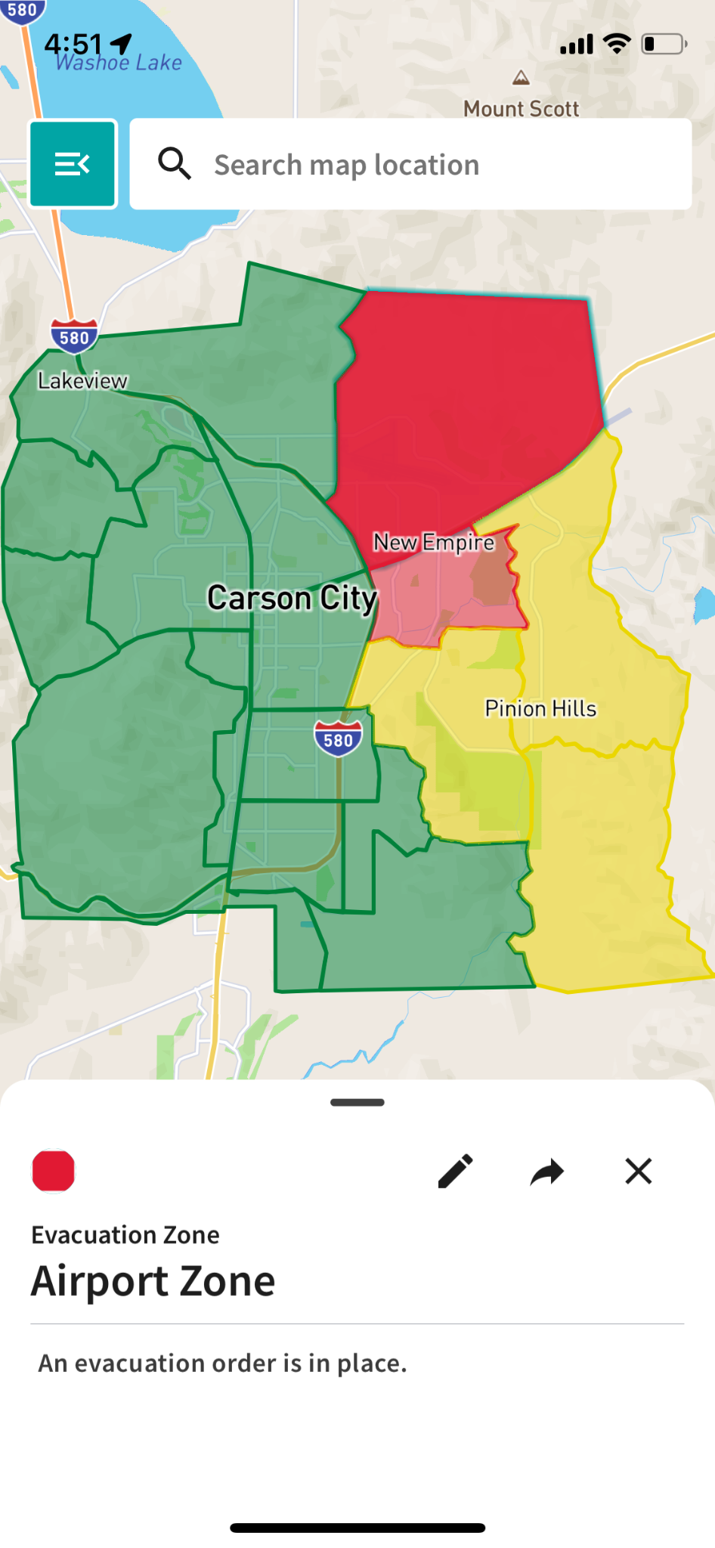
Washoe County: Evacuations
Pre-planning
Testing and training with first responders.
Real-time collaboration
Coordinate evacuations with other agencies in real-time.
Alert the public
Publish evacuation areas and instructions to the public.

Slide 13
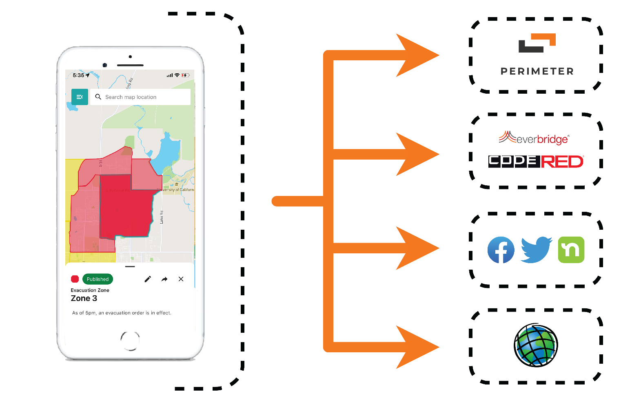
Cross-channel communication
Washoe County: Evacuations
Public web app
Notification systems
Social media
GIS tools

Slide 14
Perimeter Platform is designed for:
Washoe County: Evacuations
Real-time data updates.
Low-connectivity environments.
Accessibility and ease-of-use.
Integration with existing department tools and notification channels.
Cross-agency collaboration across jurisdictions.

Slide 15
What You Can Do:
Washoe County: Evacuations
Have a Kit
Make a Plan
Meeting place inside your neighborhood & outside
Local POC & Long-distance
Methods for communication
Place for pets
Stay Informed
Check verified social media accounts
Traditional News Media
www.Emergencywashoe.com

Slide 16
Evacuation Video

Slide 17
Video
Decision making
Steps for alerting
What people will see/experience
Information to aid with individual decision making
Setting expectations

Slide 18
Thank You!

