Slide 1

Public Process and NAB Review
Neighborhood Advisory Board

Slide 2
How Does Development Work?
Is the use allowed?
How is the site designed?
How is the building designed?
Business license

Slide 3
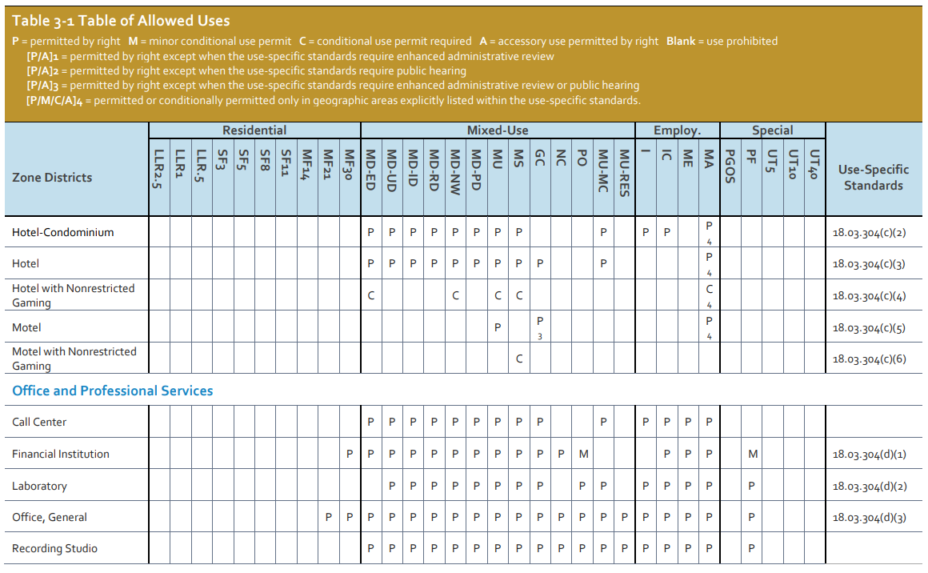
What Triggers a Project to be Reviewed?
Purpose of Table of Allowed Uses
  Administrative Review Process
  Planning Commission Approval
  City Council Approval
Table of Allowed Uses

Slide 4
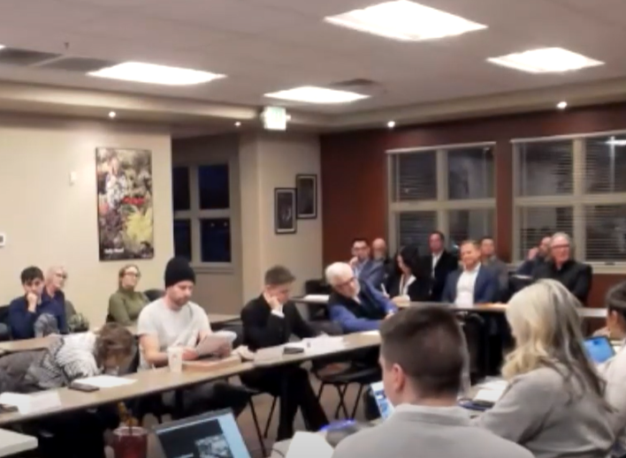
What Triggers NAB Review?
NAB’s Review:
  Development projects that require approval by Planning Commission or City Council.
NAB’s Don’t Review:
  Building Permits
  Administrative Review (30-day review process)

Slide 5
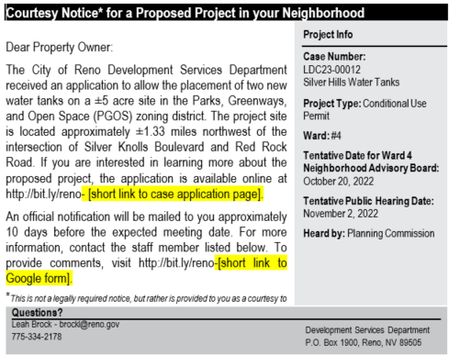
Process for Public Notice
Courtesy postcards
  Mailed out within the first week of staff review.
Public Notice postcards
  Mailed out 10 days prior to public hearing/decision date.
Example of Courtesy Notice Postcard

Slide 6

Why do Meeting Dates Change?
Staff review often results in
changes to the project.
The project dates are tentative.
All meeting agendas are posted on-line:
https://reno.primegov.com/public/portal

Slide 7
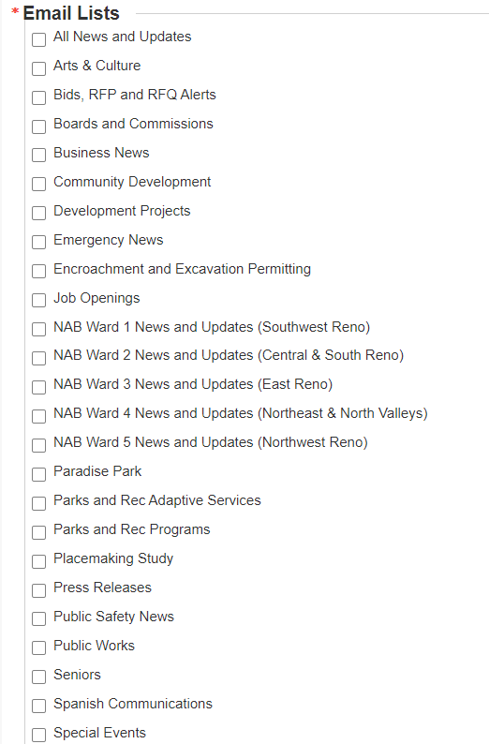
Can I Sign Up to Receive All Agendas?
YES!!!! You can sign up to receive City of Reno agendas and newsletters.
City website – “How do I sign up for newsletters”
https://www.reno.gov/how-do-i/sign-up-for/newsletters

Slide 8
Questions?

