Slide 1
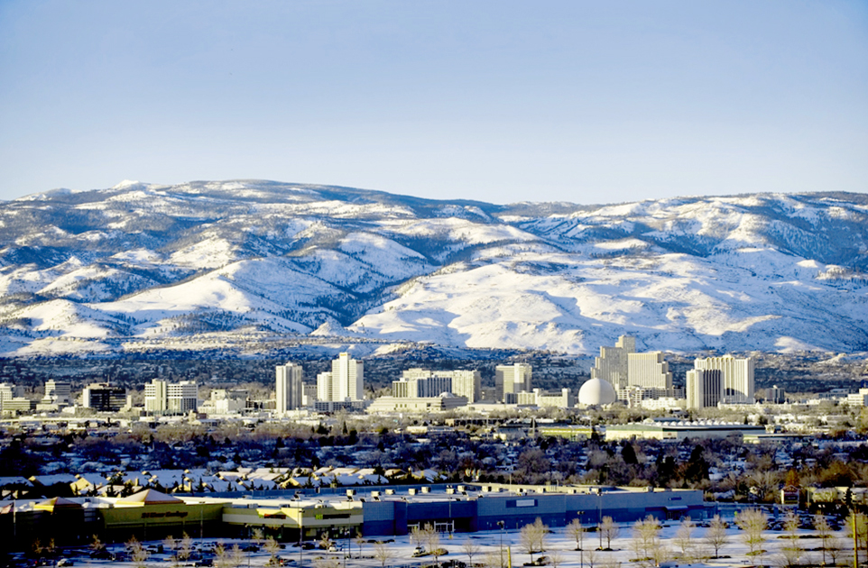
Verdi Area Multimodal Transportation Study
January 18, 2022

Slide 2
Study Purpose
Conduct multi-modal analysis to identify:
Corridor gaps in connectivity (vehicular, ped, bike, transit)
Crash and congestion hot spots
Develop strategy for developing transportation improvements
Identify short- and long-term improvements
Solicit feedback from and inform agencies, stakeholders, and general public throughout the process
Planning
Existing conditions/ needs assessment
Community visioning
Evaluation of alternatives
Action plan/ recommended improvements
Environmental
Environmental study (state or NEPA process)
Preliminary engineering
Agency issues decision
Design
Detailed corridor design
Right-of-way, utilities, and other impacts
Construction plans, permits, and funding secured
Construction
Build and deliver
WE ARE HERE
Notes:
Add develop vision (is it a freeway, arterial or blend?)

Slide 3
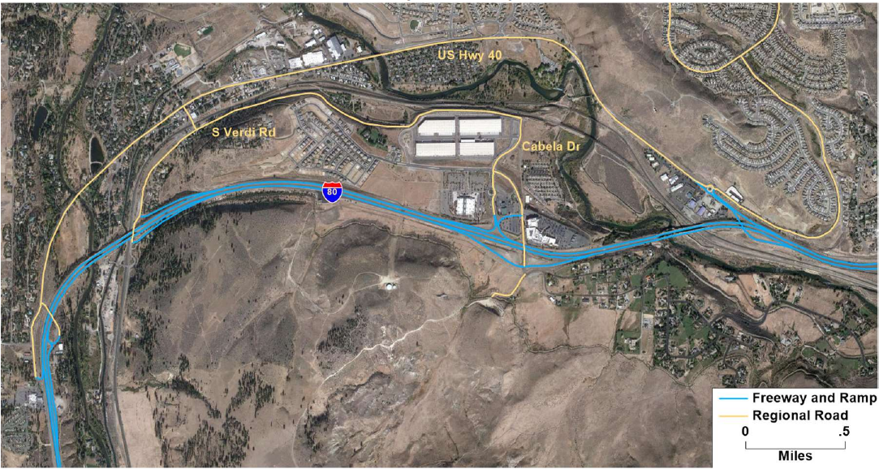
Study Limits

Slide 4
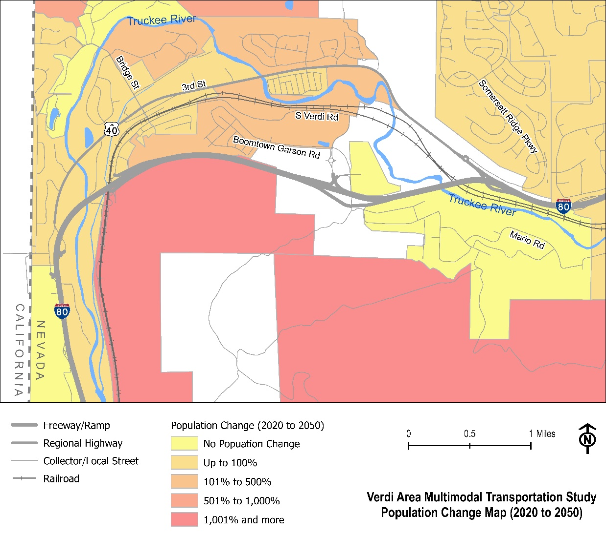
Existing Conditions – Estimated Population Change
Proposed Development
Storage Units at Gold Ranch
Mortensen Ranch
Meridian 120S
Santerra-Quilici

Slide 5
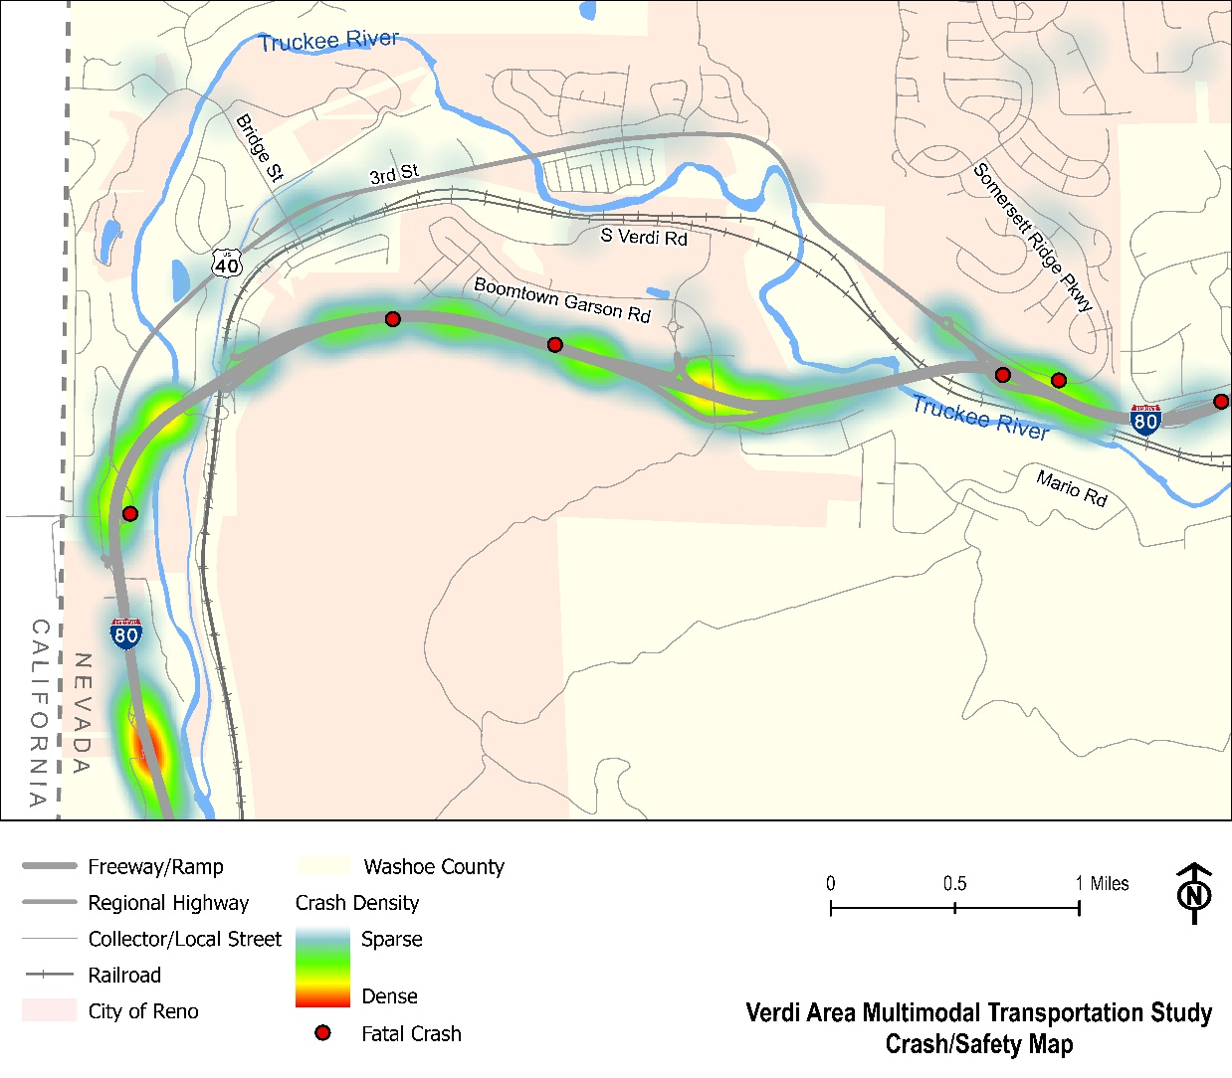
Existing Conditions – Crash Data
5-year data will be utilized
Crashes focused around I-80 interchanges

Slide 6
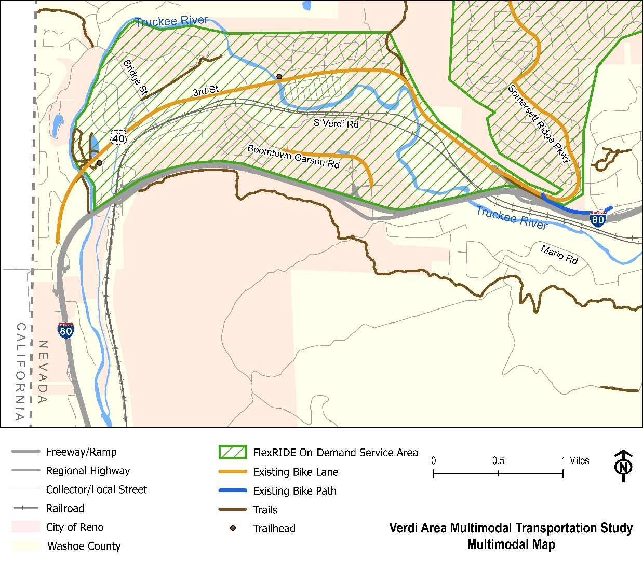
Existing Conditions – Multimodal
Transit – Flex Ride
Pedestrian – No sidewalks or ADA
Bicycle – widened shoulders on 3rd Street & Boomtown Garson Road
Recreational – Truckee River, Parks, Steamboat Ditch, OHV

Slide 7
Study Process
Review existing conditions
Identify gaps and needs
Provide proposed project recommendations
Stakeholder outreach including two potential public meetings
Schedule – 12 months overall

Slide 8
THANK YOU
Regional Transportation Commission of Washoe County
In association with
CA Group and Parametrix
West Truckee Meadows/Verdi Township Citizens Advisory Board
ddoenges@rtcwashoe.com
xwang@rtcwashoe.com
chad.anson@c-agroup.com
Building A Better Community Through Quality Transportation
rtcwashoe.com

