Slide 1


Citizen Advisory Board Presentation
CSD - Roads

Slide 2

Winter Preparedness & Operations

Slide 3
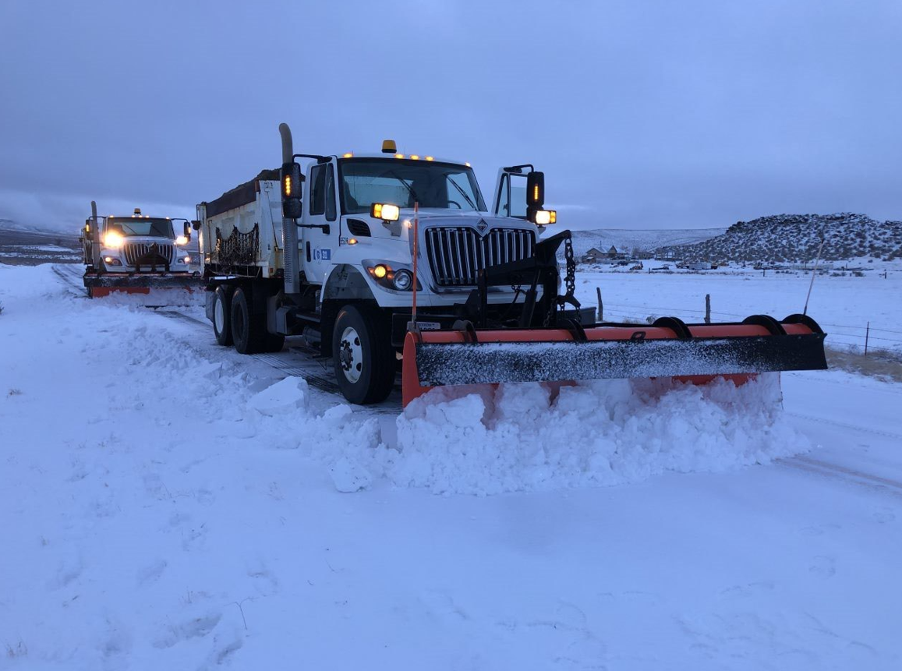
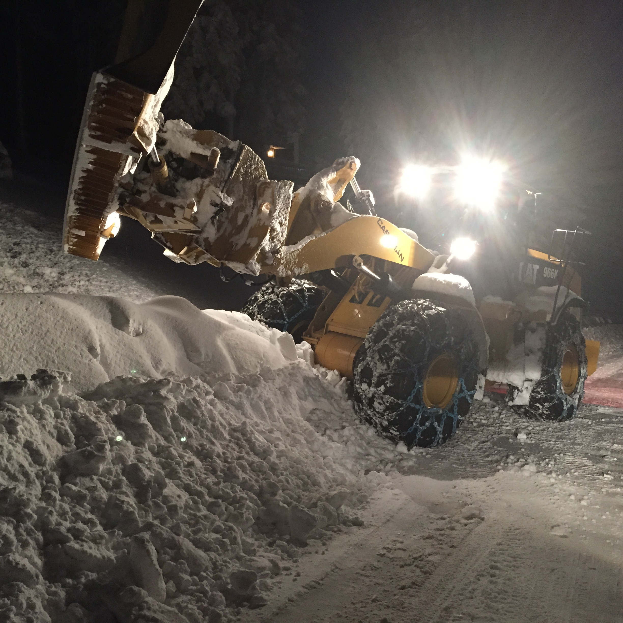
Services
CSD - Roads
November to March
  Daily Monitoring of Weather 24/7
  Pre-Treatments
    Salt/Sand – Intersections & Curves
    Brine – Grades, Bridges, High-Volume Roadways
  Snow Plowing & Snow Blowing
  Storm Cleanup
    Snow Storage & Stockpiling
    Street Sweeping

Slide 4
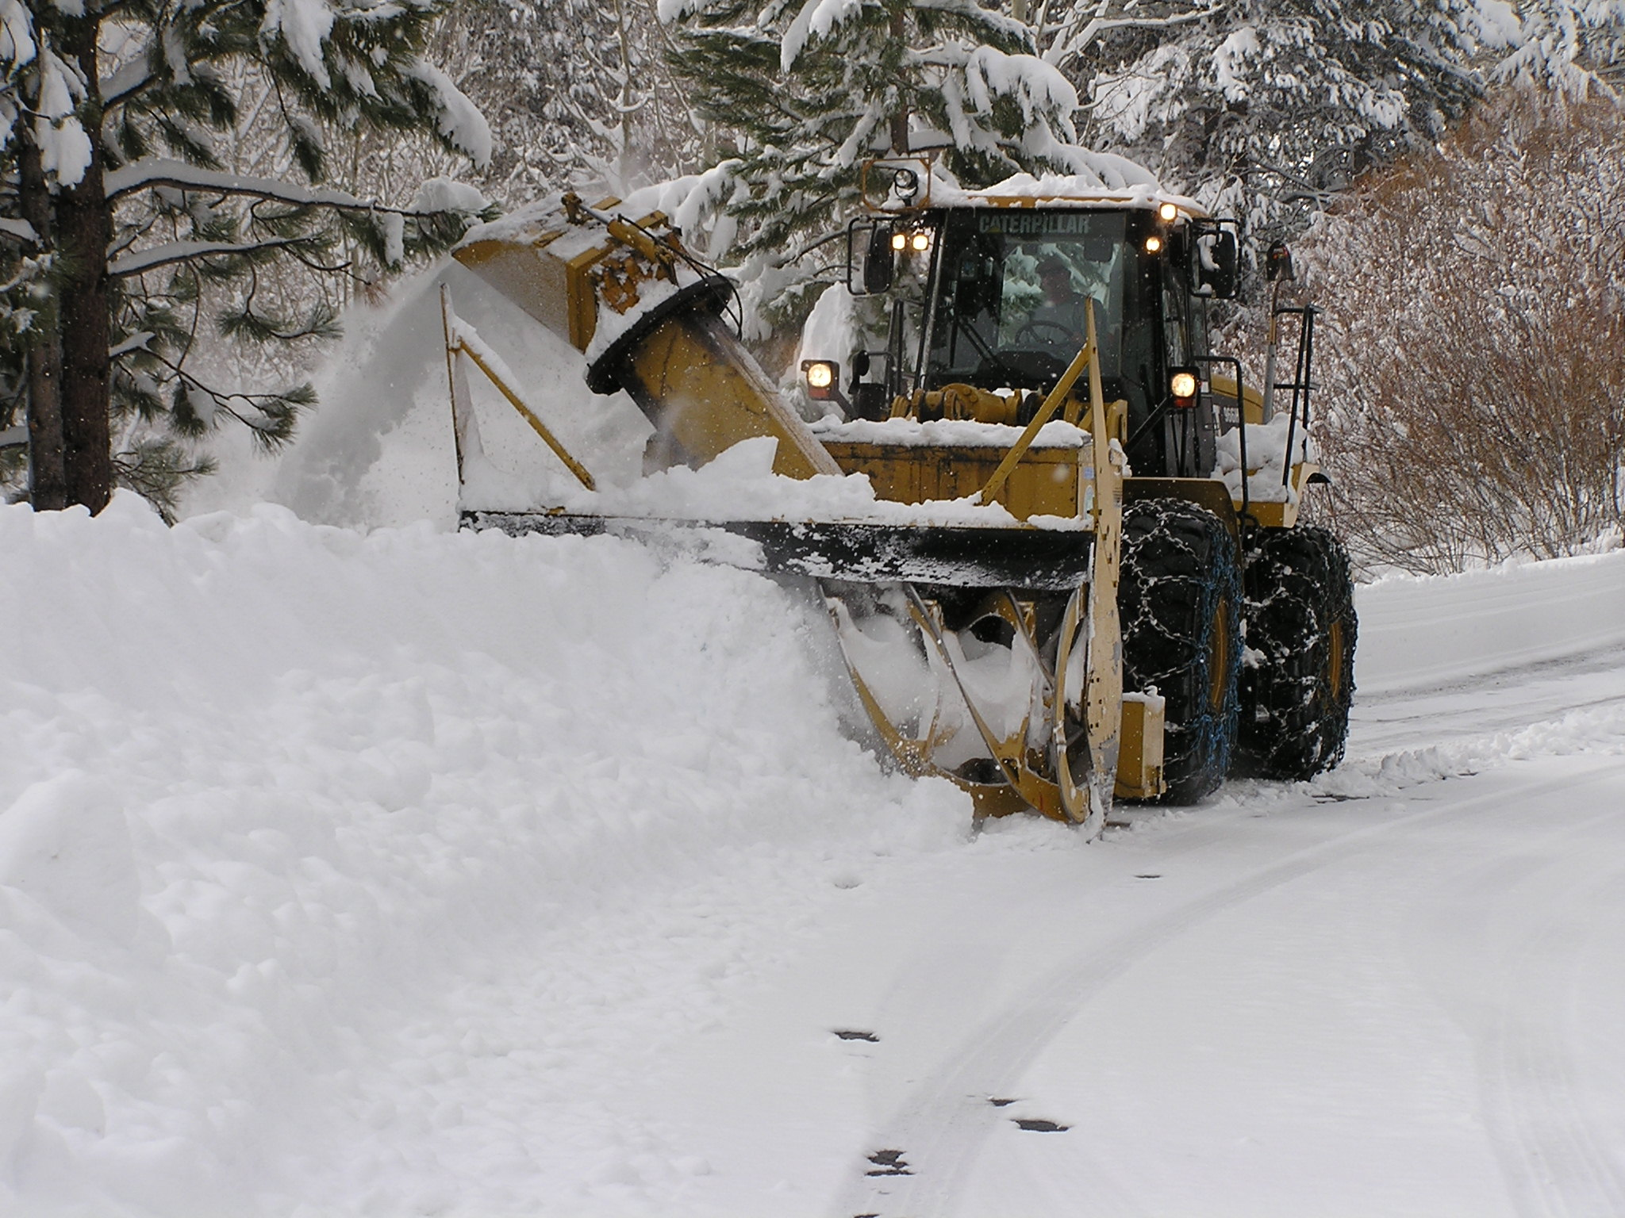
Resources & Responsibilities
CSD - Roads
Personnel
  47 Permanent Positions
  10 Intermittent Hourly’s
Equipment
  43 – Plows
  5 – Loader Mounted Snow Blowers
  7 – Graders & Backhoes
1088 Miles of Road
  762 Paved
  362 Unpaved

Slide 5
Snowplow Route Prioritization
CSD - Roads
Priority – 1
  Arterial & Collector Streets, Fire & Hospital access routes, School & Bus Routes
Priority – 2
  Secondary Arterial & Collector, Residential Roads, Remaining School & Bus Routes
Priority – 3
  Cul-de-sacs, Dead-end Streets, Industrial Streets
During heavy continuous snow Priority 2 & 3 streets will not be cleared until the snow lets up!

Slide 6
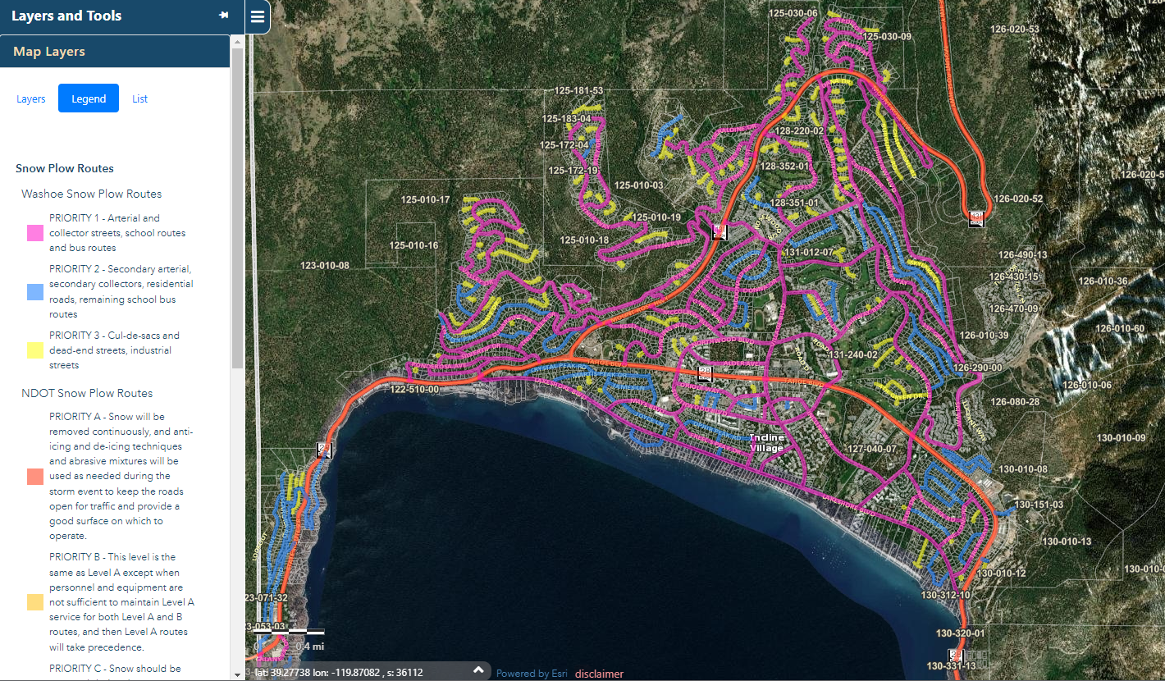
Washoe County Regional Mapping System (WORMS) – Prioritized Route Example

Slide 7
Our Goals
Provide fiscally responsible emergency response during snow events
Support the safety and mobility of our transportation system
Plow & treat county streets as efficiently and safely as possible
Keep priority streets open and passable
Minimize disruptions to traffic

Slide 8
How You Can Help
Trash cans out of the way and off the street
Be careful around snowplows and don't pass
Don't park on the street
Don't shovel or blow snow back onto roadway
Don’t sled on the street
Be patient

Slide 9
Contact Information
CSD - Roads
24/7 Call Center: (775) 328-2180
Snowplow Route Maps
gis.washoecounty.us/wrms/snow
Roads Website
www.washoecounty.gov/csd/operations/roads

Slide 10
Thank you!
CSD - Roads

