Slide 1
NV Energy: Power Safe NV
Sun Valley Citizen Advisory Board
December 1, 2025
Notes:
Katie Jo

Slide 2
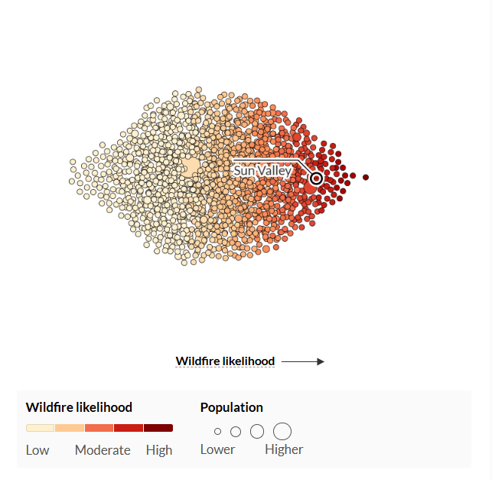
Wildfire Risk
According to the United States Forest Service, Sun Valley has a very high risk of wildfire—higher than 97% of communities in the US.
Your community is categorized as a Tier 1-Elevated risk zone at NV Energy- this means it is high priority for wildfire mitigation tactics.
Notes:
Alex/Paul

Slide 3

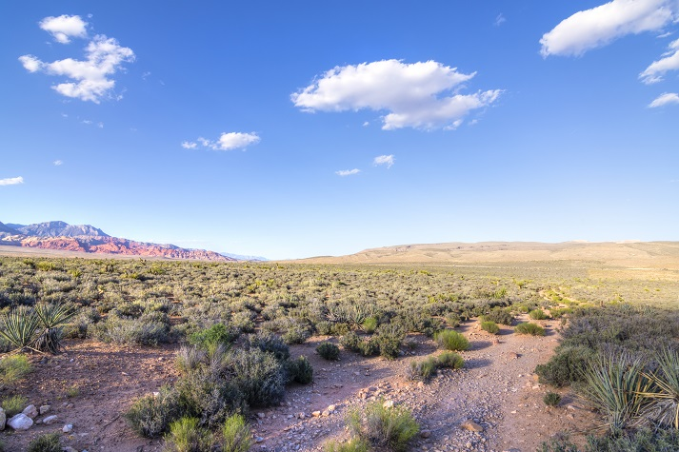






Natural Disaster Protection Program
Nevada Senate Bill 329 (2019) requires NV Energy to address wildfires and natural disasters through the Natural Disaster Protection Plan (NDPP).
Vegetation Management
Aspects of the NDPP
Inspections and Patrols
Prevention
Grid Ruggedization
Situational Awareness
Detection
Industry Experts
Fire Season Settings
Protection
PSOM
Emergency De-Energization
Notes:
Katie jo

Slide 4
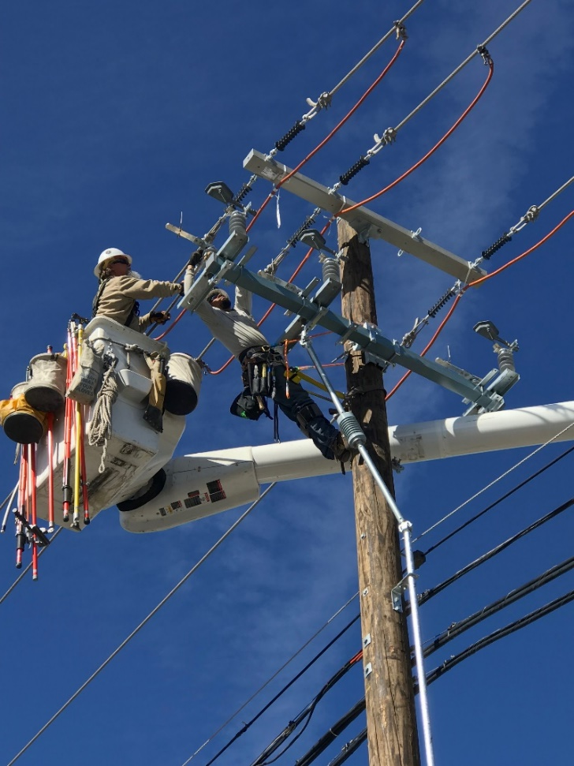
Prevention
System Hardening
Rebuilding overhead lines with covered conductor lines​
Replacing conventional fuses with non-expulsion fuses​
Replacing traditional poles with a ductile iron alternative or wrapping in a fire mesh material.
Inspections and Patrols
Perform annual patrols and detailed inspections every year.​
52,522 inspections and patrols during 2024. ​
Notes:
Will Morgan

Slide 5
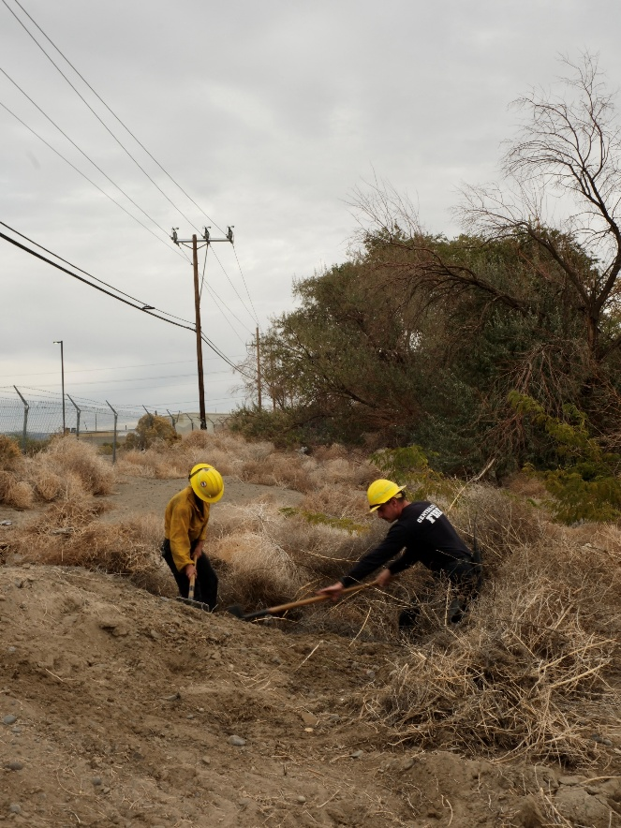
Prevention (cont.)
Vegetation Management
Vegetation management is essential to a safe & reliable electrical grid.
Tree pruning and ground fuel management create a safe zone for electrical infrastructure.
Crews have been completing ground fuels management in near lines in the area this summer.
Since 2020, the team has pruned or removed approximately 125,000 trees in high fire risk areas around Northern Nevada.
Notes:
Mark Young

Slide 6
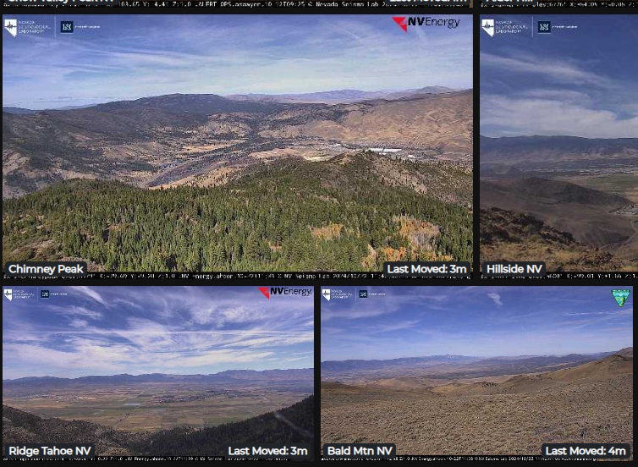
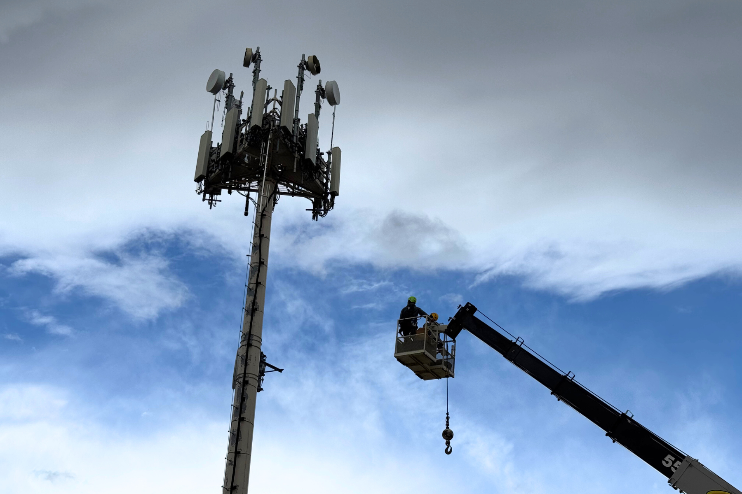
Detection
Situational Awareness
Wildfire detection cameras with 24/7 A.I. alerts and a growing network of weather stations.
Industry Experts
Two meteorologists with expertise in fire weather and behavior, dedicated to continuous weather forecasting.
Two emergency managers dedicated to handle all types of emergency events NV Energy may encounter.
Four wildfire mitigation specialists with extensive experience in fire mitigation and control activities.
Notes:
Alex

Slide 7
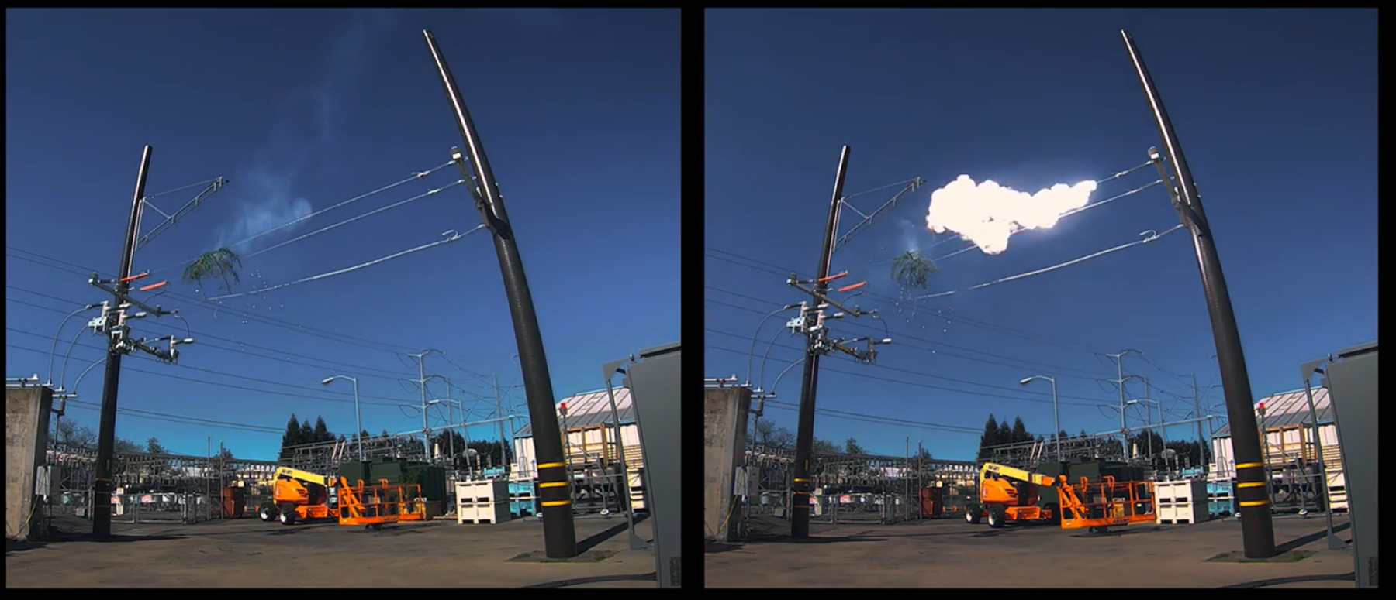
Fire Season Settings
Fire Season Settings
Use more sensitive equipment settings during high fire risk to reduce ignitions.
Lines de-energize in a fraction of a second if a fault is detected (e.g., debris, vegetation, animals).
Must patrol the line prior to re-energization
Can increase outages during times of high fire risk
DISABLED
ENABLED
Notes:
Macy

Slide 8
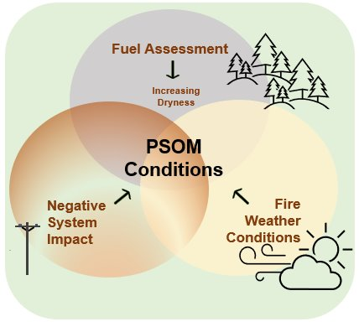
PSOM
Public Safety Outage Management (PSOM)
NV Energy will de-energize power lines during high wildfire risk periods
PSOM decisions are based on extreme weather and area conditions
Damaged or debris-contacted energized equipment can create sparks, leading to fires that spread quickly in high winds
PSOM outages are pre-planned and allow for notification prior to de-energization.
2020 | 2021​ | 2022​ | 2023​ | 2024 | 2025
1 PSOM | 2 PSOM​ | 5 PSOM​ | 1 PSOM | 6 PSOM | 5 PSOM
Notes:
Macy
So far in 2025, we have executed on 5 PSOMs across the state

Slide 9
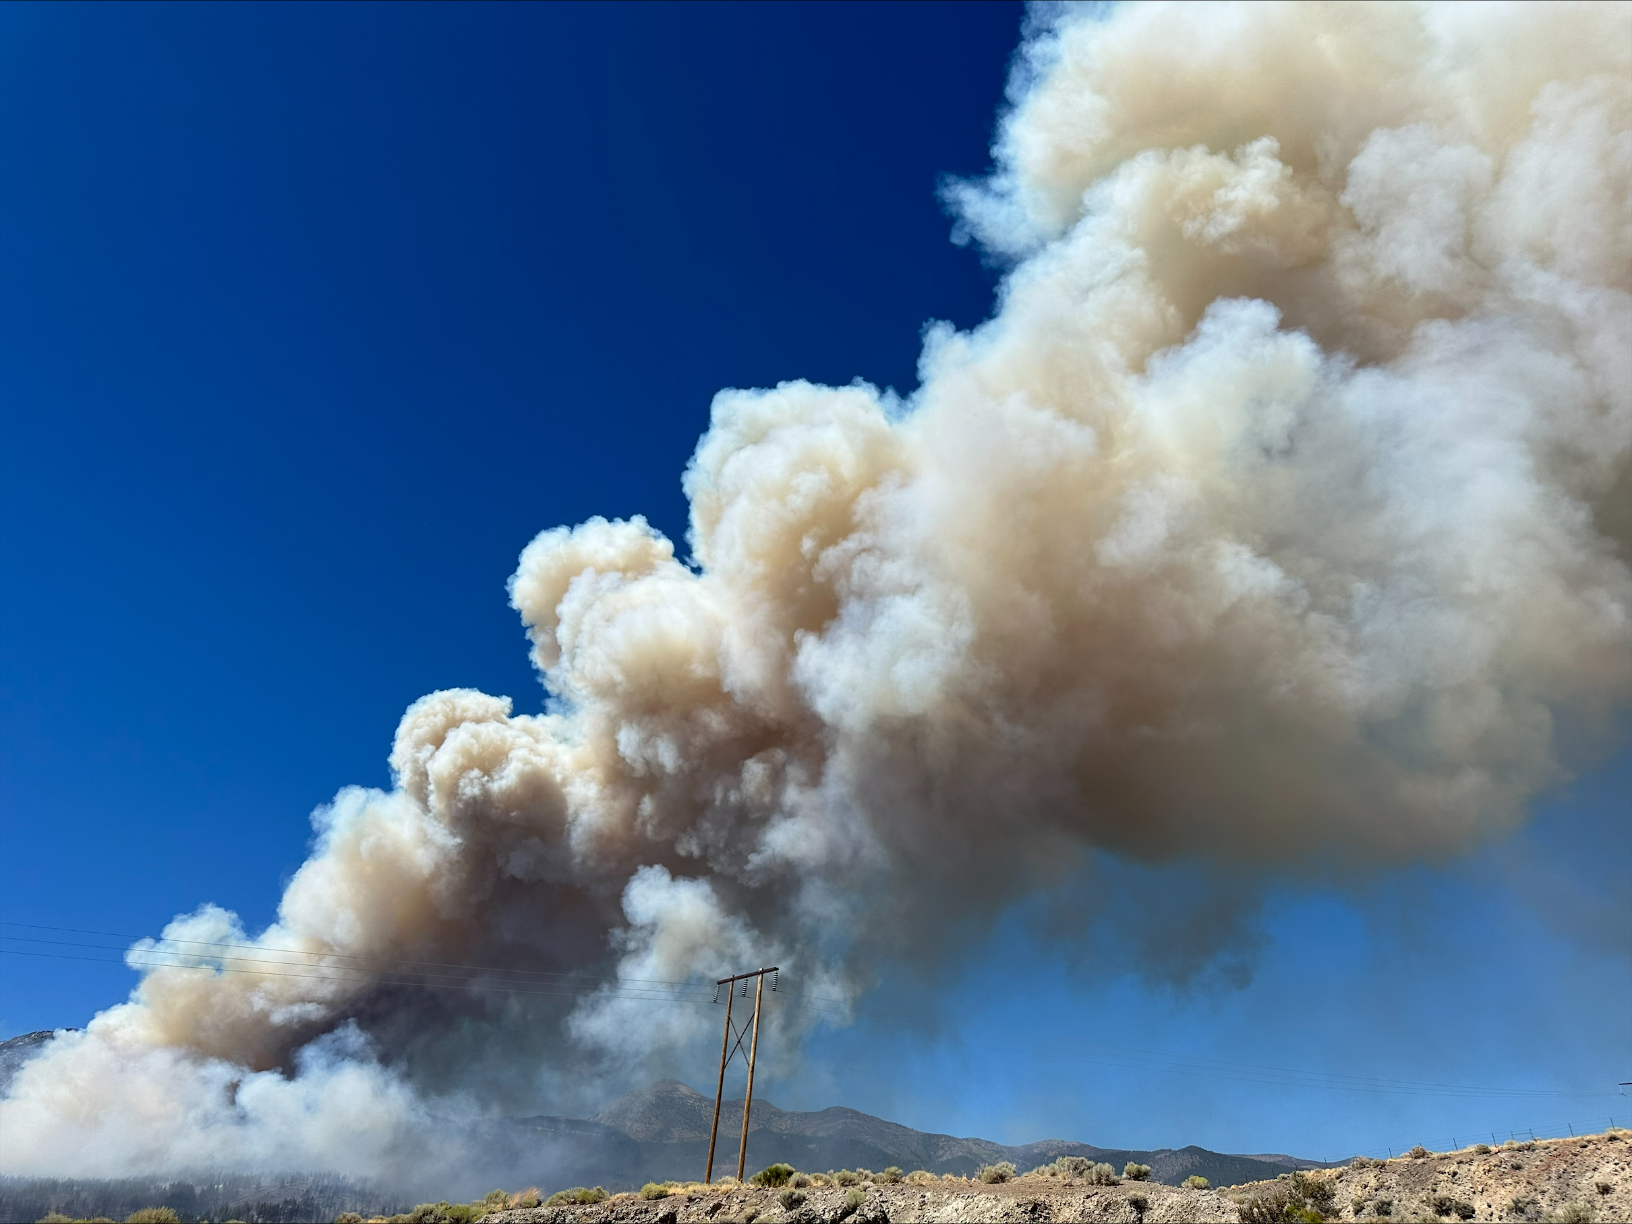
Emergency De-Energization
Active wildfires can damage electrical equipment, causing sparks and potential secondary fires, creating additional hazard for the public
NV Energy is dedicated to protecting our communities through emergency de-energizations, mitigating our equipment’s impact on fires
Emergency De-Energization
NV Energy will de-energize equipment when an unpredictable and uncontrollable wildfire gets too close to NV Energy equipment.
Notes:
Macy

Slide 10

MyAccount & Green Cross
Sign-up for notifications through NV Energy’s MyAccount portal. If you are signed up, ensure your contact information and notification preferences are up to date.
The Green Cross program is designed to aid customers who rely on electrically operated medical equipment.
Customers who qualify for Green Cross will have special status listed on their account that will allow NV Energy to prioritize communication and care
Advanced notification of scheduled outages
Prioritized restoration after an unplanned outage
Pending outage scope, lodging accommodations during an unplanned outage
Notes:
Tim Hill

Slide 11

Questions? Contact Us at...
Email: ndpp@nvenergy.com
Phone: (833) 818-2232

Slide 12

End of Presentation

