Slide 1


Code Enforcement Overview
Sun Valley CAB
August 6, 2022 (Agenda Item 9)

Slide 2

Chad Giesinger,
Planning Manager
Planning and Building Program
cgiesinger@washoecounty.gov
775-328-3626

Slide 3
What is Washoe County Code Enforcement?
Washoe County Code Enforcement: Code-Enforcement@washoecounty.gov
Part of the Planning and Development Program, CSD
Has enforcement jurisdiction outside the cities of Reno-Sparks (remainder of county)
3 Code Enforcement Officers (2 land use and 1 building)
CEO’s assigned to specific geographic areas
Sun Valley is covered by 2 officers (east/west)

Slide 4
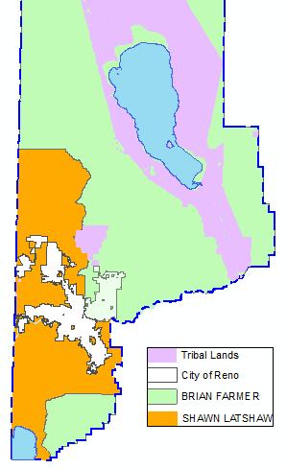
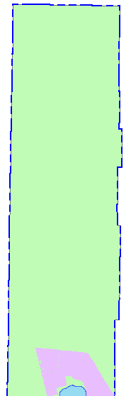
CEO AREAS OF RESPONSIBILITY
2 CEO’s Enforce Land Use + BL
Split County as Shown
1 CEO Enforces Building/Engineer
Covers Entire County
Pop. 113,306 and 47,677 houses
No Jurisdiction in Tribal or City Areas

Slide 5
What does code enforcement do?
Washoe County Code Enforcement: Code-Enforcement@washoecounty.gov
Land use and business license compliance
Building Code compliance (also engineering)
Codes enforced: Chapters 25, 30, 50, 100, 110, 125
  Business License, Liquor and Gaming, Public Nuisances, Building, Development Code, Administrative Code
Do not enforce Health (food, solid waste, air quality, EHS), Fire, Sheriff (criminal), Landlord/Tenant issues

Slide 6
Case Loads
Washoe County Code Enforcement: Code-Enforcement@washoecounty.gov
Since August 5, 2017: 3,944 Complaint Cases Opened
Over last complete 4-year span (2018 thru 2021), each CEO averaged 270 complaint cases per year
Of the total complaints 1,598 became Violation cases
Each CEO averaged 108 violation cases/year over 4-years
Violation cases represent significant on-going work and monitoring, in addition to continued complaint investigations

Slide 7
Typical Complaints
Washoe County Code Enforcement: Code-Enforcement@washoecounty.gov
Junk and abandoned vehicles / RV’s
RV living
Building material, debris, appliances (nuisance code)
Grading without a permit
Building without a permit
Storage on a vacant parcel
Doing business without a business license
Lighting

Slide 8
Types of Complaints – Most Frequent

Slide 9
Code Enforcement Policies
Washoe County Code Enforcement: Code-Enforcement@washoecounty.gov
Complaint Driven – no pro-active enforcement
All complaints are investigated
Consistent, impartial enforcement
Due process must be provided
Do not issue fines as “punishment”
Voluntary compliance is always goal (majority comply)

Slide 10
Code Enforcement Process
Washoe County Code Enforcement: Code-Enforcement@washoecounty.gov
Complaint is received through email; phone (328-6106); or Washoe311
Complainants may stay anonymous; or go on the record
Complaint is assigned to respective CEO
Complaint is investigated as soon as possible by CEO
If CEO determines a violation exists, sends an Administrative Warning Letter (30-days to comply)

Slide 11
Code Enforcement Process (cont.)
Washoe County Code Enforcement: Code-Enforcement@washoecounty.gov
If complaint is not resolved within 30-days, then a violation case is opened
Another 30 days to comply may be granted at this point, or a Penalty Notice (PN) may be issued
30 days to pay 1st PN or comply
1st PN results in $100 fine – can pay within 30 days and get 50% discount

Slide 12
Code Enforcement Process (cont.)
Washoe County Code Enforcement: Code-Enforcement@washoecounty.gov
Fee schedule: 2nd PN=$200; 3rd PN=$400; every PN thereafter = $400 each
Each PN issued grants another 30-days to comply or pay
An AW is typically granted in between the 1st and 2nd PN’s, resulting at least 90-days passing prior to 2nd PN due
Property owner is responsible
Code enforcement does not clean up property, owner does

Slide 13
Sample Enforcement Timeline (cumulative)
Washoe County Code Enforcement: Code-Enforcement@washoecounty.gov
Administrative Warning (AW) = 30 days
1st Penalty Notice (PN) = 60 days (if no extension)
2nd AW = 90 days
2nd PN = 120 days
3rd PN = 150 days
4th PN = 180 days, etc. etc.

Slide 14
Code Enforcement Process (cont.)
Washoe County Code Enforcement: Code-Enforcement@washoecounty.gov
Penalty notices may be appealed to the Administrative Hearing Office – can occur at any PN stage
If appealed, all action on case is stayed until hearing
Hearings scheduled within 60 days, often continued to additional hearings
Decisions of the Hearing Office can be appealed to either the BOA or Second Judicial Court, or both

Slide 15
Enforcement Options / Actions
Washoe County Code Enforcement: Code-Enforcement@washoecounty.gov
Fines (PN’s) and Collections
Stop Activity Orders
Witness Statements
Remediation Orders
Enforcement property liens
Misdemeanor Criminal Citation
Withholding permits, revocation of licenses or approvals
Abatement

Slide 16
Miscellaneous Enforcement Oddities
Washoe County Code Enforcement: Code-Enforcement@washoecounty.gov
Storage nuisance violations must be visible from public view
Anything behind a 6-foot is considered “screened” regardless
“Squatters” cannot be evicted by code enforcement; trespass claim must be brought by the owner, they are also not fined
RV living is usually proven by connections to utilities
Weeds are not enforceable except on bank owned foreclosures
Blight is not one bad property – high bar to meet in NRS
There is no such thing as a “fire hazard” in CE; Fire determines

Slide 17
Enforcement issues specific to Sun Valley
Washoe County Code Enforcement: Code-Enforcement@washoecounty.gov
History of development – did not meet common subdivision standards and requirements, serial parcel maps
Streets therefore not dedicated to county; many in private ownership; not maintained
High degree of junk vehicles and illegal dumping results
Lots of corner lots and easements; widespread hoarding
Lower income and senior population not able to pay for compliance efforts

Slide 18
Enforcement issues specific to Sun Valley – Private ownership of roads
Washoe County Code Enforcement: Code-Enforcement@washoecounty.gov
Many have deceased owners (e.g. Quartz)
Cannot do AE without known property owner
Sheriff does not have jurisdiction, CE does
Attractive nuisance
No realistic potential remedy to assimilate and improve
Adjacent property owner may not know they own portion of road (property line extends to the middle of the “road”)

Slide 19
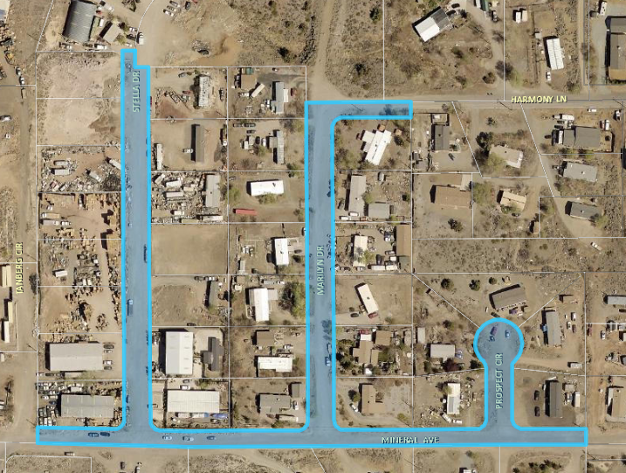
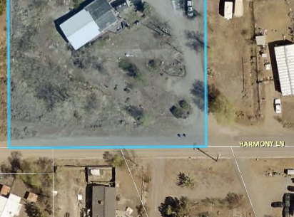
Example of Private Road Situation

Slide 20
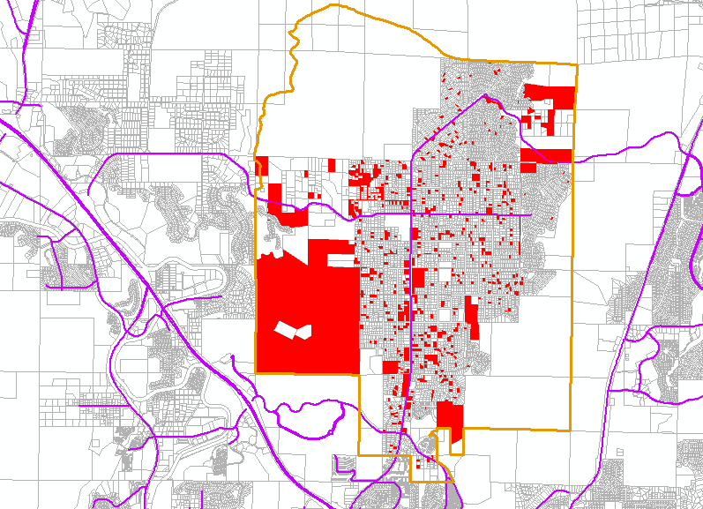
Complaint Distribution in Sun Valley
Last 4 years = 563 Complaints
14% of all WC complaints
Junk Vehicles top complaint, followed by RV living
JV are over 33% of all complaints

Slide 21
Thank you
QUESTIONS?

