Slide 1
County Accomplishments
February, 2025

Slide 2
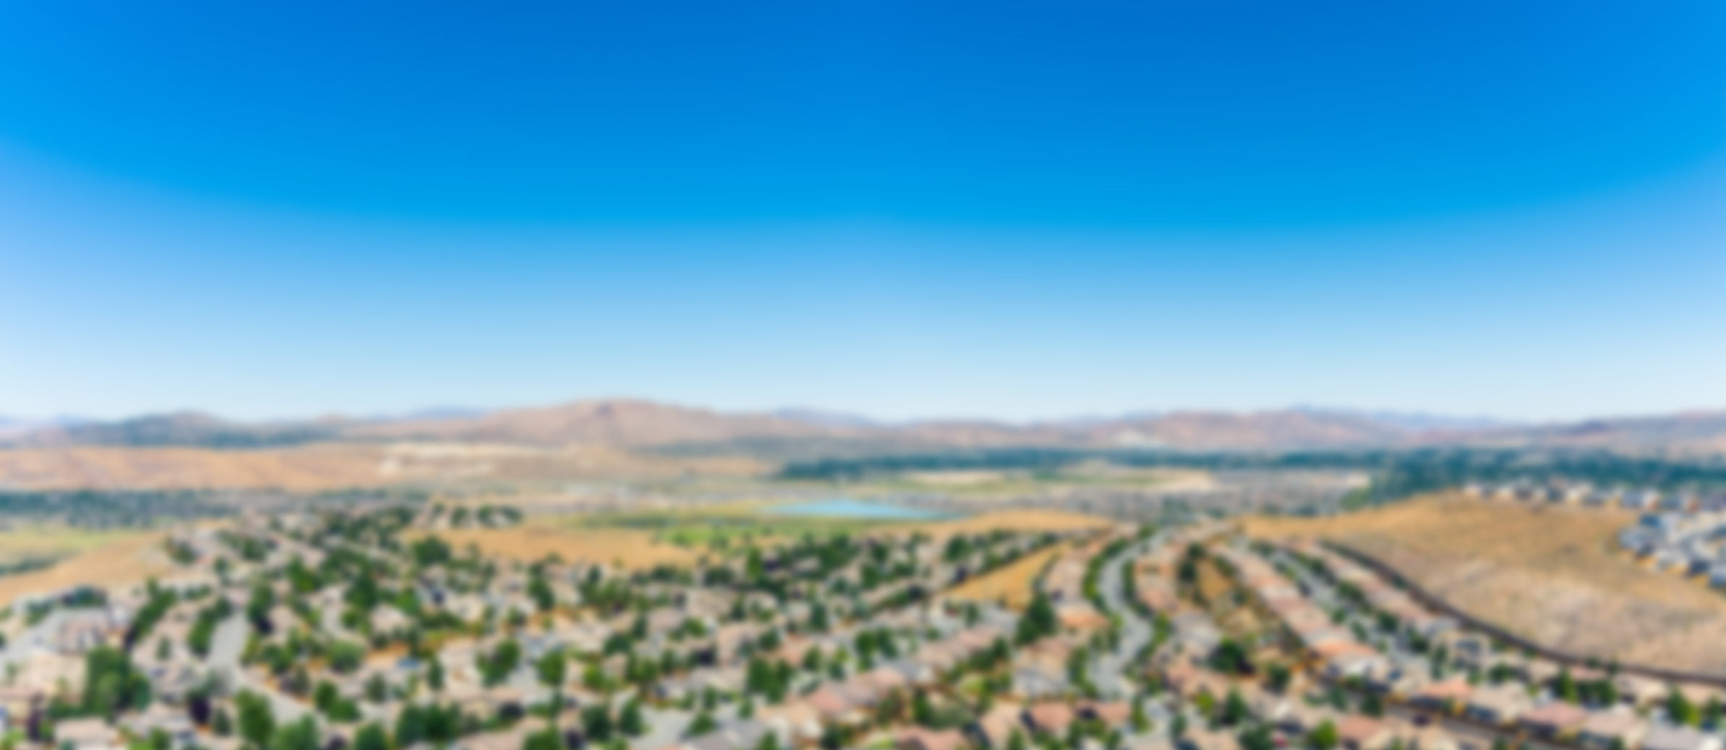
2025
Continue to follow through on strategic plan priorities (Seniors, Mental Health, Infrastructure)
while preparing for financial headwinds ahead due to flattening revenues

Slide 3
Fiscal Management Accomplishments
Structurally balanced budget
Moody's Analytics increased sales tax bond rating from Aa3 to Aa2
Unmodified audited financial statement opinion
Unanimous Board approval of all collective bargaining agreements – 4 year terms
GFOA Distinguished Budget Award - transparency
Distributed $4.5m in Washoe County Opioid Abatement and Recovery Grant Funds
Implementing Open Checkbook – transparency

Slide 4
Vulnerable Populations Accomplishments
Completed Cares Campus Construction
Renewed contracts and expanded services with providers at CARES, Safe Camp and Our Place.
Secured $20 million in State funding and started affordable housing projects on Cares Campus
Relocated Men’s Crossroads program - Opening a family Crossroads program
Launched Sequential Intercept Behavioral Health Model initiative following the Miami model.

Slide 5
Vulnerable Populations Accomplishments
Hired Opioid Analyst to develop and administer BCC approved Opioid action plan
Distributed $4.5m in Washoe County Opioid Abatement and Recovery Grant Funds
Hired Behavioral Health Administrator – Julia Ratti
Obtained BCC approval to initial County behavioral health action plan
Secured $14.5 million State IFC funding to remodel Washoe Behavioral Health Center (formerly West Hills)
Completed Phase I of 9th Street Senior Center remodel

Slide 6
Innovative Services Accomplishments
Elections
Successfully administered the February Presidential Preference Primary, June Primary and November General Presidential Elections
Implemented recommended new staffing model, renovated facilities, purchased and installed new election equipment for better efficiency (faster ballot processing)
Implemented “Top Down” Know.inc voter registration and election management system in collaboration with the SOS Elections Office.
Successfully completed recruitment for a new Registrar of Voters

Slide 7
Innovative Services Accomplishments
Regional Computer Aided Dispatch (CAD) project progressing on schedule/on budget for Fall 2025 completion
Successfully implemented technology to enhance community outreach
Development HUB
eComment
Virtual BCC meeting access for Incline Village and Gerlach communities
Wordly.ai language translation tool
BCC Approval of Washoe County Master Plan
Completed upgrade of Incline Village Court House facilities improvements

Slide 8
On-Going Regional Collaboration
Facilitated ongoing problem-solving discussions across Washoe County
Public/Private:
Children’s Cabinet
WCSD
EDAWN
RTC
RSCVA
TMCC
UNR
RHA
Health:
NNPH
REMSA
Renown
NNMC
St. Mary’s
HOPES
Managed Care Organizations
Neighboring
Jurisdictions:
NV Association of Counties
Pyramid Lake Paiute Tribe
Reno Sparks Indian Colony
Regional Dispatch/EMS/Fire:
Reno PD/Fire
Sparks PD/Fire
WCSO
Truckee Meadows Fire
REMSA
Others

Slide 9
Proposed 2025 Priorities
Continue CAB program with BCC/public input for improvements
Complete regional CAD implementation targeting Fall, 2025
Complete Washoe Behavioral Health Center (West Hills) site use plan and begin implementation
Conduct WC Justice System (DA/PD/APD) case workflow study and develop recommendations for system improvements
Update WC emergency evacuation plans
Pursue Public Private Partnership opportunities to drive WC revenue growth
Complete updates to FEMA floodplain designations

Slide 10
Thank you

