Slide 1
Emergency Preparedness
Darrell Billings
Washoe County Search & Rescue Team Member

Slide 2
You have 15 minutes to evacuate! Quick make a list of what you should take.

Slide 3

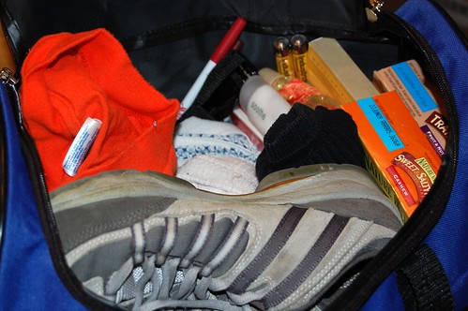
Take a look at the contents of this Go Bag.
This Photo by Unknown Author is licensed under CC BY-SA-NC

Slide 4
If you have more than 15 minutes to evacuate:
30 minutes to 1 hour
Laptops
Data Storage
Jewelry Boxes
Paintings
Suitcase with clothes
Consider packing your trailer if you have one;
Goal Zero
Generator & Gas
Dehydrated Foods & Water
Passport
Also decide on a meeting place

Slide 5
Resources
FEMA Emergency Supply Checklist
Ready.gov Build a kit
American Red Cross 2 min video

