Slide 1
Washoe County Sustainability
Brian Beffort, Sustainability Manager

Slide 2
What is Sustainability?
Allowing current generations to meet their needs without compromising the needs of future generations – 7 generations.
Triple bottom line: Ensuring a balance between economic growth, environmental care, and social well-being.
Mission Statement: Working together regionally to provide and sustain a safe, secure and healthy community. Quality of life. Continuity and quality of county services and infrastructure.
Financial Sustainability. The wise management of taxpayer dollars.

Slide 3
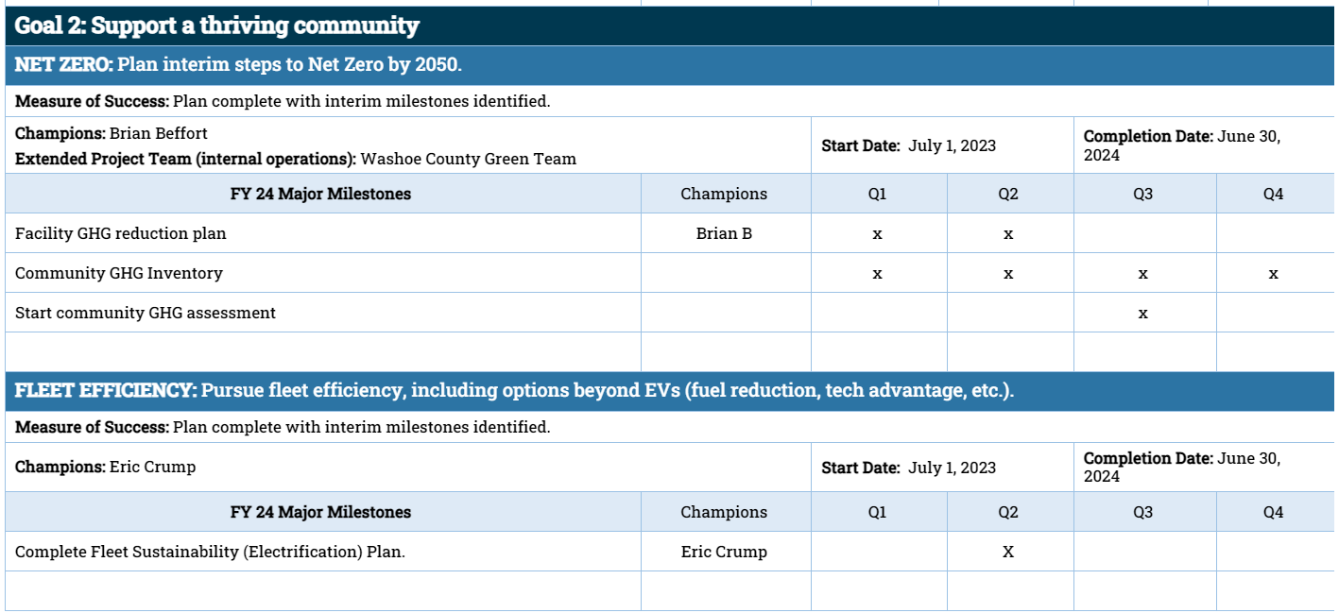
County Draft Strategic Priorities for FY 2024

Slide 4
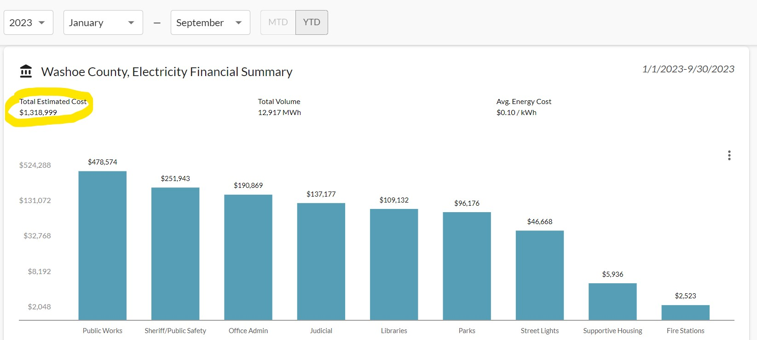
Washoe County Data from NZero
Notes:
Snapshot of our electricity bills at facilities YTD 2023. If you don’t care about climate, maybe you’ll care about how your tax dollars are spent.

Slide 5
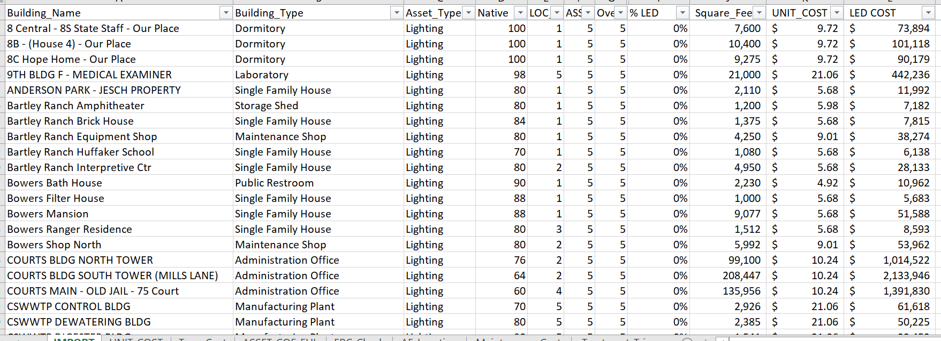
Washoe County LED lightbulbs data
Notes:
Spreadsheet from facilities, showing a few facilities that need lightbulbs switched to LED. Estimated cost for 100% switch = $20m. Payback = 7 months. Then 90% lower bills and emissions moving forward.

Slide 6
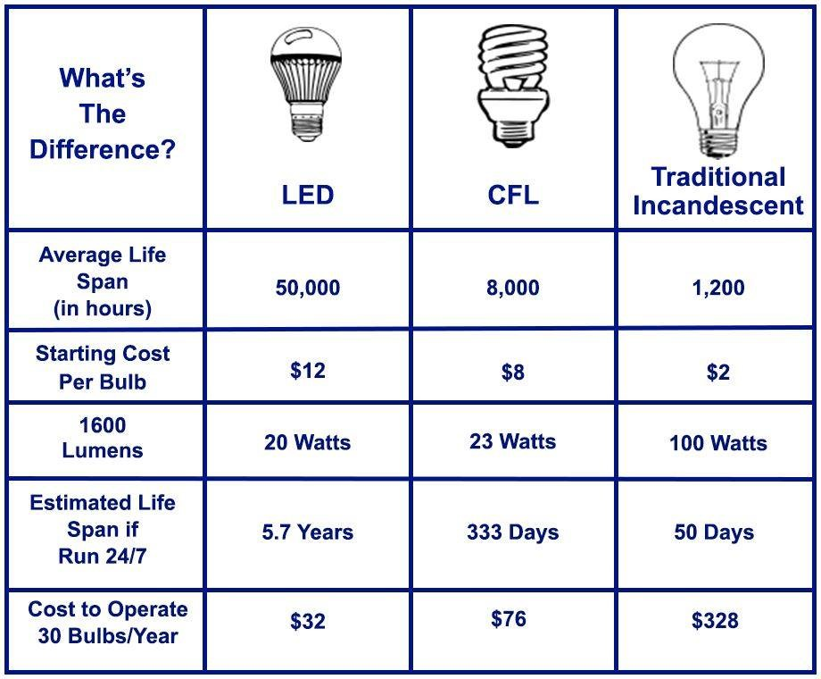
Washoe County LEDs
Notes:
Comparison of lightbulbs. 90% savings.

Slide 9
Green Recovery Plan cont.

Slide 10
Green Recovery Plan cont.

Slide 11
Green Recovery Plan cont.

Slide 12
Thank you
Questions?

