Slide 1

Mayor Ed Lawson

Slide 2
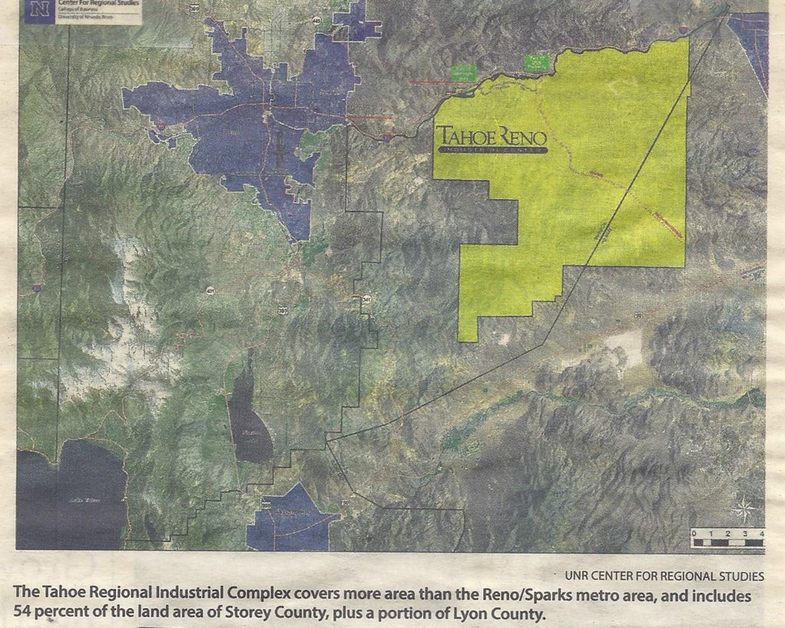
Landsbill
Notes:
Total: 873

Slide 3
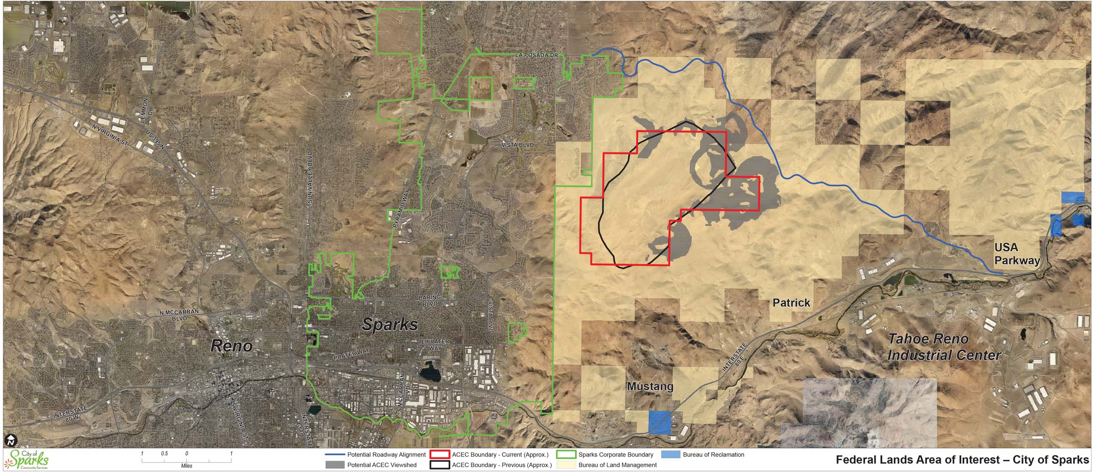
Federal Lands Areas of Interest
Notes:
Total: 873

Slide 4
Based On Current Job Growth Trends
The Region Will Absorb Desirable Land by:
• Residential: 2027
• Industrial: 2041
• Office/Retail: 2022
RCG Economics December 2021

Slide 5
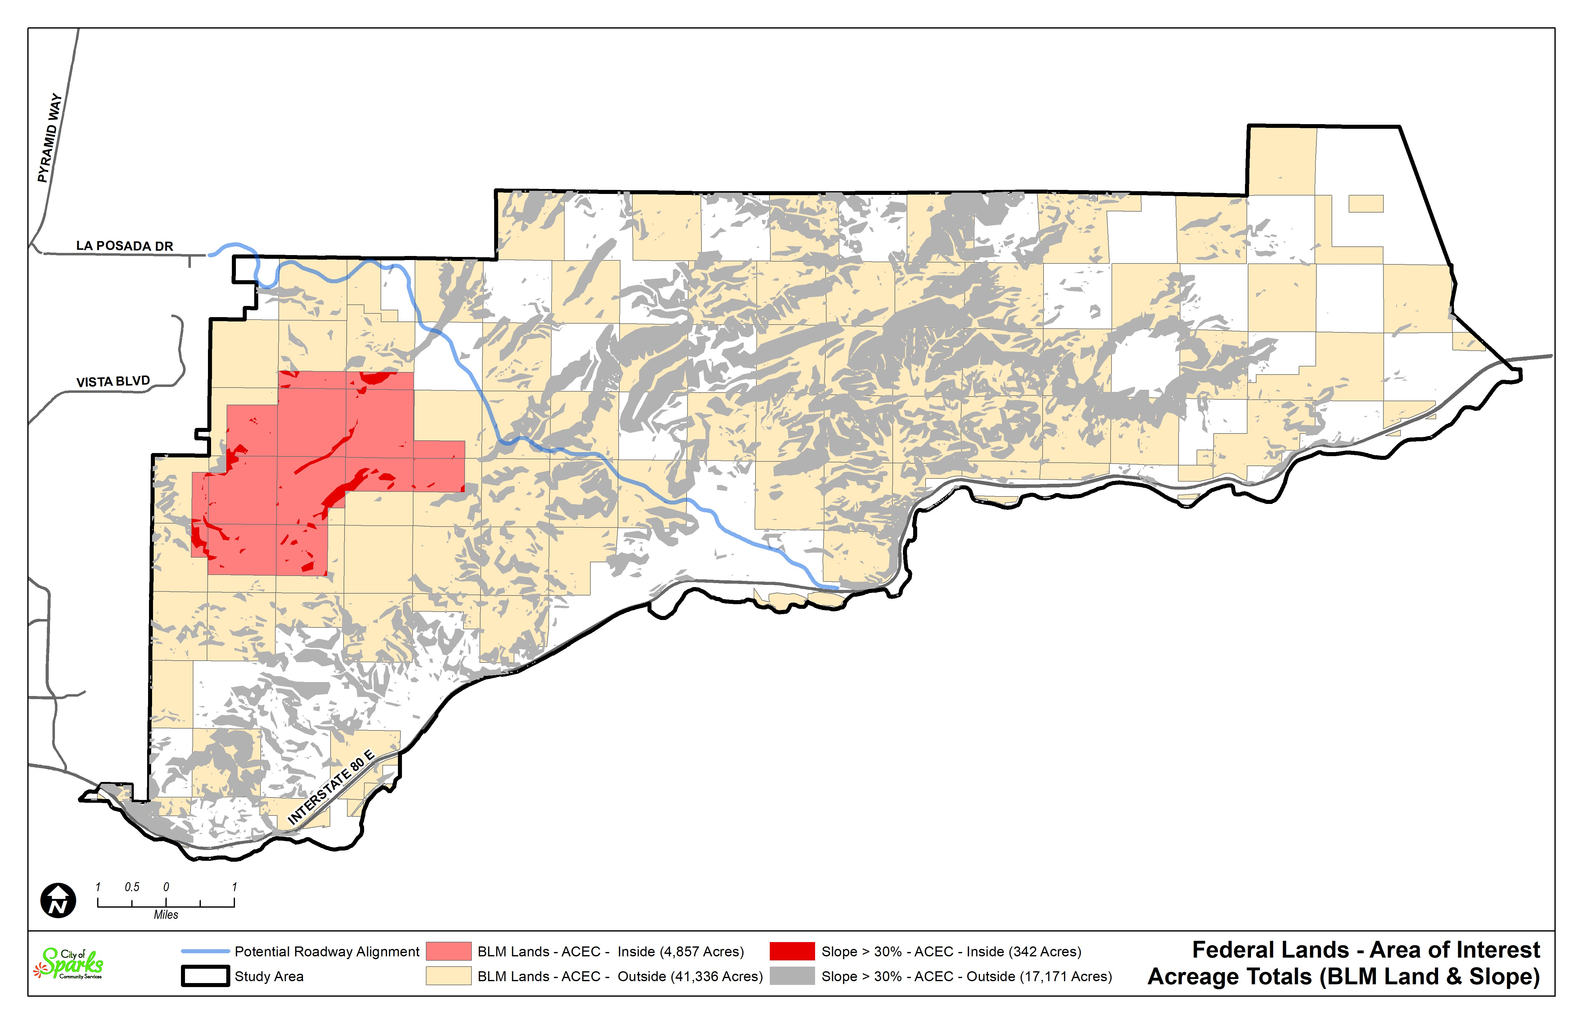

Slide 6
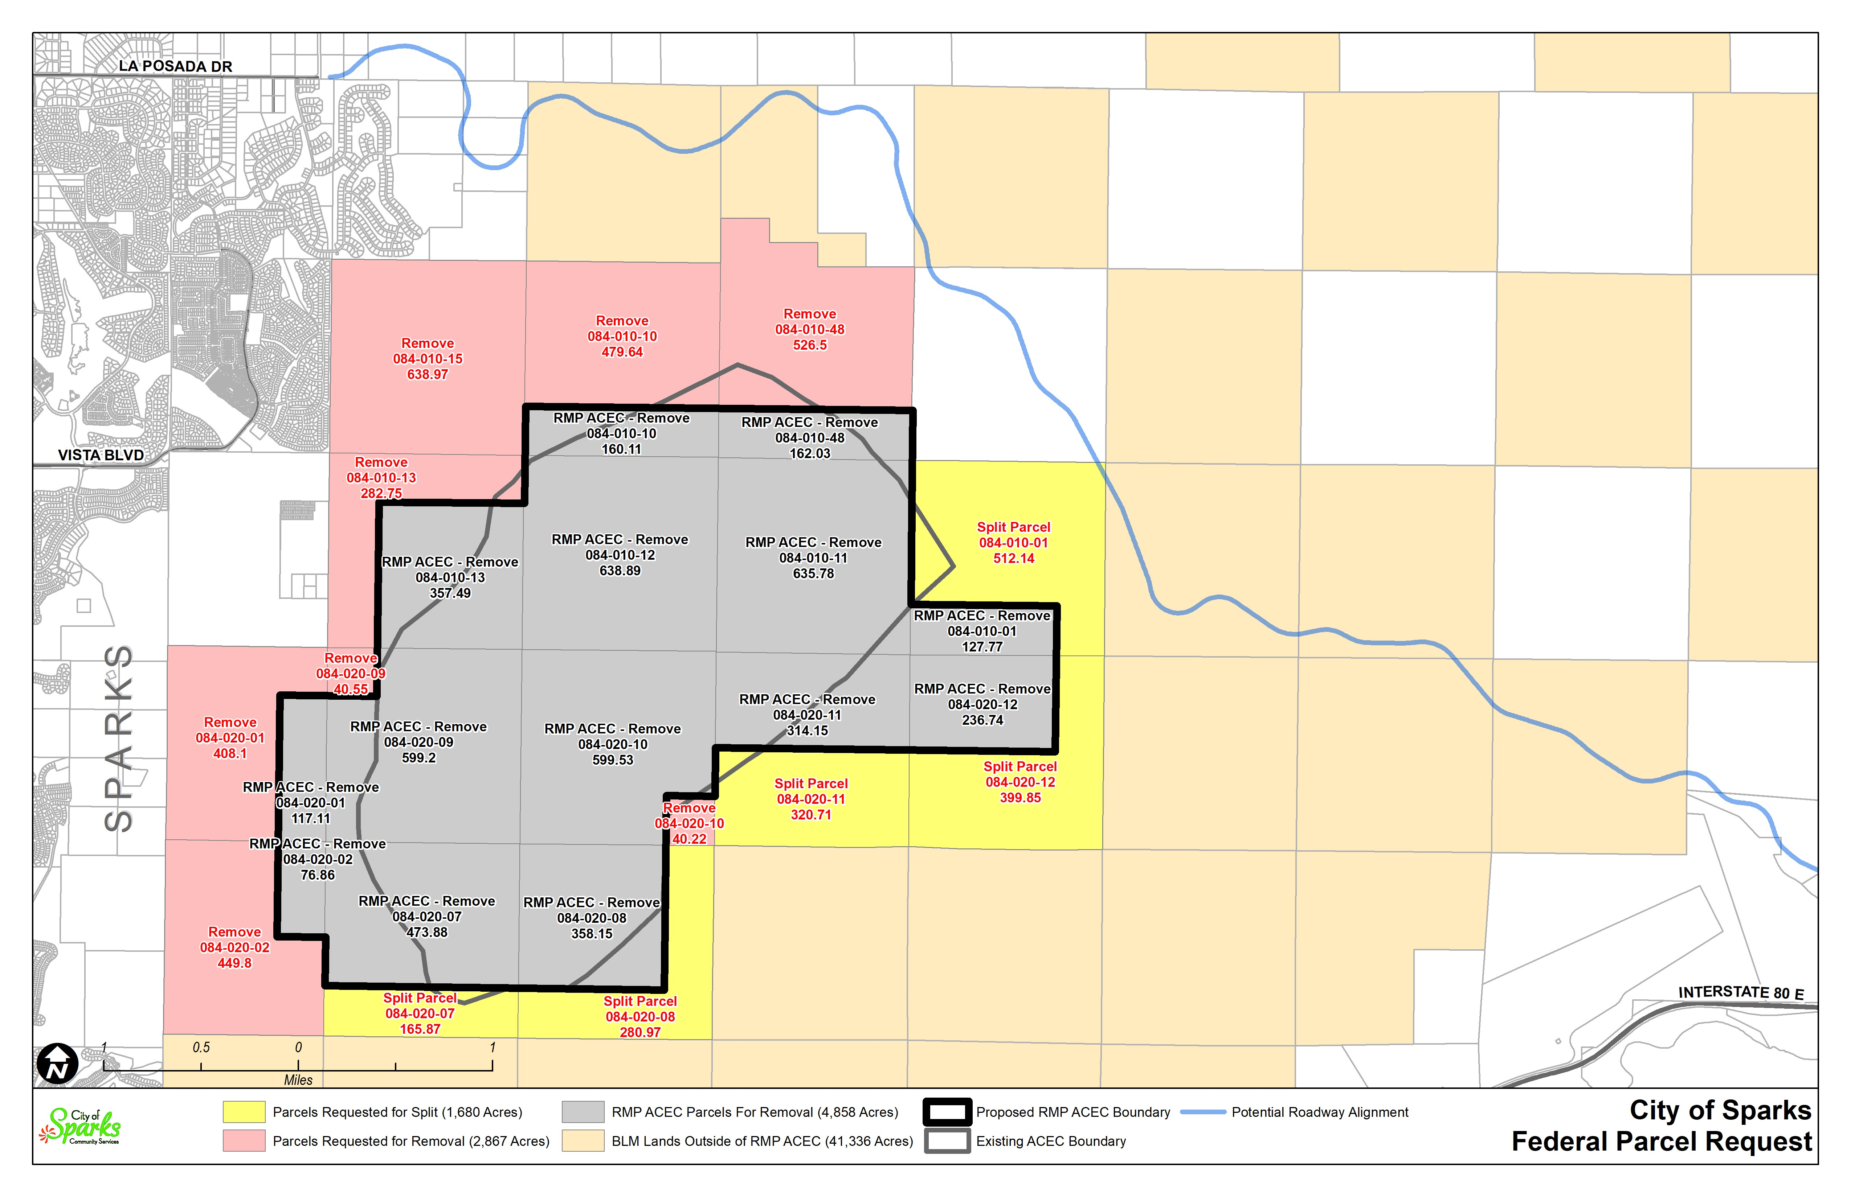

Slide 7
Regional Benefits
Address Workforce Housing
Encourage Infill Development
Potential for Land Sale Revenue to be used for:
  Truckee River Preservation
  Permanent Protections for Environmentally Sensitive Spaces
Improve Local Infrastructure to Address Growth

Slide 8
City Centers
Downtown Sparks
Oddie Blvd.
Industrial area along the Truckee River
Potentially East of Sparks
Notes:
Total: 873

Slide 9
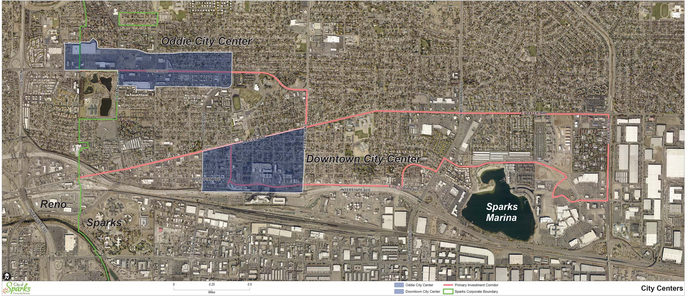
City Centers
Notes:
Total: 873

Slide 10
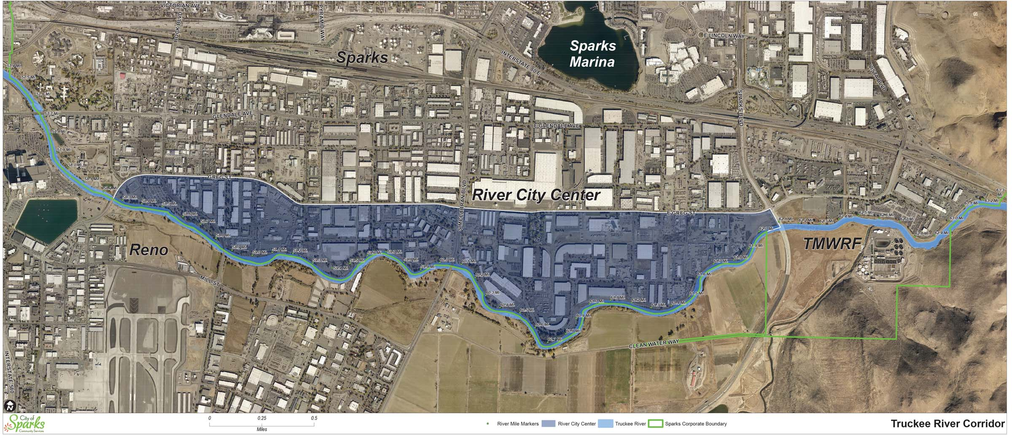
Truckee River Corridor
Notes:
Total: 873

Slide 11
Questions?

