Slide 1
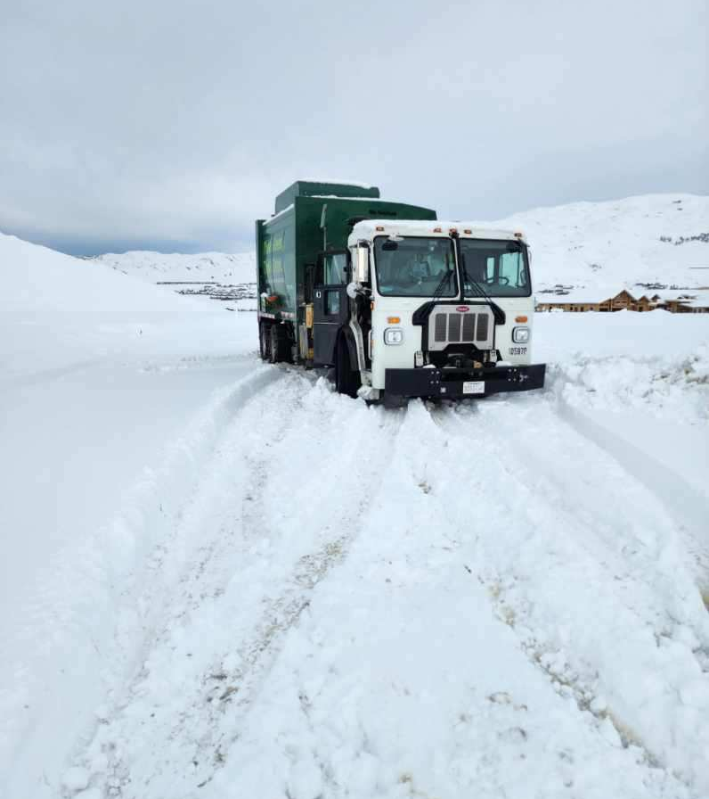
2023 Service Disruption
Extreme Weather Concerns

Slide 2
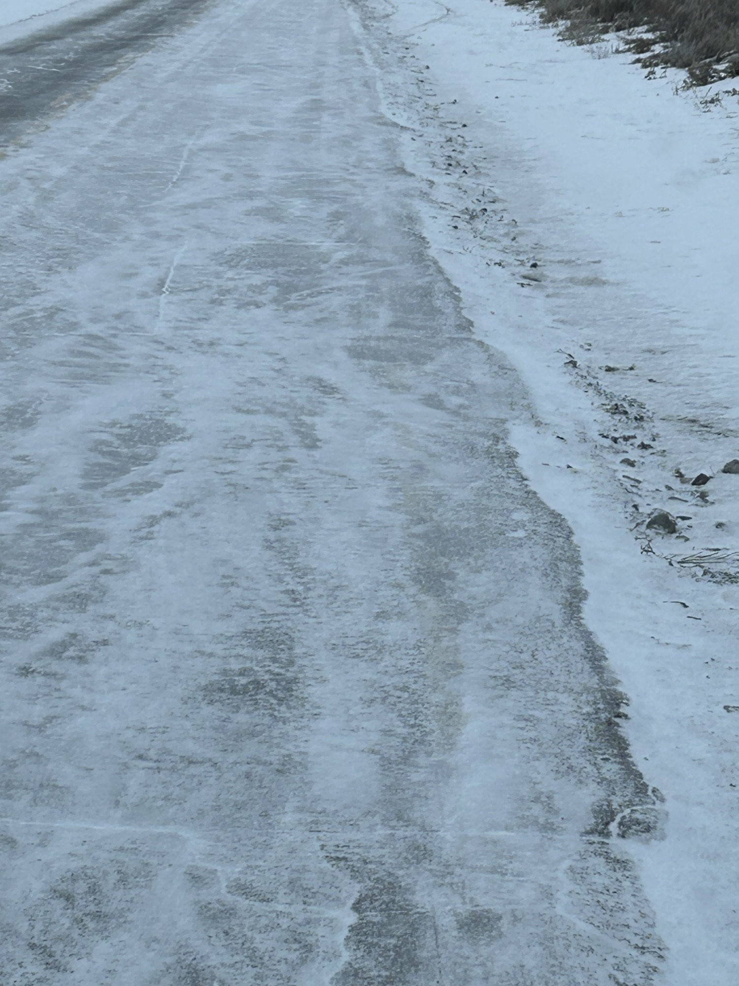
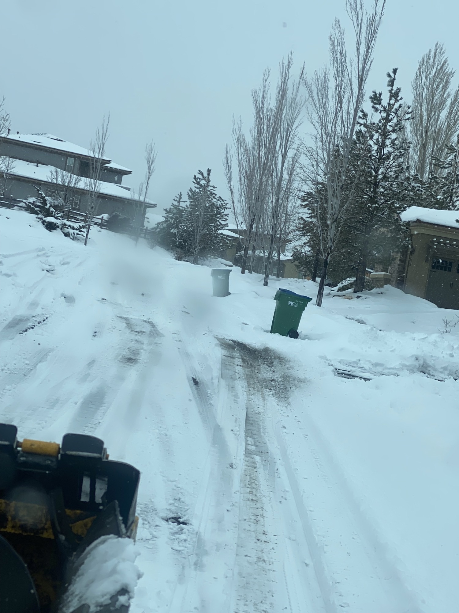
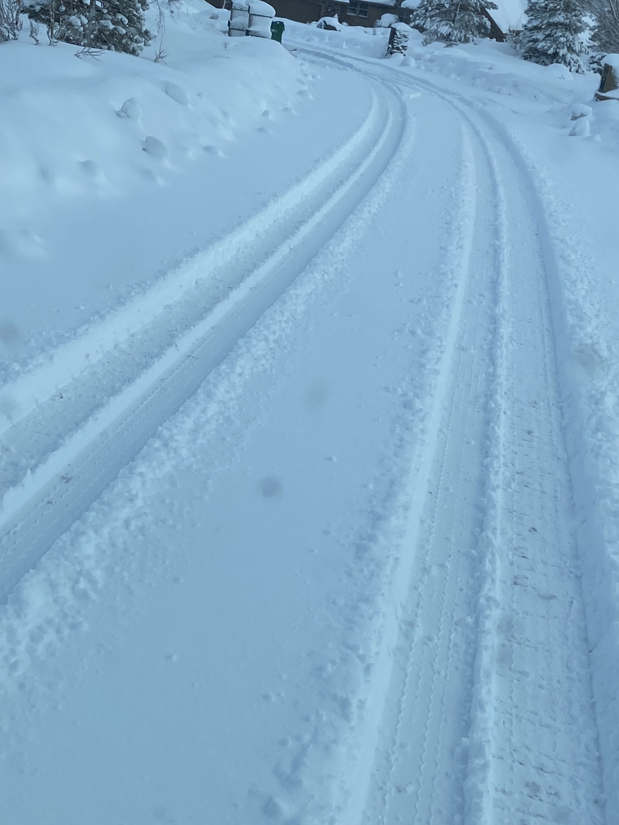
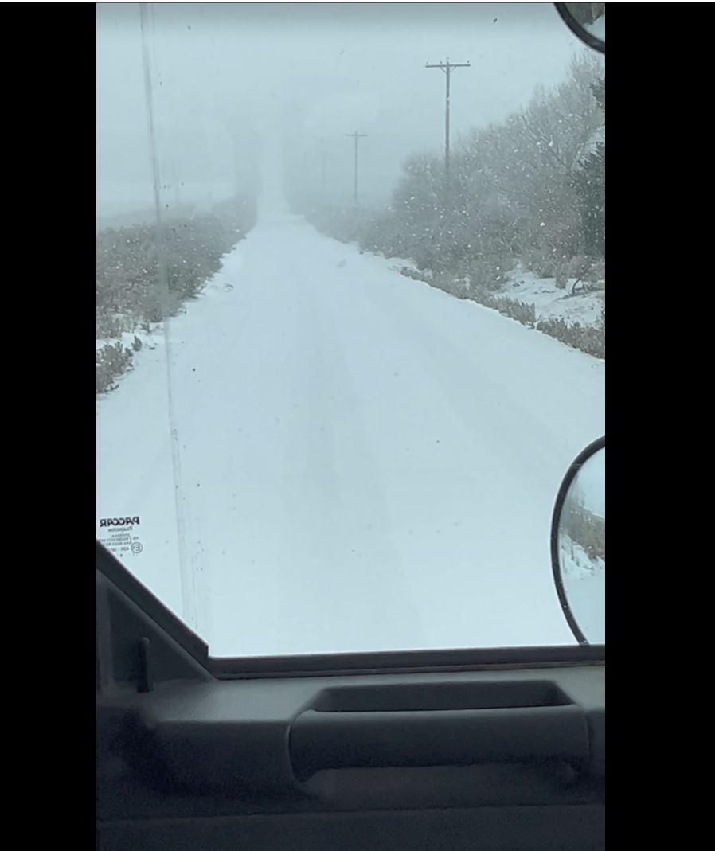
The Road to a Neighborhood May be the Problem
Afternoon melt may become ice buildup overnight
Tires/chains grabbing for traction can tear up roads – paved & unpaved
Drivers claim the middle of roads leaving less room to pass
Going up a hill, also means coming back down a hill.

Slide 3
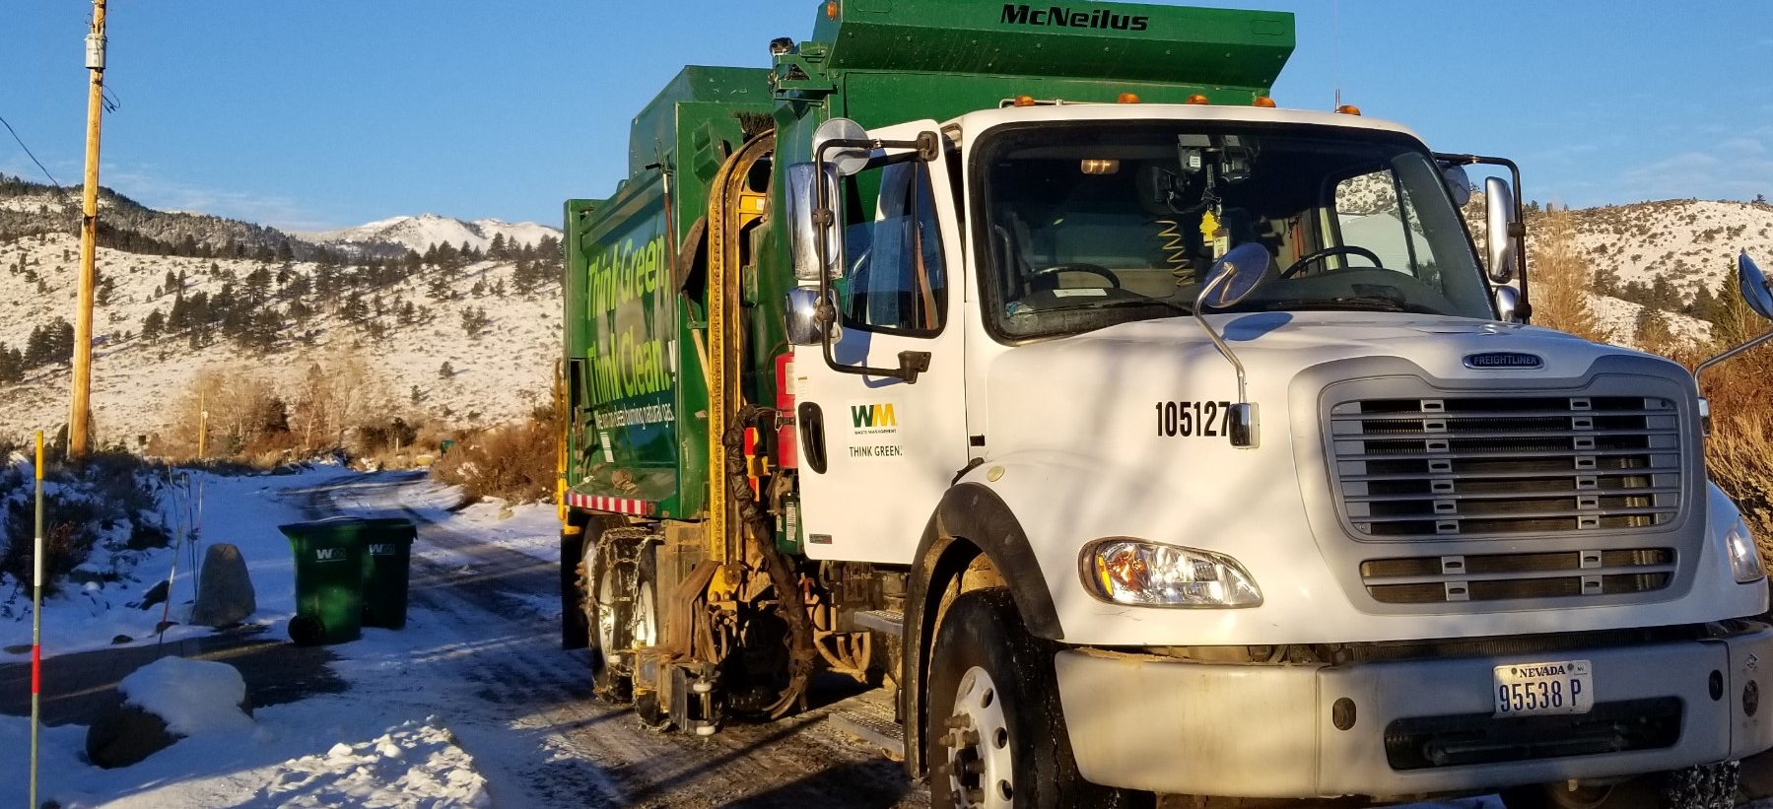
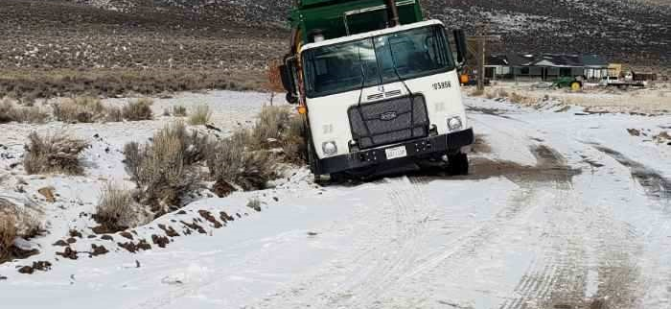
Why a Collection Truck is Different than Other Vehicles
Collection trucks weigh up to 60,000 lbs.
Collection trucks are rear wheel drive - 2 axles, 8 tires. Two steer ties in front.
Chains help back wheels grip for traction but can also rip holes in the road causing the truck to be further stuck. This risk occurs with every stop.
As the weight of trash increases, the back wheels are pushed into snow/mud. Less weight is carried by the steer tires causing the steer tires to slide when turning.
Collection truck steer tires are wider than delivery trucks.
When the steer tires slide, more room to turn is required to avoid snow berms and softened shoulders where the truck can get stuck.
Heavy duty tow trucks are required to free a trash truck and may take hours to respond.
Towing a collection truck causes damage to the truck.
If a collection truck gets stuck in a turn, or a slide the road will be blocked to other traffic until it can be removed.

Slide 4
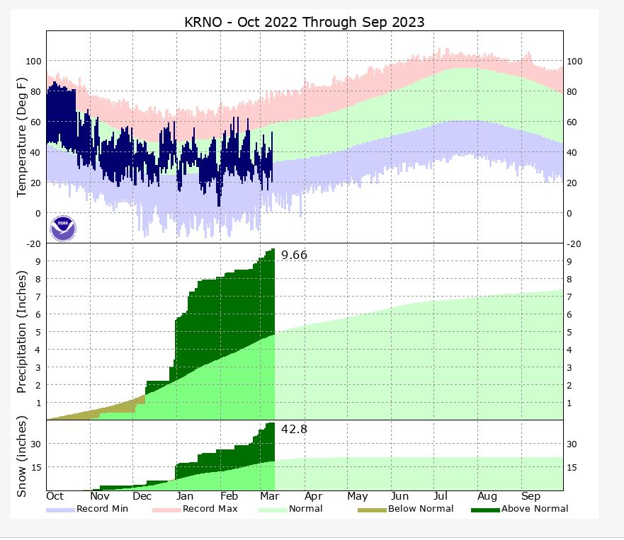
Rain & Snow Data for Reno from National Oceanic and Atmospheric Administration
Rain totals currently 9.66 inches above average
Snow totals currently 42.8 inches above average
Melting snow leaves behind soft and degraded roads

Slide 5
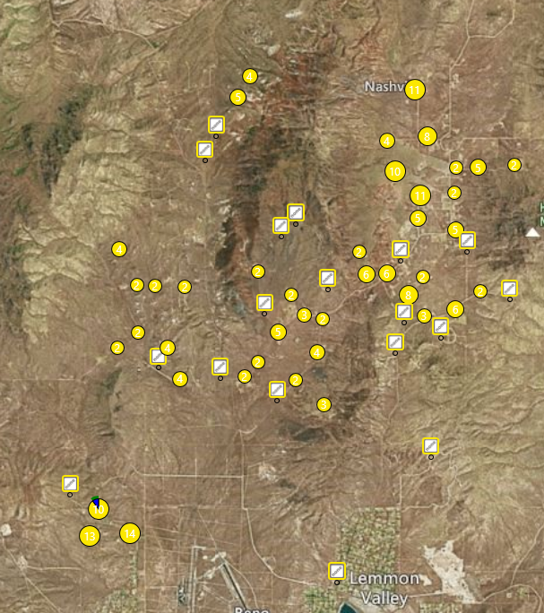
Rural Sparsely Populated Areas Have Fewer Maintained Roads
212 North Valleys

Slide 6
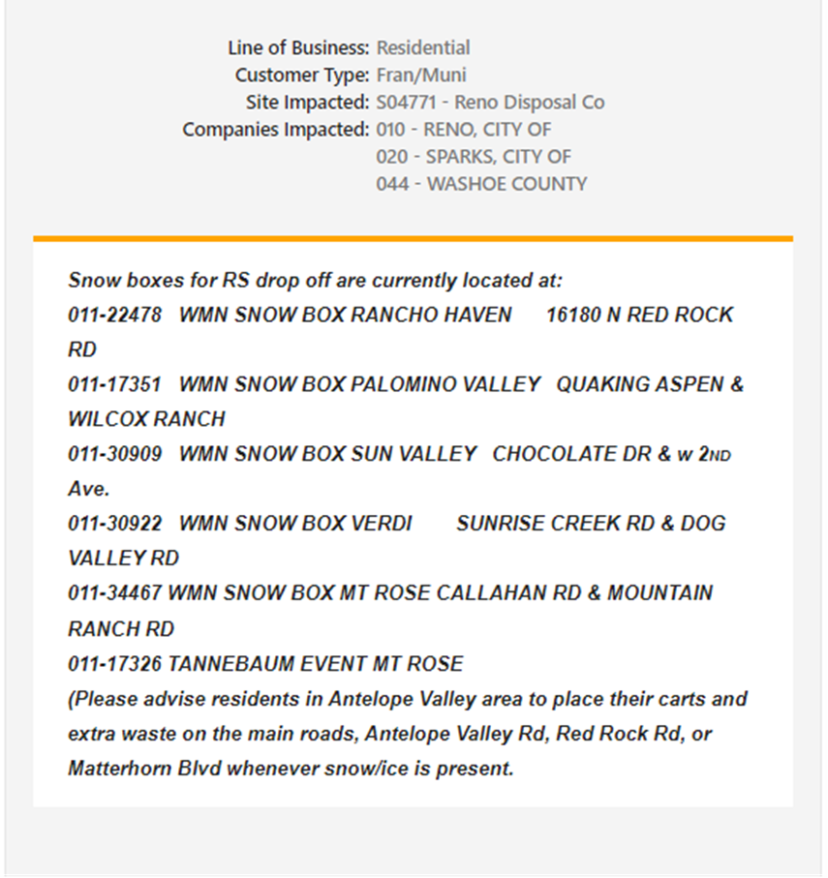
Current Solution for Rural Customers
When missed collection occurs customers are notified via method preferred on their account.
Collection of extras on next service day.
“Snow Box” dumpsters placed at accessible intersections of main roads.
Place carts at the nearest main/accessible road.
Free disposal at the transfer station.

Slide 7
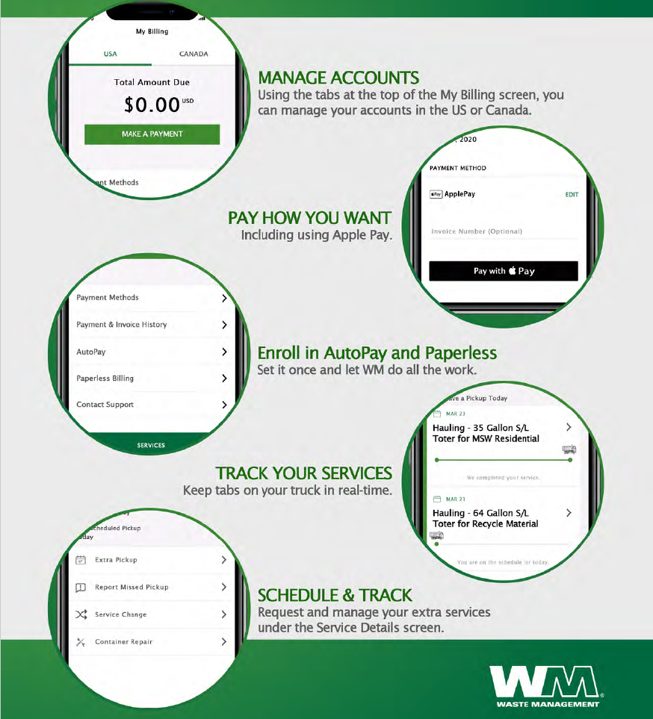
Getting Information
Call: 775-329-8822
Online: WashoeCounty.wm.com
MyWM APP
  Get Service Updates
  Manage Service Levels
  Track the truck
  Schedule Cart Swap & Other Services

Slide 8
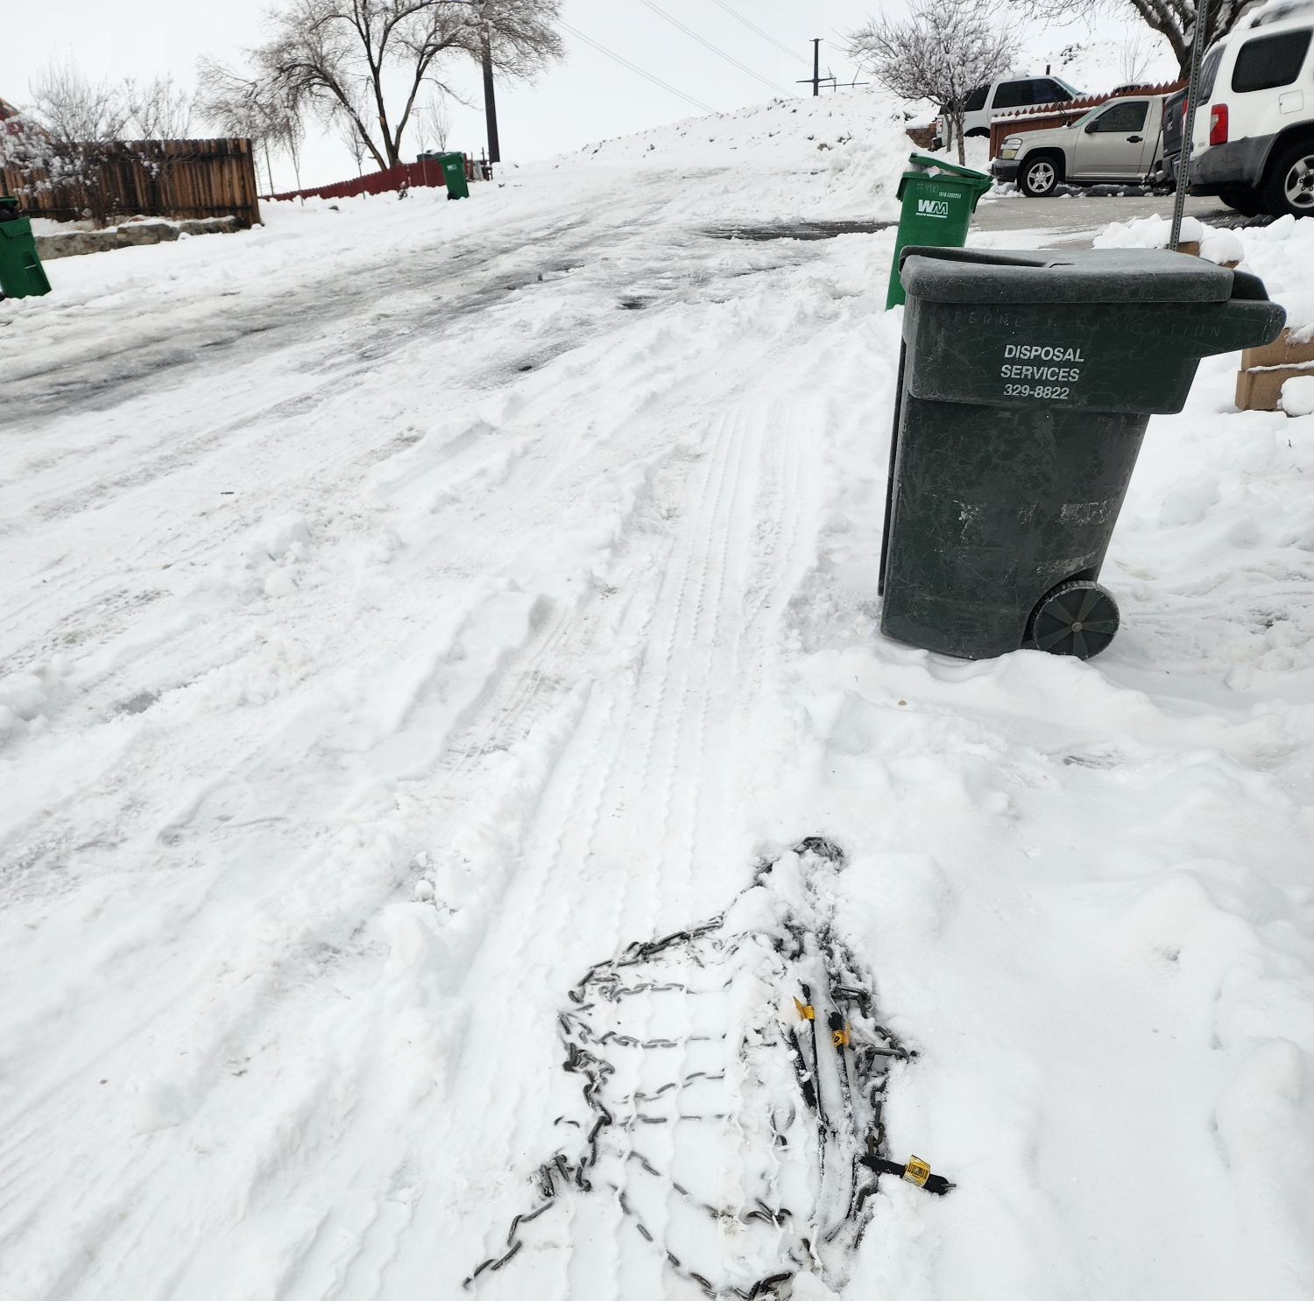
Can we find better solutions?
We want to hear your thoughts and ideas.

Slide 9
Thank you.

