Slide 2
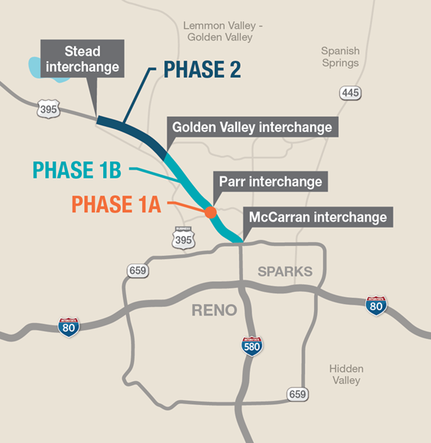
US 395 North Valleys
Project Update
Phase 1b: Widen U.S. 395 to three lanes between North McCarran Blvd. and Golden Valley Rd. *Construction in 2023.
Phase 1a: Parr/Dandini Blvd. Bridge Replacement. Complete
Phase 2: Future Widening of U.S. 395 Between Golden Valley Rd. and Stead Blvd. This phase will consist of an additional southbound and northbound lane. *Anticipated construction in 2026.

Slide 3
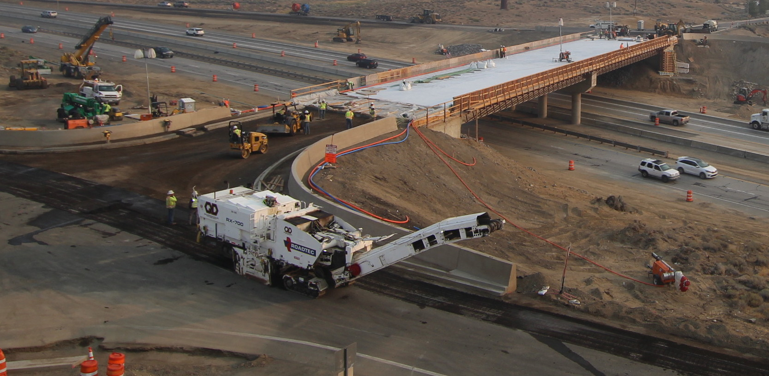
The replacement of Parr Bridge over US395 in north Reno was a vital project for the Nevada Department of Transportation and was successfully completed in Spring 2021.

Slide 4
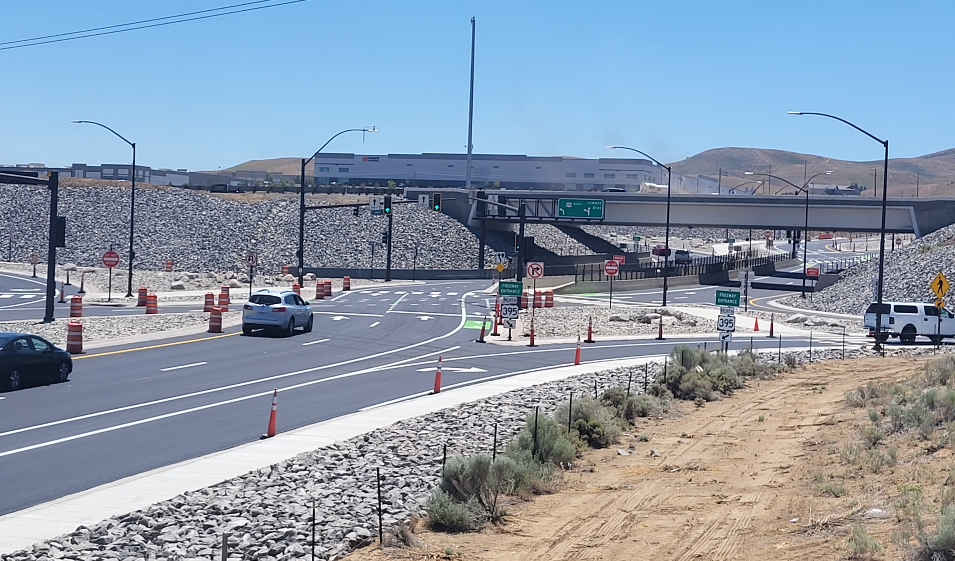
The reconfiguration of the Lemmon Dr. interchange into a diverging diamond interchange (DDI)
was complete in July 2022 with the RTC’s Lemmon Drive Project.

Slide 5
Project Improvements
Widen U.S. 395 to three general-purpose lanes
Add an auxiliary lane between the interchanges in both the northbound and southbound directions
Add a braided (cross over) ramp to the Golden Valley Road northbound exit
Add new sound walls
Rehabilitate the existing roadway

Slide 6
Traffic Control
Two lanes open in each direction during “Peak“ traffic hours
Reduced speed limits
Lane width reductions
Detours will be in place during any road closures
Marathon weekends
Communicated in advance
Work zone will be in effect 24-hours-a-day, seven days a week

Slide 7
Soundwalls
Range in height from 8 to 18 feet
Concrete post and panel or concrete masonry block
On US 395:
at Clear Acre Lane
north of Clear Acre Lane
north of Parr/Dandini Blvd.
between Parr/Dandini Blvd. and Panther Valley Interchange
just south of Panther Valley Interchange
Panther Valley Interchange at Virginia Street

Slide 9
Schedule

Slide 10
Construction Coordination
EMS
Industrial Centers
NV Energy
Regional Training Center
Residents and businesses
RTC and City of Reno (signal timing and adjacent projects)
TMCC
Transit services
Washoe County School District
Washoe County Sheriff's Office

Slide 11
Stakeholder Outreach
Media releases
One-on-one meetings
Project postcard
Weekly or as needed stakeholder updates
Website
Community and neighborhood organizations
Virtual “Public Outreach Meeting”
Project web site: dot.nv.gov/northvalleys

Slide 12
North Valleys
Improvements
RTC
Widening Lemmon Drive to four lanes between Fleetwood Drive to Ramsey Way. Status: Design in process.
NDOT
US 395 Phase 2: Golden Valley interchange to Stead interchange:. Status: Design in process.
North Virginia Complete Streets Project. Status: Design in process.
US 395 Stead Boulevard to Cold Springs Maintenance. Status: Design in process.
* Construction anticipated in 2026

Slide 13
Contact
Robert Vrooman, PE
NDOT Project Manager
rvrooman@dot.nv.gov
775-888-7317

