Slide 1
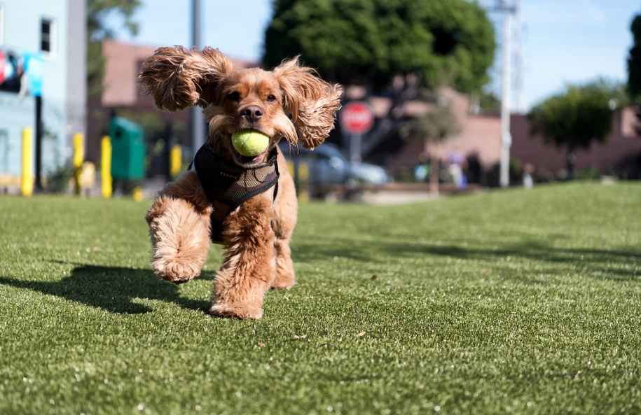
Washoe County Regional Parks &
Open Space
Off-Leash Dog Area Pilot Program

Slide 2
Why do we need off-leash areas?
Truckee Meadows area currently has:
6 dog parks (Whitaker, Virginia Lake, Link Piazzo, Sparks Marina, Biggest Little Dog Park, and Cyan Park)
2 off-leash areas (Rancho San Rafael, Wedekind Regional Park)
3,819 acres of developed parks in Reno, Sparks, and Washoe County
BLM open space has multi-use on public lands, including target shooting, where pet owners are not willing to take their dogs off-leash with the threat of wildlife and people. Also, most pet owners must drive a far distance to reach public lands and end up using any close open grass field.
Widespread apartment living with dogs has people searching for open space to let their dogs run!
The off-leash areas and dog parks we have are very busy and impacted by the growing population.

Slide 3
Washoe County Parks Pilot Program
Washoe County Regional Parks and Open Space has started a one-year pilot program
Three Washoe County Parks with soccer fields have off-leash hours during the soccer off-season, November through February
The same three parks have off-leash hours during non-team use times March through November

Slide 4
Rule signs for off-leash areas
This field is designated as a “off-leash” dog area during non-team use.
Hours:
November 1st through March 1st 8am-sunset everyday
March 1st through November 1st Monday thru Friday 8am-1pm
**THIS IS A PILOT PROGRAM. IF RULES AND HOURS ARE NOT RESPECTED THEN THIS FIELD WILL NOT BE PERMITTED FOR “OFF-LEASH”. IF RULES AND HOURS ARE FOLLOWED, MORE PARK FIELDS IN ADDITION TO THIS ONE WILL BE DESIGNATED FOR “OFF-LEASH”.
PLEASE BE RESPECTFUL!

Slide 5
Rule signs for off-leash areas con’t
Aggressive dogs are not permitted.
You are legally responsible for your dog's behavior and any injuries or damages he/she causes.
By entering the dog off-leash area, you do so at your own risk and agree to abide by all park rules.
Never leave the off-leash area without your dog(s), leave them unattended, or allow them out of sight. Your dog should be under voice control, meaning they are obedient and respond to your commands.
You are required by law (WCC Chapter 55) to clean up after your dog and carry a suitable container for dog feces. Remove and dispose of waste in bins provided.

Slide 6
Rule signs for off-leash areas con’t
Always carry a physical leash; leash dog(s) when entering/leaving park.
Female dogs in heat are not permitted in this area.
All dogs must have current vaccinations and licenses by law (WCC Chapter 55)
No more than three dogs per handler
For animal related emergencies please call Washoe County Regional Animal Services dispatch
(775) 322-DOGS
For any questions or concerns please call
Washoe County Regional Parks (775) 785-4512

Slide 7
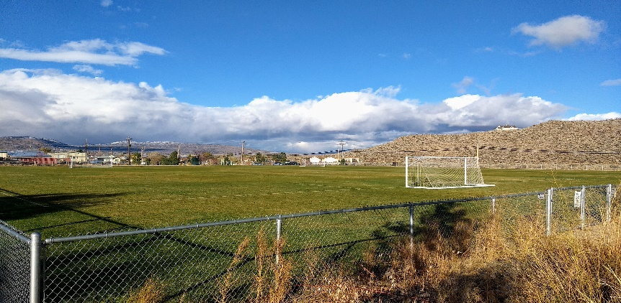
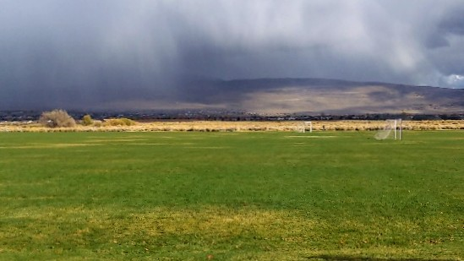
Pilot Program Parks
North Valleys Regional Park (80 x 80 soccer field)
  8085 Silver Lake Rd., Reno 89506
  Fully fenced 80 x 80 soccer field
Lazy 5 Regional Park (lower soccer field)
                7100 Pyramid Way, Sparks 89436
Unfenced soccer field far away from
main road and surrounded by sagebrush on three sides. Playground and pavilion are at a distance from fields.
South Valleys Regional Park (lower soccer field)
White’s Creek Park (fenced-in soccer field)

Slide 8
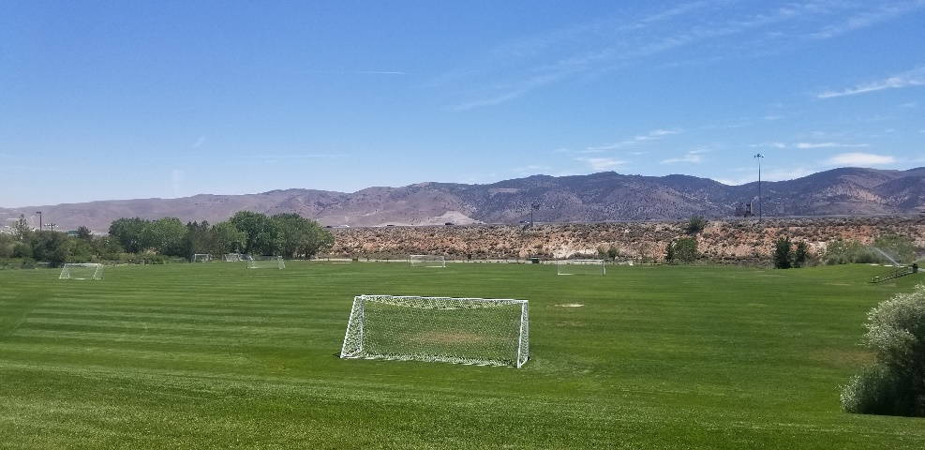
Pilot Program Parks
South Valleys Regional Park 15650 Wedge Pkwy., Reno 89511
                Lower soccer field between Library
and playground. Chain link fence on two sides, split rail and retaining wall on the other sides.

Slide 9
Review of Pilot Program since November
Total average users per day November-present: 89 people plus their dogs
Busiest off-leash field: South Valleys Regional Park
Total dog bag boxes replaced November–present: 24 boxes
Total dog waste picked up by staff November-present: 28 piles
Total Number of damage reports: Zero
Total calls to Animal Services: Zero
Comments from the public: Personal interactions have been 100% positive. Social media and email comments have been 80% positive, 20% negative.
Sport Leagues have been informed, no comments or questions have been voiced.

Slide 10
What’s Next?
Sport field reservations start March 1st. Off-leash dog use hours will change to Monday thru Friday 8am-1pm starting March 1st thru October 31st
Volunteer cleanup of off-leash fields will take place end of February
Possible “Clean Field Volunteer” program to start in March
North Valleys CAB meeting is February 15th
Next quarterly update to Parks Commission in May

