Slide 1

Digital Equity

Slide 2

Behzad Zamanian
Chief Information Officer

Slide 3
Broadband Needs
Performed a high-level Broadband feasibility needs study
  Broadband USA (Indicators of Broadband Needs)
Attended and hosted several regional broadband groups with other agencies
Met with several service providers
  Identify locations
  Learn recommended approaches
Identified high priority areas within the County
Met with regional entities to look for partnership opportunities

Slide 4
Broadband Needs
Performed a high-level Broadband feasibility needs study
  Broadband USA (Indicators of Broadband Needs)
Attended and hosted several regional broadband groups with other agencies
Met with several service providers
  Identify locations
  Learn recommended approaches
Identified high priority areas within the County
Met with regional entities to look for partnership opportunities

Slide 5
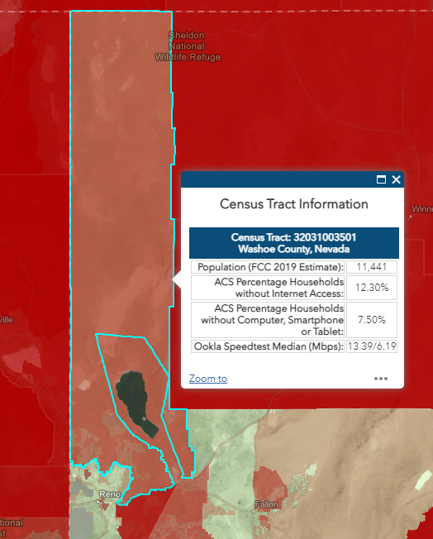
Initial Findings/Priorities
Northern Washoe County (Gerlach)
Downtown Reno
Echo Loder School / Yori Park
Pyramid Lake
Deer Park
Governor’s Bowl Park
Lake Virginia
Reno housing Authority
Wooster High School

Slide 6
Proposed Solution / Benefits
Use PLPT fiber from i-80 to Nixon PLPT fiber
Build 55 miles of aerial fiber from Nixon to Gerlach
Light up Library, School District, Community Center, and Public Safety Stations
Vendor to offer high speed Internet to the community

Slide 7
Gerlach Broadband Funding Source
Formed a regional partnership with PLPT and OSIT to fund the project:
  Phase I-A
    Use PLPT fiber from i-80 to Nixon
    Build and install fiber optic cable infrastructure from Nixon to Gerlach
    E-Rate 60%
    FCC Matching 10%
    OSIT 30%
    Washoe County covers the monthly fee for lid fiber for Library, School District, Community Center, and Public Safety Stations
  Phase I-B
    The proposed solution would fully support the community from day one. The vendor is paying for additional fiber lines that it can use to serve customers in Gerlach.
    Washoe County will apply for Broadband grants to install fiber to homes.

Slide 8
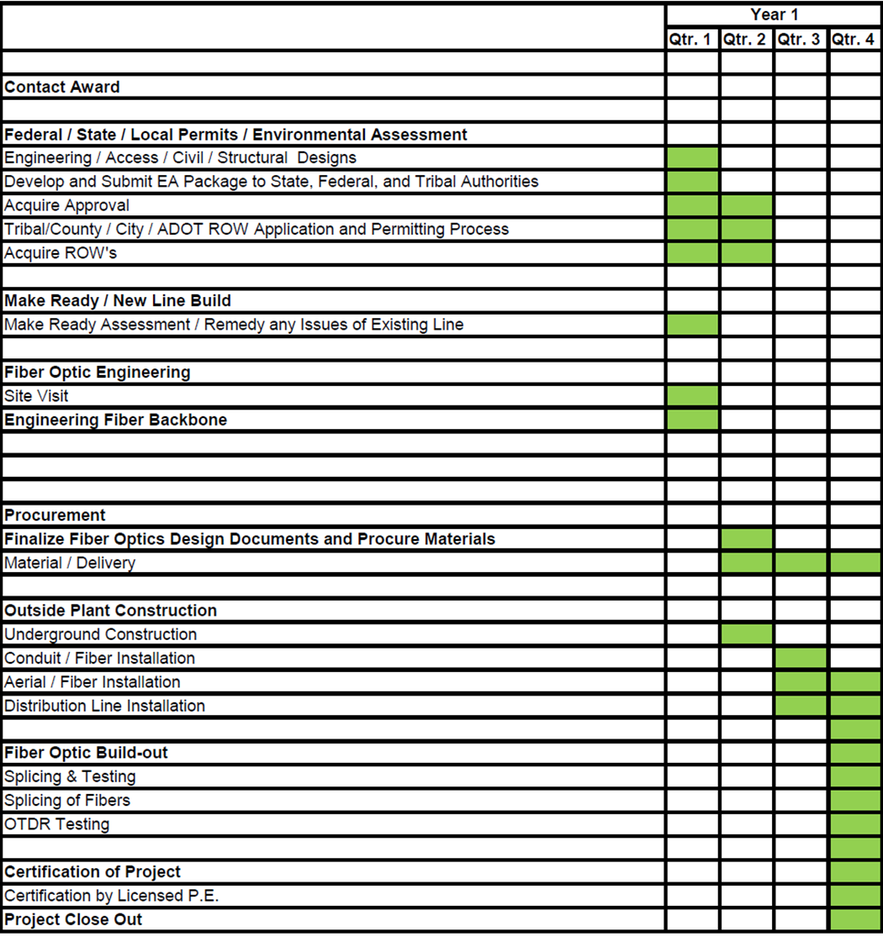
Gelach - Timeline
Developed a working committee – February
Developed and published RFP - March-April
Reviewed proposals - April-May
Awarded RFP to Digital Technology Solutions (DTS) – May
Established MOU with PLPT on 6/17
County Approval – June 28, 2022
Implementation Timeline July 22 – June 23

Slide 9
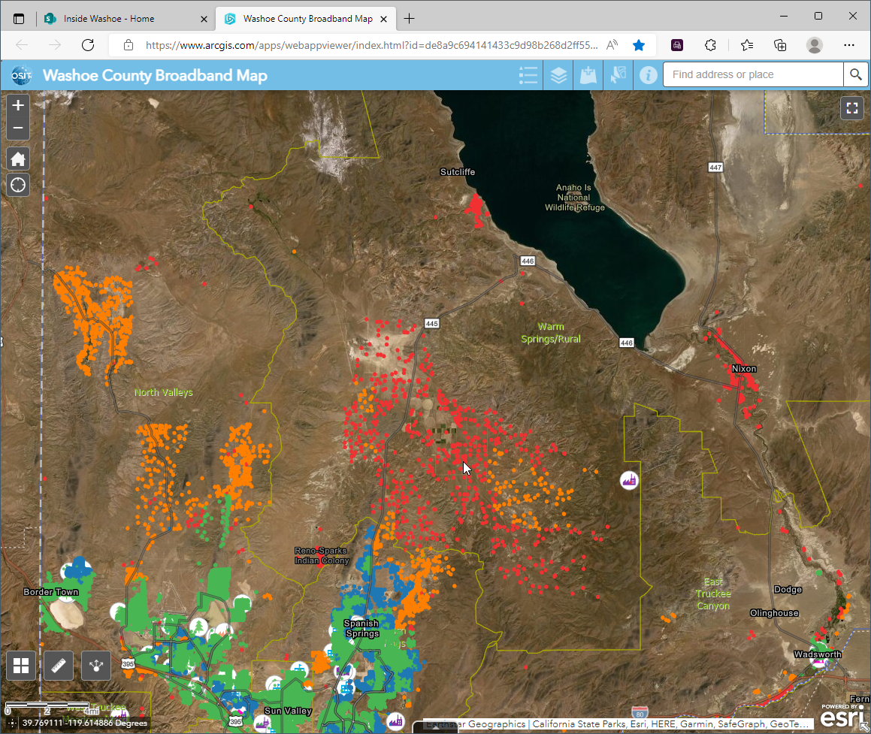
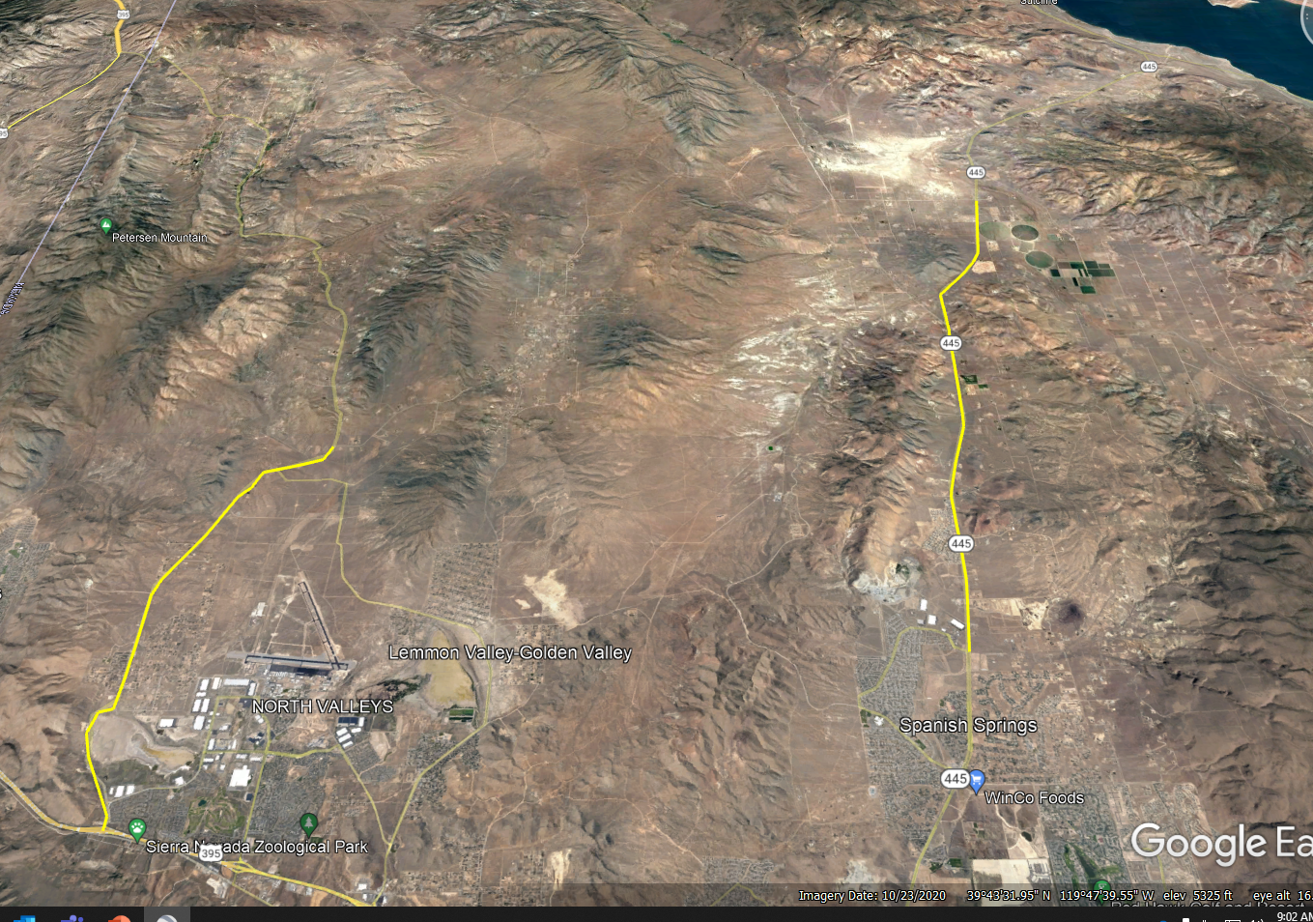
North Valley
Options
  RTI
  Plumas-Sierra
  Starlink

Slide 10
Next Step
Meetings with RTI, Plumas-Sierra, Starlink
Grant opportunities
Partnership with Tribes, NDOT, State, and other agencies
Survey communities
Digital Equity Program
  Access to affordable, high-speed internet
  Access to affordable technology requirements
  Access to relevant and high quality, effective training and support for digital skill development and use

Slide 11
Thank you
Questions?

