Slide 1
Incline Village / Crystal Bay, NV
March 27, 2025
Chase Janvrin
General Manager
chase@placemate.com

Slide 2
Agenda
Background on Lease to Locals
Regional Results — Truckee, E. Placer County, S. Lake Tahoe
Incline Village / Crystal Bay Program
Launch Overview
Policies Review
Progress Update

Slide 3
Background on Lease to Locals

Slide 4
Placemate’s Vision and Mission:
Vision: We envision a world where communities thrive because local employees can find stable housing.
Mission: Our mission is to help local employees secure housing in tourism-based economies, through innovative public and private partnerships across the country.
Notes:
Evolution

Slide 5
Lease to Locals: Program Overview
Convert existing housing stock to new longer-term rentals for the local workforce in tourist towns
Provide property owners a one time cash incentive to convert their properties into seasonal and long-term rentals
Allow local governments to quickly and efficiently address critical “missing middle” housing needs

Slide 6
Lease to Locals Overview
Property Owners (POs)
+
Local Tenants
Participants
I have a property I’d consider renting… and this program helps make that work
As a local, I need an affordable place to rent to continue living here
1
2
3
Process
Property Qualifies for the Program
Qualified Tenant(s) Secured
Property Owner
Receives Grant
Partnership
The local Jurisdiction oversees the program and provides funding
Collaboration
Placemate administers and is the face of the program for the participants

Slide 7
Tenant and Property Owner Journey
Making the connection
Property Owners
Placemate
Local Tenants
I found a listing on Placemate.com
Determines eligibility
Supports the application process
Facilitates throughout
I secured tenants
Or
Or
I found a listing on another platform
I need to secure tenants
Or
I know of a property, will we both qualify?

Slide 8
Lease to Locals Placemate’s Role
Property Owner Qualification
Oversee targeted marketing
Dedicated program webpage / phone #
Onboarding phone call and ongoing support
Ability to self-list property on Placemate
Tenant Qualification
Ability to create renter profile on Placemate to match with properties
Verify local employment/income via paystub or employer letter
Verify tenant ID
Compliance and Reporting
Submit full application packet to Town Staff
Ongoing compliance with mid-year and year-end check ins
Reporting and regular updates to Town staff and Town Council
Notes:
Operational implementation partner

Slide 9
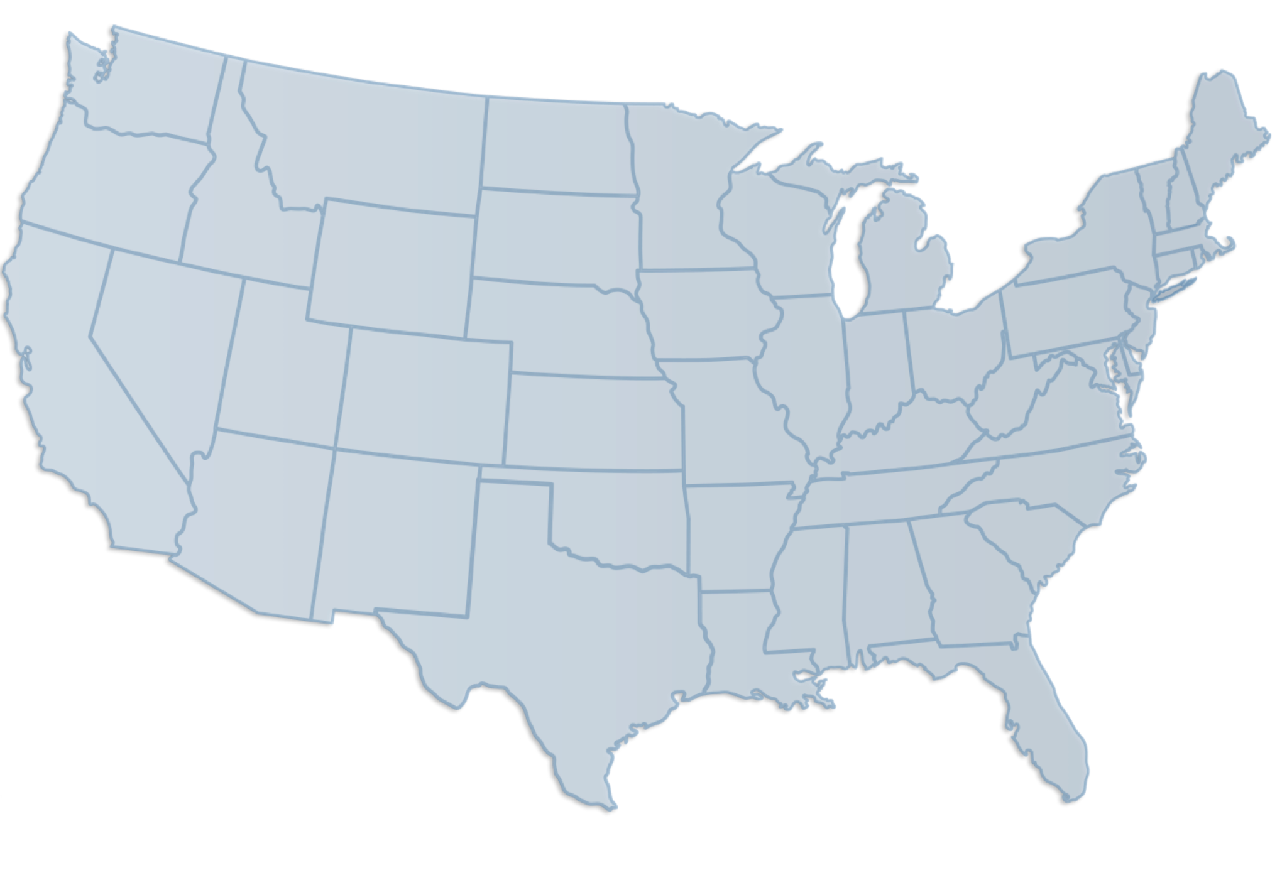
Lease to Locals: Markets
Truckee, CA
November 2020
Summit County, CO
October 2021
South Lake Tahoe, CA
January 2022
Placer County, CA
August 2022
Ketchum, ID
October 2022
Eagle County, CO
June 2023
Nantucket, MA
September 2023
Provincetown, MA
April 2024
Woodstock, VT
May 2024
Mammoth Lakes, CA
August 2024

Slide 10
Regional Results:
Truckee
E. Placer County
S. Lake Tahoe

Slide 11
RESULTS | Truckee | SLT | E. Placer | Total/Avg
Launch Date...................................................... | Nov 2020 | Jan 2022 | Aug 2022 | n/a
Properties Awarded Grants............................. | 218 | 53 | 107 | 378
No. of people housed....................................... | 532 | 129 | 254 | 915
Avg property rent.............................................. | $2,490 | $2,249 | $2,575 | $2,438
Grants Allocated............................................... | $1,653,508 | $225,000 | $1,044,250 | $2,922,758
Avg Cost per Unit (including program costs) | $9,016 | $9,792 | $11,909 | $10,239
Avg Cost per Tenant (including program costs) | $3,695 | $4,023 | $5,017 | $4,245
Average cost of construction for one new Affordable Housing unit on the N. Shore is approaching $1mm

Slide 12
IV / CB Program Review

Slide 13
Lease to Locals: Launch Overview
Pilot program was results of the Washoe Tahoe Housing Partnership recommendation
Funding provided by Washoe County
Tahoe Prosperity Center was contracted with the County to collect community feedback
With guidance from Placemate we arrived at the guidelines
Program launch pushed to February to avoid launching during holiday slowdown
8 month onboarding period, 12 month compliance

Slide 14
Program Policies
Property must be located in the Incline Village Crystal Bay Planning Boundary
Leases can be long-term (12+ mo) or seasonal (5-11 mo) and subject to a maximum rent cap of $4,000/mo
At least one adult in the household must be locally employed at least 30 hours per week
Property can not have been a full time rental in the past 12 months
Incentive amounts are $4,500 for long-term leases or $2,000 for seasonal leases (max of 4 Qualified Tenants)
Gross Income can not average greater than 200% of the area median income ($141,750).

Slide 15
Pipeline Funnel and Results
31
Total property owner leads
(Actively trying to reach 9)
8
Not Qualified / Not Interested
(Only 1 Not Interested)
16
Interested/Future Interest
7
Listed
Notes:
Profiles on Placemate.com

Slide 16
Questions
Chase Janvrin
General Manager
chase@placemate.com

