Slide 1
Water Quality of the Incline Village and Crystal Bay Watershed
for the
Incline Village/Crystal Bay Citizen Advisory Board

Slide 2
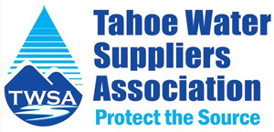
Key Takeaways

Slide 3
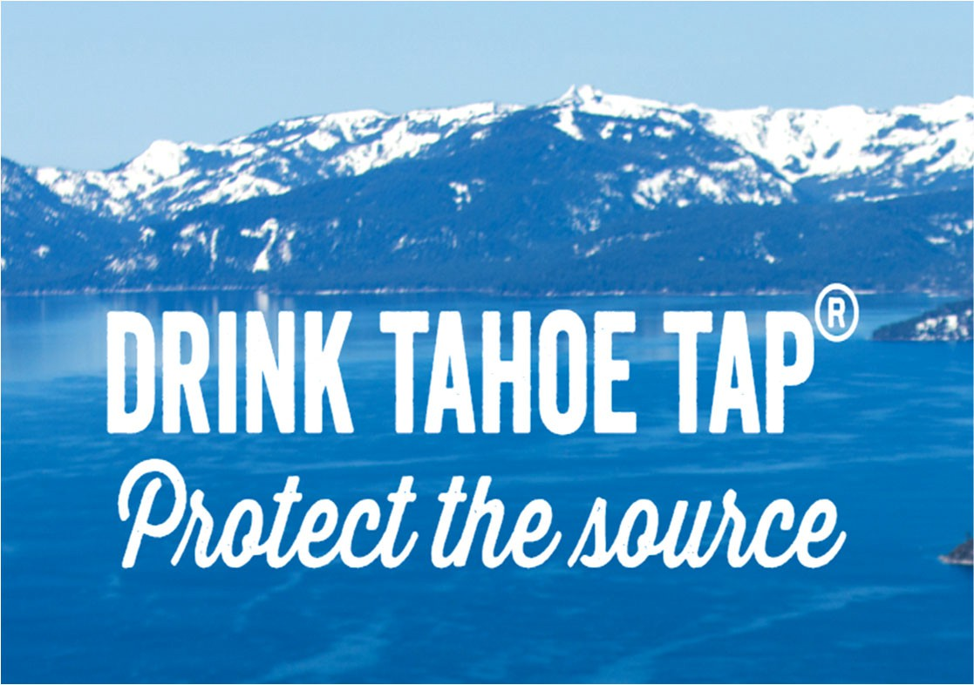
COMMONLY ASKED QUESTIONS
Where does my drinking water come from?
The source of your drinking water is Lake Tahoe. Pumped
directly out of the lake, your drinking water is first disin- fected, then distributed through 90 miles of pipelines, stored in one of 13 water storage tanks and finally deliv- ered to your property. Due to the high quality of our drink- ing water source, IVGID is not required to perform filtra- ton. Our treatment system meets stringent natonal water quality standards through rigorous watershed manage- ment practces, extensive water quality monitoring and state-of-the-art ozone and ultraviolet disinfecton with a chlorine residual.
Should I be concerned about lead?
Your water meets State and Federal requirements for lead. If pre-
sent at elevated levels, this contaminant can cause serious health problems, especially for pregnant women and young children. Lead in drinking water is primarily from materials and components associated with service lines and home plumbing. IVGID’S water system is responsible for providing high quality drinking water, but cannot control the variety of materials used in plumbing compo- nents. When your water has been sitng for several hours, you can minimize the potental for lead exposure by flushing your tap for 30 seconds to 2 minutes before using water for drinking or cooking. If you are concerned about lead in your drinking water, you may wish to have your water tested. Informaton on lead in drinking water, testng methods, and steps you can take to mini- mize exposure is available from the Safe Drinking Water Hotline at 800-426-4791 or htp://www.epa.gov/safewater/lead.
Should I filter the water?
IVGID tap water is safe and pleasant to drink from the tap. If you
have concerns about the tap water, a simple carbon block filter (pitcher or tap mount) will remove final traces of metals (from your plumbing), chlorine (a disinfectant required in municipal wa- ter distributon) and resolve any taste or odor issues.
What agencies set testing standards for drinking water?
In order to ensure that tap water is safe to drink, the EPA pre-
scribes many regulatons and testng requirements that limit the amount of certain contaminants in water provided by public water
systems. The Food and Drug Administraton (FDA) regulatons es- tablish limits for contaminants in botled water. In general, the
EPA standards for tap water are much more stringent than the FDA standards for botled water.
How can I get involved?
The United States Environmental Protecton Agency (EPA) issued
revisions to the naton’s Lead and Copper Rule, which included mandatng an inventory of all water service lines in the U.S. Our community water system (IVGID) needs to determine the material of each service line within our District. IVGID would be grateful for your partcipaton in determining the material of the private por- ton of the service line. To complete our online survey and for more informaton go to htps://www.yourtahoeplace.com/news/2023- public-works-lead-copper-rule-survey
WATER QUALITY CONSUMER CONFIDENCE REPORT 2024 FOR CALENDAR YEAR 2023
1220 SWEETWATER ROAD, INCLINE VILLAGE NV 89451 . OFFICE HOURS M-F 8AM TO 4:30PM
P: (775)832-1203 . F: (775)832-1260 . PW@IVGID.ORG . WWW.IVGIDPUBLICWORKS.ORG
This brochure is a snapshot of the quality of the water that we provided last year. Included are the details about where your water comes from, what it contains, and how it compares to Environmental Protecton Agency (EPA) and Nevada Department of Environmental Protecton (NDEP) state standards. We are commited to providing you with informaton because informed customers are our best allies. It is important that customers be aware of the eﬀorts that are contnually being made to improve their water systems.
More informaton about contaminants and potental health eﬀects can be obtained by calling the EPA’s Safe Drinking Water Hotline (800-426-4791) or by visitng the EPA website at www.epa.gov/safewater.
The sources of drinking water (both tap water and botled water) include rivers, lakes, streams, ponds, reservoirs, springs, and wells. As water travels over the surface of the land or through the ground, it dissolves naturally occurring minerals and, in some cases, radioactve material, and can pick up substances resultng from the presence of animals or from human actvity.
How healthy is our drinking water?
Our drinking water is healthy and pleasant to drink. The
water tests well below the maximum contaminant level for both health and aesthetc contaminants. IVGID has been past recipients of the “Best Tastng Water in Nevada Award” from the Nevada Rural Water Associaton. IVGID is a member of the Tahoe Water Suppliers Associaton (TWSA). This group provides a unified voice for source wa- ter protecton in the Tahoe Basin.
SOURCE NAME | SOURCE WATER TYPE
Lake Tahoe Intake at Burnt Cedar Water Disinfecton Plant | Surface Water
CONTAMINANTS THAT MAY BE PRESENT IN SOURCE WATER BEFORE TREATMENT INCLUDE:
Microbial contaminants, such as viruses and bacteria, which may come from sewage treatment plants, septc systems, agri- cultural livestock operatons and wildlife.
Inorganic contaminants, such as salts and metals, which can be
naturally-occurring or result from urban stormwater runoﬀ, in- dustrial or domestc wastewater discharges, oil and gas produc- ton, mining or farming.
Pestcides and herbicides, may come from a variety of sources such as stormwater run-oﬀ, agriculture, landscaping and resi- dental users.
Radioactve contaminants, which can be naturally occurring or the result of mining actvity.
Organic contaminants, including synthetc and volatle organic chemicals, which are by-products of industrial processes and petroleum producton, may also come from gas statons, urban stormwater run-oﬀ, and septc systems.
In 2020, the local water providers were awarded the American Water Works Associaton “Exemplary Source Water Protecton Program Award.” As purveyors of some of the finest drinking water in the United States, we en- courage you to fill up a glass and DRINK TAHOE TAP®.
For more informaton please contact: Public Works (775) 832‐1203
We add disinfectant to protect you against microbial con- taminants. The Safe Drinking Water Act (SDWA) requires states to develop a Source Water Assessment (SWA) for each public water supply that treats and distributes raw source water in order to identfy potental contaminaton sources. The state has completed an assessment of our source water, for informaton visit NDEP at htps:// ndep.nv.gov/water/source-water-protecton/source- water-assessment .
To learn more about how you can protect the source of your drinking water, visit the TWSA website: www.TahoeH2O.org, the IVGID Public Works website: www.ivgidpublicworks.org, or call (775) 832-1284.
Does IVGID add fluoride to the drinking water?
No, fluoride is not added to IVGID’s drinking water.
MESSAGE FROM THE EPA
Some people may be more vulnerable to contaminants in drinking water than the general populaton. Immuno- compromised persons, such as those with cancer under- going chemotherapy, persons who have undergone organ transplants, people with HIV/AIDS or other immune sys- tem disorders, some elderly, and infants can be partcular- ly at risk from infectons. These people should seek advice about drinking water from their health care providers. EPA/CDC guidelines on the appropriate means to lessen the risk of infecton by Cryptosporidium and other micro- bial contaminants are available from the Safe Drinking Water Hotline (800-426-4791) or visit www.epa.gov/ safewater. Drinking water, including botled water, may reasonably be expected to contain at least small amounts of some contaminants. The presence of contaminants does not necessarily indicate that the water poses a health risk.
In order to ensure that tap water is safe to drink, the EPA prescribes regulatons which limit the amount of certain con- taminants in water provided by public water systems. We treat our water according to the EPA’s regulatons. Food and Drug Administraton (FDA) regulatons establish limits for contaminants in botled water, which must provide protec- ton for public health. Our water system tested a minimum of 15 samples per month in accordance with the Total Coli- form Rule for microbiological contaminants. Coliform bacte- ria are usually harmless, but their presence in water can be an indicaton of disease-causing bacteria. When coliform bacteria are found, special follow-up tests are done to deter- mine if harmful bacteria are present in the water supply. If this limit is exceeded, the water supplier must notfy the public by door postng, newspaper, television or radio.
ABOUT IVGID
The Incline Village General Improvement District, commonly referred to as IVGID, is a quasi-public agency established under Nevada Revised Statute, Chapter 318 and chartered to provide water, sewer, trash and recreaton services for the unincorporated communites of Incline Village and Crystal Bay, Nevada. It is governed by an elected Board of Trustees which, actng on behalf of the electorate, sets policy and determines strategies to accom- plish its charter. Both Incline Village and Crystal Bay, Nevada are located within Washoe County, the entty that had the authority to create IVGID.
¡ATENCIÓN!
Este folleto contene información sobre la calidad de su agua potable y está disponible en español.
Por favor llame a (775)832-1203 para obtener una versión traducida.

Slide 4
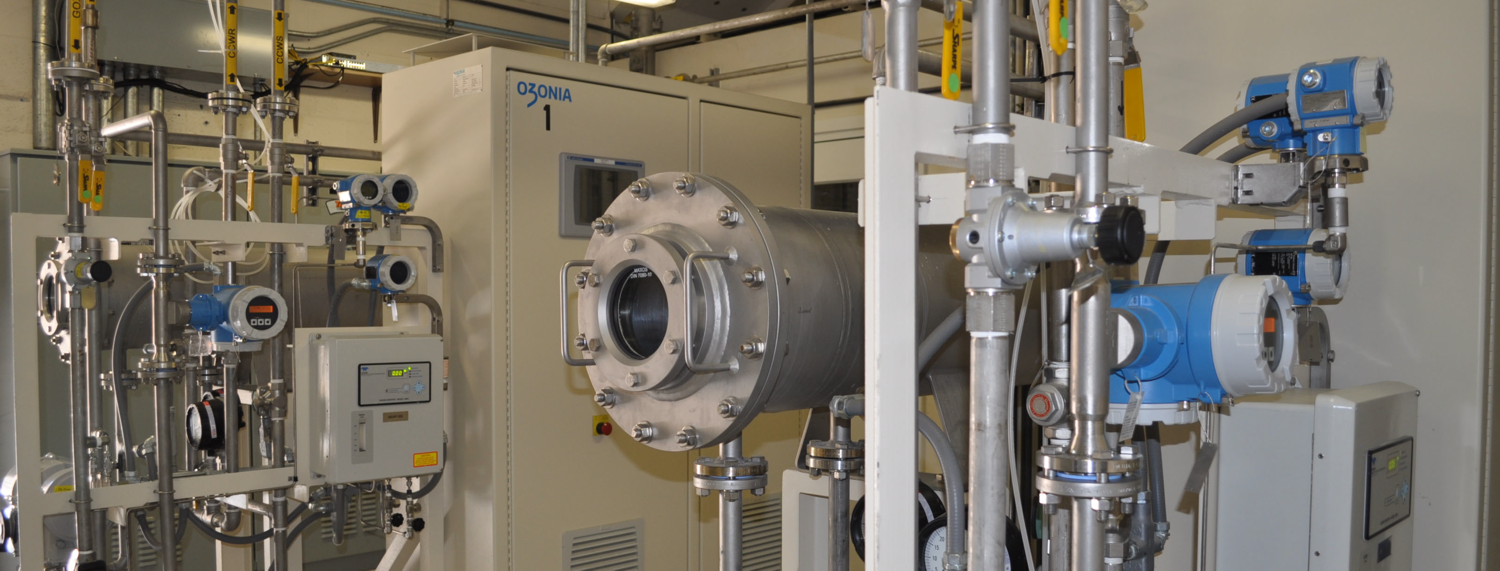
TEST RESULTS: 2023 WATER QUALITY DATA
WATER QUALITY DATA ‐ INCLINE VILLAGE GID
Public Water System (PWS) #NV0000158
Microbiological | Result | MCL | MCLG | Typical Source
No Detected Results were Found in the Calendar Year of 2023
The water provided to you is safe and high quality. Our tap water exceeds all natonal standards.
The following tables list all of the drinking water contaminants which were detected during the 2023 calendar year. The presence of these contaminants does not necessarily indicate the water poses a health risk. Unless noted, the data presented in this table is from the testng done January 1 - December 31, 2023. The state requires us to monitor for certain contaminants less than once per year be- cause the concentratons of these contaminants are not expected to vary significantly from year to year. Some of the data, though rep- resentatve of the water quality, is more than one year old.
Violatons: IVGID is required to include an explanaton of any violatons. There were no violatons in 2023. We are required to monitor your drinking water for specific contaminants on a regular basis. Results of regular monitoring are an indicator of whether or not our drinking water meets health standards. There are no additonal required health eﬀects violaton notces.
Regulated Contaminants | Unit | Sample Date | Highest Level Detected | Range | MCL | MCLG | Typical Source
BROMATE | ppb | 04/19/2023 | 2.8 | 0-2.8 | 10 | 1 | Byproduct of drinking water chlorinaton
Type | Category | Analyte | Compliance Period
No Violations Occurred in the Calendar Year of 2023
Radionuclides | Collection Date | Highest Level Detected | Range | Unit | MCL | MCLG | Typical Source
No Detected Results were Found in the Calendar Year of 2023
TERMS & ABBREVIATIONS
Maximum Contaminant Level Goal (MCLG): the “Goal” is the level of a contaminant in drinking water below which there is no known or expected risk to human health. MCLG’s allow for a margin of safety.
Maximum Contaminant Level (MCL): the “Maximum Allowed” MCL is the highest level of a contaminant that is allowed in drinking water. MCL’s are set as close to the MCLG’s as feasible using the best available treatment technology.
Acton Level (AL): the concentraton of a contaminant that, if exceeded, triggers treatment or other requirements that a water system must follow.
Treatment Technique (TT): a treatment technique is a required process intended to reduce the level of a contaminant in drinking water.
Maximum Residual Disinfectant Level (MRDL): the highest level of a disinfectant allowed in drinking water. There is convincing evidence that additon of a disinfectant is necessary for control of microbial contaminants.
Maximum Residual Disinfectant Level Goal (MRDLG): the level of a drinking water disinfectant below which there is no known or expected risk to health. MRDLG’s do not reflect the benefits of the use of disinfectants to control microbial contaminants.
mg/L: milligrams per liter
No Detected Results (ND): laboratory analysis indicates that the consttuent is not present.
Parts per Million (ppm) or milligrams per liter (mg/L)
Parts per Billion (ppb) or micrograms per liter (µg/L)
Picocuries per Liter (pCi/L): picocuries per liter is a measure of the radioactvity in water.
Millirems per Year (mrem/yr): measure of radiaton absorbed by the body.
Million Fibers per Liter (MFL): million fibers per liter is a measure of the presence of asbestos fibers that are longer than 10 micrometers.
Nephelometric Turbidity Unit (NTU): nephelometric turbidity unit is a measure of the clarity of water. Turbidity in excess of 5 NTU is just notceable to the average person.
pH: pH is a measure of the acidity or basicity of an aqueous soluton. Pure water is said to be neutral, with a pH close to 7.0 at 25 °C (77 °F). Solutons with a pH less than 7 are said to be acidic and solutons with a pH greater than 7 are basic or alkaline.
TDS: Total Dissolved Solids is a measure of the combined content of all inorganic and organic substances contained in a liquid.
TTHM: Total Trihalomethanes (bromoform, chloroform, bromodichloromethane, chlorodibromomethane)
RAA: running annual average.
Soft/Hard Water: Because it is the precise mixture of minerals dissolved in the water, together with the water's pH and temperature, that determines the be- havior of the hardness, a single-number scale does not adequately describe hardness. However, the United States Geological Survey uses the following classificaton into hard and soŌ water: Classificaton by hardness in mg/L: SoŌ = 0 to 60; moderately hard = 61-120; hard = 121-180; very hard >180.
Disinfection Byproducts | Unit | Monitoring Period | Running Annual Average | Range | MCL | MCLG | Typical Source
TOTAL HALOACETIC ACIDS (HAA5) | ppb | 2023 | 7 | 5.2-10 | 60 | 0 | Byproduct of drinking water disinfecton
TTHM | ppb | 2023 | 22 | 0-28.6 | 80 | 0 | Byproduct of drinking water chlorinaton
LEAD and COPPER | Unit | Sample Year | 90th Percentile Level Detected Range |  | AL | Sites Over AL | Typical Source
COPPER, FREE | ppm | 2020-2022 | 0.01 | 0-0.014 | 1.3 | 0 | Corrosion of household plumbing systems; Erosion of natural deposits; Leaching from wood preservatves.
LEAD | ppb | 2020-2022 | 0 | 0-4.5 | 15 | 0 | Corrosion of household plumbing systems; Erosion of natural deposits.
Secondary Contaminants | Unit | Sample Date | Highest Level Detected | Range | SMCL | MCLG
CHLORIDE | ppm | 05/02/2023 | 3.7 | 3.7 | 400
MAGNESIUM | ppm | 05/02/2023 | 2.5 | 2.5 | 150
PH | pH | 05/02/2023 | 8.16 | 8.16 | 8.5
SODIUM | ppm | 05/02/2023 | 9.8 | 9.8 | 200 | 20
SULFATE | ppm | 05/02/2023 | 3.7 | 3.7 | 500
TOTAL DISSOLVED SOLIDS | ppm | 05/02/2023 | 77 | 77 | 1000
The EPA website has a helpful guide on drinking water regulations.
It is available on their website: www.epa.gov/ground‐water‐and‐drinking‐water/national‐primary‐drinking‐water‐regulation‐table
OZONE GENERATOR AT BURNT

Slide 5
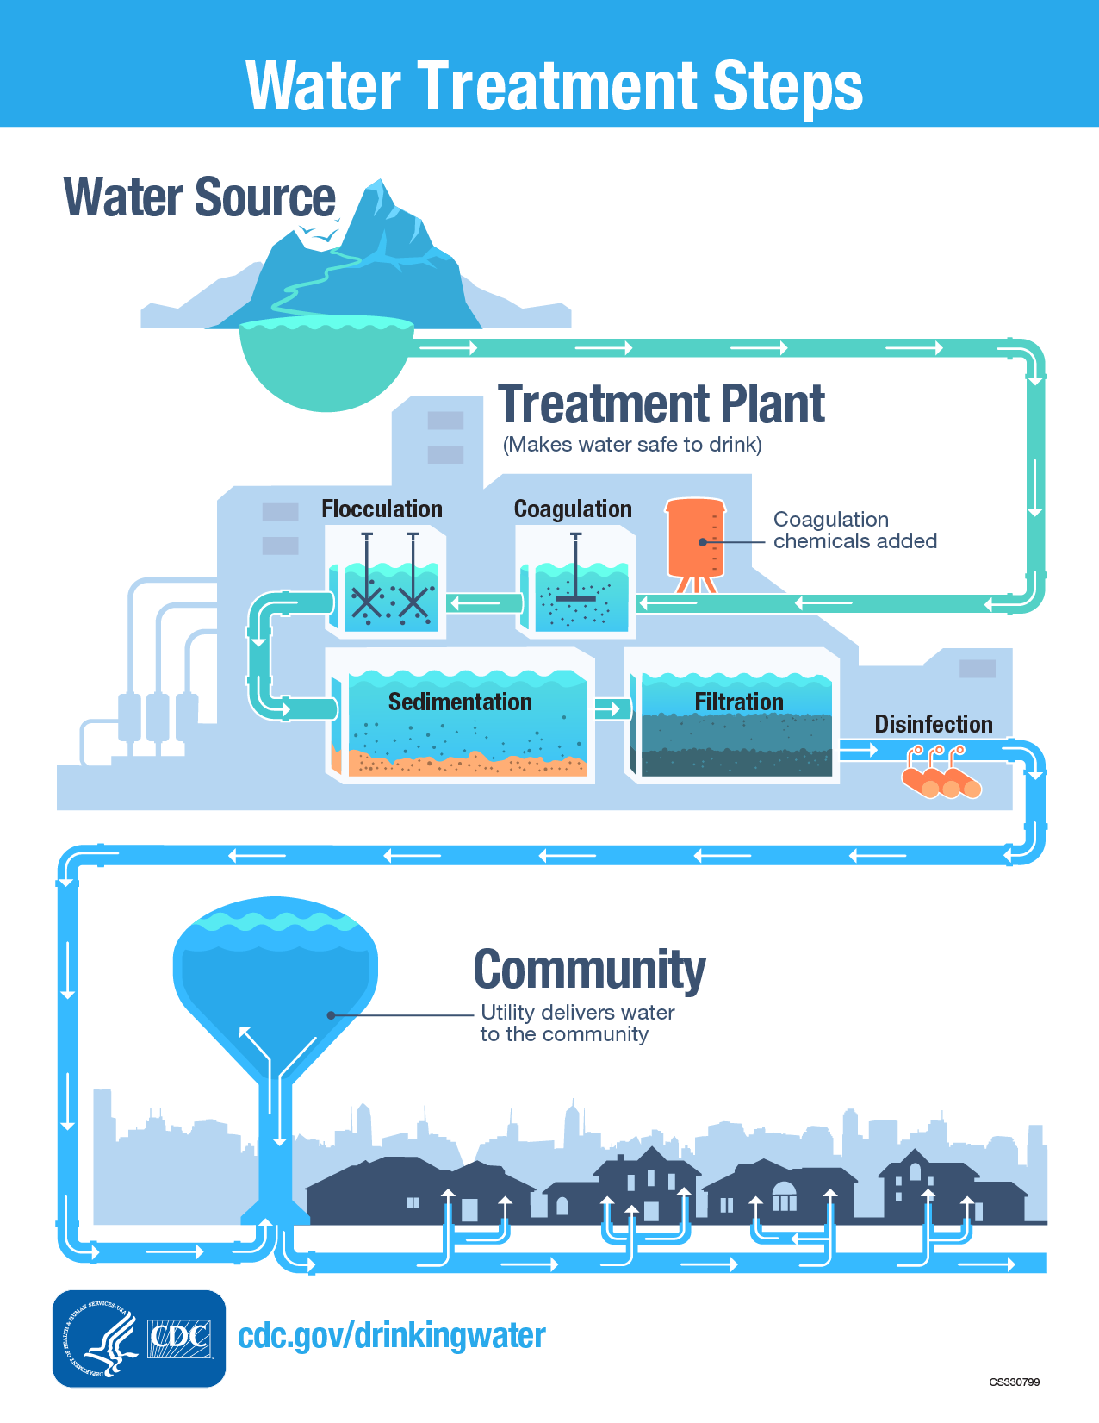
Public water systems often use a series of water treatment steps:
Monitoring (multistep)
Coagulation
Flocculation
Sedimentation
Filtration
Disinfection
Distribution
Filtration Exempt Water (FE) systems require fewer water treatment steps:
Monitoring (multistep) and water quality
Disinfection
Distribution
Watershed Control Program
Six TWSA members, including the IVGID/Edgewood, are permitted as FE water treatment systems. Only 160 FE systems out of 160,000 public water systems.

Slide 6
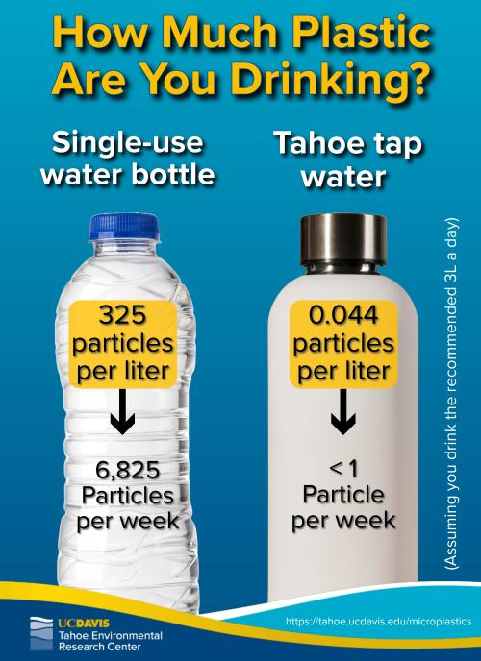

Slide 8
To Sink or Swim: A Snapshot Evaluation of the Fate and Types of Microplastics in Lake Tahoe
A Report to the Nevada Division of Environmental Protection.
Gjeltema, J., Senft., K. Lang, J., Sesma, S. and Schladow, G. 2023.
ucdavis.edu
The primary goal was to examine and document the current status of microplastic pollution within Lake Tahoe. Municipal water samples sourced from the lake were also evaluated for the presence of microplastic particles.

Slide 9
To Sink or Swim: A Snapshot Evaluation of the Fate and Types of Microplastics in Lake Tahoe

Slide 10
What does this sampling means for Tahoe Tap? Initial sampling shows excellent source water. Water suppliers are motivated to continue sampling efforts.
Drinking water regulatory environment moving towards standardization and prescriptive monitoring.
LAKE TAHOE MUNICIPAL TAP WATER
AVERAGE OF 0.044 PARTICLES/L
1 PLASTIC PARTICLE PER 22.7/L
AT 3 L/DAY = POTENTIAL 1 PLASTIC PARTICLE /WEEK
Comparison:
Average of 325 microplastic particles per liter of bottled water. https://www.frontiersin.org/articles/10.3389/fchem.2018.00407/full Sherri A. Mason*

Slide 11
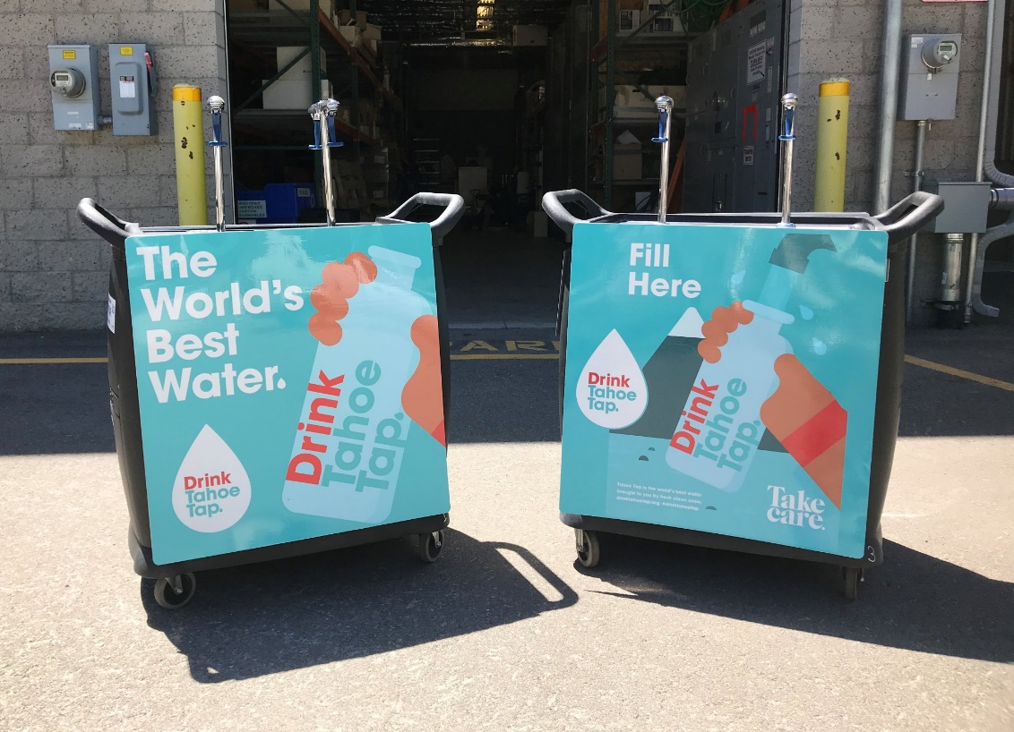
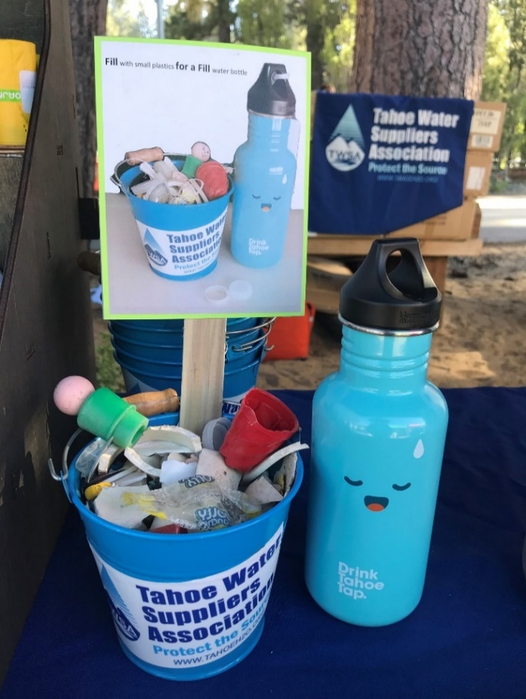
What you can do today to prevent microplastic pollution
Say no to single-use plastics
Special events hydration stations
Community Cleanups/Microplastics Fill for Fill challenge

Slide 12
Key Takeaways
www.tahoeh2o.org
DrinkTahoeTap@ivgid.org

