Slide 1
Incline Village/Crystal Bay CAB
2025 Tahoe Area Plan Update
December 16, 2024

Slide 2
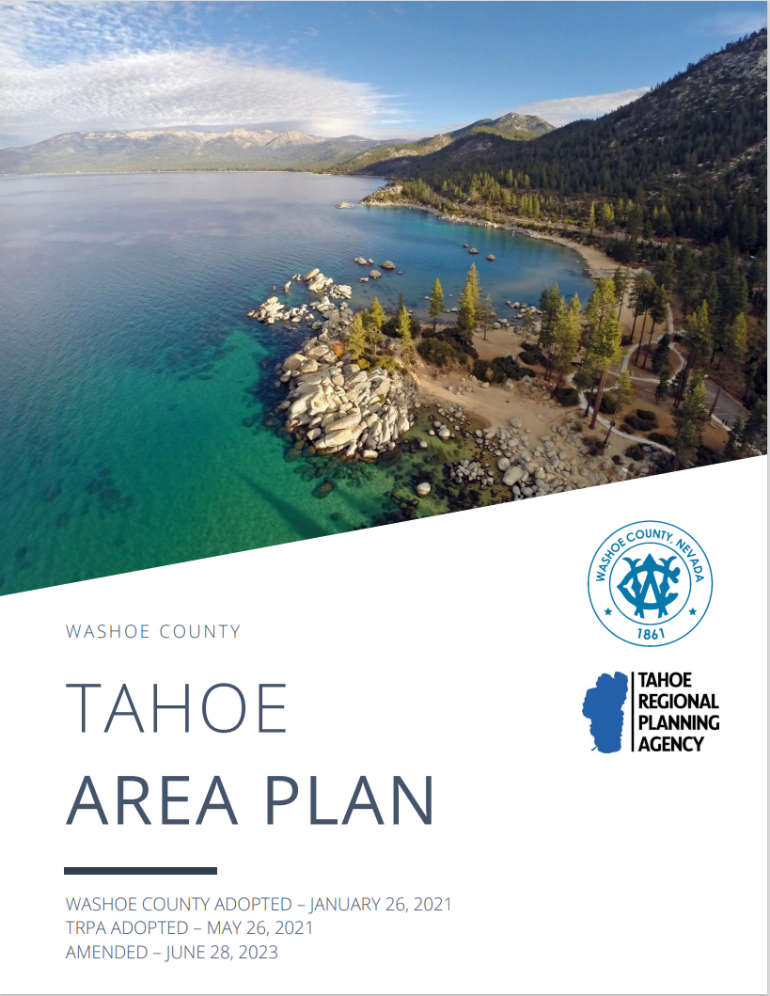
Background
Tahoe Area Plan adopted in 2021 after extensive public outreach process
Serves as the master plan for the Tahoe Area (Incline Village & Crystal Bay)
Guides future of land use and development
Article 220 (Tahoe Development Code Standards) and Article 220.1 (Design Standards) adopted as appendices

Slide 3
2025 Update—Why Now?
In 2023, TRPA adopted the “Phase 2 Housing Amendments,” focused on supporting deed-restricted affordable multi-family developments
Necessitates amendments to Washoe County Code to conform with updated TRPA rules and policies
Lessons learned from plan implementation since 2021
Identified potential code improvements
Focused update; vision established in 2021 update

Slide 4
Scope

Slide 5
Process
Public outreach process not designed to re-envision region
Tahoe Area Plan is a recent and comprehensive reflection of the community’s vision based on years of engagement
Fulfill need to quickly come into conformance with recent TRPA amendments
Public outreach focuses:
Transparency and clarity
High-quality code and policy
Focused scope in order to meet necessary timeline and due to available resources

Slide 6
Timeline
[insert updated timeline image]

Slide 7
Kat Oakley, Senior Planner
Washoe County CSD – Planning Division koakley@washoecounty.gov 775-328-3628

