Slide 1
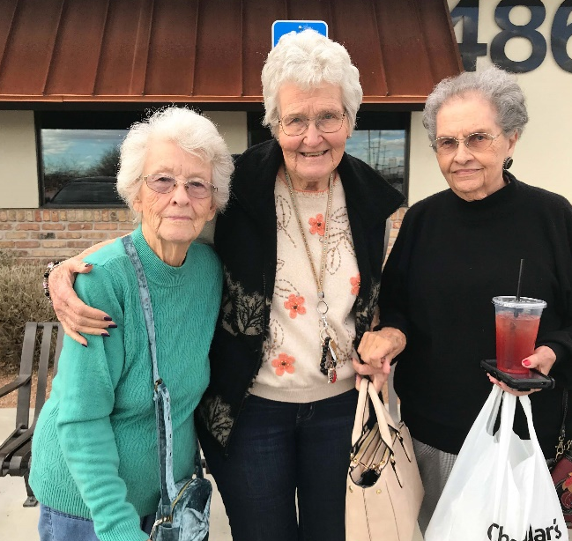

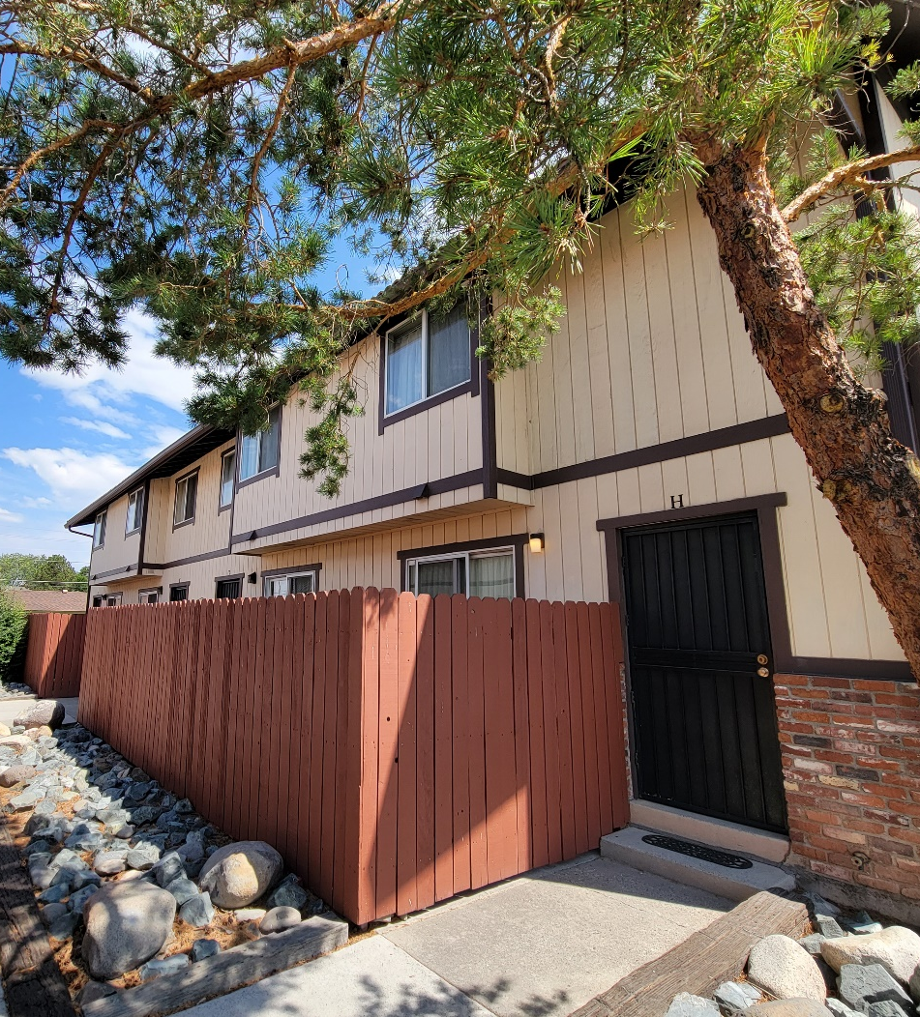
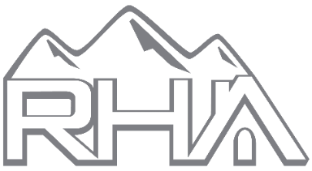
RENO HOUSING AUTHORITY
Dr. Hilary Lopez, executive director
City Council 5.24
Notes:
Thank for the opportunity for me to tell the story of the Reno Housing Authority and what we do for Nevadans today.

Slide 2
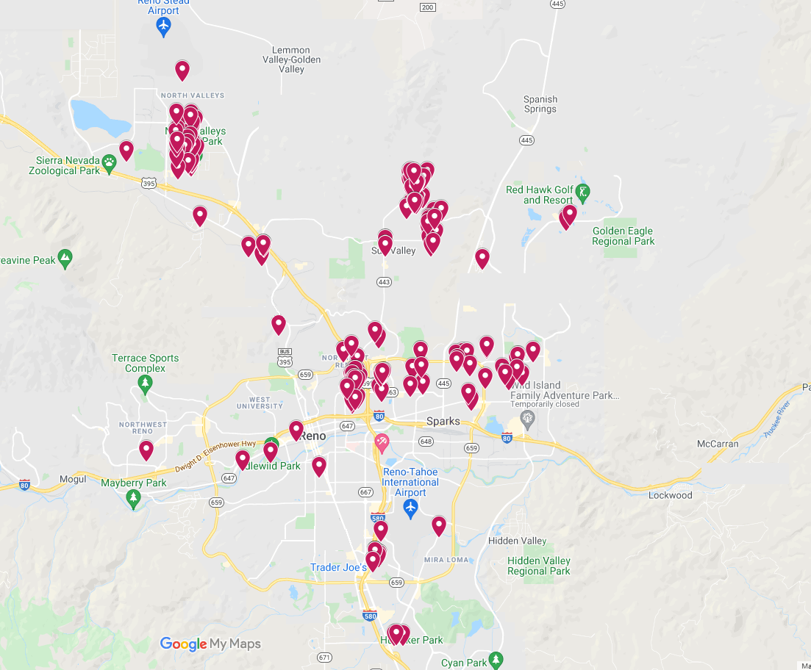

WHO WE ARE
WHO WE SERVE
Created 1943
HUD-designated top performing agency for more than 20 years
Largest affordable housing provider in Washoe County
2/3 of residents are seniors and persons with disabilities
Nearly 15,000 residents
Notes:
Created in 1943 as the Housing Authority of the City of Reno, we expanded in the 1970s into Sparks and Washoe County, including Gerlach, Wadsworth and Incline Village, and have acted as the regional housing authority for nearly 50 years.
We’re a quasi-governmental, not-for-profit, entity. The federal government provides program subsidies, but our own business activities support much of our overhead. We’ve been a designated top performer by the U.S. Department of Housing and Urban Development for more than 20 years.
In 2013 we received the Moving to Work designation. Based on our performance and fiscal responsibility, we were one of only 39 agencies (of more than 3,000) selected to receive it. We’re the only housing authority in the state with the designation. What it means is that HUD relies on us to develop and test innovative housing programs/policies that can, and have been, adopted across the nation.
While the RHA has a county-regional focus, our subsidiary, Washoe Affordable Housing Corporation, operates throughout all parts of Nevada, from Vegas, Elko, Carson City, Yerington and more.
We’re the largest affordable housing provider in Washoe County and because we and Washoe Affordable exist, nearly 15,000 Nevadans have a safe secure place to call home.
More than 2,500 of our households earn less than 30% of the Area Median Income.

Slide 3
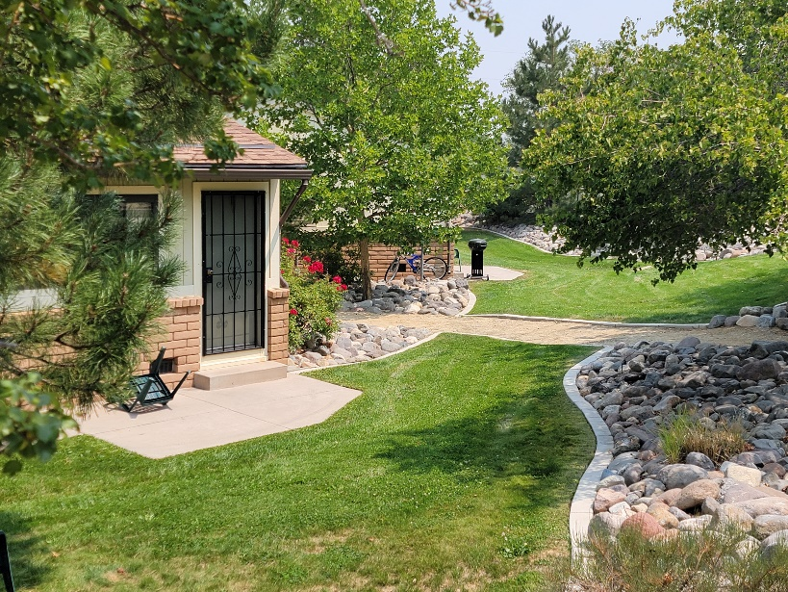
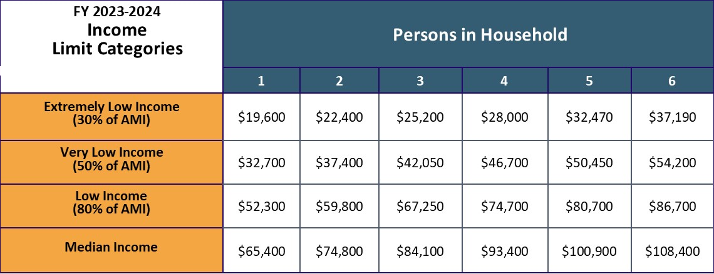
AREA MEDIAN INCOME: WASHOE COUNTY
Workforce housing is defined as housing for those who earn 80-120% AMI
Notes:
Let’s talk more about the Area Median Income, A-M-I. HUD sets it annually for cities and counties across the nation. It’s updated annually and is the best barometer to determine whether one’s household income is above, at or below the median.
The top line of this graph is who we serve most. 68% of our residents fall into the category of Extremely Low Income. Without RHA assistance, in our market these people would spend 90% of their income on a roof over their heads. They’d be choosing each day whether to eat, pay their rent or get medical care. That’s why we exist.
Let’s also define workforce housing. HUD states that it’s housing for those who earn 80 to 120% of the Area Median Income.

Slide 4
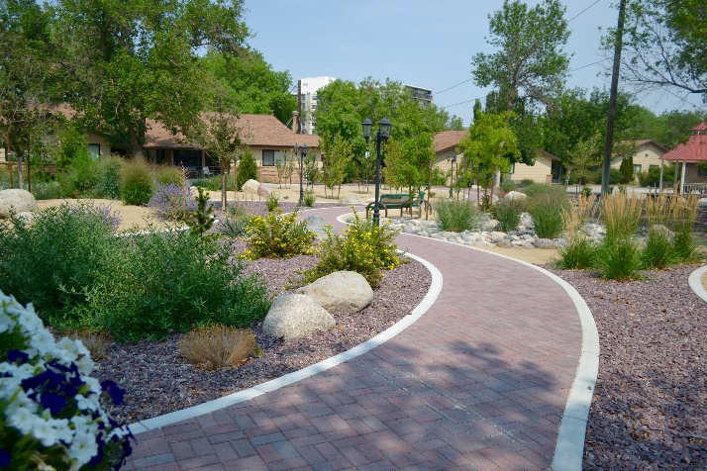
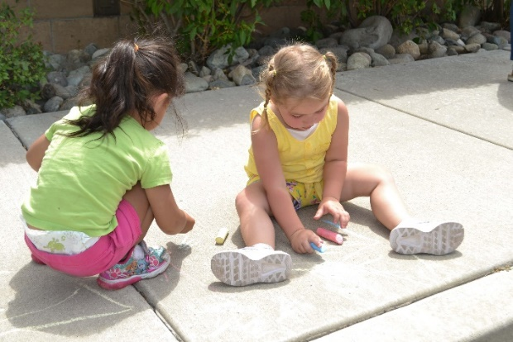

TRADITIONAL HOUSING PROGRAMS
Permanently affordable housing via federal subsidies
Own-operate eight Public Housing sites
    ~750 units in total
    Residents pay no more than 30% of their income
Resident councils, similar to Neighborhood Advisory Boards, plan community events
Redevelopment of several public housing sites to better meet the long-term needs of our community and residents
Notes:
Like some, but not all, other housing authorities, there are 2 sides to RHA, our traditional housing programs and our expanded housing options.
Public Housing is one of the traditional federal programs designed in 1937 to provide affordable housing to low-income households. Today public housing accounts for about 18% of the affordable housing nationwide. Our eight Public Housing complexes are well maintained and safe.
Each of these complexes has a resident council that helps plan community events and self-govern. These councils give residents a sense of community and cooperation.
All our public housing units are permanently affordable. These units will never charge market rate.
Thanks to state ARPA (or HMNI) and WCHC funds, RHA can make significant investments in several of its public housing properties. Part of this investment is increasing the density at our Hawk View property as part of the redevelopment of that site, the substantial rehabs of Silverada and Stead Manor, and the moderate rehab of John McGraw public housing in Sparks and the adjacent Silver Sage property. This investments will improve ADA accessibility, modernize systems, make properties and units more energy efficient, and provide high-quality, affordable housing for many generations to come.

Slide 5
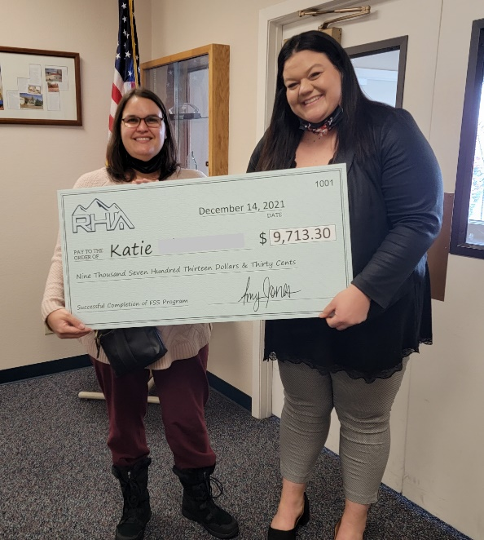
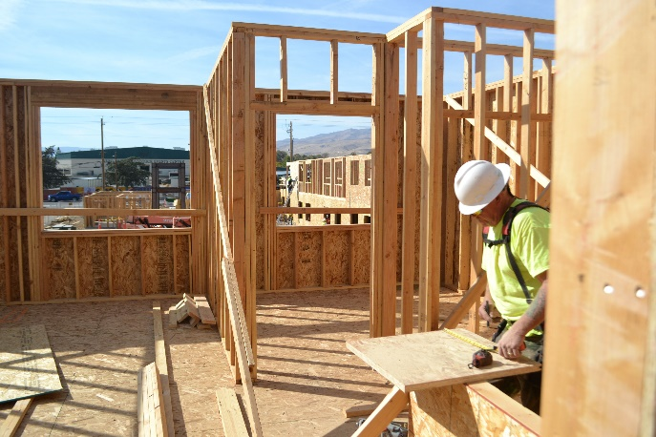
TRADITIONAL HOUSING PROGRAMS
Permanently affordable housing via federal subsidies
Manage housing voucher programs (formerly Section 8)
    Provide ~3,000 vouchers to individuals and families
    Veterans
    Former foster youth
    Homeless or facing homelessness
    Residents pay no more than 30% of gross income
Workforce Development programs help people obtain self sufficiency
Notes:
Rental Assistance voucher programs, including the popular Housing Choice Vouchers, are more prevalent today and well known than public housing. Through RHA’s rental assistance programs, over 3,000 households have a voucher that subsidizes their rent and allows them to live wherever they’d like in Washoe County. Near family and friends. Close to medical care and schools.
Of these 3,000, more than 500 have a specialty housing voucher earmarked specifically for veterans (400), former foster youth (15), victims of domestic violence, and homeless or those facing homelessness (137). These voucher programs are provided in conjunction with our partnerships through the V-A, Health Plan of Nevada, Catholic Charities and more. Each of these voucher recipients participates in ongoing case management to ensure they receive the wraparound services they need to gain more and more self-sufficiency.
Through federal funding, we also provide subsidies to Eddy House, helping former foster youth and other youth aged 18 to 24. RHA helps subsidize the drop-in housing offered on-site in downtown Reno.
Not only do we house people, through our development programs for youth and adults, we help them realize a path to self-sufficiency. We’ve built strong partnerships to help clients get more education, better paying jobs, break the cycle of poverty and build generational wealth through home ownership.
As an example, Anna was a public housing resident. She came to us thinking she didn’t have any job skills and had no insight into how to keep a job. Through our program we helped her create small, attainable goals, that got bigger and bigger over time. Fast forward to today, Anna has worked full-time for the past three years and graduated from the program, walking away with more than $21-thousand dollars saved in an RHA escrow account. She’s using it as a down payment on her own home. Anna is off public housing assistance.
A similar youth workforce development program helps young people with career planning, resume writing, financial literacy, leadership skills, and so much more. Teens who complete this program and graduate high school can walk away with $20,000 for college, trade school, a reliable vehicle, or to help their family.
Our self-sufficiency programs work; they change lives.

Slide 6
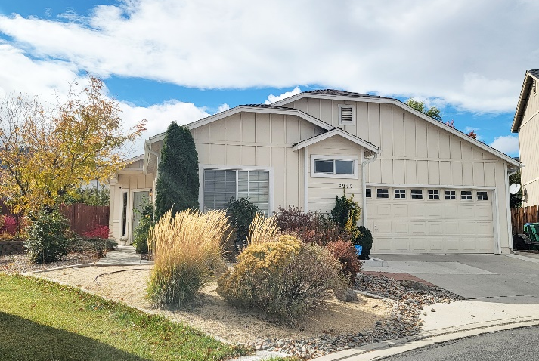
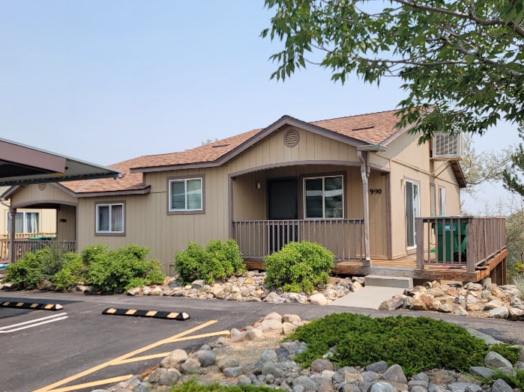
RHA COMMUNITY BENEFIT PROPERTIES
Permanently affordable housing via RHA
Own 530+ apartments, duplexes and single-family homes, all unsubsidized
Choose to rent them all below market-rate
Serve an additional 1,500 people through our own strong financial stewardship
Used as a path to home ownership
Notes:
Our housing authority brings more than $60 million to the region every year from federal programs alone, but through our other affordable housing activities, we’ve grown our entire program to do so much more than we’re federally funded for.
Through these expanded housing activities, we’ve built or purchased more than 500 homes that we rent out below market rate. Every single one is rented below market rate. There are some apartments, some condos, duplexes and some single-family homes. They’re spread out all over the county.
We use these properties as a step-up. Residents go through our workforce development programs, earn more money, can move into these sites in great neighborhoods and eventually get off housing assistance altogether.
And again, these properties? Permanently affordable.

Slide 7
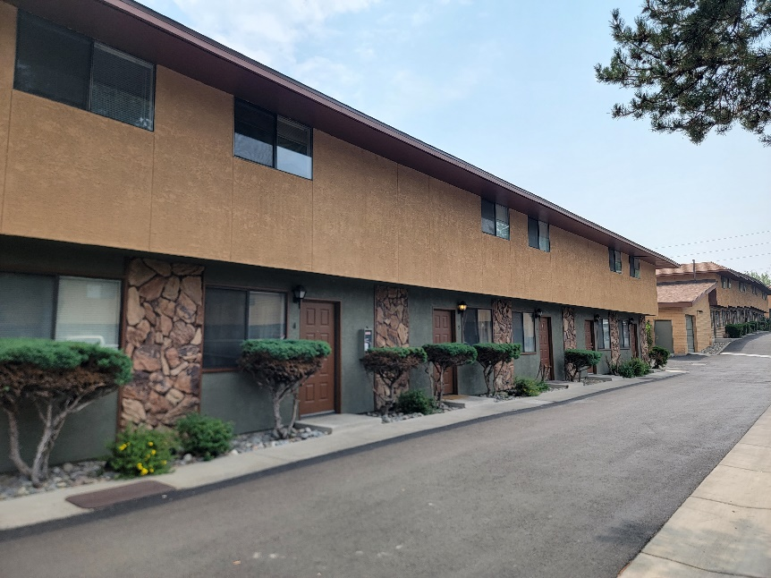
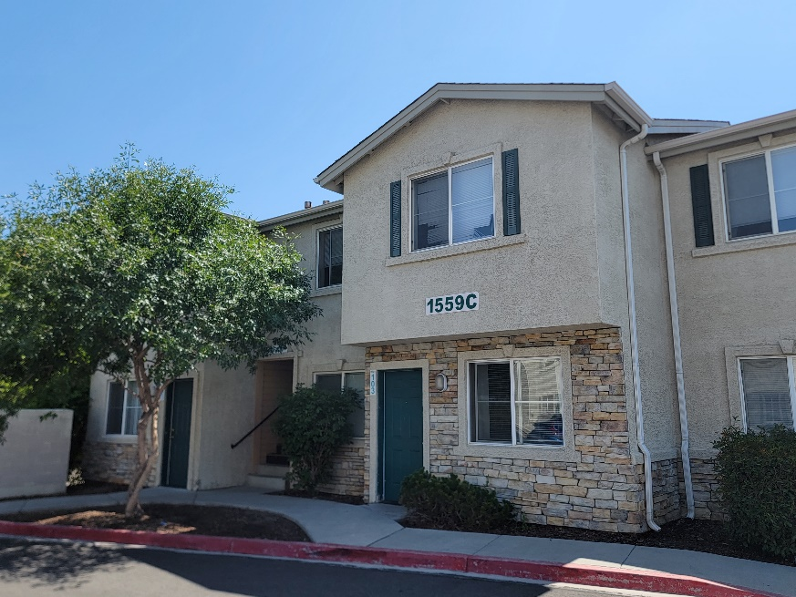
RHA COMMUNITY BENEFIT PROPERTIES
Sarrazin Arms (54 units) – Purchased in 1992 using HOME Funds
Ala Moana (156) – Purchased in 1996 using bonds
Silver Sage Court (16) – Built in 1996, expired LIHTC project*
Yorkshire Terrace (30) – Built in 1997, expired LIHTC project
Carville Court (6) – Purchased in 1997 as a foreclosure
D&K Horizons (4) – Purchased in 1998 using a HUD grant
Prater Way Apartments (16) – Purchased in 2005 using RHA funds*
Pilgrim Rest (7) – Owned by Pilgrim Rest Baptist Church, managed by RHA since 2006
Colonial Court (12) – Purchased in 2008 using RHA funds*
Idlewild Townhomes (34) – Purchased in 2012 using RHA funds
Scattered Site Homes (165) – Purchased between 2009-2015 using Neighborhood Stabilization Program (NSP) funds**
Willie J. Wynn Apartments (44) – Built in 2020 using LIHTC, HOME Funds and loans
*Sparks properties
Notes:
We don’t receive any outside funding to support these 544 units of expanded housing options. RHA started acquiring these types of properties in the early 1990s. We used different funding mechanisms to purchase the properties and took advantage of downturns in the market to perform strategic buying to acquire the properties at very low prices. Had we not done this, we could not have afforded to purchase these sites. We are always looking at innovative ways to create more affordable housing in our community, whether it’s the possibility of a property conversion or purchasing an existing affordable complex.

Slide 8
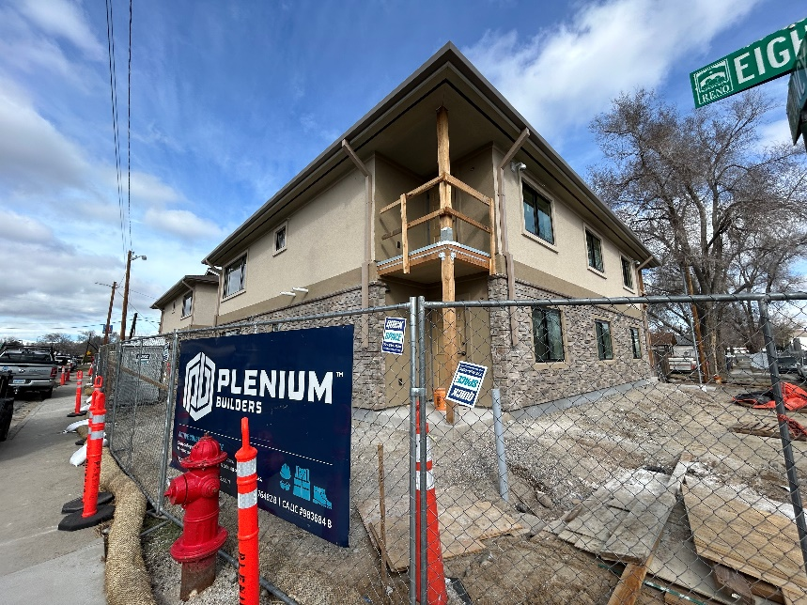
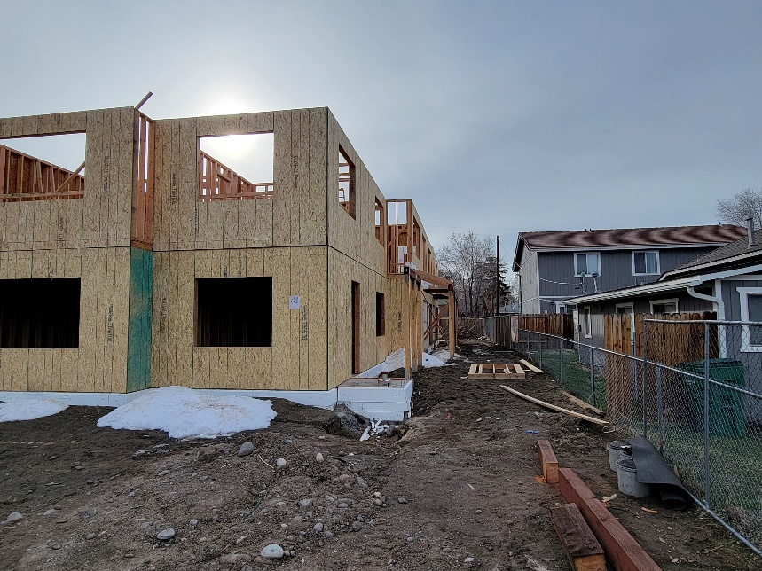
RHA COMMUNITY BENEFIT PROPERTIES
Permanently affordable housing via RHA
Opening new 12-unit development this year
  Serving homeless or at-risk veterans
Currently under construction – Railyard Flats
  15 unit “missing middle” units in Sparks
Distributed millions in CHAP funding
  Kept 3,000 households from being homeless
  Paid landlords $32 million
Emergency Eviction Assistance
  Local contract to assist with those not in RHA system
Notes:
Next for us is a new building, Dick Scott Manor. It’s set to house up to 12 homeless veterans thru a partnership with the V-A and is scheduled to open in the next few months. All residents of Dick Scott Manor will receive case management services through the V-A, including addiction/recovery services, mental health assistance, and financial literacy.
We managed and distributed $32 million dollars in 26 months, for Nevadans impacted by COVID. We’ve continued serving city of Sparks with its recent emergency rental assistance program.
Lastly, we have a contract with JF Downey company. They help the difficult cases. Those who haven’t been able to be helped by other organizations and who are not able to be put into the RHA system, i.e. , no open waitlists, criminal records, poor rental history, etc.

Slide 9
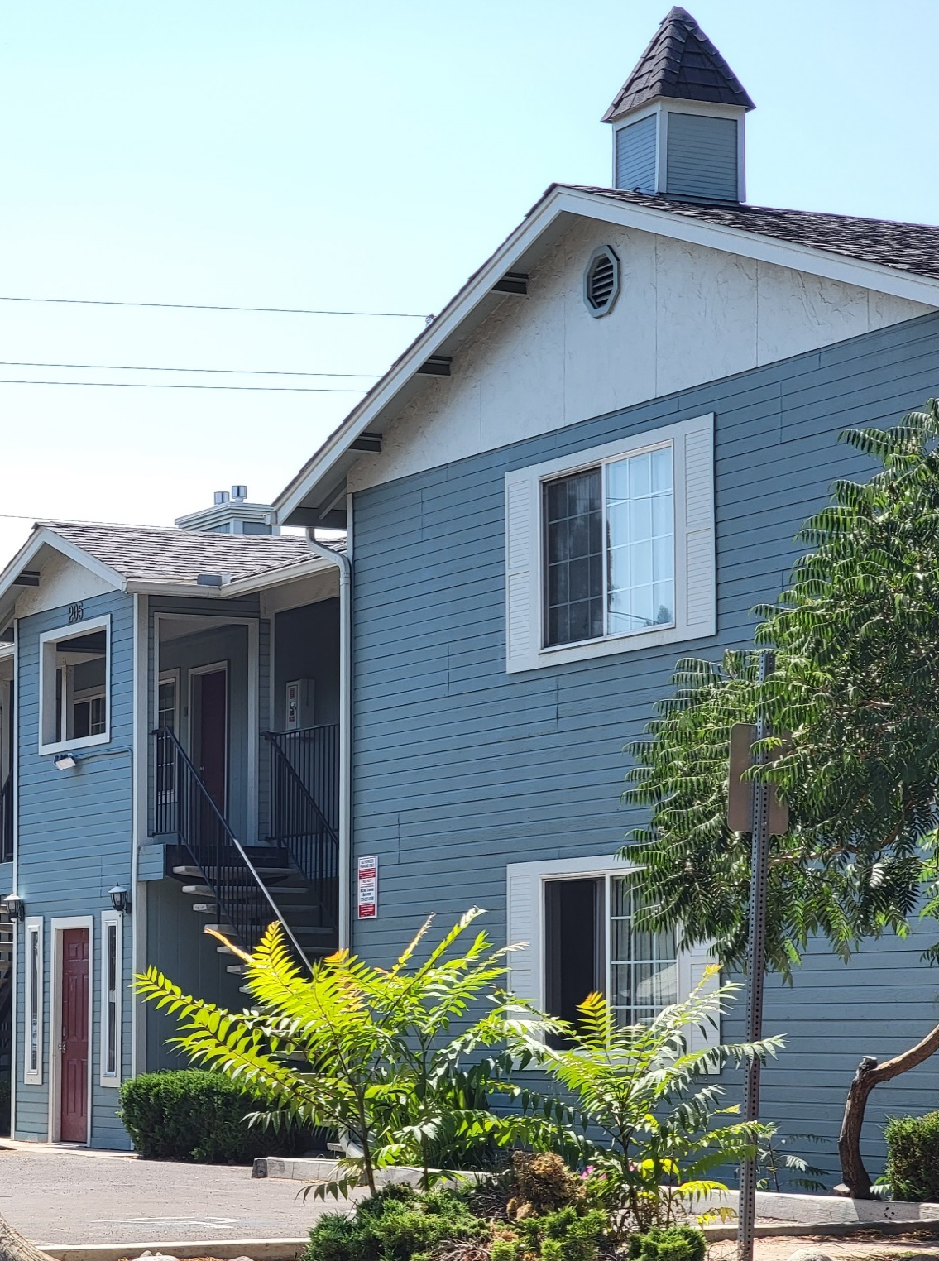
CHALLENGES
Expensive housing, land, building costs
Hundreds of expiring LIHTC properties
All coupled with population growth; low vacancy rates
Some loans at our disposal, but RHA isn’t federally funded to procure housing, nor does any municipality fund us on a regular basis – not funded by any local taxes
Notes:
Land is at a premium in the area, with very little developable land near public transportation, employment, grocery, pharmacy, all of which are of the utmost importance to our residents.
And as everyone likely knows, the cost of building materials and labor (RHA must pay prevailing wage) makes properties even more difficult to obtain.
Dozens of Low-Income Housing Tax Credit Properties are set to have their affordability factor sunset in the next 6 years. According to the Truckee Meadows Regional Strategy for Housing Affordability, by 2023, 32 tax credit properties in Washoe County will reach the end of their affordability mandate. By 2028, it’s 41. This means the properties can be sold and can then charge market rate, lessening affordable housing options even more for our low-income seniors, persons with disabilities and families. That’s hundreds of units that may no longer remain affordable for low-income residents.
And keep in mind, the number of seniors in Washoe County doubled in the past 20 years. The vast majority of those people are on fixed incomes.
BUT affordable housing improves chances of success regarding one’s health, education, work and self-sufficiency. Affordable housing provides the first step, the possibility, the opportunity for success, whatever that may look like for each client. RHA provides opportunity through our workforce development programs, through our youth programs and through our senior activities. RHA provides opportunities to those who just need a chance, one lucky break in order to move forward and succeed.

Slide 10
NO ONE CREATES MORE PERMANENT AFFORDABLE HOUSING.
Notes:
We’ve been a HUD-designated top performing housing authority for more than 20 years.
At the RHA, all we do is affordable housing and most of our employees say they wouldn’t do anything else. There’s humanity in the work we do.
We’ve been here since 1943. We’ll be here until 2043 and beyond.
This tag line is 100% true. In Washoe County, no one creates more permanent affordable housing than RHA. No one.

Slide 11
NO ONE CREATES MORE PERMANENT AFFORDABLE HOUSING.
NO ONE.
Notes:
I’m happy to answer any questions you may have.

