Slide 1
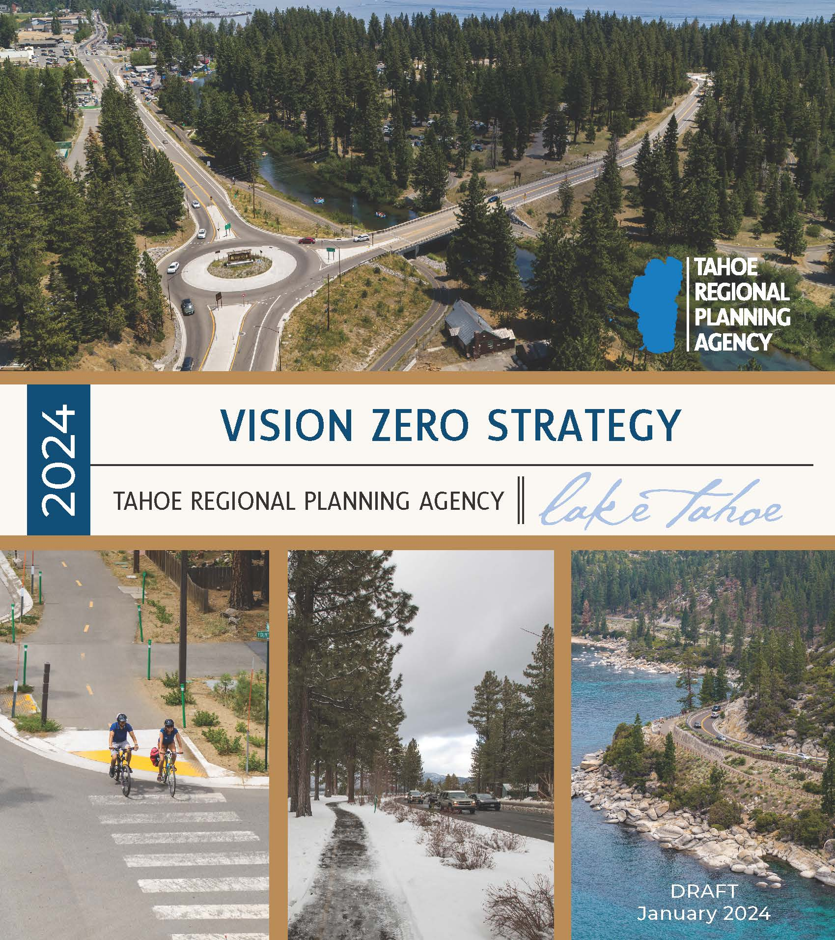
2024 Vision Zero Draft Strategy
Rachael Shaw
Associate Transportation Planner
Notes:
Hi everyone and thank you for having me this evening. My name is Rachael Shaw, and I am a transportation planner at TRPA. I am here to talk to you about our Vision Zero Draft Strategy, which we just released last Friday for public comment. This is a strategy focused on transportation safety and improving safety for all road users, that is people walking, biking, rolling, driving, or riding transit. I will caveat that as this is a brief presentation, I won’t be able to cover everything in the strategy, but I encourage you to read it on your own time and submit public comment through February 2nd.

Slide 2
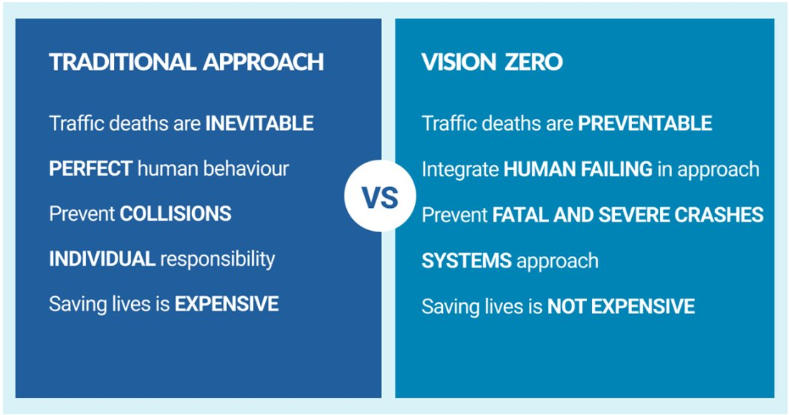
What is Vision Zero?
Originated in Sweden in 1997​
Fundamentally different way to approach traffic safety​
One Main Goal: eliminate all traffic fatalities and serious injuries for all road users
Photo: Vision Zero Network
Notes:
Vision Zero began in Sweden in 1990s and has since spread to other countries and adopted by more than 45 communities in the U.S. Since its inception, Swedish fatalities for all road users has dropped by more than 50 percent. Similar results have also occurred across other European Vision Zero countries and has begun to manifest in the United States as well.​
​
Vision Zero has one main goal since it’s inception, which is to eliminate all traffic fatalities and severe injuries.​ Vision Zero communities commit to significant reductions in serious injuries and fatalities and typically set a goal for getting to zero. The TRPA Governing Board will consider committing to a goal of zero by 2050 at our next meeting on February 28th.
​
While Vision Zero has been a bit of a buzz word lately, it is just not a slogan or a tagline, it’s a fundamentally different way to approach traffic safety. ​
The traditional approach has the narrative that traffic deaths are inevitable, and that the responsibility is on individuals to behave perfectly. Vision Zero seeks to move beyond traditional transportation safety practices to address one of the largest preventable health crises. It says that although human mistakes are inevitable, we can design for human mistakes and prevent traffic deaths. It focuses on a systems approach with shared responsibility.​
​
​

Slide 3
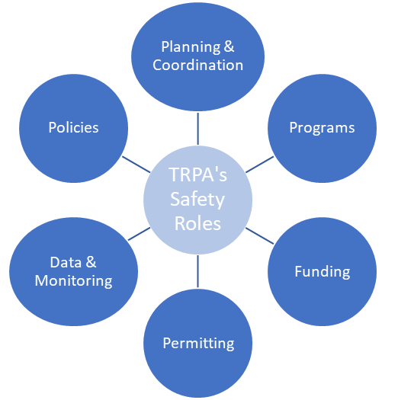
TRPA’s Role in Safety
Notes:
The Vision Zero Strategy is not a new plan, but a comprehensive update to the 2019 Lake Tahoe Region Safety Strategy, with a focus on the principles and goals of Vision Zero. Safety is not a new role that TRPA is taking on. Safety has been part of our Regional Transportation Plan since 2004.
TRPA has quite a few roles that we fill when it comes to roadway safety. First, as the MPO we are required to establish and report on annual safety targets to each state. We also have a role in establishing policies, and we revisited the safety policies in the last Regional Transportation Plan and made recommended revisions that will be considered for adoption in the 2025 RTP which we are starting to update. As you know, we have a role in regional coordination, and this is extremely important for safety as we need a coordinated and systems approach. We also provide funding for safety projects such as the Regional Grant Program and supports local eligibility for funding opportunities.

Slide 4
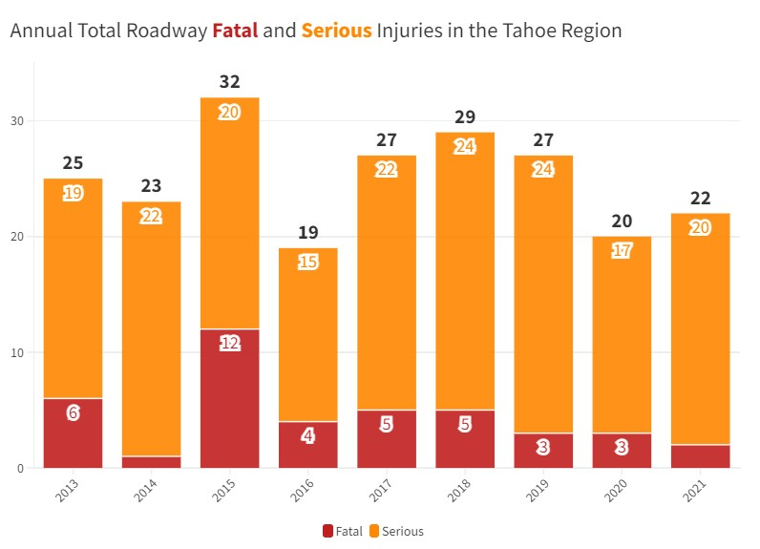
Why Does Tahoe Need Vision Zero?
Notes:
Why does Tahoe need a vision zero? From 2013 to 2021, there were 41 fatalities and 183 serious injuries on Tahoe’s roadways, according to crash data reported by state and local law enforcement agencies. This amounts to an average of 5 deaths and 20 life changing severe injuries each year.
I want to acknowledge when I mention this data that these are not just numbers, but family members, friends, colleagues, and community members that have been greatly affected by these traumatic events.

Slide 5
Strategy Overview
Crash Data Analysis
Projects List
Equity Considerations
Strategies & Policy Recommendations
Funding Opportunities
Countermeasures Toolbox
Public Participation
Notes:
This slide shows some of the key elements included in the strategy. The strategy dives into the crash data with a data analysis chapter that investigates nine years of crash data and the contributing factors. We look at crashes by modes, lighting, weather, driver actions. From these contributing factors, we identify a toolbox of 40+ engineering countermeasures that are best suited to address them, with the context of Tahoe and our snowy environment. For example, edgeline rumble strips to address roadway departure crashes and enhanced crosswalks with flashing beacons to reduce pedestrian involved crashes. We also look at TRPA’s roles in safety and develop strategies and policy recommendations that TRPA can implement. This strategy builds on our transportation equity study and identifies equity benefits of Vision Zero.

Slide 6
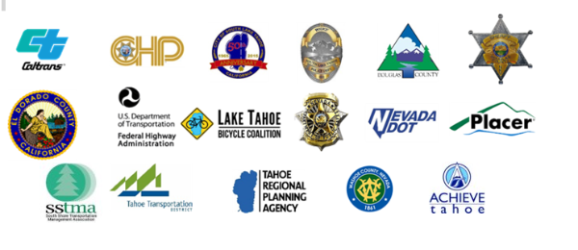
Stakeholder Input
Transportation Technical Advisory Committee (TAC):
  Local jurisdictions
  Law enforcement
  Fire departments
  State Departments of Transportation
  Advocacy groups
Notes:
We convened a transportation technical advisory committee with local jurisdictions, law enforcement, fire departments, state departments of transportation, advocacy groups, and more.
Each of these agencies has a unique role in advancing transportation safety in the region.

Slide 7
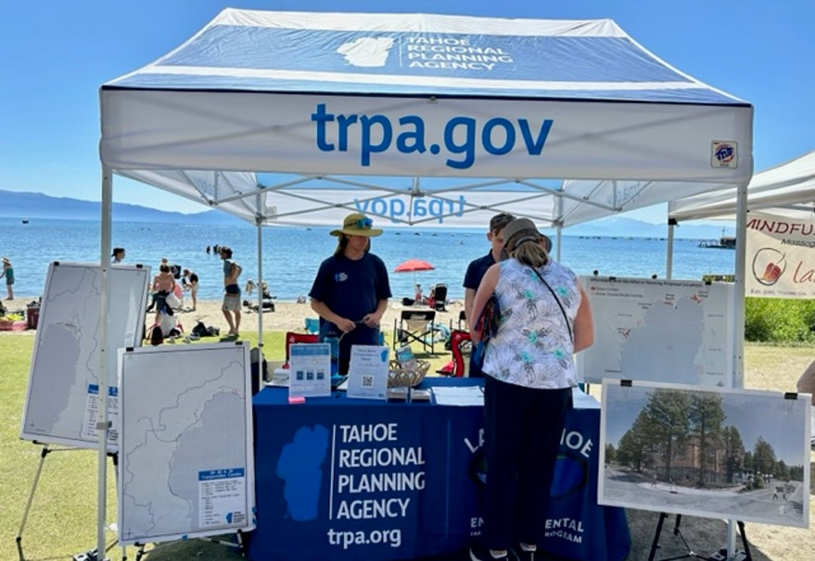
Public Participation
April to September
320 Survey Responses
Gathered input from more than 400 people at community events
Notes:
Public participation was another key part of this strategy. We held pop-up tables at community events and spoke to more than 400 people. We also received over 300 responses on our survey. I also received feedback from a community member that they had recently submitted comments to the Washoe County Transportation Plan and were experiencing survey fatigue, so I reached out to Washoe County to receive those responses and consider them as well.

Slide 8
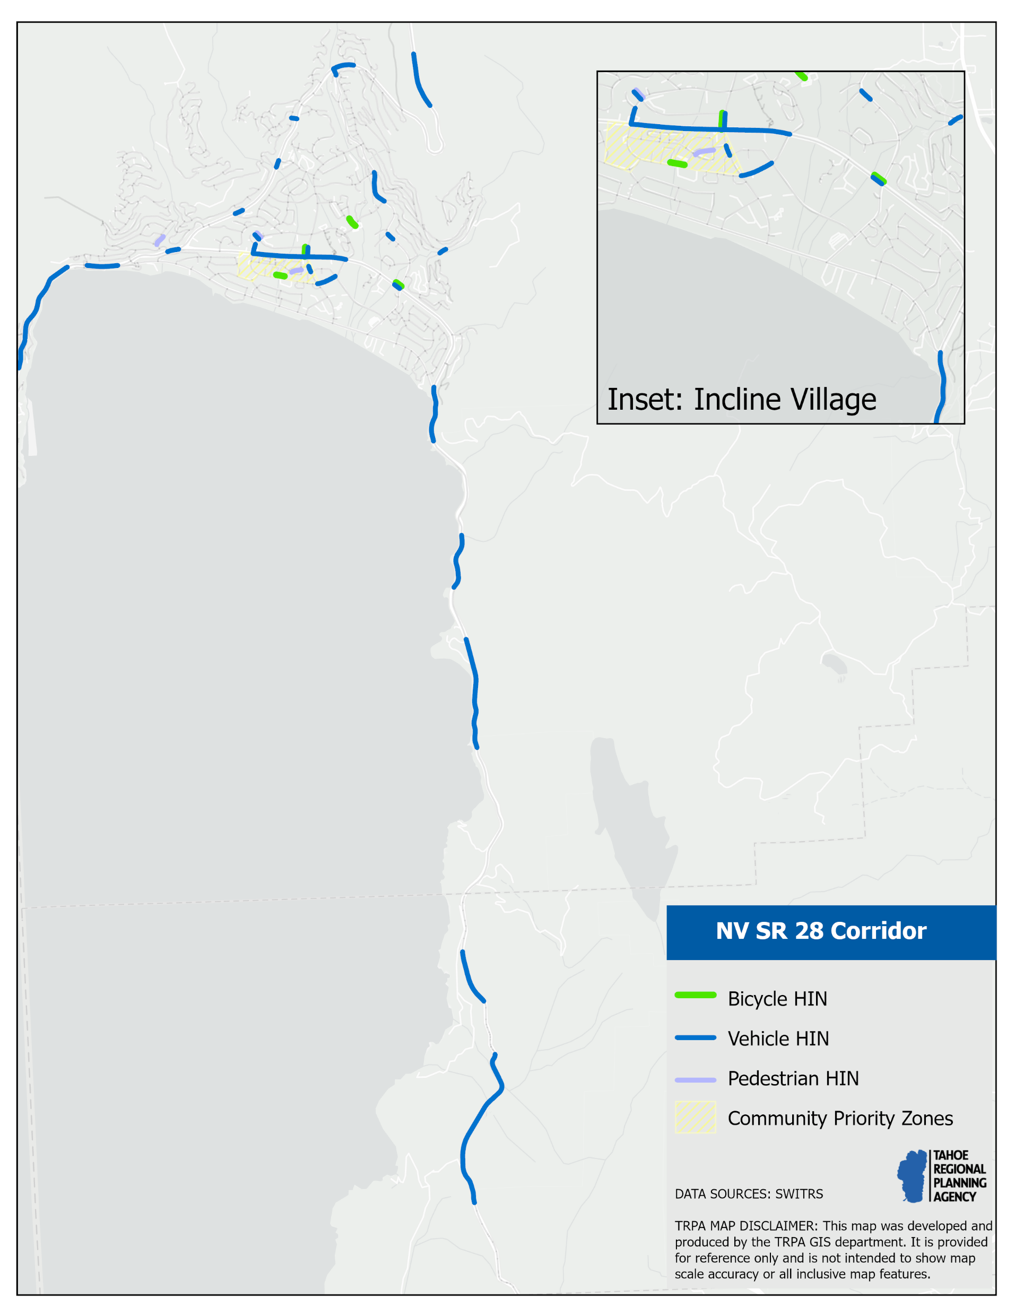
High Injury Network
HINs identify streets with a higher concentration of injury crashes
Developed High Injury Networks by Mode:
  Bicycle
  Pedestrian
  Vehicle
Notes:
A pivotal data analysis developed in this strategy is the High Injury Network. A High Injury Network is a widely used tool by transportation agencies to identify streets with a higher concentration of injury crashes. We developed High Injury Networks by mode, one for bicycle, pedestrian, and vehicle. Shown on the right is the High Injury Networks for the NV SR 28 corridor.

Slide 9
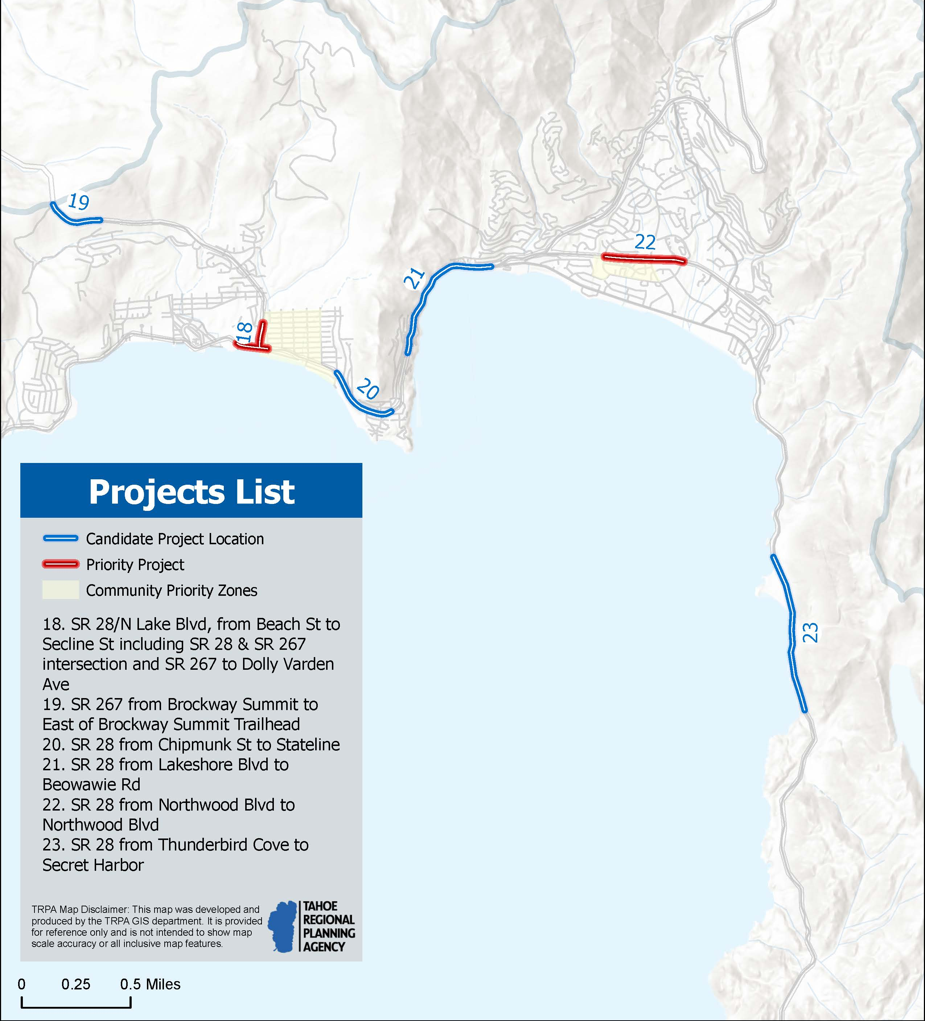
Projects List
Identified 30 candidate locations & 8 priority projects
Project list based on:
  High Injury Network
  Crash Data
  Equity
  Bicycle Level of Traffic Stress
  Public input
Notes:
The High Injury Network, along with crash data, equity considerations, a bicycle level of traffic stress, and public input informed a list of 30 candidate projects. From the list of 30, we refined it down to a top 8 priority list, with specific countermeasures recommended for those locations.
I want to highlight some of the projects identified for your community in the map on the right. #21 in blue is SR 28 from Lakeshore Blvd to Beowawie Rd. #22 is SR 28 from Northwood Blvd to Northwood Blvd in red. #23 is SR 28 from Thunderbird Cove to Secret Harbor.

Slide 10
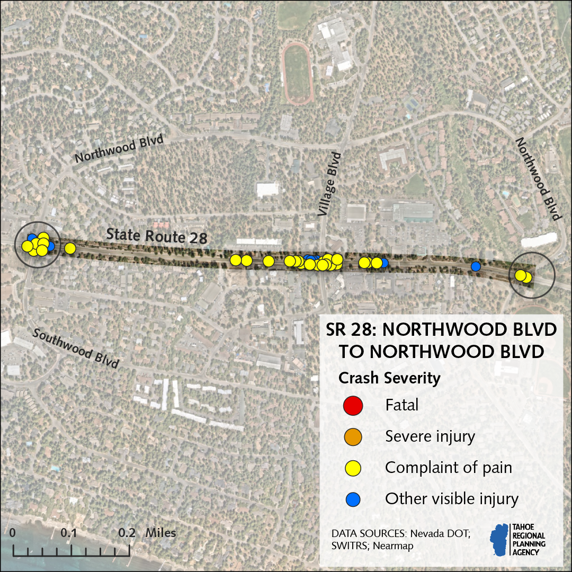
SR 28 Northwood to Northwood Potential Countermeasures
-Convert to intersection, 4 way stop, or roundabout
-Enhance crosswalks and improve RRFB
-ADA bus stop
-Bus pull out
-Protected intersection
-Enhance crosswalks
-Leading pedestrian intervals
Leading Pedestrian Intervals
Notes:
SR 28 from Northwood to Northwood Blvd is one of the priority projects identified based on the fact that a total of 37 fatal or injury crashes occurred along this segment. This segment is on the HIN, in a community priority zone, and has a moderate to high level of bicycle stress. The strategy identifies potential engineering countermeasures for this location. I want to emphasize that these are meant to be a guide, but projects are still subject to adjustments. Any projects in the Top 8 may undergo in-depth studies, planning, environmental analysis, and public engagement overseen by implementing agencies.
These are some of the proposed countermeasures that are informed by recommendations in the Washoe County Transportation Plan. For example, at Northwood Blvd and SR 28 East intersection, the plan identified converting into a 4 way stop or roundabout, enhancing the crosswalk and RRFB, upgrading the bus stop to ADA, and adding a bus pull out. We’ve added protection intersection as an additional consideration, which would add concrete bulb-outs to shorten crossing distances. We are currently working with NDOT on a cost estimate and timeline but are expecting phased improvements. NDOT has conducted an intersection evaluation, and the preliminary recommendation of the study is for construction of a roundabout at this intersection. Additional scoping and engineering analysis will occur before a final design is selected.

Slide 11
Next Steps
Final Strategy to TRPA Governing Board February 28th
Seeking TRPA Governing Board commitment to Vision Zero: zero fatalities and serious injuries by 2050
Update crash data on website regularly
Report on progress every 2 years
Notes:
We will be taking the final strategy to our Governing Board on February 28th seeking adoption of a resolution that commits the Tahoe region to a goal of zero fatalities and serious injuries by 2050. This commitment will help us get more funding for transportation safety projects, make sure our policies are aligned with vision zero, and encourage local agencies to take the same commitment. It will also align us with both states, which have adopted similar goals.
This strategy is meant to be a living document that continues long after endorsement

Slide 12
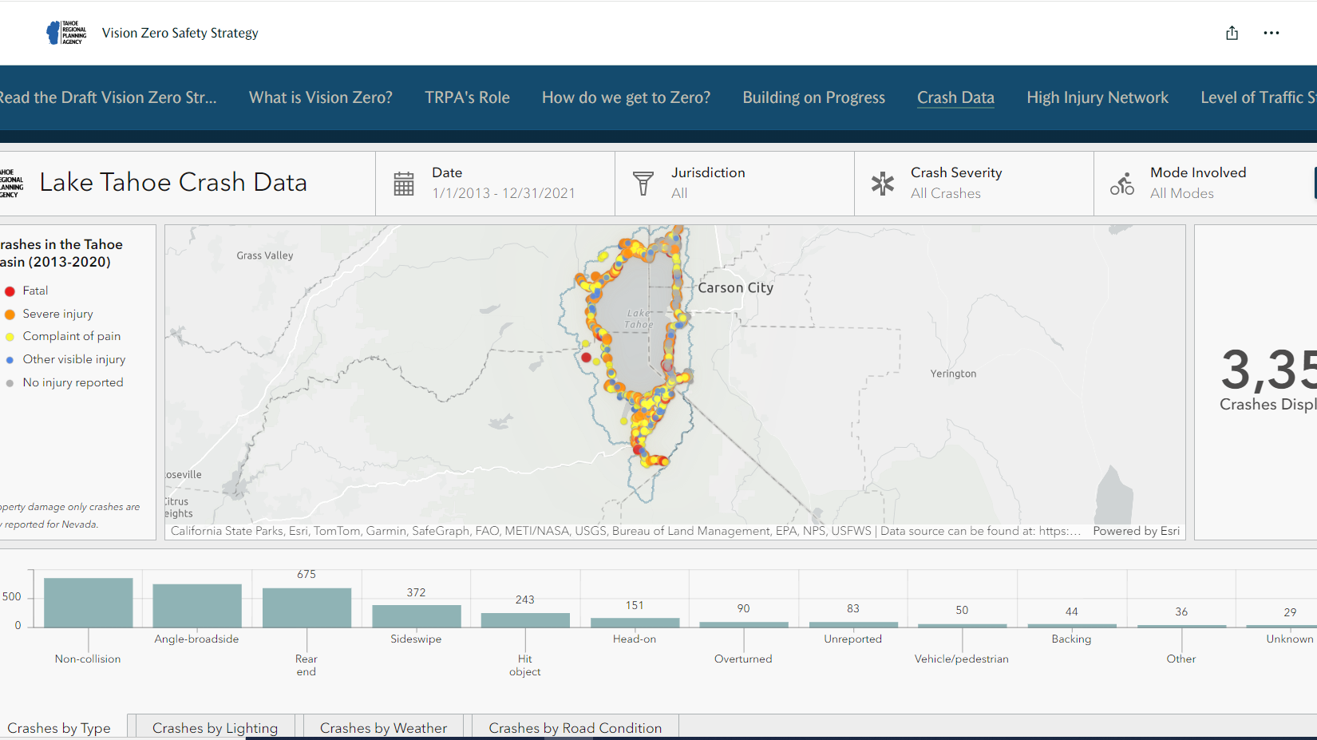
Notes:
We have a lot more information, data analyses, and interactive tools on our website, trpa.gov/visionzero, if you want to learn more. Shown here is the crash data dashboard that allows you to look at all the recorded crashes that have occurred in your community over the last 9 years.

Slide 13
Comments & Questions?
Read the draft strategy at: trpa.gov/visionzero
Rachael Shaw
Associate Transportation Planner
Rshaw@trpa.gov
775-589-5267
Notes:
I’m open to comments and questions now or by email or phone through February 2nd.

