Slide 1
Steps for
Area Plan Update
Incline Village / Crystal Bay

Slide 2
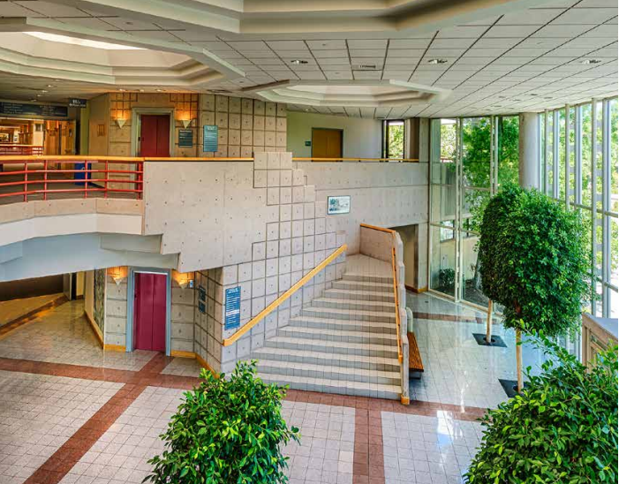
Tahoe Area Plan Update
WC Strategic Plan
Economic Impacts (objective)
Meet the Needs of Our Growing Community (goal)

Slide 3
Making changes to the Tahoe Area Plan
Washoe County: Economic Impacts
15 identified steps to amend the Area Plan (9-12 months)
8 of those steps include public input opportunities
Area Plan amendment has been prioritized by the Board of County Commissioners as priority number 4.
Currently WC staff have completed 1.5 priorities of the board
Still need to finalize 1.5 priorities for housing affordability in Unincorporated WC

Slide 4
Making changes to the Tahoe Area Plan*
Washoe County: Economic Impacts
Project kickoff. Staff identifies code sections to be impacted by update (based on prior guidance from Board of County Commissioners [BCC] and TRPA).
Submit notice of intent to amend the Area Plan to TRPA
Planning Commission (PC) or BCC initiates code amendment (can theoretically be done with PC adoption hearing; TBD when this step will be taken)
Draft language prepared by Washoe County
Draft circulated to community and stakeholders for input (in-person and online options) [public input opportunity] (Neighborhood Meetings)
Draft environmental checklist prepared for TRPA
TRPA Regional Plan Committee (RPC) Info Meeting [public input opportunity]
* Steps and their order are subject to change. Project includes code and master plan amendments.

Slide 5
Making changes to the Tahoe Area Plan*
Washoe County: Economic Impacts
Planning Commission adoption hearing [public input opportunity]
BCC introduction and 1st reading [public input opportunity]
BCC 2nd reading and possible adoption [public input opportunity]
Environmental assessment or checklist to be finalized
Washoe County submits changes to TRPA for conformance review
TRPA Advisory Planning Committee (APC) hearing [public input opportunity]
TRPA RPC hearing [public input opportunity]
TRPA Governing Board hearing [public input opportunity]
* Steps and their order are subject to change. Project includes code and master plan amendments.

Slide 6
Thank you

