Slide 1
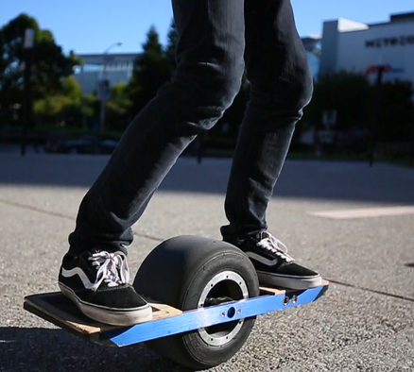
EDUCATION OVER ENFORCEMENT
SPEED is the ISSUE
High speeds are common with regular bicycles as well as E-bikes. Roller skates, skateboards, and one-wheels can operate at unreasonable speeds.
Advances in technology are unknown so we must focus on TRAIL USER ETIQUETTE
This Photo by Unknown Author is licensed under CC BY-SA

Slide 2
GLOBAL ISSUE vs.
REGIONAL RESPONSIBILTY
Reno/Tahoe/Truckee are destinations for global travelers. High speeds on trails and roads is not unique to this area.
We can do our best to inform, educate, and encourage shared trail etiquette.
Implementation of a shared path trail etiquette campaign requires assistance, cooperation and involvement from EVERYONE. Become a steward of trails by educating without confrontation.

Slide 3
Current Collaborative Management &
Trail Etiquette Discussions
Tahoe Fund
Take Care Tahoe
Truckee Trails
Town of Truckee
Tahoe Regional Planning Agency (TRPA) – Lake Tahoe Pathway Partnership
Nevada Department of Transportation (NDOT) - Lake Tahoe Pathway Partnership
Washoe County

Slide 4
Washoe County as a stakeholder
New Trails Program Coordinator – Christina Thayer
  Hired in March 2022
  Working to develop collaborative partnerships for trail programs and management throughout Incline Village and the adjacent Nevada trail systems.
  Looking at long-term solutions for common trail issues.

Slide 5
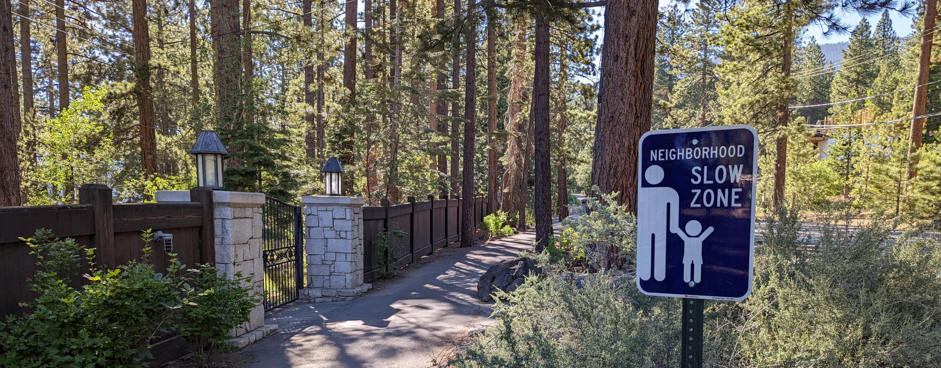
SIGNS HAVE BEEN
PLACED ALONG LAKESHORE MULTI-USE PATH
Message: Slow zone &
Neighborhood area

Slide 6
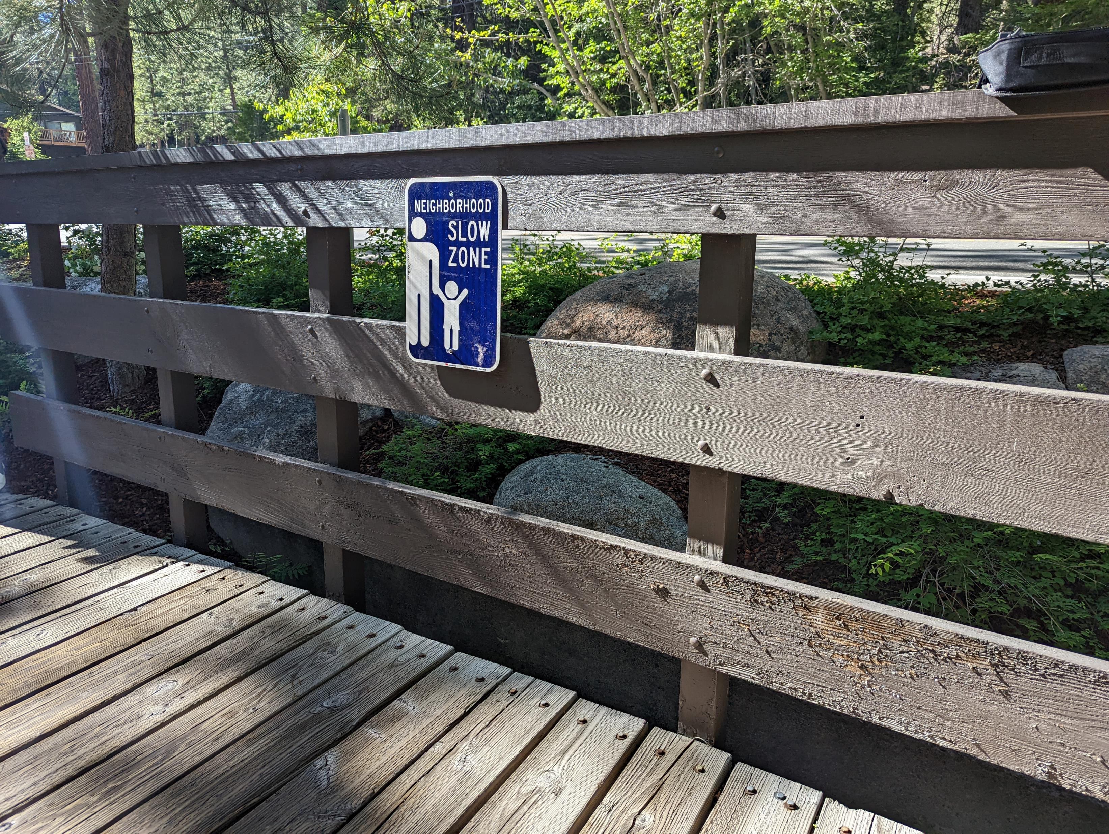
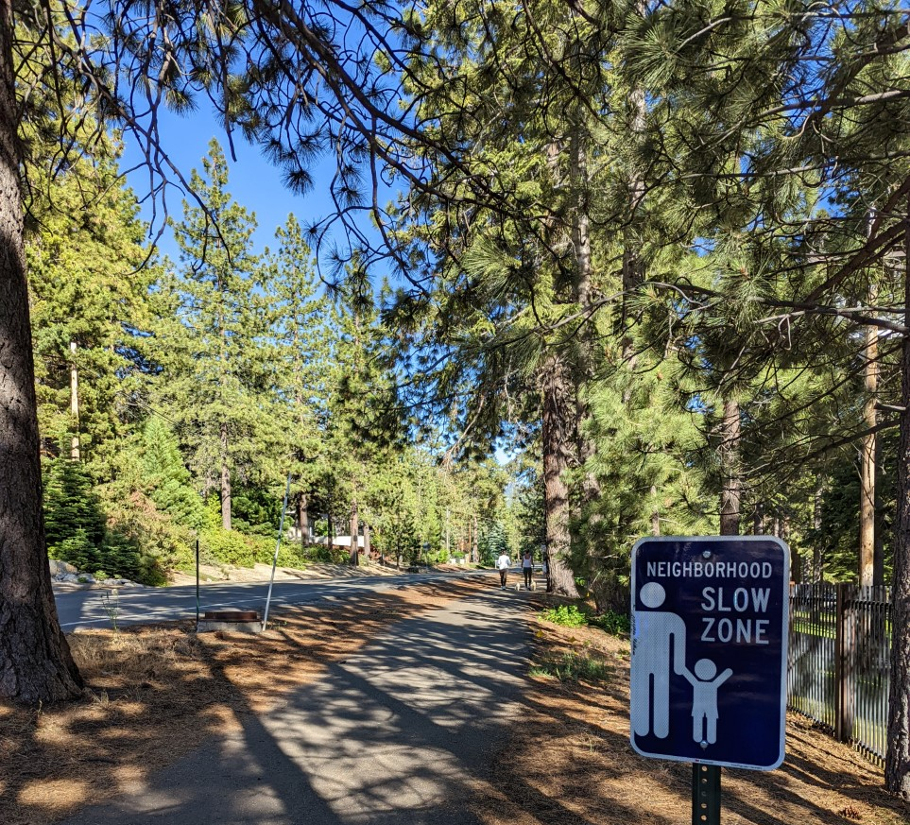
Additional signs to be placed along Village Paths

Slide 7
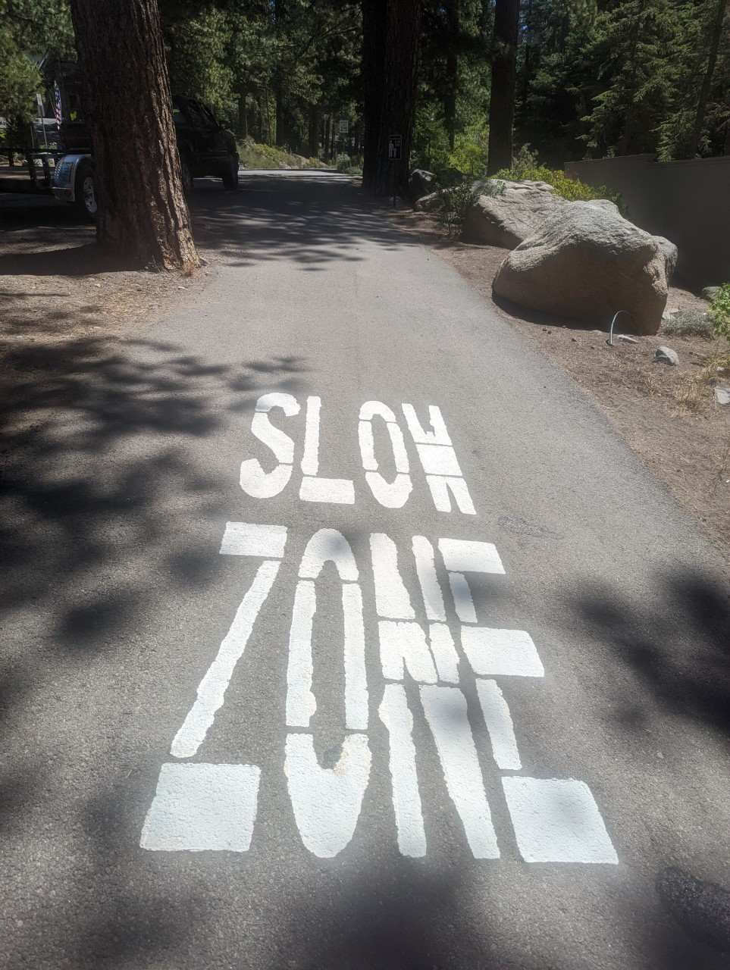
‘SLOW ZONE’
MESSAGING PAINTED ALONG 6.11 MILES OF THE LAKESHORE PATH
TARGETED AREAS:
TRAIL INTERSECTIONS, CONGESTED AREAS AND NEIGHBORHOOD CROSSINGS

Slide 8
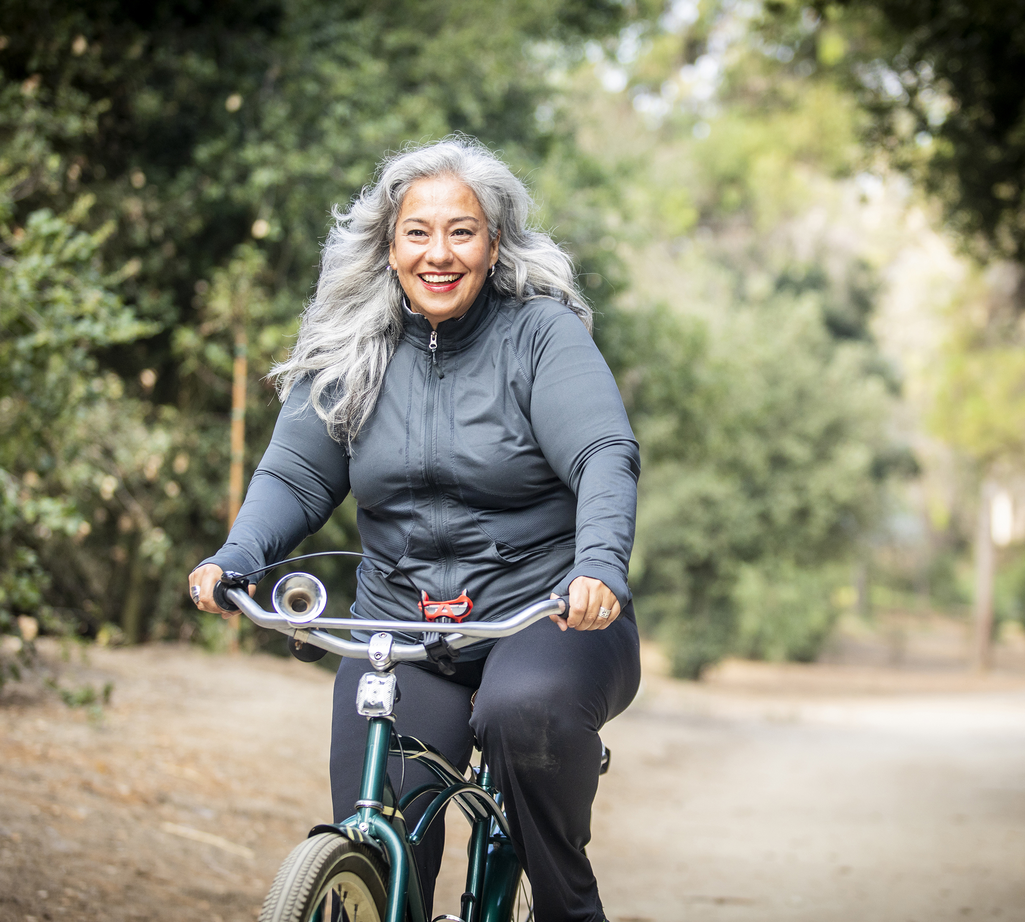
What Comes Next?
EDUCATION CAMPAIGN
Region: Tahoe Basin/Truckee…and beyond.
Stakeholder Involvement – municipalities, neighborhoods, organizations, land management agencies, businesses, etc.
Collaboration on messaging: Signs, social media posts, trail ambassadors, bicycle rental agreements, QR code messages available at trailheads and kiosks.

Slide 9
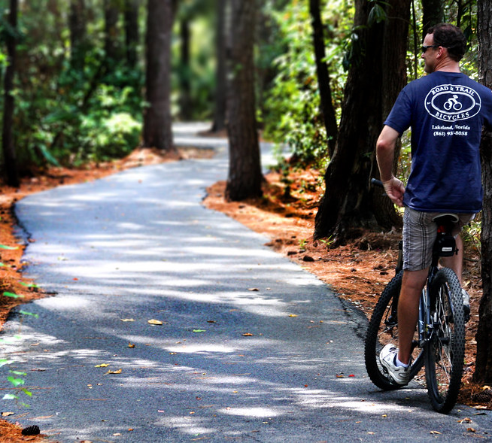
TRAIL ETIQUETTE MESSAGING
Multi-Use Paths are for EVERYONE
SLOW Speeds for SAFETY
COMMUNICATE – Announce passing, use a bell, utilize hand signals, use night lights, speak kindly to each other.
Faster travel should move to integrate with vehicle traffic on the street
Pass on the left. Stay to the right.
Don’t let your group block the flow of traffic. Walk in small clusters to the right.
Yield to those with mobility challenges, wheelchairs and adaptive devices.
Avoid stopping in the middle of the trail. Move to one side, out of the flow of traffic
Avoid confrontation – EDUCATE OVER ENFORCEMENT.
This Photo by Unknown Author is licensed under CC BY-SA-NC

