Slide 1
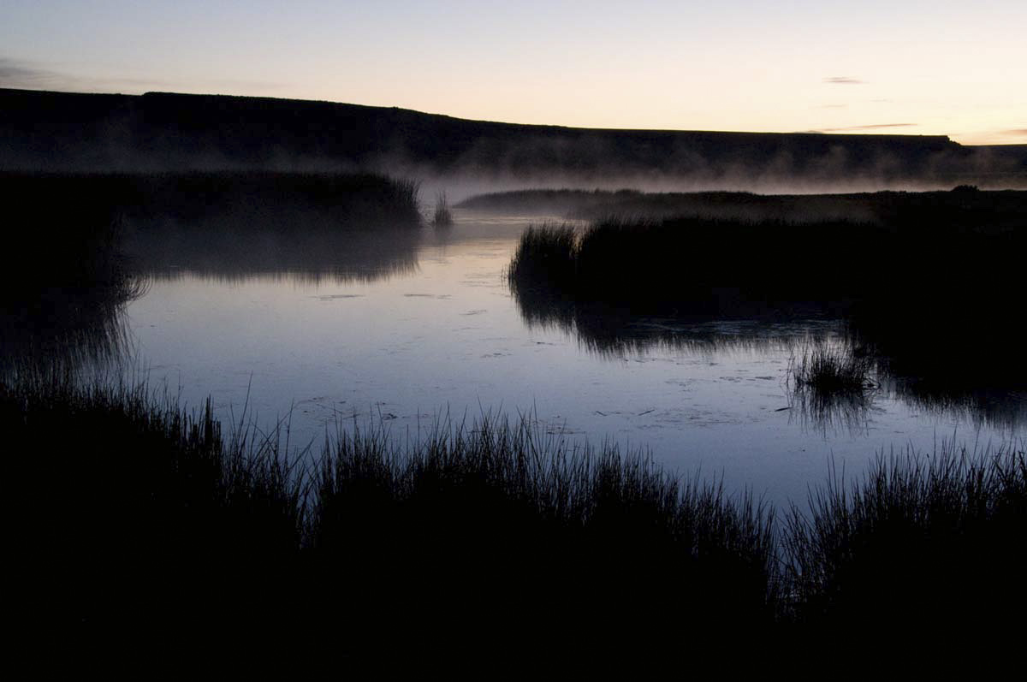
Washoe County Sustainability
Brian Beffort, Sustainability Manager
Washoe County Sustainability
Brian Beffort, Sustainability Manager

Slide 2
What is Sustainability?
Allowing current generations to meet their needs without compromising the needs of future generations. Indigenous wisdom: Planning for seven generations.
Triple bottom line: Ensuring a balance between economic growth, environmental care, and social well-being. Continuity and quality of county services and infrastructure.
Mission Statement: Working together regionally to provide and sustain a safe, secure and healthy community. Quality of life.
Financial Sustainability. Honoring the wise management of taxpayer dollars.

Slide 3
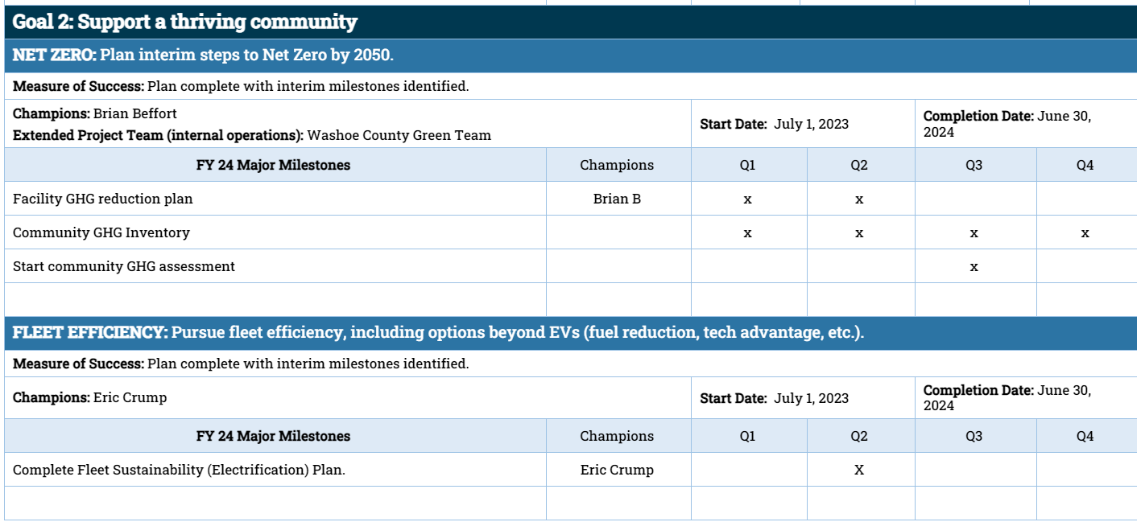
County Draft Strategic Priorities for FY 2024

Slide 4
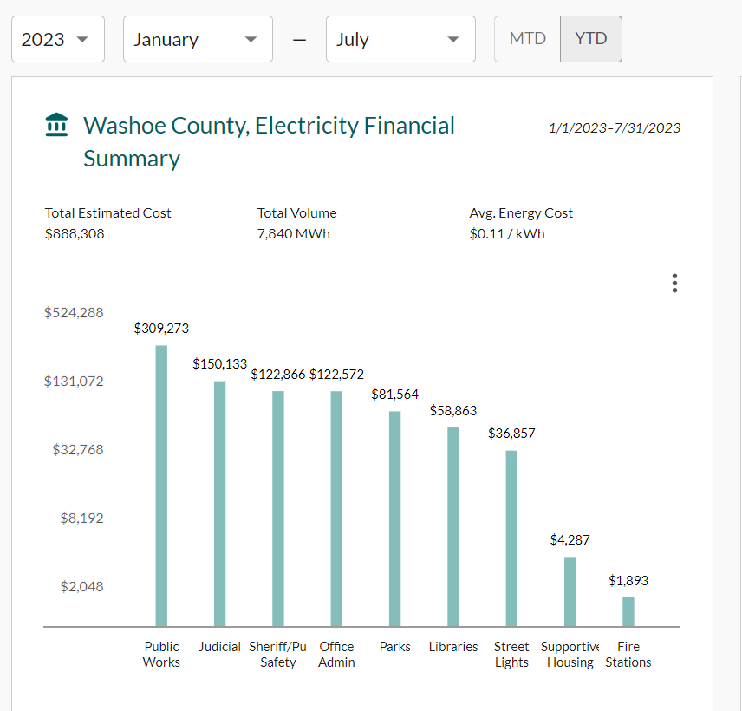
Washoe County Data from NZero
Notes:
Snapshot of our electricity bills at facilities YTD 2023. If you don’t care about climate, maybe you’ll care about how your tax dollars are spent.

Slide 5
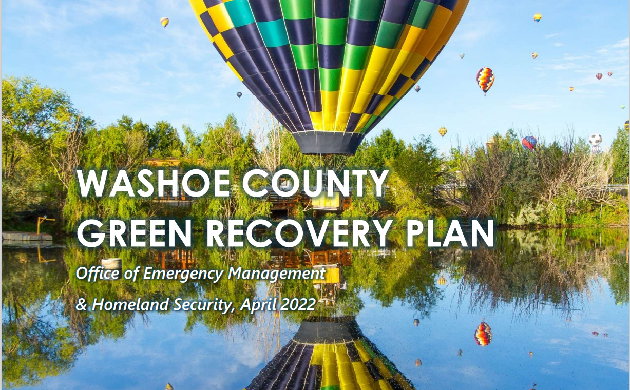

Slide 7
Green Recovery Plan cont.

Slide 8
Green Recovery Plan cont.

Slide 9
Green Recovery Plan cont.

Slide 10
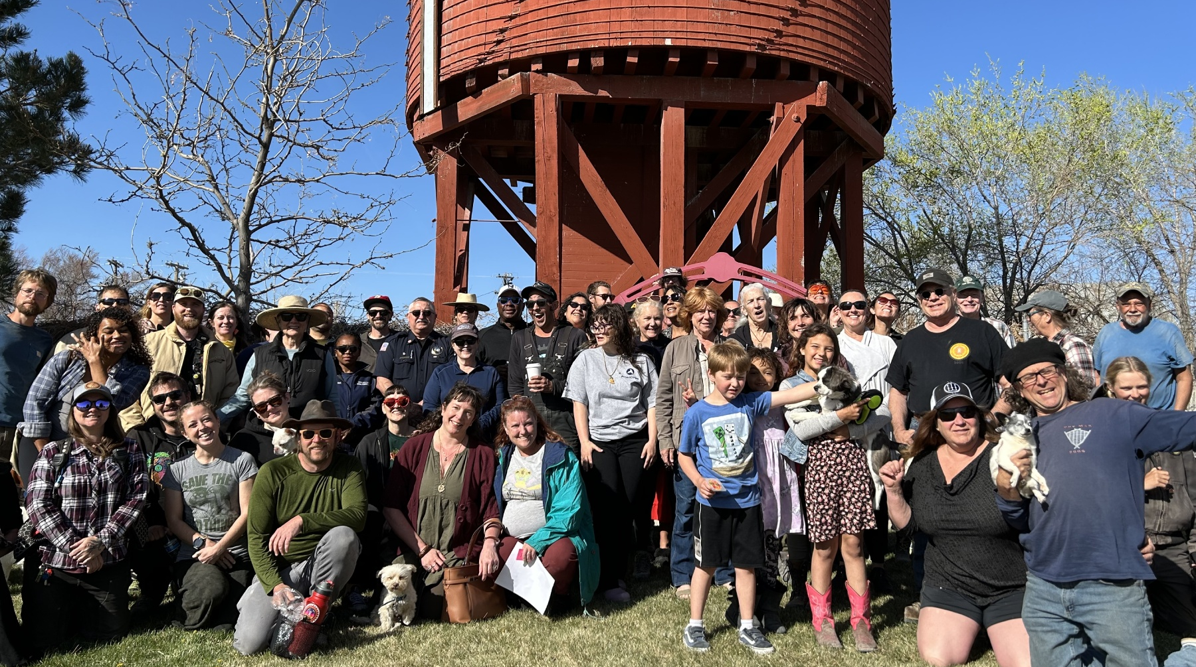
Green Recovery Plan cont.

Slide 11
Green Recovery Plan cont.

Slide 12
Green Recovery Plan cont.
“Team Climate-Resilient Gerlach” has been chosen as one of 67 winners in the U.S. Department of Energy’s Energizing Rural Communities Prize.
This prize comes with $100k to support the following team to envision and design a pathway to net-zero carbon emissions for Gerlach, Nevada, by 2050.
Washoe County
Gerlach Citizen Advisory Board and General Improvement District
Nevada Energy
Nevada Clean Energy Fund
UNR Department of Civil & Environmental Engineering
Burning Man Project
Nzero
YOU!

Slide 13
Thank you
Questions?

