Slide 1
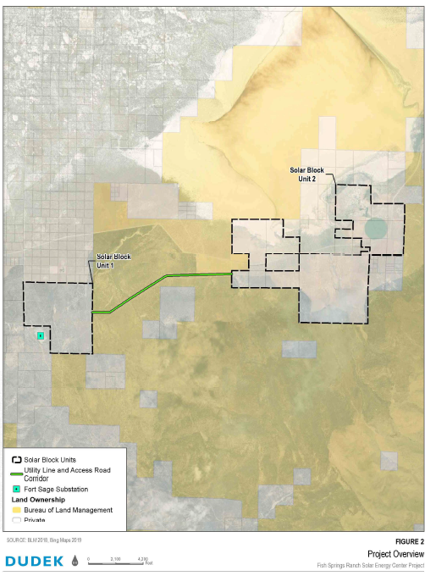
WSUP21-0001 Fish Springs Solar
Washoe County Planning Commission
April 6, 2020

Slide 2
Background/Request
Applicant is requesting to establish a 120MW renewable energy use facility
Applicant is requesting a major grading permit for:
627 acres of ground disturbance
143,000cy of cut/fill
Request to vary height, landscaping, and parking standards
Meets threshold of a Project of Regional Significance

Slide 3
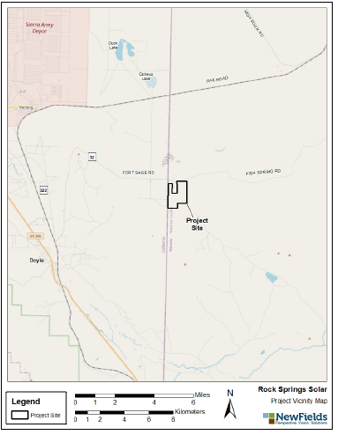
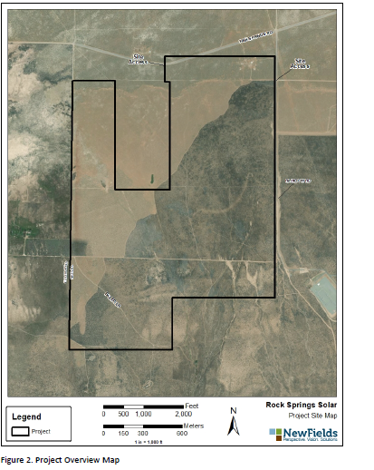
Vicinity Map

Slide 4
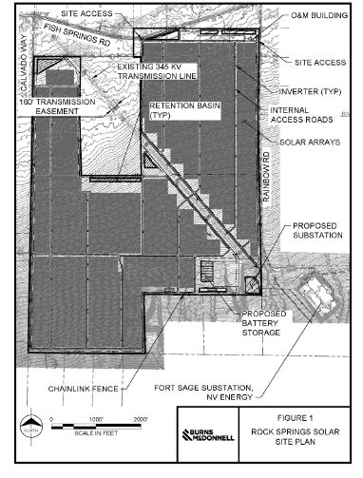
Background/Request – Solar Array

Slide 5
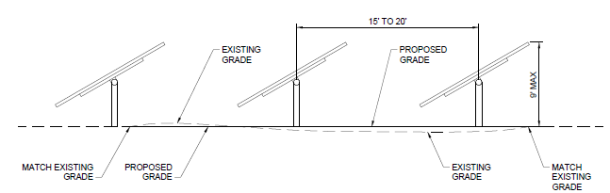
Solar Panel Elevations

Slide 6
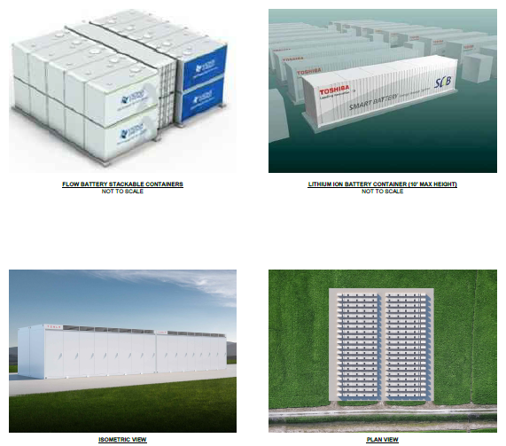
Background/Request – Battery Container

Slide 7
Background/Request – Control Facility

Slide 8
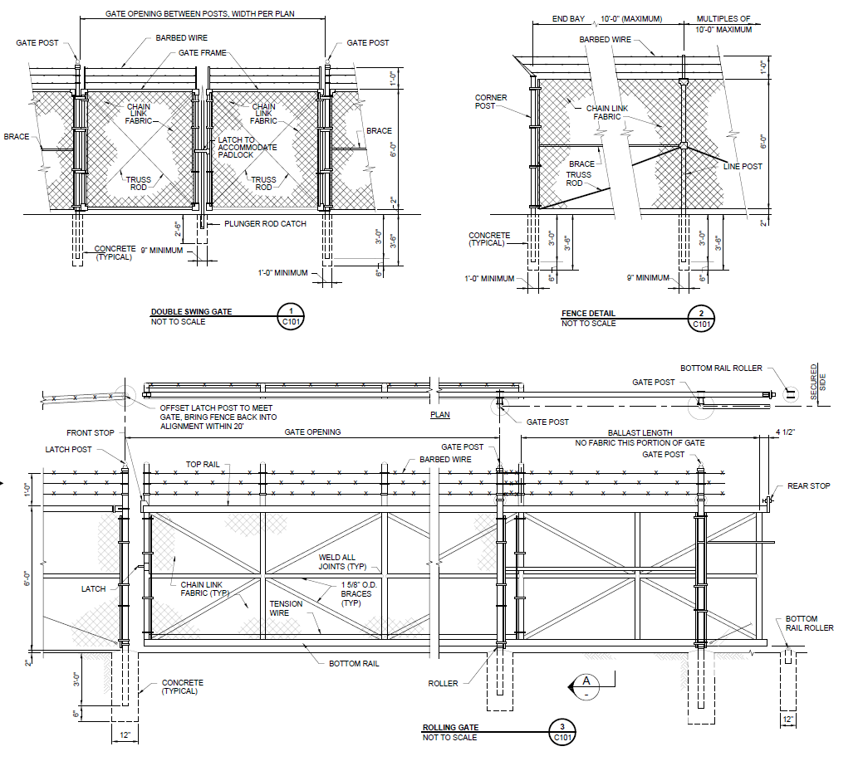
Fence Details

Slide 9
Article 302/304 - Uses
Proposed facility matches the definition of Energy Production, Renewable Energy
Use is permissible in General Rural zoning with an approved SUP
All affected parcels are zoned General Rural

Slide 10
Article 306 – Accessory Structures
Applicant is currently determining the configuration of battery system structures.
Potentially housed in connex (cargo containers)
Per 110.306.10(g)1(ii) – applicant is allowed up 1 cargo container per acre
Maximum of 660 connex boxes
Required to be painted a solid muted color by code

Slide 11
Article 310 - Temporary Uses
Application does not specifically outline a temporary contractor’s yard
If a contractor’s yard is established, staff has recommended conditions of approval requiring it to abide by the provisions of WCC 10.310.45.

Slide 12
Article 324 – Communication Facilities
Application mentions a potential communication tower of 150ft.
This is not included in the review of the application and may require a SUP in accordance with WCC 110.324.35

Slide 13
Article 406 – Building Placement Standards
Applicant is not requesting to vary setbacks.
However, substation reaches 100ft in height
Staff recommends varying the height standards for the substation and other required electrical equipment
All other structures shall meet the required height and setback requirements
Front | Side | Rear | Max Height
30ft | 50ft | 30ft | 35ft

Slide 14
Article 410 - Parking
Applicant is requesting to waive the required parking design standards
Staff recommends waiving parking lot design, wheel stops, striping and marking, paving, landscaping, and lighting requirement (110.410.25b,a, c-g)
Staff does not recommend waiving parking stall sizing or access requirements. (110.410.25b,h-i)
Applicant is required to provide 3 parking spaces and required loading spaces.
Loading spaces will be determined at building permit.

Slide 15
Article 412 - Landscaping
Applicant is requesting to waive all landscaping standards.
The area is remote and rural
Does not match the character
Staff recommends waiving formal landscaping requirements and solid screening requirements.
Applicant required to maintain any landscaping placed on the property beyond the waived requirements

Slide 16
Fence Details

Slide 17
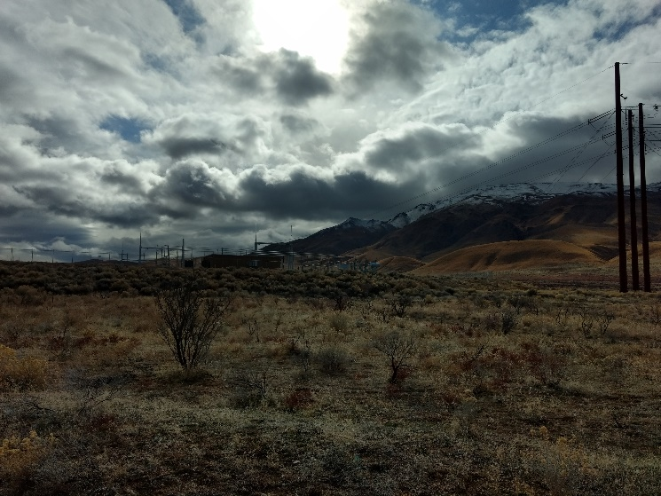
Surrounding Area

Slide 18
Article 414 – Lighting and Sound
Proposed 14ft tall security lighting complies with WCC 110.414.21

Slide 19
Article 438 - Grading
Applicant originally requested major grading across 627 acres with 143,000 cy of cut and fill.
Type of Regulation | Requirements
 | Front Yard | Side Yard | Rear Yard | Setback Envelope
Slopes | 3:1 | 3:1 | 3:1 | 3:1
Difference from Natural Grade | 4ft | 4ft | 4ft | NA
Retaining Wall Height | 4.5ft | 6ft Res/8ft non res | 6ft Res/8ft non res | 10ft
Retaining Wall Terrace Widths | Min. 6ft | Min. 6ft | Min. 6ft | Min. 6ft
Retaining Wall Bench Widths | Min. 4ft | Min. 4ft | Min. 4ft | Min. 4ft
Intersection Angle | 45 degrees | 45 degrees | 45 degrees | 45 degrees
Transitions | Contoured | Contoured | Contoured | Contoured

Slide 20
Grading - Continued
Applicant is required to meet all grading standards outlined in Article 438
Applicant shall be required to submit a noxious weed plan for any imported fill in accordance with HD 2.2
Applicant is currently requesting to revise the request to include 426,000cy of cut and 426,000 cy of fill.
Staff does not see any issues with this change in request.
Will mitigate the need to come in for a future Amendment of Conditions.
Grading/Drainage plans permits still need to be reviewed by planning and engineering at building permit stage

Slide 21
Article 505 - Signs
Applicant is proposing a single 4ft x 8ft (32sf) sign at entry.
This meets requirements per WCC 110.505.15.1 for a free standing sing.

Slide 22
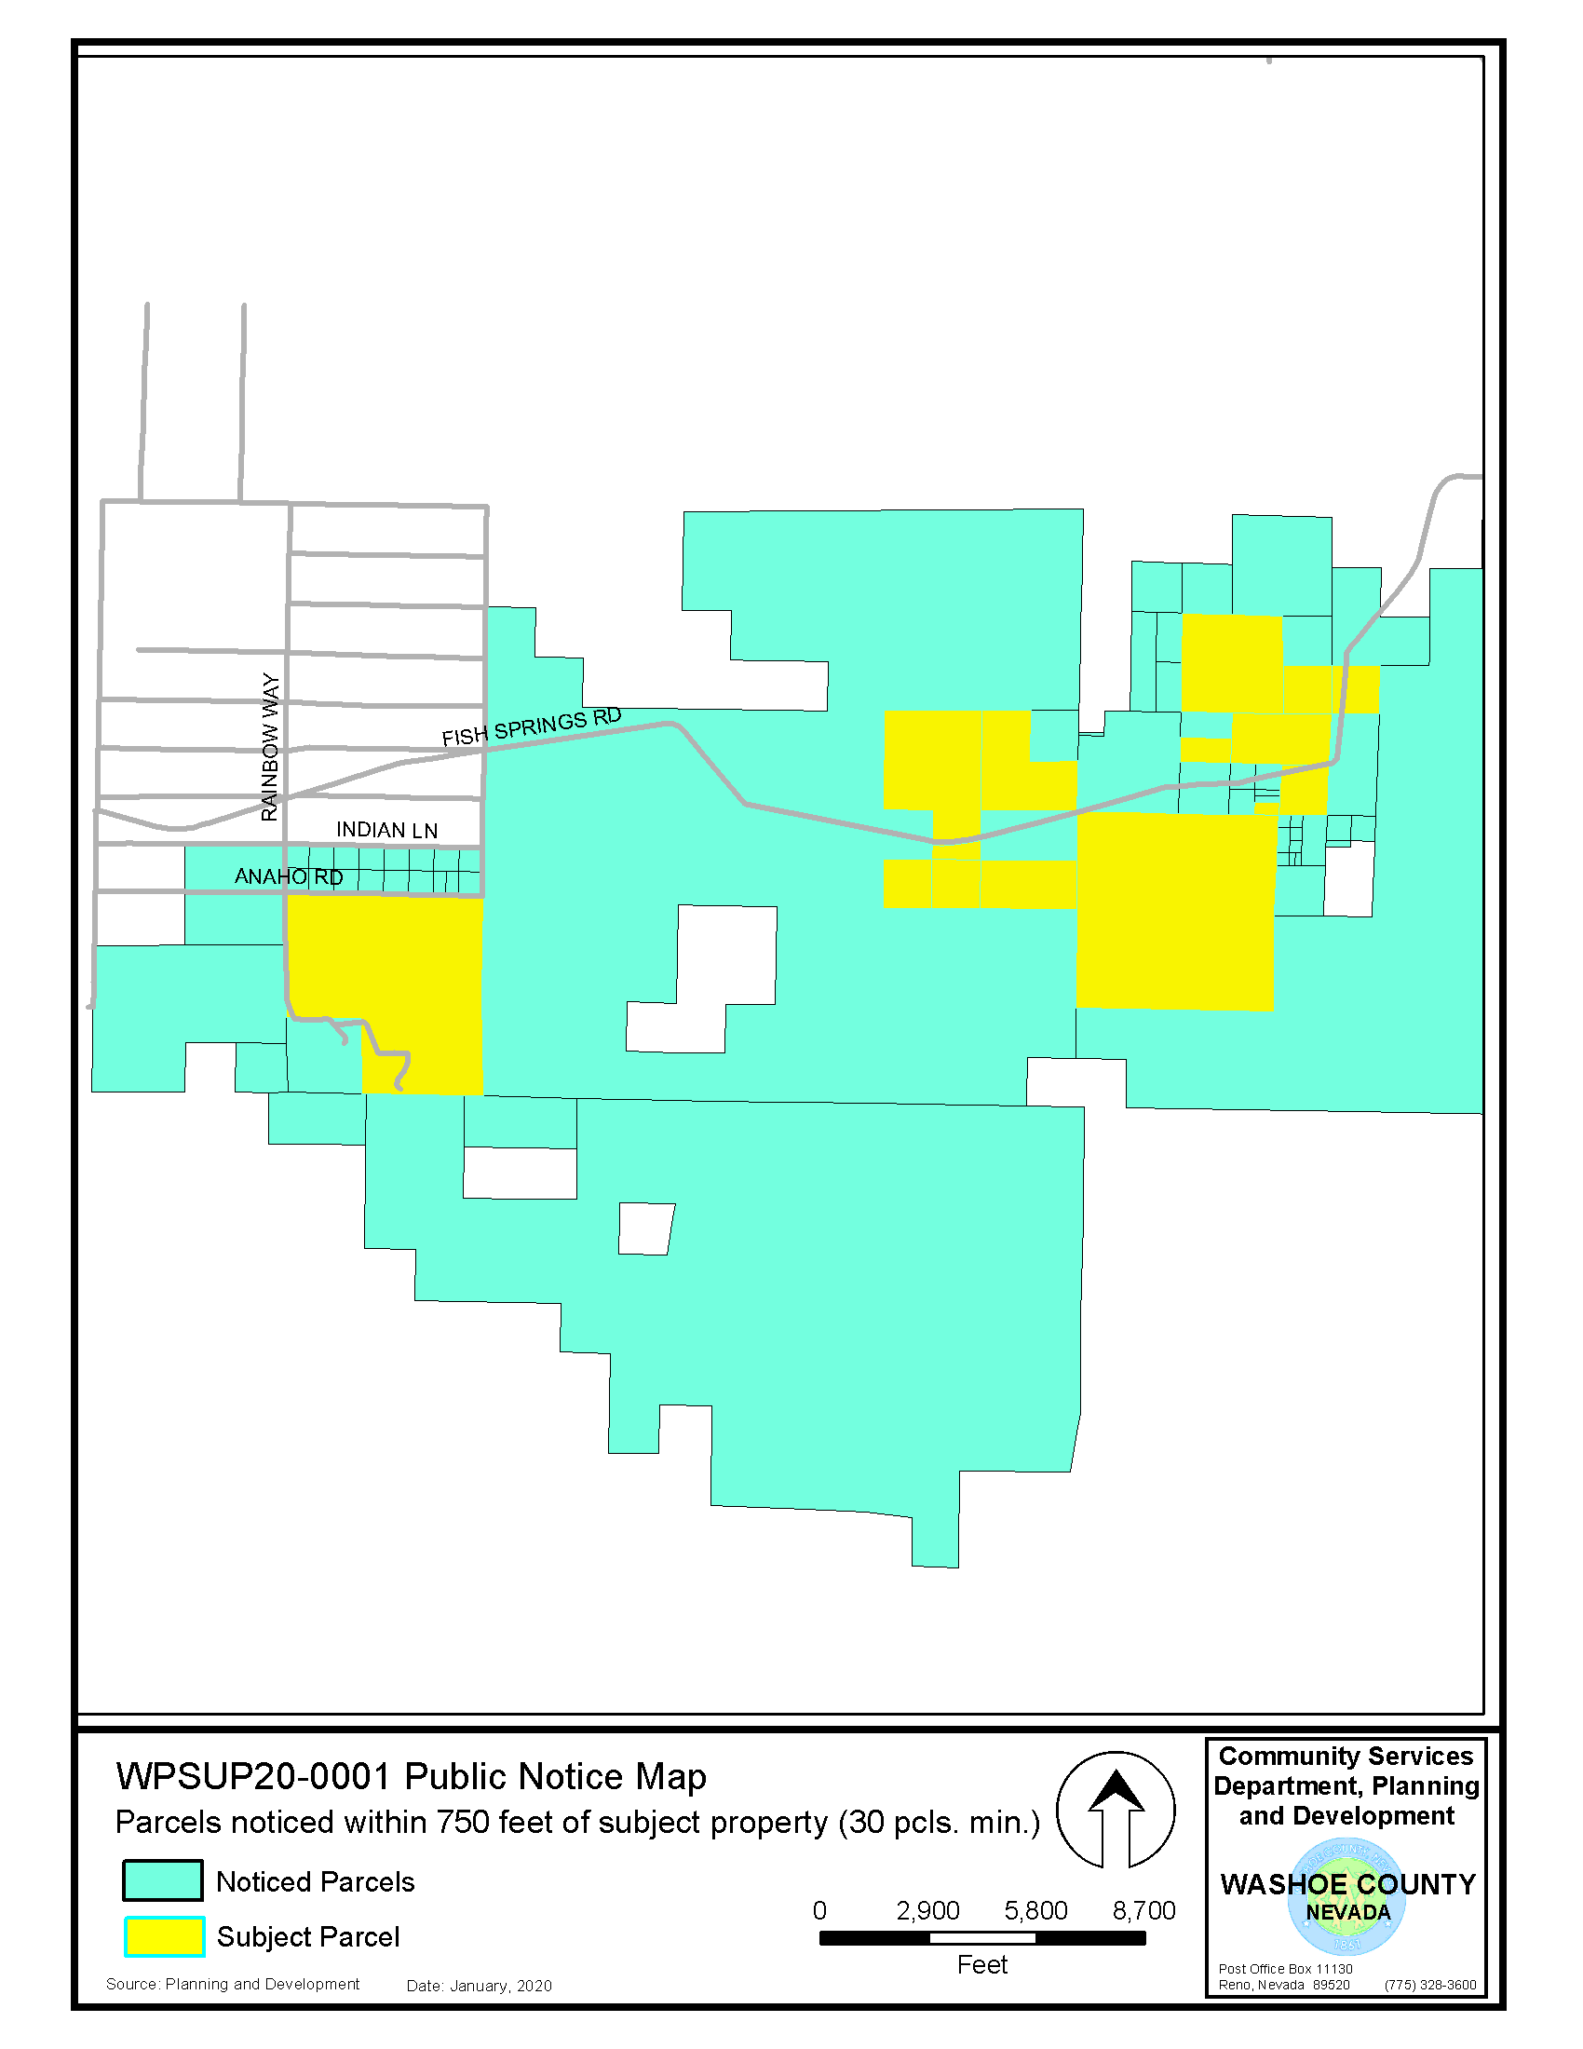
Public Notice & CAB
Notice sent to 41 affected property owners within 1250 feet from the site.

Slide 23
CAB Meeting
Meeting originally scheduled February 11, with Gerlach Empire CAB, which was canceled due to not being in area.
Meeting rescheduled for March 8, 2021 with North Valleys CAB, which was cancelled.
Staff sent out worksheets to both CABs and received 2 worksheets regarding concerns on:
Impacts to wildlife
Potential for battery leakage
Road traffic impacts (specifically on Pyramid Highway)

Slide 24
Neighborhood Meeting – Plan Response
Applicant provided feedback to the CAB
Energy storage system comes with built in fire suppression
Site will be remotely monitored
Roads/culverts will be maintained to county standards
Anticipating 250 workers instead of 400 workers at peak build out
Agree to not build slatted fences
Willing to work with neighboring property owners related to drainage
Heat island effect has not impacted neighboring tree farms prior

Slide 25
Special Use Permit Findings
1. Consistency. That the proposed use is consistent with the action programs, policies, standards and maps of the Master Plan and the High Desert Area Plan;
2. Improvements. That adequate utilities, roadway improvements, sanitation, water supply, drainage, and other necessary facilities have been provided, the proposed improvements are properly related to existing and proposed roadways, and an adequate public facilities determination has been made in accordance with Division Seven;
3. Site Suitability. That the site is physically suitable for an energy production, renewable use and major grading permit and for the intensity of such a development;
4. Issuance Not Detrimental. That issuance of the permit will not be significantly detrimental to the public health, safety or welfare; injurious to the property or improvements of adjacent properties; or detrimental to the character of the surrounding area;
5. Effect on a Military Installation. Issuance of the permit will not have a detrimental effect on the location, purpose or mission of the military installation.
And having made the additional findings per 110.810.35:
6. Environment. That the proposed development is not unduly detrimental to surrounding properties, land uses and the environment in general;
7. Impact on Scenic Resources. That the proposed development will not unduly block scenic views or degrade any surrounding scenic resources; and
8. Reclamation. That the proposed development will reclaim the site and all affected areas at the conclusion of the operation.

Slide 26
Recommendation
Those agencies which reviewed the application recommended conditions to address applicable codes and impacts associated with the project. After a thorough analysis and review, staff recommends that the Planning Commission carefully consider all aspects of Special Use Permit number WSUP21-0001 and the nature of the stringent recommended conditions of approval and approve the requested Special Use Permit.

Slide 27
Possible Motion – Special Use Permit
APPROVAL: I move that, after giving reasoned consideration to the information contained in the staff report and information received during the public hearing, the Washoe County Planning Commission approve with conditions Special Use Permit Case Number WSUP21-0001 for Applicant CED Rock Springs Solar LLC for the following requests:
The establishment of a 120MW photovoltaic generation facility and 84MW battery energy storage system, which is an Energy Production, Renewable Use type;
Major grading for 627 acres of ground disturbance, including 426,000cy of cut and 426,000cy of fill for site preparation;
Requests to vary height, landscaping and parking requirements;

