Slide 1
Department of Alternative Sentencing
2023 Annual Report

Slide 2
OUR AGENCY
Mission Statement
The mission of the Department of Alternative Sentencing is to increase safety in the community by reducing recidivism among criminal offenders through a rehabilitative environment that includes accountability for offenses, opportunities for gaining and applying life skills, and sanctions for regressive behaviors.
Vision Statement
Dedication to improving the quality of life in our community through promoting community safety, providing innovative services, and rehabilitating offenders while treating all people with dignity and respect.

Slide 3
MESSAGE FROM THE CHIEF
Embracing a steadfast commitment to the community, adult probation serves as a vital link in fostering rehabilitation and societal reintegration. With a focus on accountability, support, and personal growth, the mission of adult probation transcends punitive measures, aiming to empower individuals and contribute to the well-being of the community we serve.
As the Chief of Alternative Sentencing, my unwavering commitment extends beyond mere oversight; it is ensuring that we embody a dedication to transformative justice. By fostering collaborative partnerships, implementing evidence-based practices, and prioritizing the holistic development of individuals under supervision, I strive to lead a probation system that not only ensures public safety but actively contributes to the flourishing of the individual and the community.
To my staff, I am acutely aware that the heart of our commitment to the community lies in your dedicated efforts. Your tireless work, compassion, and professionalism are the driving forces behind the success of the Washoe County Department of Alternative Sentencing. Together, we forge a path toward rehabilitation, fostering a positive change, and ultimately contributing to the collective greatness of the community we call home.

Slide 4
Organizational Chart

Slide 5
Department Overview
The Department of Alternative Sentencing, under the authority of NRS 211A, is responsible for the monitoring of all pre-trial and misdemeanor adjudicated cases directed to us by any court within Washoe County. Case responsibilities may include but are not limited to in-person reporting, monitoring counseling progress or referral, provisions for job training, drug and alcohol testing and random in-home visits any time without a warrant. Cases are monitored for the duration of the suspended sentence which could be up to three years or until such time the probationer is released or revoked by the court of jurisdiction.​
The Department of Alternative Sentencing is also the County's designated agency to provide all drug testing services as outlined in 2019 Legislative Bills AB236 and SB316. Each bill has language that requires the utilization of drug and alcohol testing that shall be completed. The Department has embraced its role as the Regional Drug Testing Facility by providing best practice drug testing services to 27 local and regional agencies.

Slide 6
Strategic Plan
Develop proactive and evidence-based programs and services to reduce recidivism and focus on the core task of offender rehabilitation.
Increase collaboration with other departments to promote effective community policing, drug testing services and critical incident response.
Enhance Pre-Trial Supervision services provided to the courts.
Utilize technology to provide expanded services to clients, such as check-ins, house arrest, and alcohol and drug monitoring.
Continue to build an agile and resilient organization, with structures and processes that support our goals and ensure we are accountable to our community.
Nurture the belief in the intrinsic value of every person and continue to place people as the focus of our work.

Slide 7
2023 Probation Highlights
Supervised an average of 2,046 probation and pre-trial cases per month.
Opened first STAR House to provide sober living housing and resources for Alternative Sentencing participants.
Expanded the house-arrest program by 57%.
Rolled out two grant funded remote check-in kiosks into the community.
Diverted 284,670 jail days at a cost savings of $50,671,260 (based on daily jail cost rate of $178/day).

Slide 8
2023 Alternative Sentencing Statistics

Slide 9
ALTERNATIVE SENTENCING
Case Types
Probation –A person who has been convicted of a misdemeanor, who:
Has had his or her sentence suspended pursuant to NRS 4.373 or 5.055, and is serving that suspended sentence; or
Has been sentenced to a term of residential confinement pursuant to NRS 4.3762, or 5.076, and is serving that term of residential confinement.
Pretrial –A person who has been charged with or convicted of a misdemeanor, gross misdemeanor or felony and who has been released from custody before trial or sentencing, subject to the conditions imposed by the court.
Courtesy –A person whose primary supervision is conducted by another agency but has been referred to the department for services such as residential confinement, drug/alcohol testing, electronic monitoring, or full supervision for out of state cases.

Slide 10
ALTERNATIVE SENTENCING – 2023 STATISTICS

Slide 11
ALTERNATIVE SENTENCING – 2023 STATISTICS

Slide 12
ALTERNATIVE SENTENCING – 2023 STATISTICS

Slide 13
ALTERNATIVE SENTENCING – 2023 STATISTICS

Slide 14
ALTERNATIVE SENTENCING – 2023 STATISTICS

Slide 15
ALTERNATIVE SENTENCING – 2023 STATISTICS
Electronic Monitoring
 | Jan | Feb | Mar | Apr | May | June | July | Aug | Sept | Oct | Nov | Dec | Totals
GPS Monitoring | 123 | 129 | 121 | 126 | 116 | 126 | 127 | 127 | 132 | 141 | 145 | 148 | 130/Mo
Phone Monitoring | 8 | 8 | 7 | 7 | 6 | 4 | 3 | 3 | 4 | 5 | 3 | 0 | 5/Mo
HA Contacts | 117 | 308 | 443 | 604 | 693 | 469 | 382 | 688 | 584 | 613 | 532 | 758 | 6,191
HA Violations | 2267 | 4182 | 4956 | 4342 | 4091 | 4456 | 2328 | 1377 | 960 | 982 | 929 | 1205 | 32,075
Remote Breath | 190 | 216 | 228 | 232 | 221 | 231 | 224 | 227 | 233 | 232 | 223 | 219 | 223/Mo
Breath Samples | 11585 | 14471 | 16109 | 15676 | 16533 | 16098 | 15818 | 12985 | 16852 | 16017 | 15819 | 16073 | 184,036
Positive Samples | 185 | 167 | 159 | 190 | 258 | 219 | 277 | 142 | 157 | 451 | 157 | 158 | 2520

Slide 16
SUPPORT IN TREATMENT, ACCOUNTABILITY AND RECOVERY

Slide 17
SUPPORT IN TREATMENT, ACCOUNTABILITY AND RECOVERY
The Department of Alternative Sentencing was awarded a 1-year grant from the State of Nevada Division of Public and Behavioral Health, in the amount $439,487, in May 2022.
Second year of staff funding secured through October 2024.
Four positions were included in the grant and were hired between August and September,2022.
Probation Officer
Case Manager
Clinician
Peer Support Specialist
Staff were provided both internal and external training prior to taking first case.
First client assigned to S.T.A.R program in October 2022.
On December 31, 2023, 29 active participants.
Serve clients from 25-71 years old, average client age is 35.
Opened STAR House in October 2023.

Slide 18
190 Total STAR Program Referrals

Slide 19
STAR Drug Testing Appearance and Results Comparison By Month
Programming Month | Drug Testing Compliance Rate | Drug Testing Positivity Rate | Number of Participants by Month in Program
1 | 69% | 74% | 58
2 | 79% | 46% | 53
3 | 84% | 24% | 41
4 | 93% | 21% | 34
5 | 92% | 7% | 28
6 | 93% | 6% | 25
7 | 96% | 4% | 20
8 | 93% | 16% | 18
9 | 95% | 15% | 11
10 | 87% | 16% | 9
11 | 78% | 14% | 8
12 | 85% | 7% | 8

Slide 20
12-Month STAR Recidivism Data Review
Redefining Success, Reinforcing Public Safety
17 Violation Arrests among a total of 62 participants over a 12-month period.
4 Participants convicted of new criminal charges, with 2 being ordered to return to the STAR program.
In the year prior to STAR’s inception, 65% of the individuals currently enrolled were arrested 2 or more times and charged criminally. Since the launch of the STAR program, a mere 6% of the individuals engaged in the program have gone on to accrue new criminal charges.

Slide 21
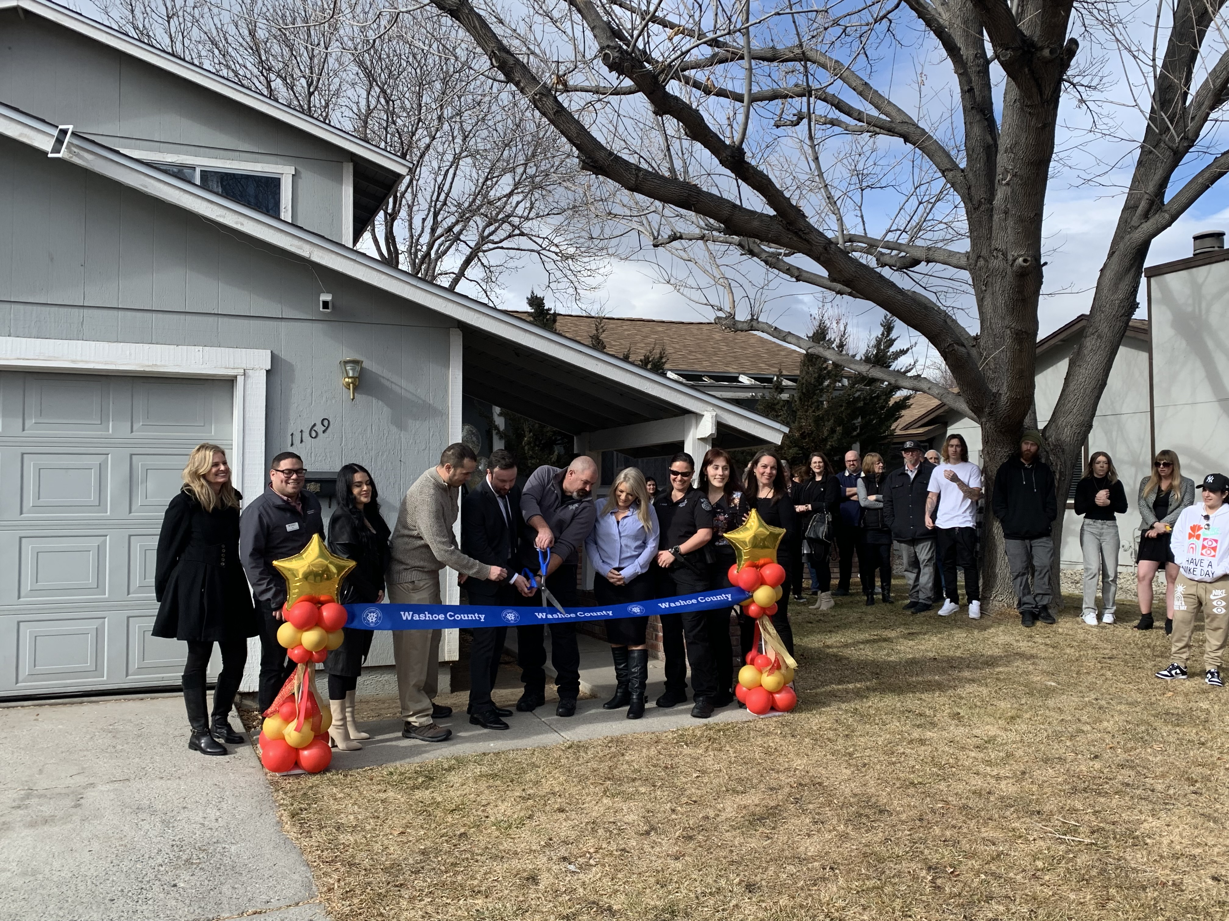
STAR Recovery House
FRN funded project
Life Changes Inc. and SilverSummit Health Plan collaboration
Sober living for 8 STAR program participants
Live-in House Manager
A revolving door of prosocial opportunity
Reps for Recovery
Food Bank of Northern Nevada
The Change Companies
SilverSummit

Slide 22
REVENUE
 | 2020 | 2021 | 2022 | 2023
Probation Fees | $13,644 | $44,589 | $86,910 | $67,951
Self- Pay Test Fees | $228,470 | $311,703 | $327,295 | $333,205
Electronic Monitoring Fees |  |  | $69,365 ** | $66,155
Subsidized Income | $447,749 | $652,825 | $742,264 | $828,844
Total | $689,863 | $1,009,117 | $1,225,834 | $1,296,155
** Electronic Monitoring Fees not tracked until 2022

Slide 23
2023 Sober 24 Statistics

Slide 24
SOBER 24
2023 Sober 24 Highlights
Remain a Naloxone Leave Behind location through the University of Nevada – CASAT Program
Completed over 330,000 drug and alcohol tests
184,036 Breath Samples Taken
153,323 Drug Tests Completed
Conducted testing for 27 local and out of area organizations

Slide 25
SOBER 24 – 2023 STATISTICS
Sober 24 Drug Testing
Number of individuals tested: 6,356
Number of samples collected: 153,456
31,726 positive samples (20.67% positivity rate)
Number of assays (drugs) tested: 1,115,768
Illicit Drugs with the highest positivity rate:
THC 9.44%
Amphetamines 4.08%
Fentanyl 3.08%
Alcohol 2.74%
Opiates 1.03%
All other drugs at or below 1% positivity rate

Slide 26
Thank you
Chief Justin Roper

